Slide 1

Videoscopic
Uncovering political insights one video at a time
SHRIVU | BEN | Estella
PROJECT NAME

Slide 2
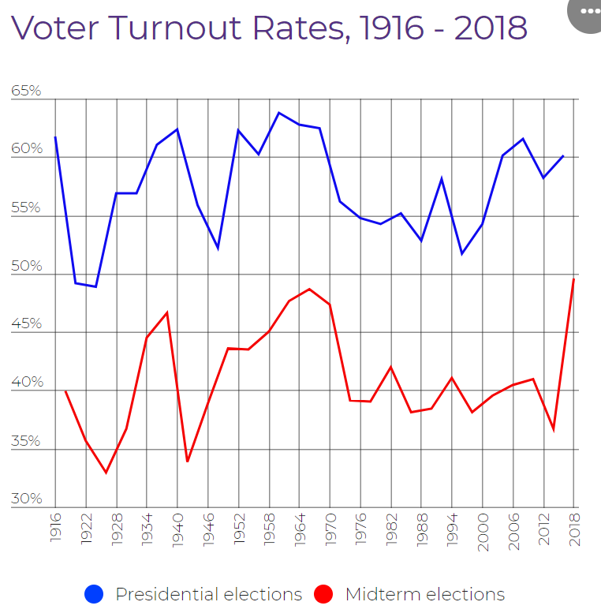

USA Civic Engagement
Videoscopic

Slide 3

Young American’s Civic Engagement
Less than 50%
of eligible young Americans vote
Videoscopic

Slide 4

TECH DEMO
OUR features
Realtime on screen insights
Keyword analysis using Google NLP
Political bias detection
197M
VIEWERS in the US
11%
Young Americans Users
Notes:
© Copyright PresentationGO.com – The free PowerPoint template library

Slide 5


Architecture Diagram
Content
Background
Google NLP
Flask
Bias
DB
Clarify.ai
Computer Vision
Wikipedia

