Slide 1
深入淺出 Python 2023.02.21 廖唯辰 @Deep Learning

Slide 2
Outline
Environment
Built-in Functions
Packing and Unpacking
Class

Slide 3
Outline
Environment
Built-in Functions
Packing and Unpacking
Class

Slide 4
Environments
(NYCU) We’ll provide workstation
(Local) Install Python3
(Local / Remote) Jupyter Notebook
(Cloud) Google Colab

Slide 5
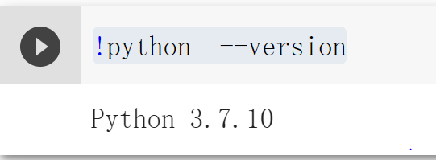
Python version
python >= 3.6
Command: python –V
Colab: !python --version

Slide 6
Outline
Environment
Built-in Functions
Packing and Unpacking
Class

Slide 7
Built-in Functions
Reference: Built-in Functions — Python 3.9.2 documentation

Slide 8
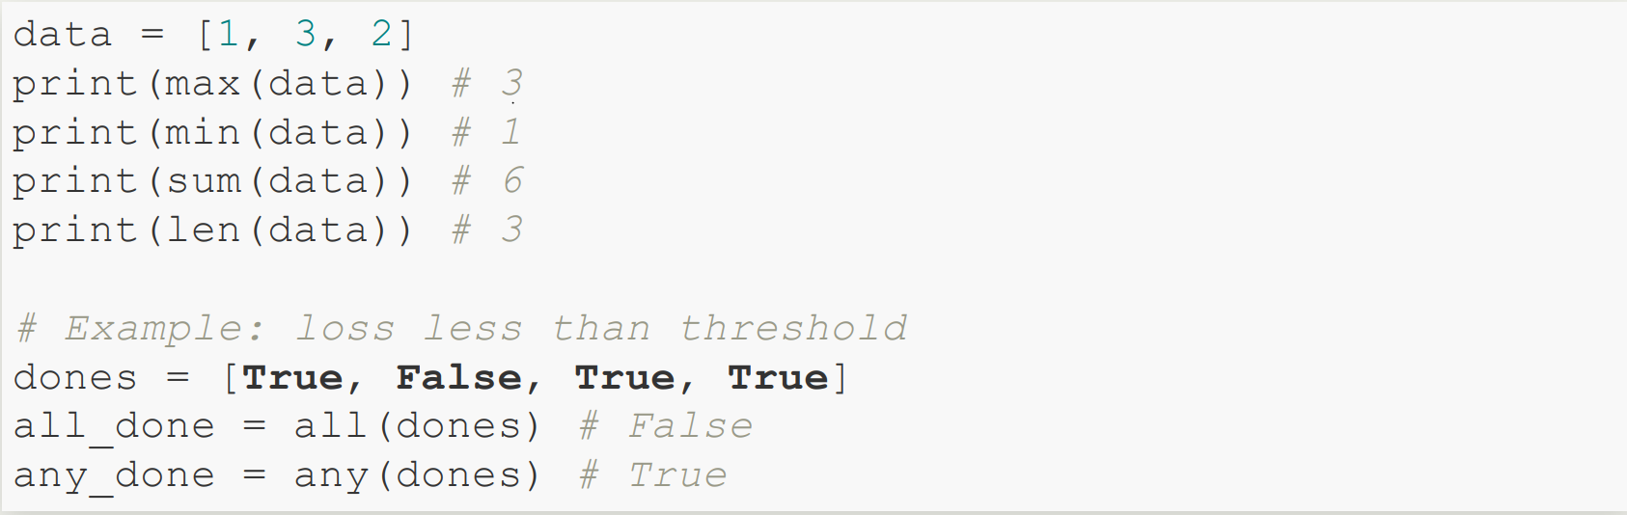
Example

Slide 9
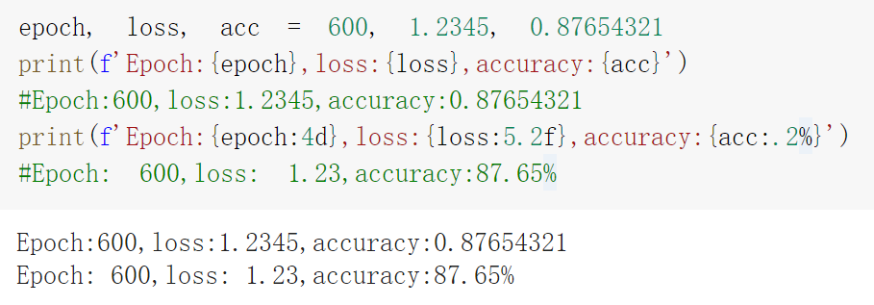
Format String
子串開頭有 f
字串內大括號包住變數

Slide 10
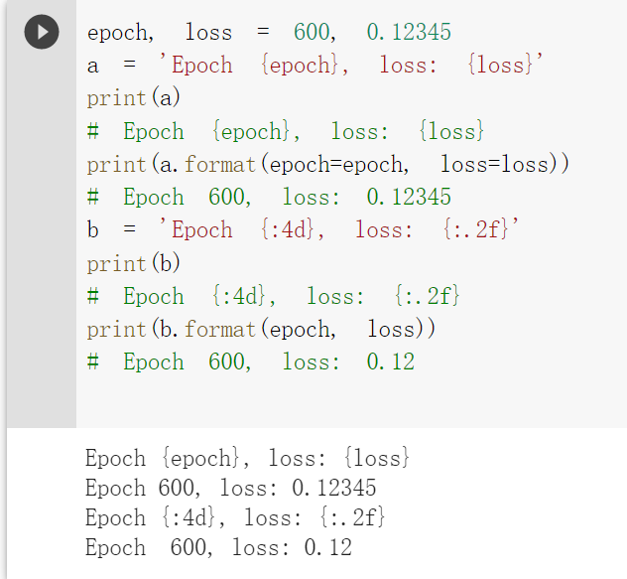
Format 方法
Notes:
使用內建format函數

Slide 11
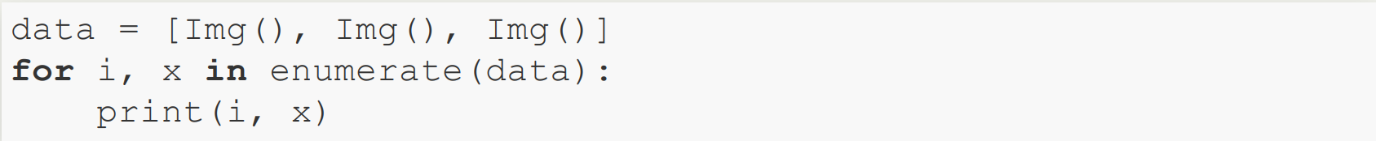
Enumerate
iterable: list, tuple, dict, …
>>> print(list(enumerate([‘A’, ‘B’, ‘C’])))
[(0, ‘A’), (1, ‘B’), (2, ‘C’)]
enumerate(iterable, start=0)
Img1 Img2 Img3
0 Img1
1 Img2
2 Img3

Slide 12
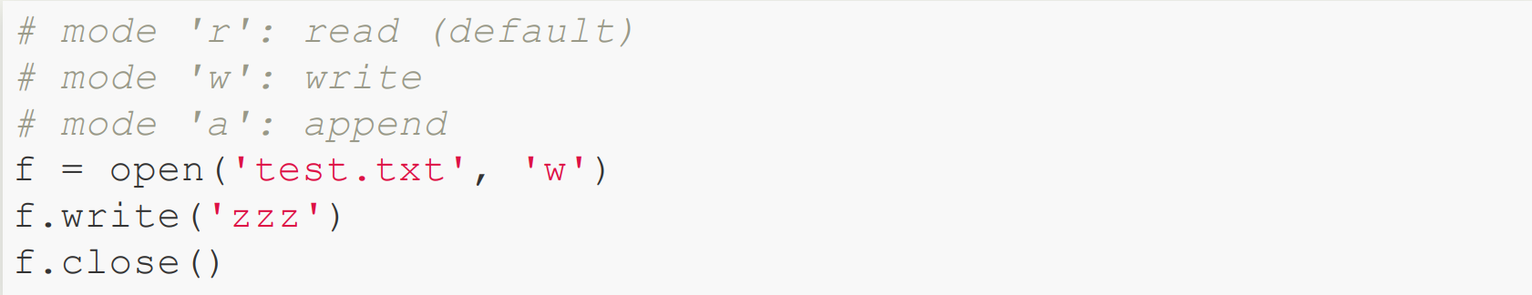
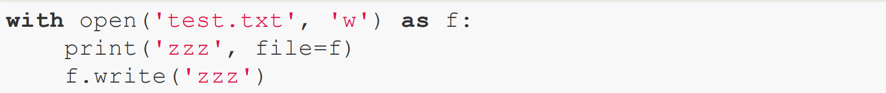
Open
Open 簡寫:

Slide 13
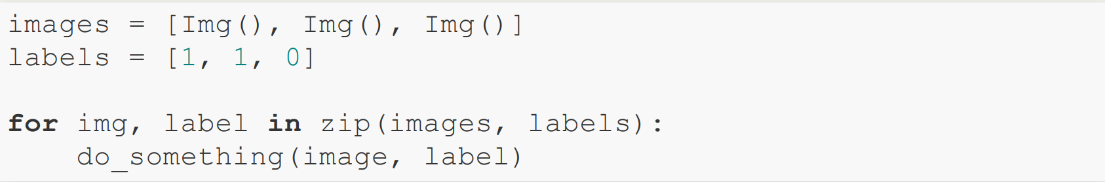

zip
與 enumerate 混用:

Slide 14
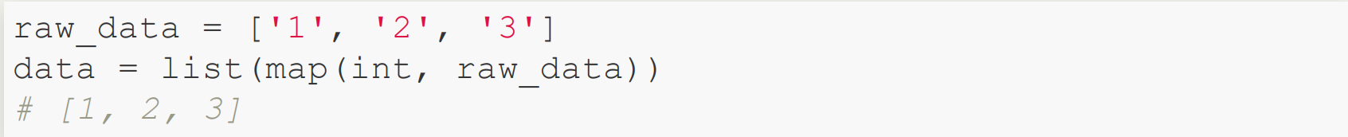
map
map(function, iterable, ...) ，通常與 list 混用輸出 list。(tuple也可以)

Slide 15
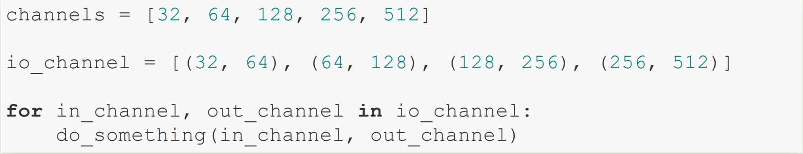
Practice 1
How to generate io_channel ?

Slide 16
Practice 1
Given
How to generate io_channel without hardcoding the values?
Hint: zip, slice

Slide 17
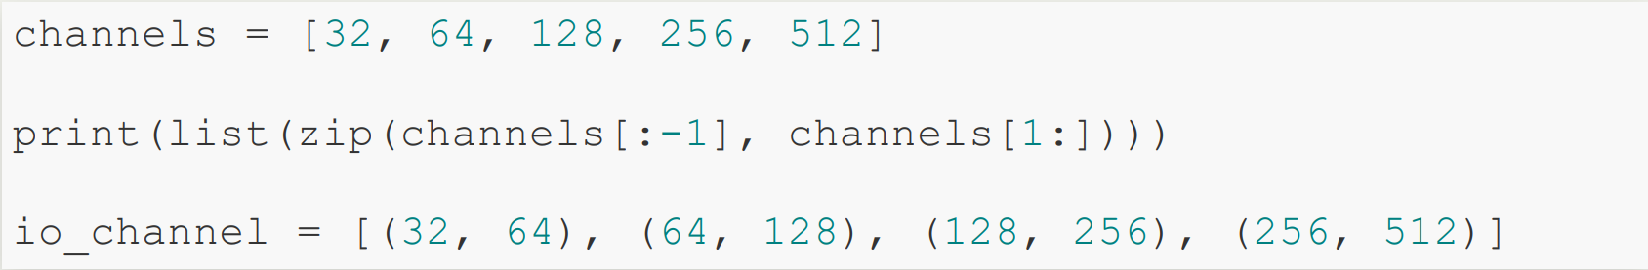
Practice 1 : Answer

Slide 18


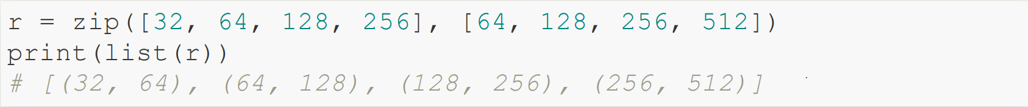
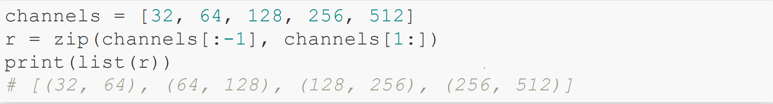
Practice 1 : Review

Slide 19
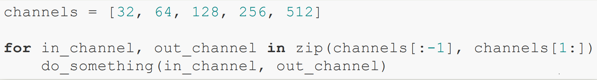
Practice 1 : Example

Slide 20
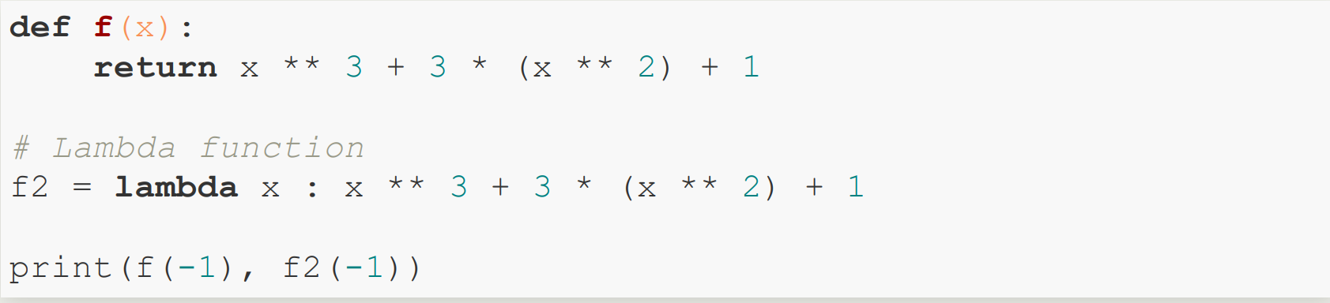
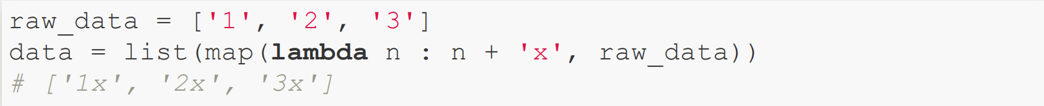
Lambda Function
Lambda Function 搭配 map

Slide 21
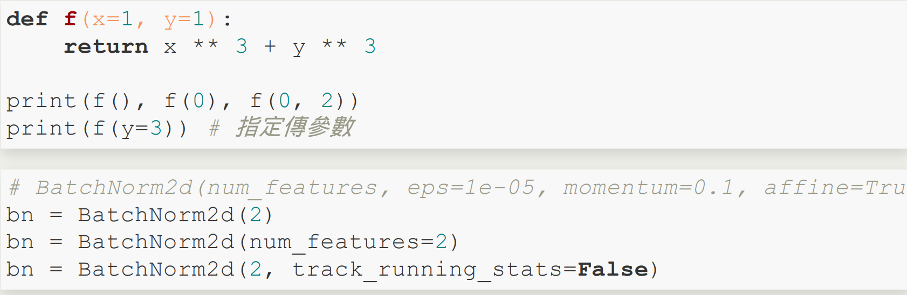
Default Argument and Positional Argument

Slide 22
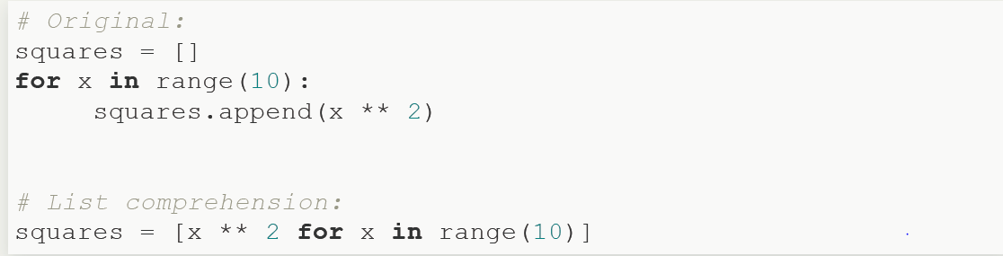
List Comprehensions

Slide 23
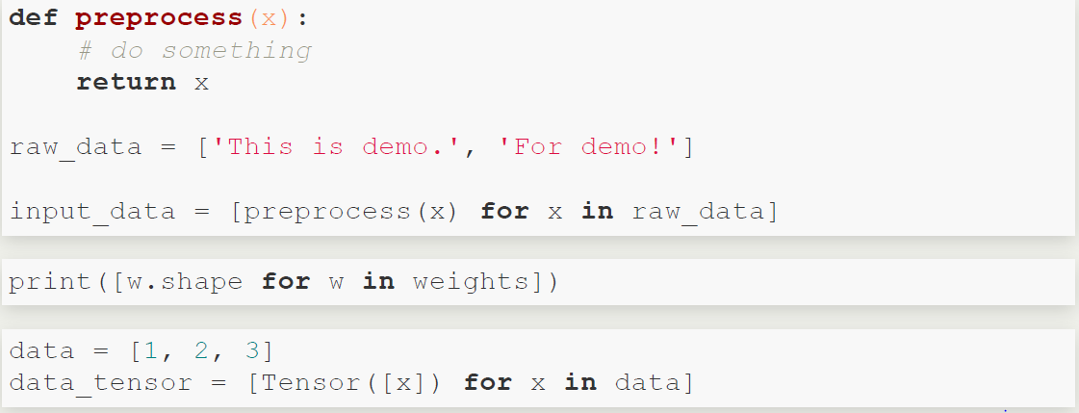
List Comprehensions: Example

Slide 24
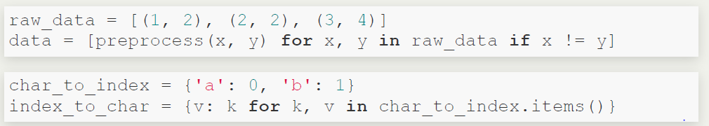
List Comprehensions: Example

Slide 25
Outline
Environment
Built-in Functions
Packing and Unpacking
Class

Slide 26
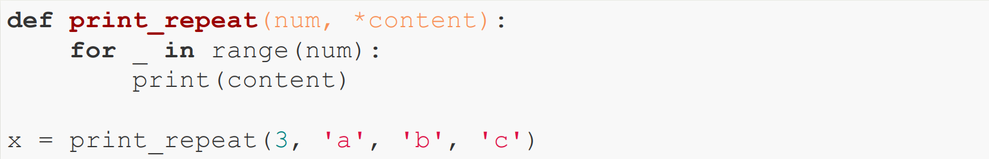

*args
* 可做為 Packing 或 Unpacking 使用，看資料流方向。
* 作為 Packing 使用
Tuple: (‘a’,’b’,’c’)

Slide 27
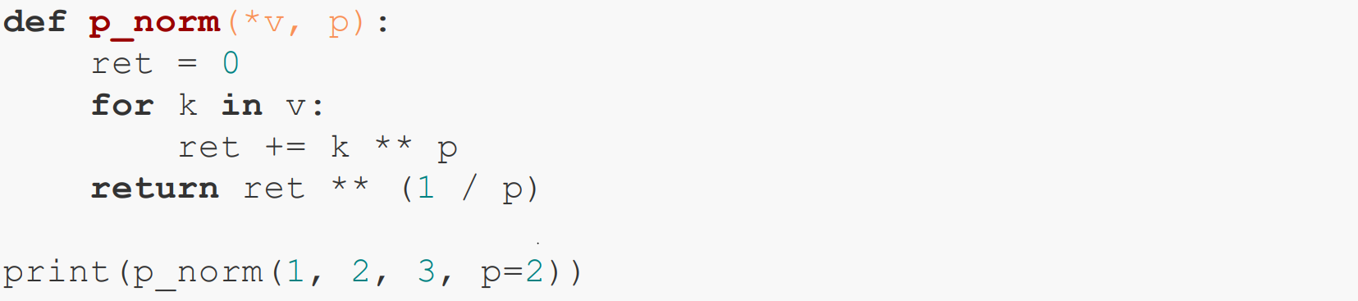

*args : example
* 作為 Packing 使用
keyword-only argument
v: (1,2,3)
p: 2

Slide 28
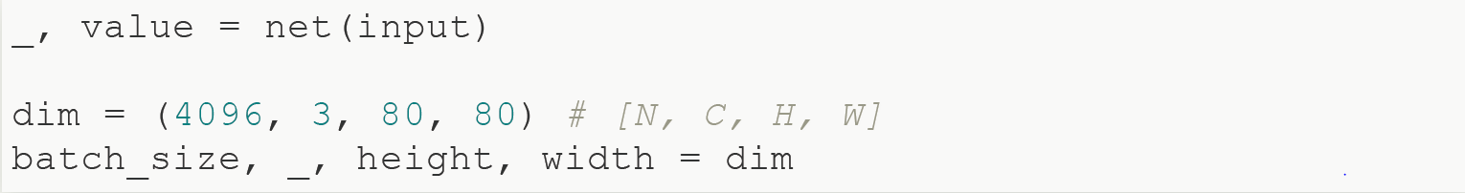
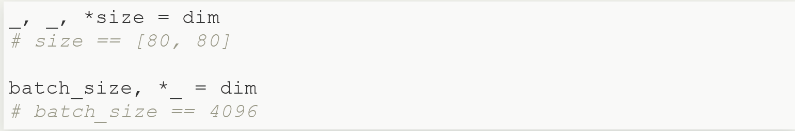
Iterable Unpacking
tuple, list, str
底線 _ 忽略該變數
搭配使用 * (* 作為 Packing 使用)

Slide 29
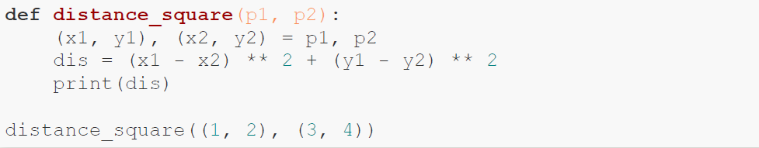
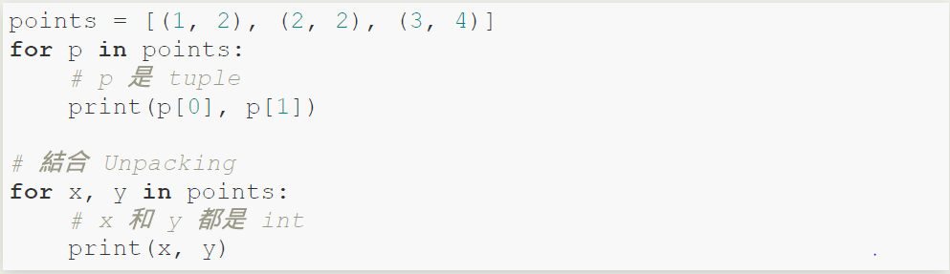
Iterable Unpacking: example
Example 1
Example 2

Slide 30
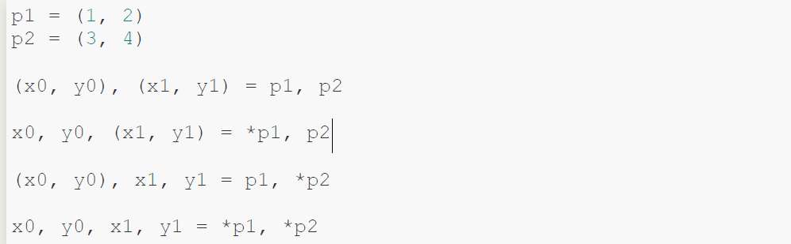
Iterable Unpacking: *args
* 可用於 Iterable 物件(tuple, list …)做 unpacking

Slide 31
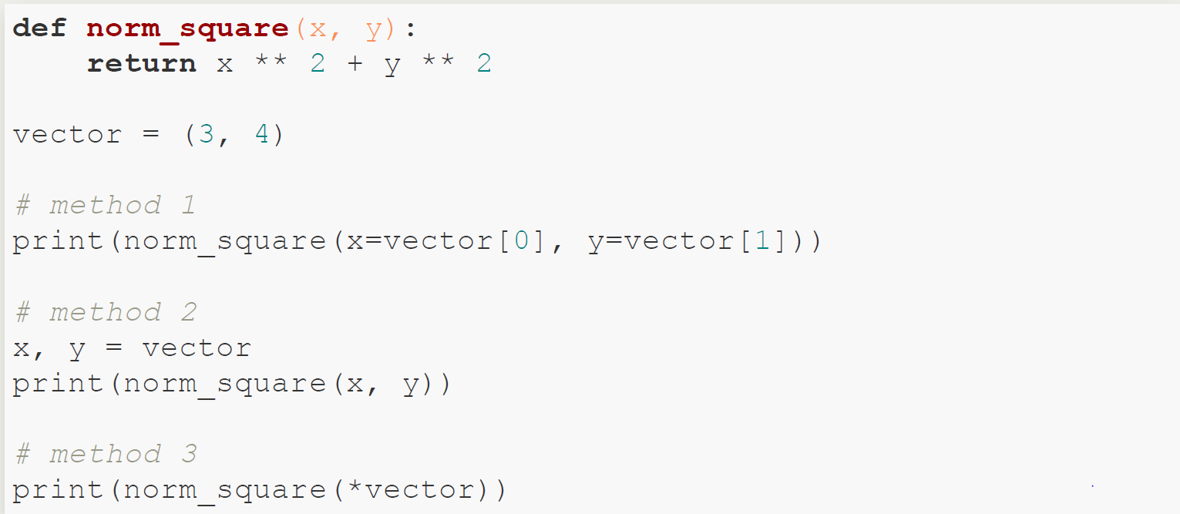
Iterable Unpacking: example
Example 3
* 作為 Unpacking 使用

Slide 32
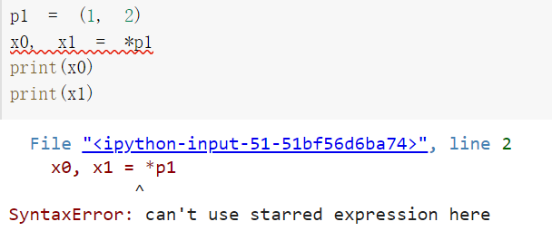
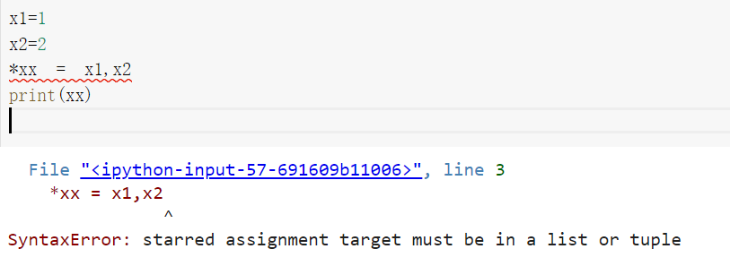
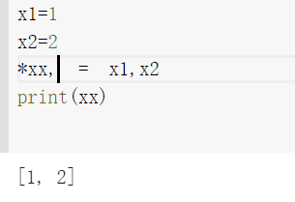
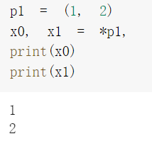
Iterable Unpacking: example
注意!: * 不能單獨使用，需要搭配 “, “或是當作函數的參數，不論是 packing or unpacking。
* 作為 Unpacking 使用
* 作為 Packing 使用

Slide 33
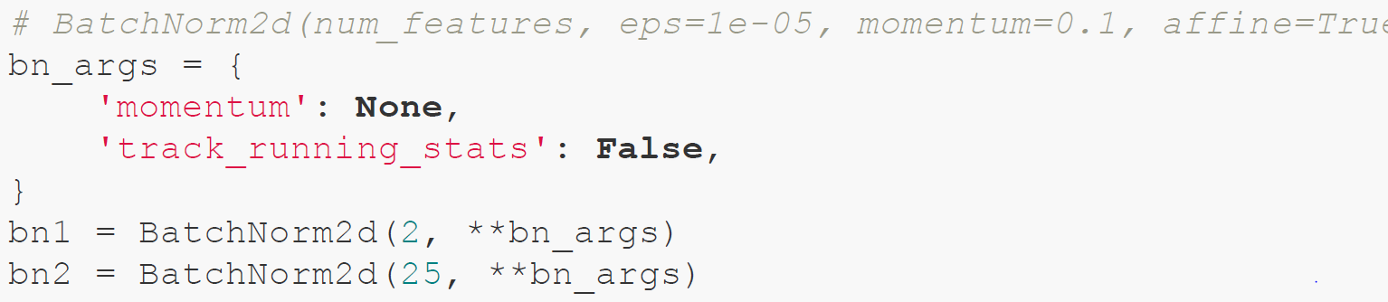
Dictionary Unpacking

Slide 34
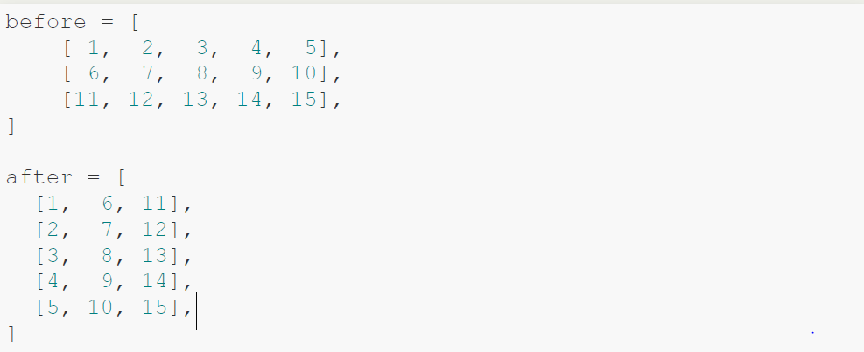
Practice 2: Transpose List of List
如何只使用一行進行轉置矩陣?
One-liner Hint: zip, list, map

Slide 35
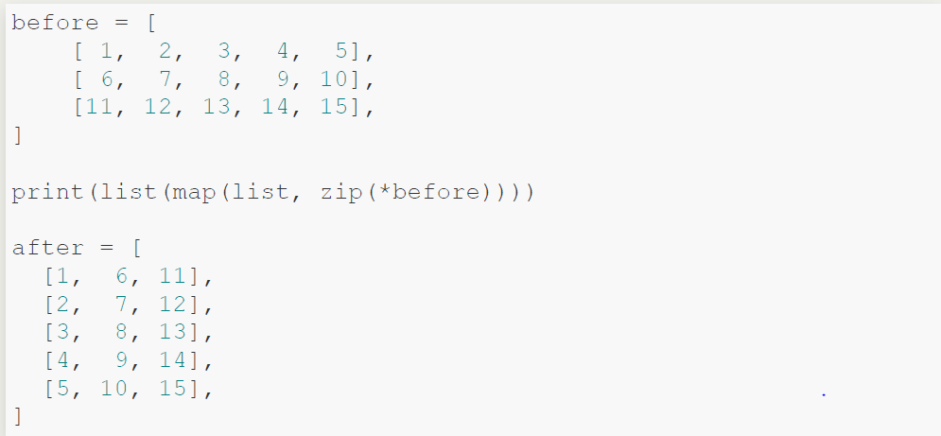
Practice 2: Answer

Slide 36
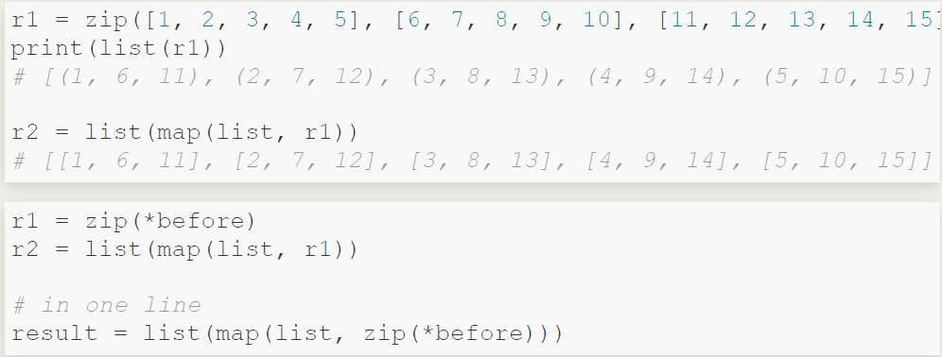
Practice 2: Review

Slide 37
Outline
Environment
Built-in Functions
Packing and Unpacking
Class

Slide 38
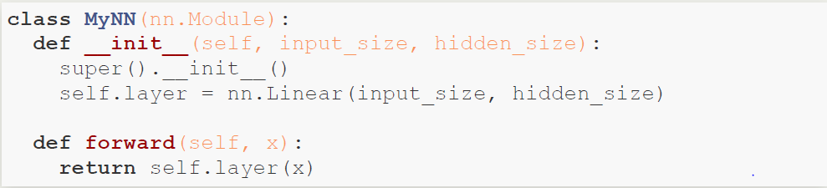
Class
inheritance from nn.Module

Slide 39
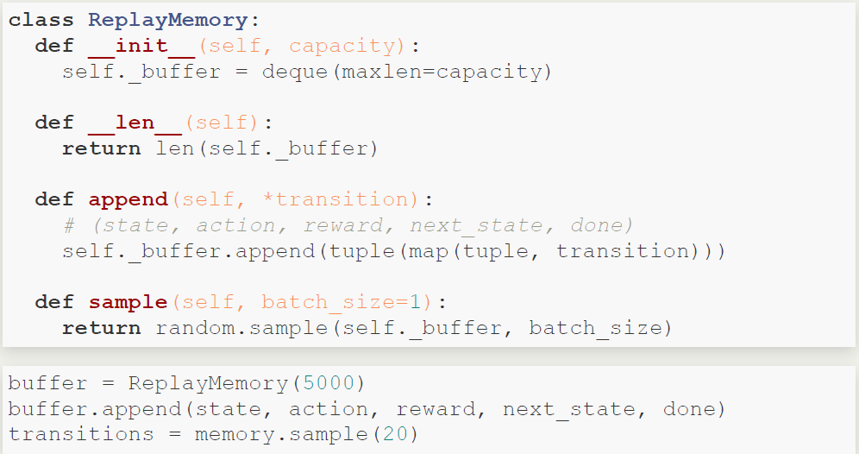
Class: example
__len__
len(buffer)
__getitem__
buffer[i]

