Slide 1
《数据库系统原理》
Principles of Database Systems

Slide 2
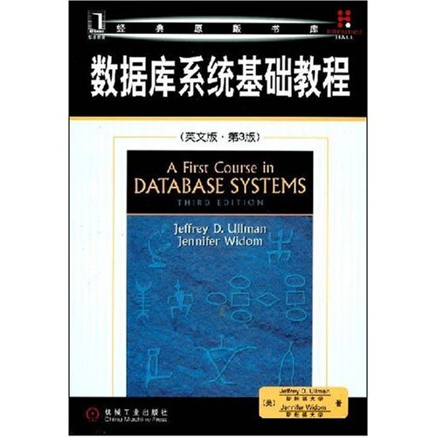
Textbook
A First Course in Database Systems
(Third Edition)
J. D. Ullman, J. Widom
机械工业出版社, 2008.8
Note: A Chinese translation version has been published, but the original version is recommended.
Lu Chaojun, SJTU

Slide 3
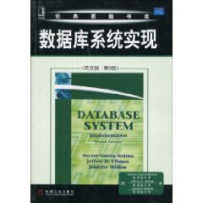
Reference
Database System Implementation
(Second Edition)
H. Garcia-Molina
J. D. Ullman
J. Widom
机械工业出版社, 2010.1
Lu Chaojun, SJTU

Slide 4
Course Material
My slides can be found at
ftp://ftp.cs.sjtu.edu.cn:990/lu-cj/fcdb
or
ftp://public.sjtu.edu.cn
(userid/password = lucj/public)
Homepage of the Textbook
http://www-db.stanford.edu/~ullman/fcdb.html
Lu Chaojun, SJTU

Slide 5
Basic Concepts

Slide 6
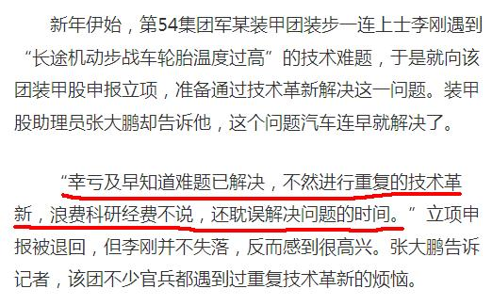
Lu Chaojun, SJTU

Slide 7
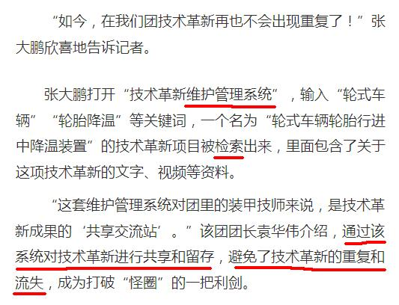
Lu Chaojun, SJTU

Slide 8
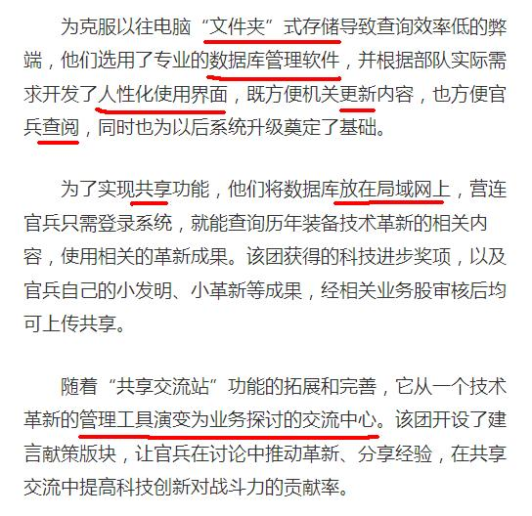
Lu Chaojun, SJTU

Slide 9
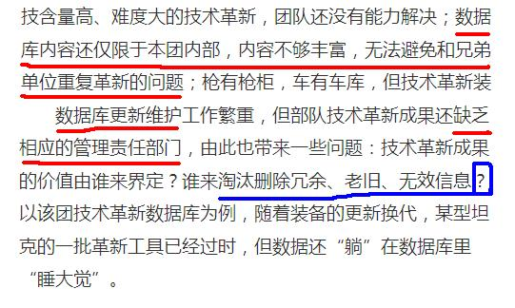
Lu Chaojun, SJTU

Slide 10
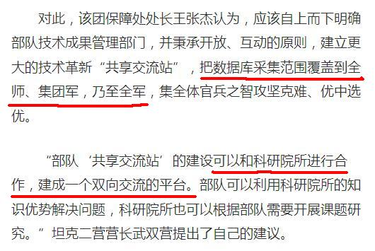
Lu Chaojun, SJTU

Slide 11
What’s a Database?
A collection of data.
  Very large amounts of data
  Structured and interrelated data
  Operational data
  Persistent data
Managed by a DBMS
Used by applications
Lu Chaojun, SJTU

Slide 12
What’s a DBMS?
Supports storage of v.l.a.d. over a long period of time
Supports efficient access to DB
Supports a query language: DDL and DML
Supports durability of DB
Supports concurrent access to DB
Supports atomic access to DB
……
Lu Chaojun, SJTU

Slide 13
DBMS Architecture
User/Application
Query processor Transaction manager
Execution engine Logging/Recovery/CC
Index/file/record manager
Buffer manager
Storage manager
data, metadata, index, log records, statistics
Lu Chaojun, SJTU

Slide 14
What’s a DBS?
Hardware
DB
DBMS
People
  DBA
  Applications programmer
  End user
Lu Chaojun, SJTU

Slide 15
Why DB?
Information sharing
Data independence
  Program + Data
    Dependent: P1+D1, P2+D2, …
    Independent: (P1, P2, … ) + D
Lu Chaojun, SJTU

Slide 16
History of Data Management
Manual
File system
DB
  Late 1960s: hierarchical, network
  1970s: relational model
  Present: OR, XML
Lu Chaojun, SJTU

Slide 17
DBS Studies
DB modeling and design
  E/R, UML, ODL
  Relational implementation
  Semistructured data modeling and programming
DB programming
  Algebra- and logic-based
  SQL
  Embedded SQL, PSM, CLI, JDBC, PHP
DBMS implementation
Lu Chaojun, SJTU

Slide 18
End

