Slide 1
Relational Data Model
Lu Chaojun, SJTU

Slide 2
What’s a Data Model?
A notation (collection of conceptual tools) for describing data as seen by the user.
  Structure of data (math representation)
    Examples: relational model = relations(tables); semistructured model = trees/graphs.
  Operations on data.
  Constraints on data.
Lu Chaojun, SJTU

Slide 3
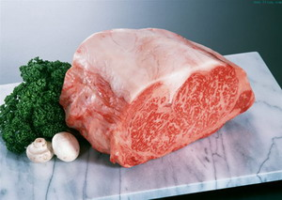


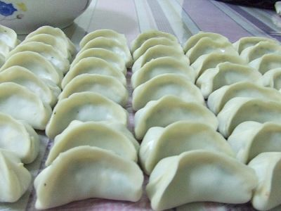
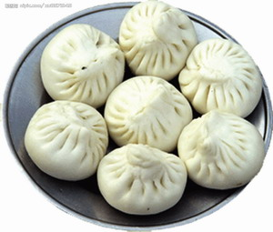

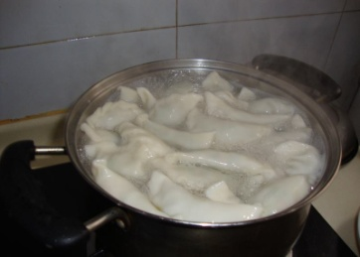


Data Model: An Analogy
Data
Structure
Operation
Constraint
站得住
不能煮破
18个褶
Lu Chaojun, SJTU

Slide 4
Some Data Models
Widely used today:
  Relational, OR
  Semistructured
Others
  OO
History:
  Hierarchical
  Network
Lu Chaojun, SJTU

Slide 5
Comparison
Relational model is preferred, because of its
  simple and limited, yet versatile, approach to structuring data
  limited, yet useful, collection of operations
  allow implementation of VHL language: SQL
    ease of use: just state what to do
    efficiency: optimization possible
Semistructured models have more flexibility, but less preferred in DBMS
Lu Chaojun, SJTU

Slide 6
Relational Model: Basics
Relation = table
Attribute = column ( header)
tuple = row
Reminder:
In math, a relation R is a subset of
S₁× S₂ ×… × S_{n}
i.e.
R = {(a₁, a₂,…, a_{n}) | a_{i} ∈ S_{i} }
Lu Chaojun, SJTU

Slide 7
Relation: an example
Attributes
(column
headers)
codename name
007 James Bond
008 Steven Chow
Spy
Tuples
(rows)
Relation
name
Lu Chaojun, SJTU

Slide 8
Relational Model: Basics(cont.)
Relation schema = relation_name(attribute_list)
  usually not change over time
  SET of attributes, not a LIST.
    But take the “list” as standard order.
  Optionally: types, other structure info
  Example: Spy(codename,name)
Relation instance = current set of tuples
  change over time
  Not a list
Relational DB schema = set of relation schemas
RDB instance
Lu Chaojun, SJTU

Slide 9
Table Def. in SQL:2003
A table has an ordered collection of one or more columns and an unordered collection of zero or more rows.
  Each column has a name and a data type.
  Each row has, for each column, exactly one value in the data type of that column.
Lu Chaojun, SJTU

Slide 10
Relational Model: Basics(cont.)
Domains
  atomic values for each attributes
  each attribute is associated with a domain (type)
  E.g. R(A1:D1,A2:D2)
Key
  attribute(s) to distinguish tuples in a relation
  E.g. R(A1, A2, A3)
  Semantic constraint
  Create artificial keys
Lu Chaojun, SJTU

Slide 11
Why Relational Model?
Very simple model
  single data-modeling concept: relation
Very High-level prog. language: SQL
  simple yet powerful
Design theory
  mathematically strict
Lu Chaojun, SJTU

Slide 12
SQL
Standard DB language
  SQL:2003, SQL:2008
SQL: DDL + DML
Relations in SQL
  Stored relation: table
  View: not stored, constructed when needed
  Temporary table: constructed by SQL processor
SJTU Lu Chaojun
Lu Chaojun, SJTU

Slide 13
SQL Data Types
Data Types
  CHAR(n), VARCHAR(n), clob
  BIT(n), BIT VARYING(n), blob
  BOOLEAN
  SMALLINT, INT/INTEGER, BIGINT
  DECIMAL(n,d)/NUMERIC(n,d), FLOAT/REAL, DOUBLE PRECISION
  TIME WITH/WITHOUT TIME ZONE, TIMESTAMP WITH/WITHOUT TIME ZONE, DATE, INTERVAL
Implicit type coercions
Lu Chaojun, SJTU

Slide 14
SQL Values
Integers and reals: as expected
Strings: single quotes!
  Two single quotes = real quote
    e.g., ’I’’m Back.’
Any value can be NULL.
Date: DATE ’yyyy-mm-dd’
  Example: DATE ’2011-01-11’
Time: TIME ’hh:mm:ss’, with optional fractions of a second
  Example: TIME ’15:30:02.5’
SJTU Lu Chaojun
Lu Chaojun, SJTU

Slide 15
SQL:2003 Data Types
A data type is a set of representable values. Every data value belongs to some data type.
Data type
  Predefined: specified by ISO/IEC 9075, and provided by the SQL-implementation.
    Atomic
  Constructed
    Atomic
    Composite
  User-defined
Lu Chaojun, SJTU

Slide 16
Defining Relation Schema
CREATE TABLE name (
column_1 type_1,
... ,
column_n type_n
);
  Most simple table declaration.
Lu Chaojun, SJTU

Slide 17
Example
CREATE TABLE Student (
sno CHAR(10),
name VARCHAR(20),
age INTEGER,
dept VARCHAR(30)
);
Lu Chaojun, SJTU

Slide 18
Drop Table
DROP TABLE relation;
  No longer part of DB schema
  Tuples also removed
Lu Chaojun, SJTU

Slide 19
Modifying Relation Schema
ALTER TABLE relation
ADD column type
| DROP column;
  ADD: use NULL values as default.
Lu Chaojun, SJTU

Slide 20
Default Values
CREATE TABLE Student (
sno CHAR(10),
name VARCHAR(20),
age INT DEFAULT 18,
dept VARCHAR(30) DEFAULT ‘CS’
);
  Default to NULL, if not designated.
Lu Chaojun, SJTU

Slide 21
Declaring Keys
An attribute or list of attributes may be declared PRIMARY KEY or UNIQUE.
Either says that no two tuples of the relation may agree in all the attribute(s) on the list.
There are a few distinctions to be mentioned later.
Lu Chaojun, SJTU

Slide 22
Declaring Single-Attribute Keys
Place PRIMARY KEY or UNIQUE after the type in the declaration of the attribute.
Example:
  CREATE TABLE Student (
  sno CHAR(10) PRIMARY KEY,
  name VARCHAR(20),
  age INTEGER,
  dept VARCHAR(30)
  );
Lu Chaojun, SJTU

Slide 23
Declaring Multiattribute Keys
A key declaration can also be another element in the list of elements of a CREATE TABLE statement.
This form is essential if the key consists of more than one attribute.
  May be used even for one-attribute keys.
Lu Chaojun, SJTU

Slide 24
Example: Multiattribute Key
The student number and course number together are the key for SC:
  CREATE TABLE SC (
  sno CHAR(10),
  cno CHAR(5),
  grade INTEGER,
  PRIMARY KEY (sno, cno)
  );
Lu Chaojun, SJTU

Slide 25
PRIMARY KEY vs. UNIQUE
There can be only one PRIMARY KEY for a relation, but several UNIQUE attributes.
No attribute of a PRIMARY KEY can ever be NULL in any tuple. But attributes declared UNIQUE may have NULL’s.
Lu Chaojun, SJTU

Slide 26
End
Lu Chaojun, SJTU

