Slide 1
waveref.py
post-processing module for wave reflection
github.com/sshi02/waveref

Slide 2
overview
central part of the waveref module is reflection()
Implementation of Goda and Suzuki 76
(ESTIMATION OF INCIDENT AND REFLECTED WAVES IN RANDOM WAVE EXPERIMENTS)
implementation roadmap
decomposition using FFT
equation (5)
(Goda and Suzuki)
outbound checks
wave number approximations
energy calculations
return amplitude, coefficient of reflection
Newton-Raphson
test cases

Slide 3
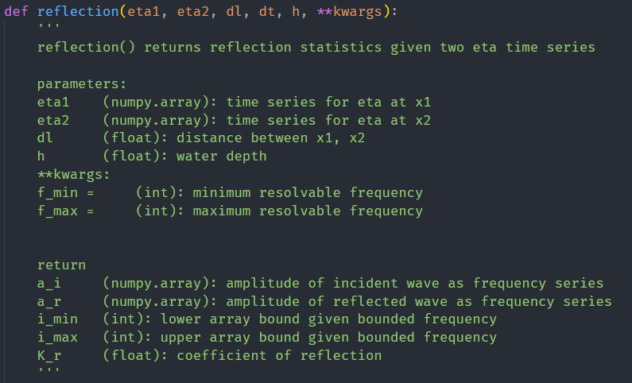
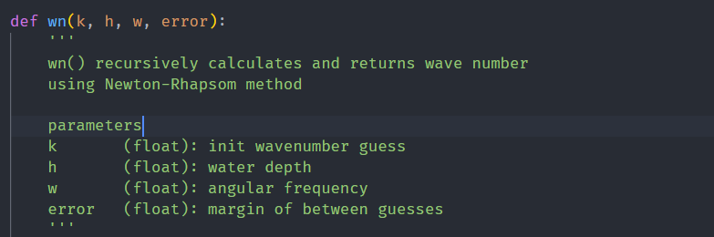
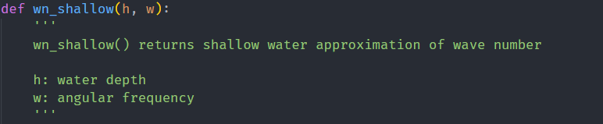
overview — code
waveref.py
├── reflection()
├── wn()
└── wn_shallow()

Slide 4
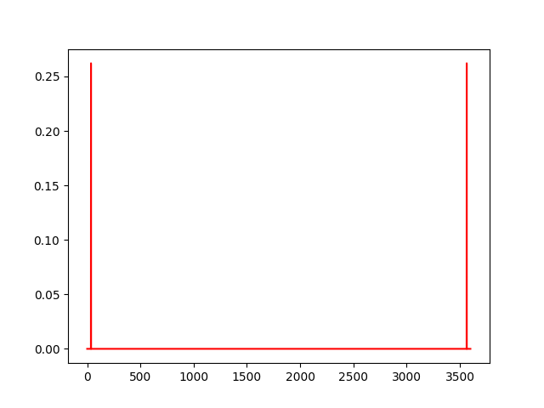
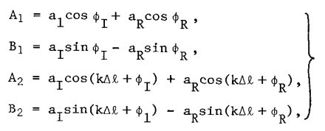

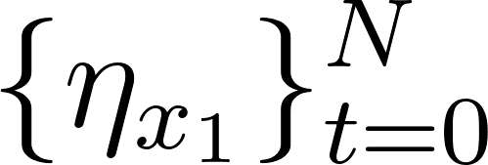
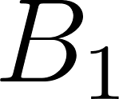

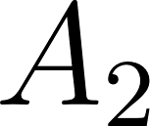
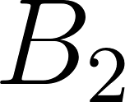
decomposition via fft()
untruncated spectra from test 1 in test.py
truncated at index N/2
(Nyquist Frequency)
fft()
normalized by N/2

Slide 5
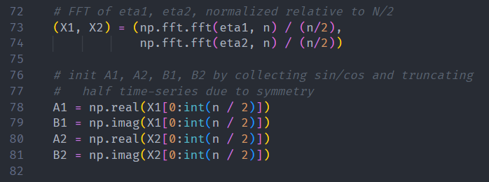
decomposition via fft() — code
1: arrays and methods largely dependent on NumPy
73: normalized FFT of first eta time series
74: normalized FFT of second eta time series
[78 -> 81]:
extracting cosine and sine components by separating real and imaginary values from FFT
each frequency series is truncated at the Nyquist Frequency

Slide 6

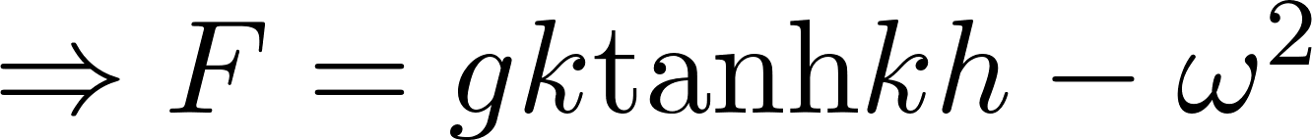

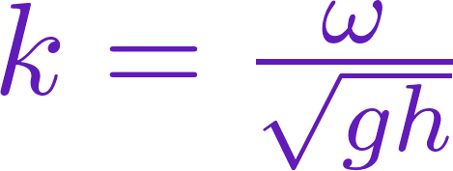

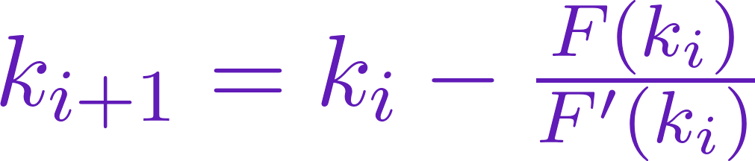
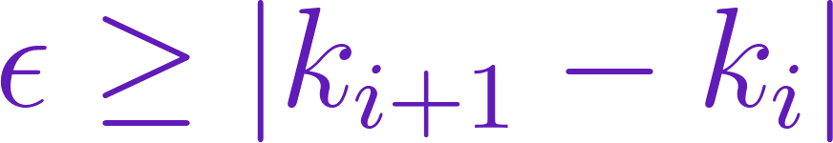
wavenumber approximation
(Newton-Raphson
Method)
(shallow water approximation)
Else,
If yes, return.

Slide 7
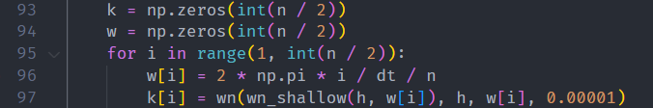
wavenumber approximation — code
1: wn() relies on NumPy math operations
2. wn_shallow() relies on module Math
93: init array for wavenumber
94: init array for angular frequency
95: iterating through wavenumber array
96: angular frequency given relative index
97: wavenumber approximation using a recursive Newton-Raphson function, fed an initial guess using a shallow water approximation.
error is set to 10⁻⁵

Slide 8
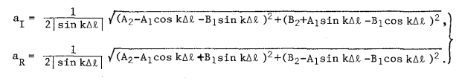


equation (5) (with a small correction)
appears to be a small error in the paper
diverging condition
relatively straightforward to implement (but long)

Slide 9
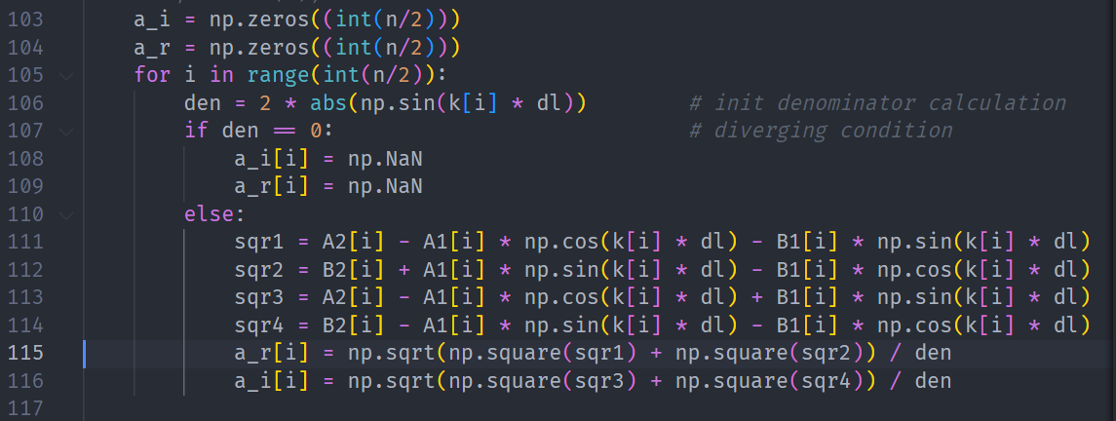
equation (5) — code
diverging condition check
equation (5)

Slide 10

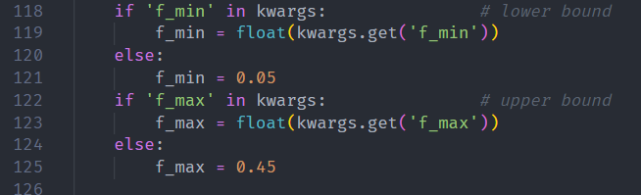
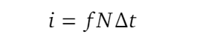

frequency limits → array limits

Slide 11
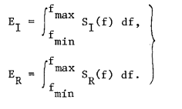
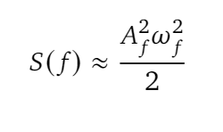
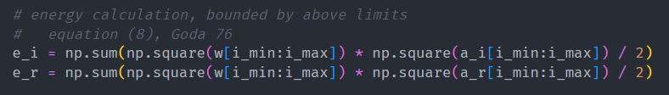


energy and coefficient of reflection

Slide 12
limitations and test cases
assume 1-D, flat bottom cases
small numerical convergences
optimizing gauge placement (Wenneker and Hofland 14)
test.py
idealized: two opposing waves of differing heights
idealized: standing wave
FUNWAVE-TVD: regular wave maker with wall collision
FUNWAVE-TVD: regular wave maker with 10-degree slope
FUNWAVE-TVD: solitary wave with wall collision

Slide 13
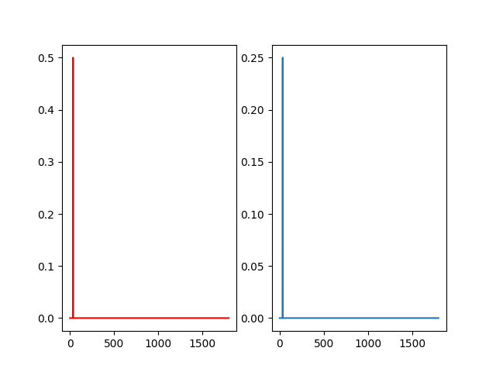
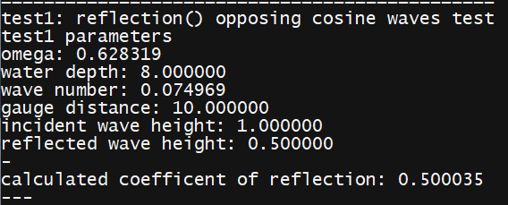
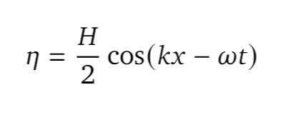
idealized case: opposing waves
H_{I} = 1.0
H_{R} = 0.5
Gauge Locations: 100, 110
a_{I}
a_{R}

Slide 14
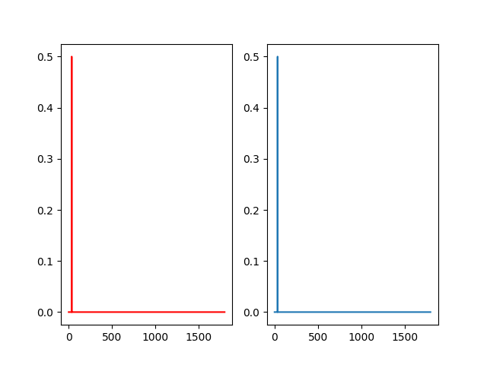
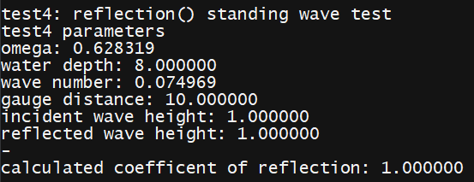
idealized case: standing waves
H_{I} = 1.0
H_{R} = 1.0
Gauge Locations: 100, 110
a_{I}
a_{R}

Slide 15
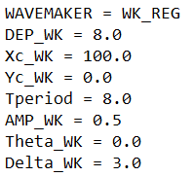
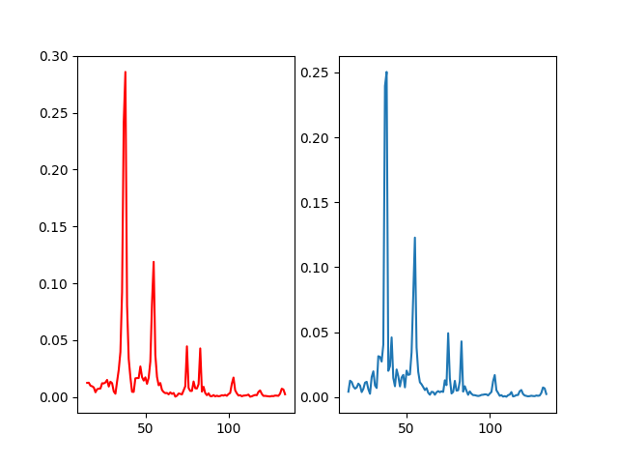
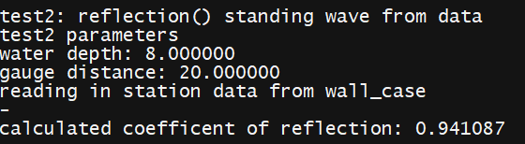
FUNWAVE-TVD case: wall collision
Gauge Locations: 300, 310

Slide 16
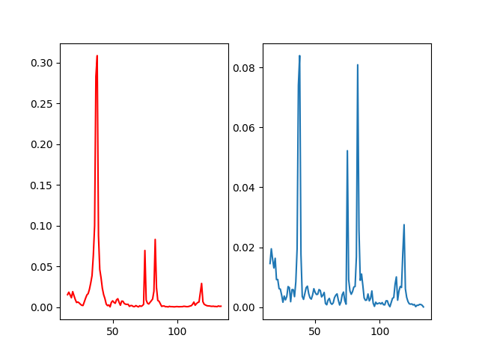
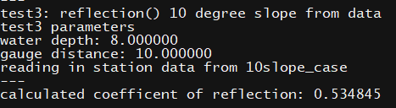
FUNWAVE-TVD case: 10-degree slope
Gauge Locations: 200, 210

Slide 17

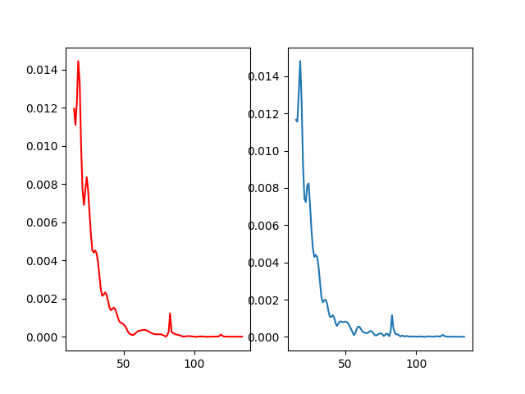
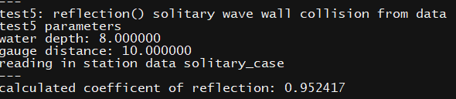
FUNWAVE-TVD case: solitary wave
Gauge Locations: 200, 210

Slide 18
conclusion
relatively complete implementation of Goda and Suzuki 76
with a small but important correction
ideal test cases: reflection() performs perfectly
FUNWAVE-TVD cases: reflection performs as expected

