Slide 1
How well does the model identify loans that yield higher returns?
Randomly sample 100 completed loans from out-of-sample (test) dataset.
Calculate modeled and predicted net present value* (NPV) for each loan.
Calculate actual NPV for each loan.
Define 3 methods of ranking the 100 loans:
Highest actual NPV (rank of 1) to lowest actual NPV (rank of 100)
Highest modeled NPV to lowest modeled NPV
Random ranking
For each method of ranking, calculate the portfolio NPV of including loans 1 through 100.
Repeat this process 1,000 times and compare the means for each ranking methodology.
*NPV returns the sum of cash flows discounted at the required rate of return. The discount rate was set at 5%, which is roughly the average yield reported on Lending Club’s website: https://www.lendingclub.com/info/statistics-performance.action

Slide 2
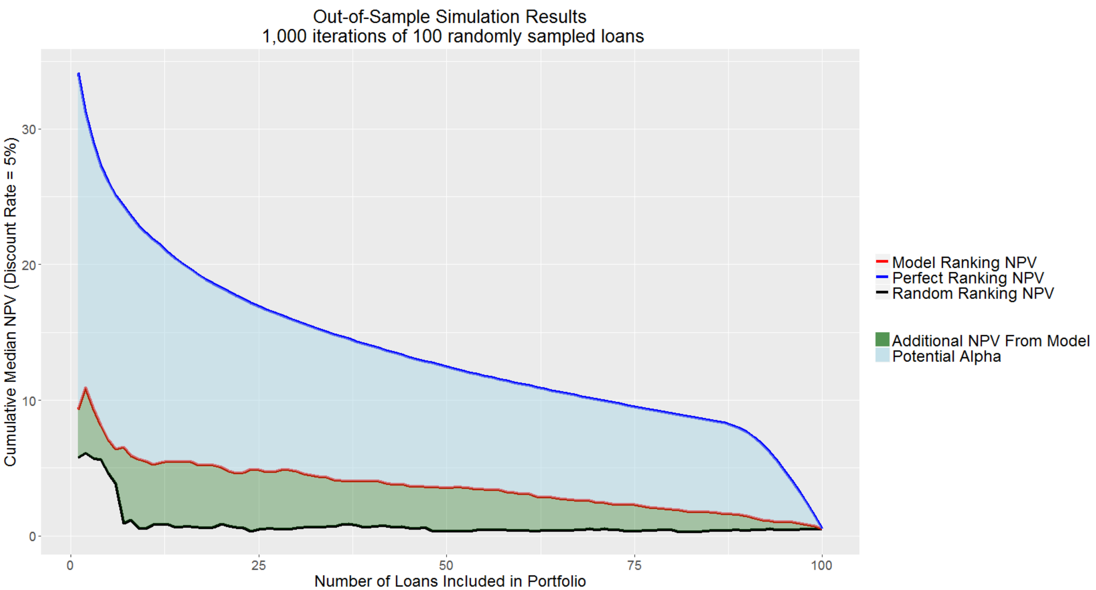
Perfect ranking –
$23 NPV (29% return) for first 10 loans.
Selecting the first 10 loans out of 100 random loans yields an additional $5 in NPV – using the model almost doubles and investor’s return.
Model Ranking –
$6 NPV (11% return) for first 10 loans.
Random Ranking –
$1 NPV (6% return) for first 10 loans.

