Slide 1
Stroke Prediction
Group-7
Sanchit Vijay
Sanjana S Godolkar
Shikha Sharma
Guoshan Yu

Slide 2
Table of Contents
Definition
Scope of Project
Data and features
Expected Outcomes
Architecture
Logical Architecture
Data Flow Diagram
Implementation
Results

Slide 3
Scope of the Project
Our project aims to utilize machine learning algorithms to develop models that predict the risk of having a stroke.
To use tools from Amazon Web Services to implement the project.

Slide 4
Data and Features
Source: Kaggle ("healthcare-dataset-stroke-data")
• 5,110 observations with 12 attributes
• Attributes: ID, Gender, Age, Hypertension, Heart Disease, Ever
Married, Work Type, Residence Type, Avg. Glucose Level, BMI,
Smoking Status, Stroke
• Imbalanced dataset:
Stroke cases: 249
Non-stroke cases: 4861

Slide 5
Data Preprocessing
Cleaning and preparing data for model development
• Excluding 'id' column
• Handling missing values: Filling null values in 'BMI' column with
mean
• Label encoding for categorical variables
• Balancing the dataset using the SMOTE technique

Slide 6
Feature Reduction
• Dropped the following features:
‘gender’ , ’ever_married’ , ‘work_type’ ,
‘Residence_type’ , ‘avg_glucose_level’ , ‘bmi’ ,
‘smoking_status’
• Keeping the following features:
‘age’ , ‘hypertension’, ‘heart_disease’

Slide 7
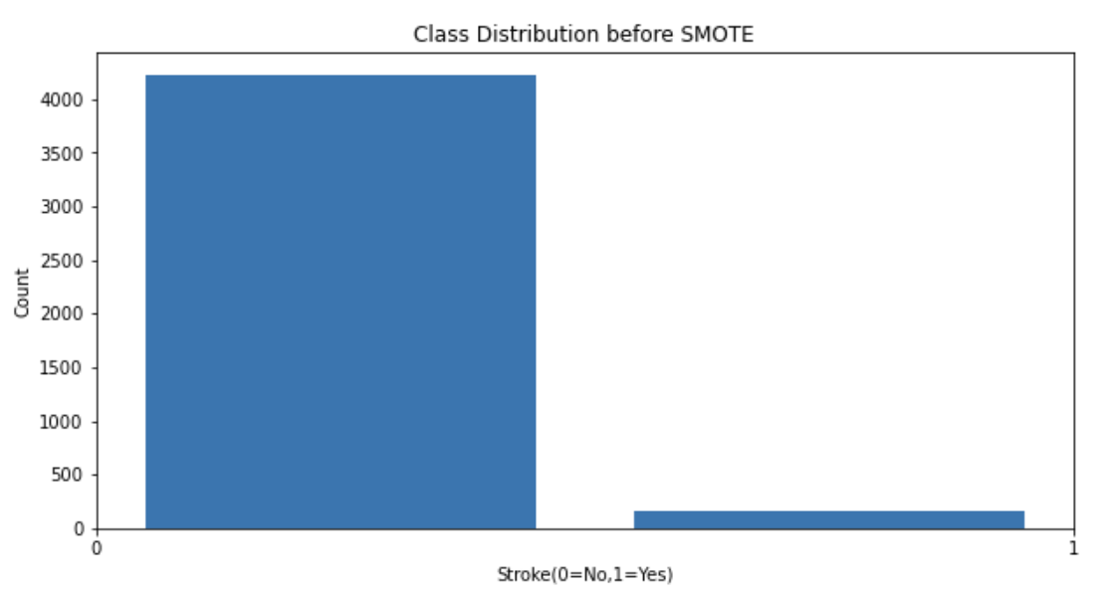
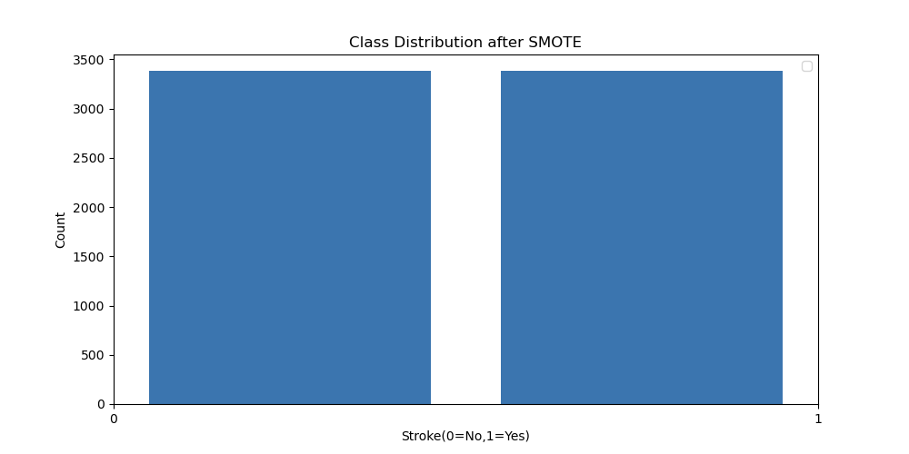
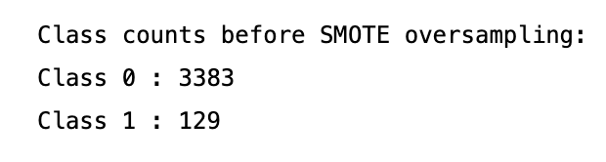
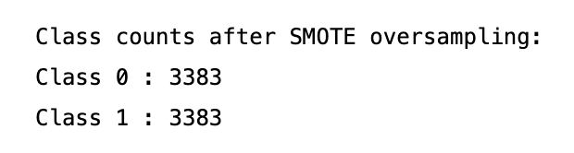
Before and After SMOTE

Slide 8
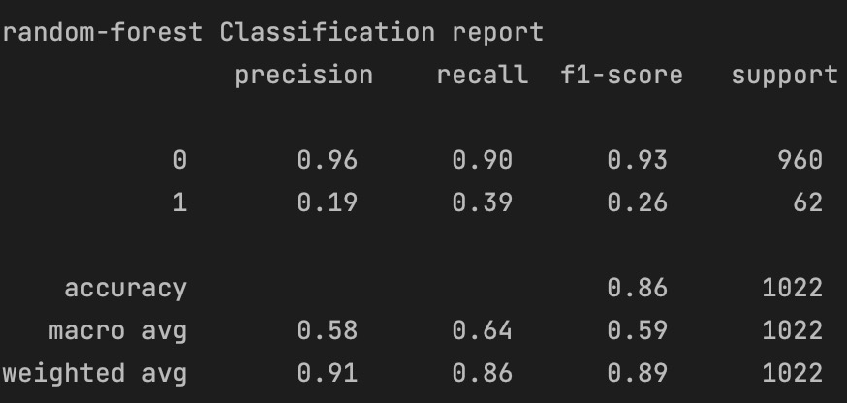
Models- Random Forest

Slide 9
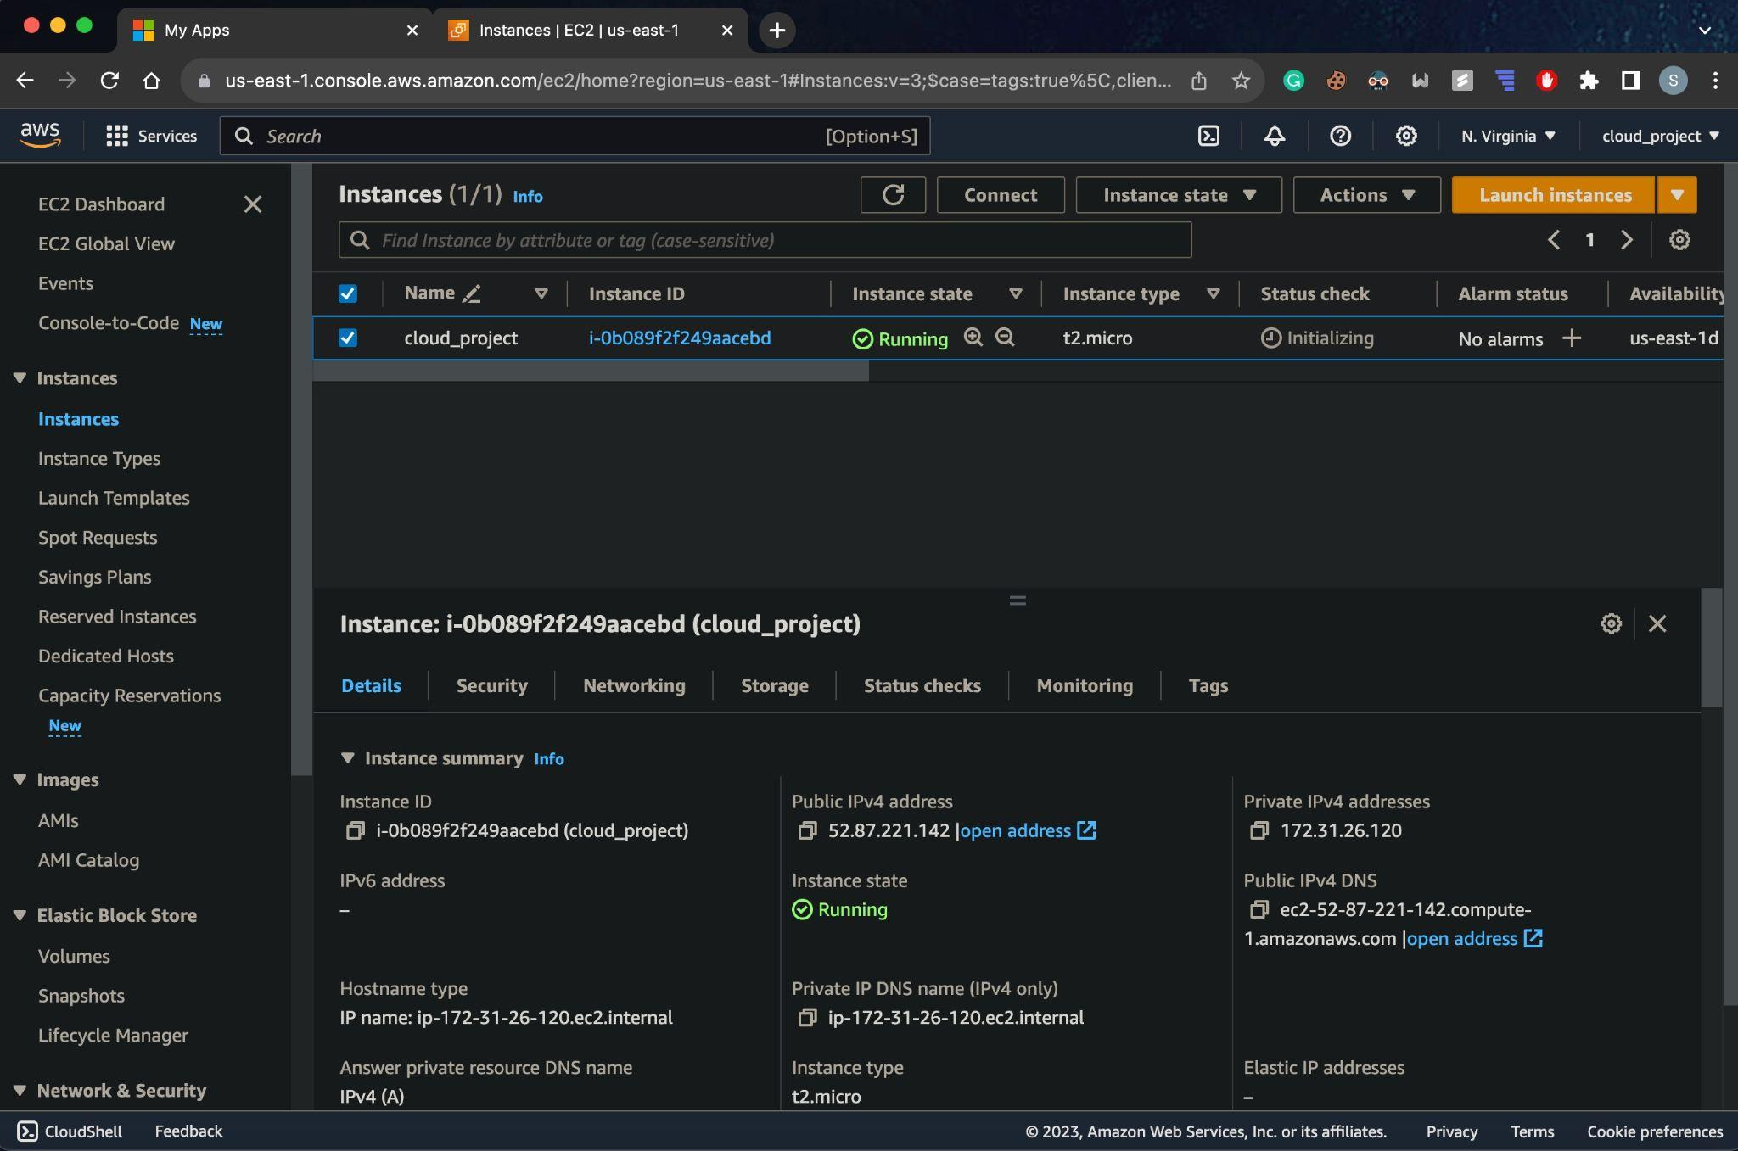
Implementation

Slide 10
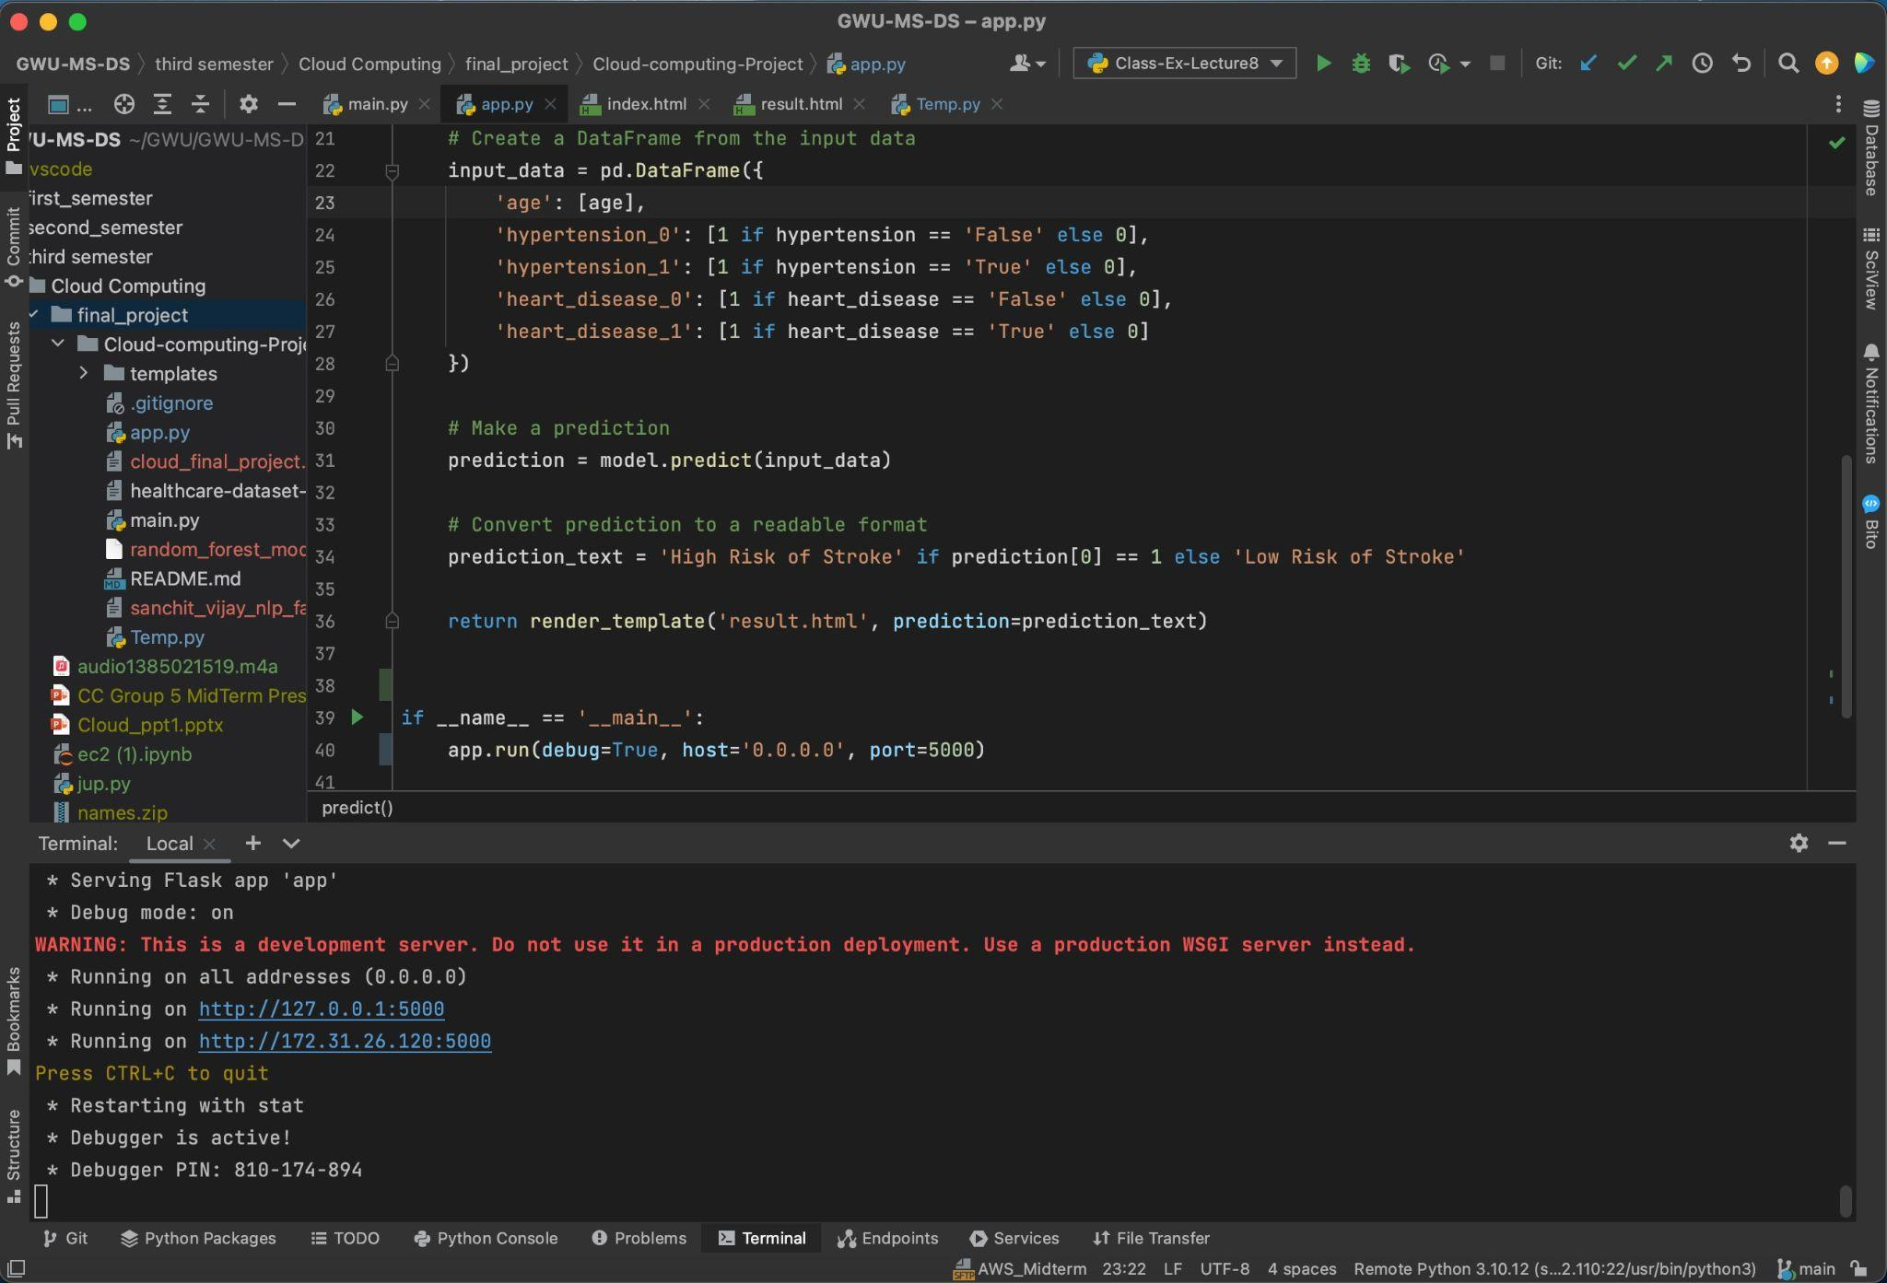
Implementation

Slide 11
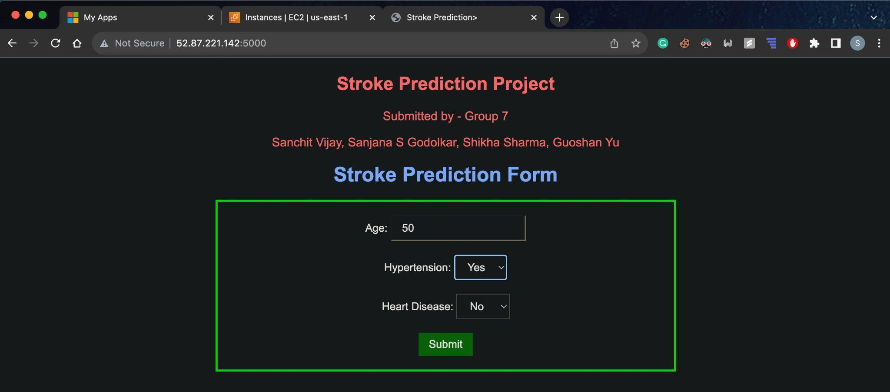
Implementation

Slide 12
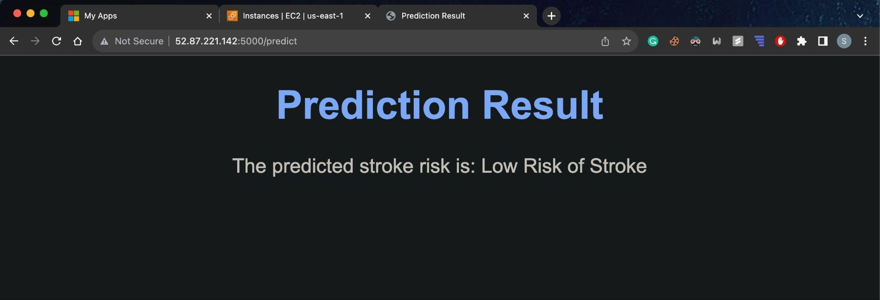
Implementation

Slide 13
Expected Outcomes
Expected Outcome from AWS Deployment:
Set up AWS cloud Infrastructure with IAM,EC2,VPC
Expected Outcome from modelling:
Use the best-performing machine learning model (Random Forest) to estimate the likelihood of an individual experiencing a stroke.

Slide 14
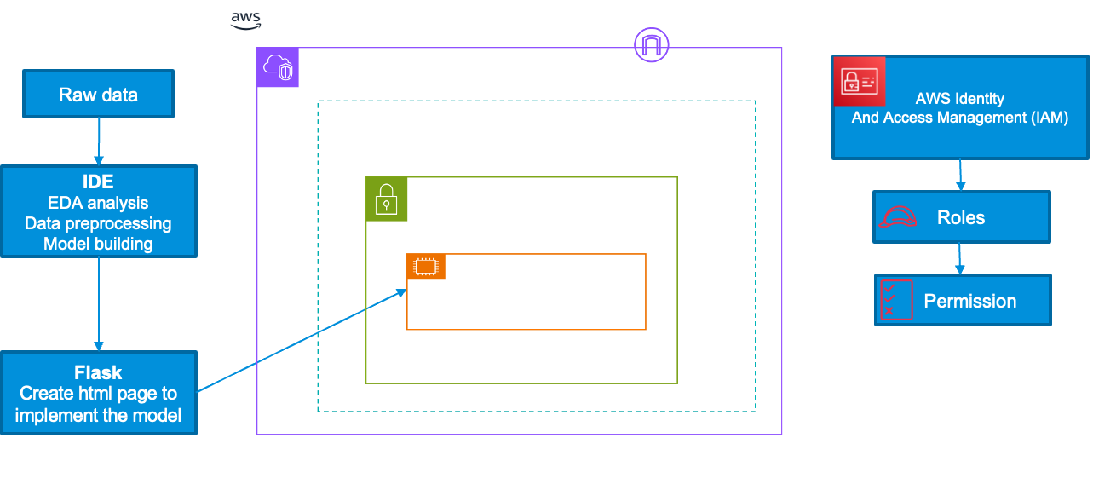
Logical Architecture

Slide 15
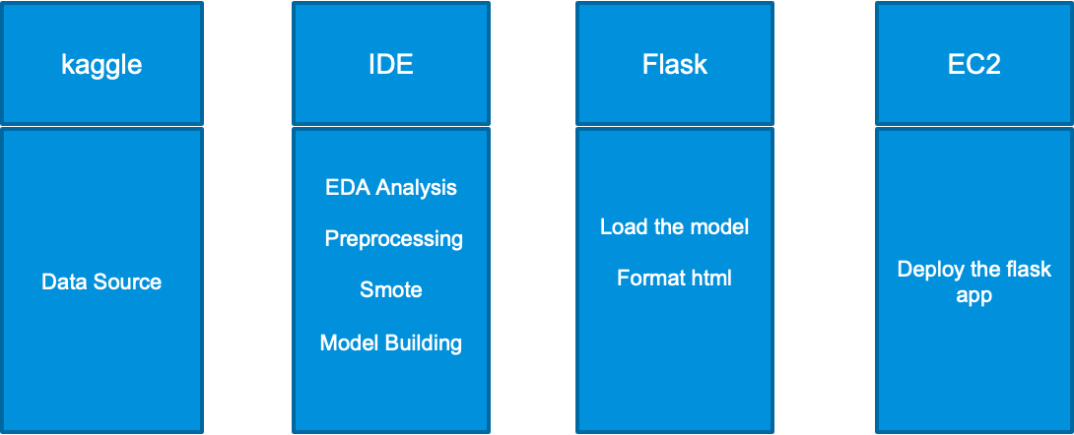
Data Flow Diagram

Slide 16
Conclusion
Successfully integrated the trained Random Forest model into a Flask web application.
Demonstrated practical application with a user-friendly interface for stroke risk prediction.
Achieved deployment on AWS EC2, ensuring global accessibility and scalability.

Slide 17
Thank you

