Slide 1
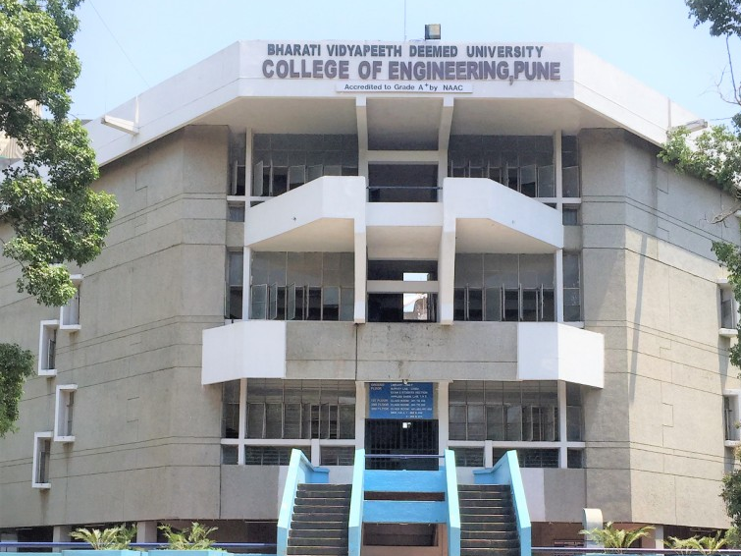



BHARATI VIDYAPEETH DEEMED UNIVERSITY
COLLEGE OF ENGINEERING , PUNE
GRAVITY LIGHT
DEPARTMENT OF
ROBOTICS AND AUTOMATION
SUBMITTED BY:
Shivani Shinde(Rollno.31)
Rohit Patil (Rollno.25)
Jay Chavan(Rollno.06)
Rohit Sonawane(Rollno.41)
SUBMITTED TO:
Dr. Pradeep D. Jadhav

Slide 2
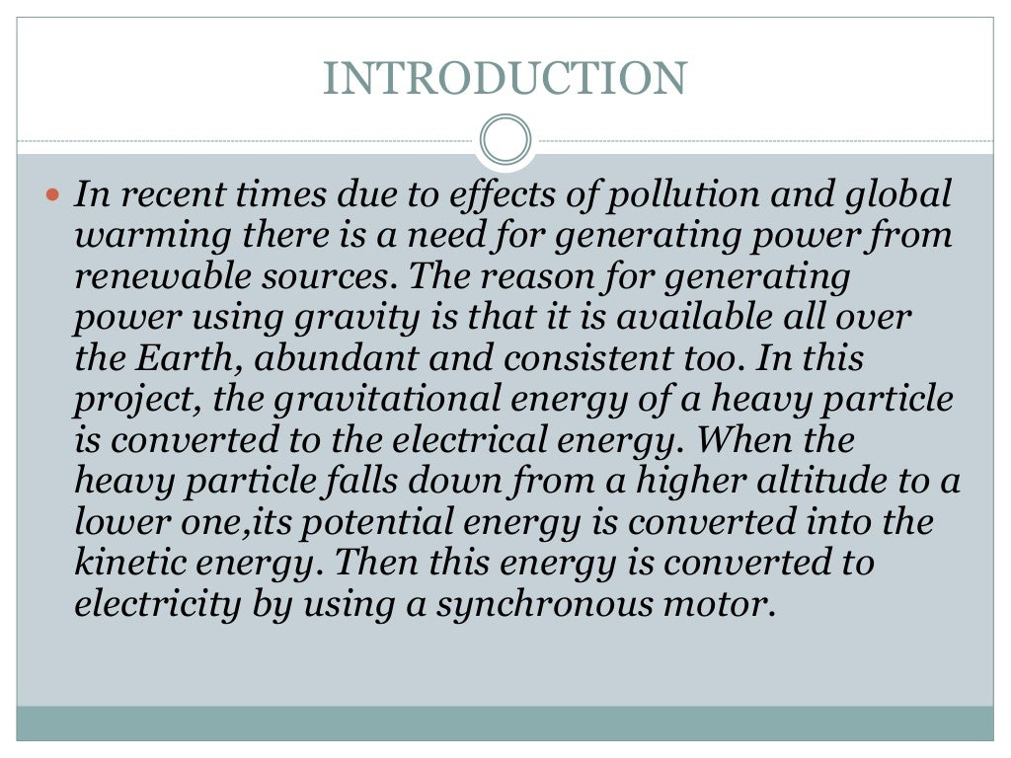

Slide 3
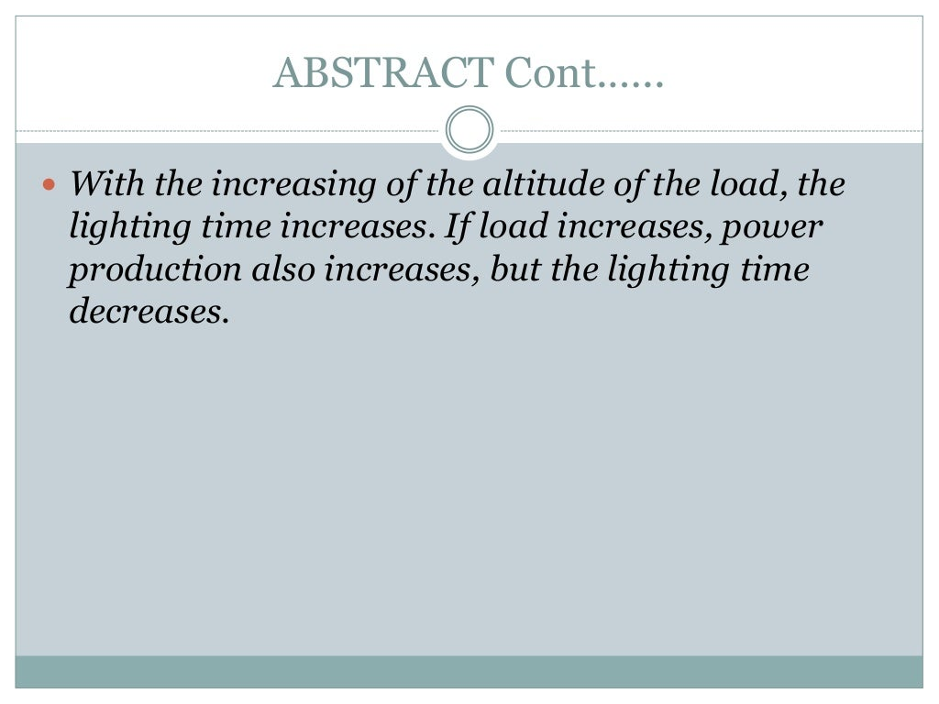

Slide 4


Slide 5
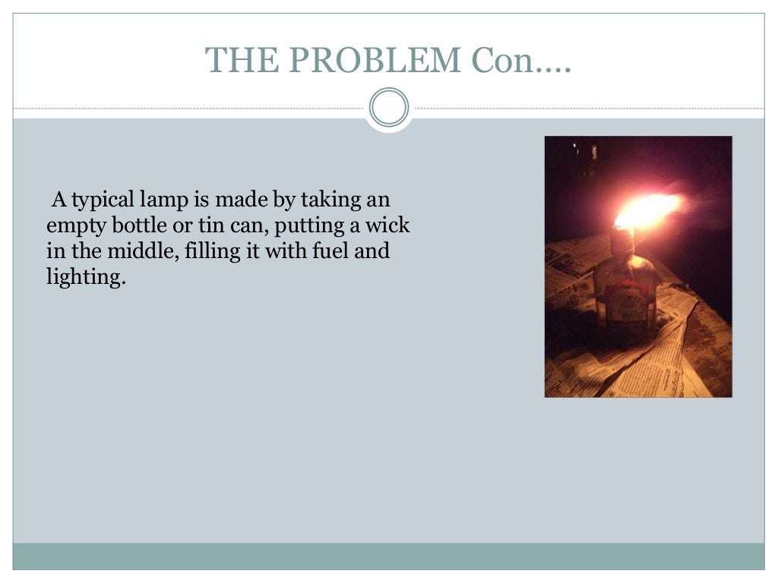

Slide 6
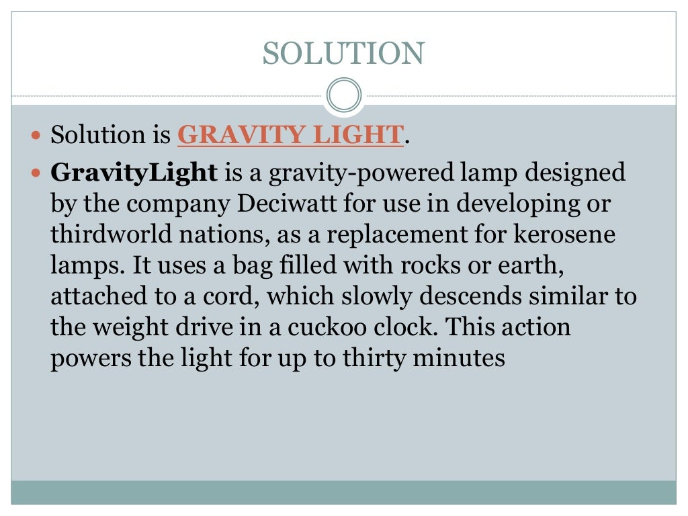

Slide 7
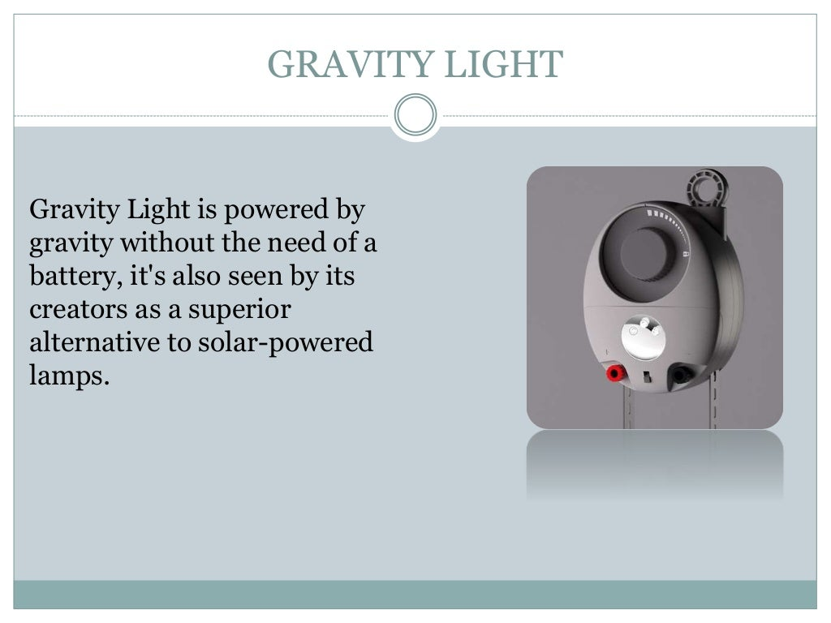

Slide 8
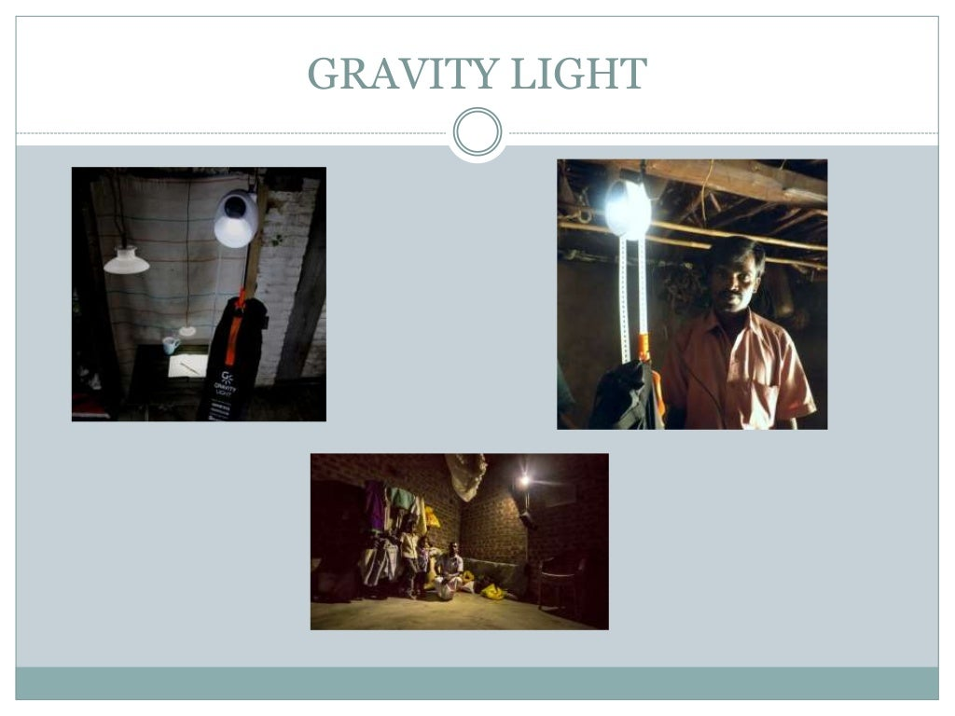

Slide 9
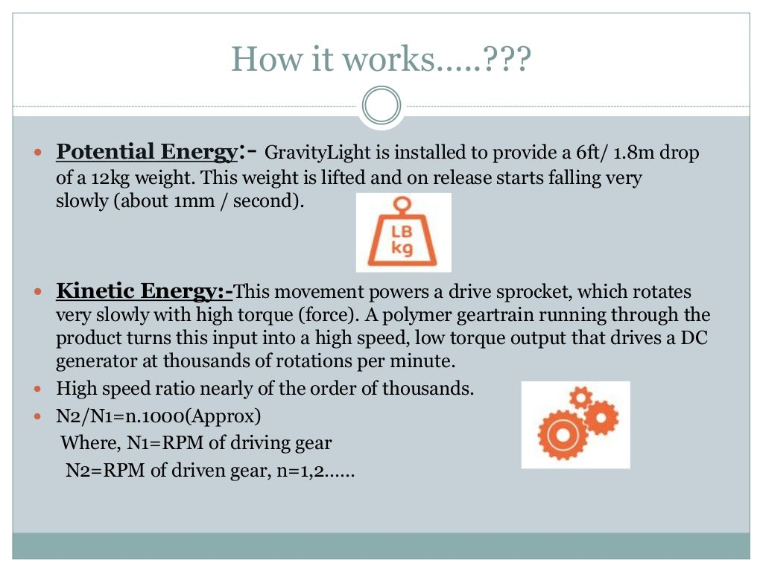

Slide 10
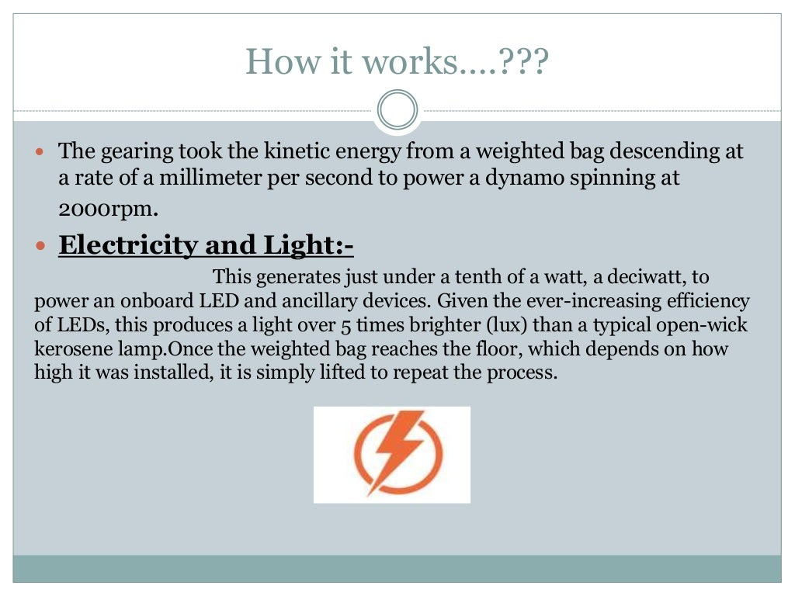

Slide 11
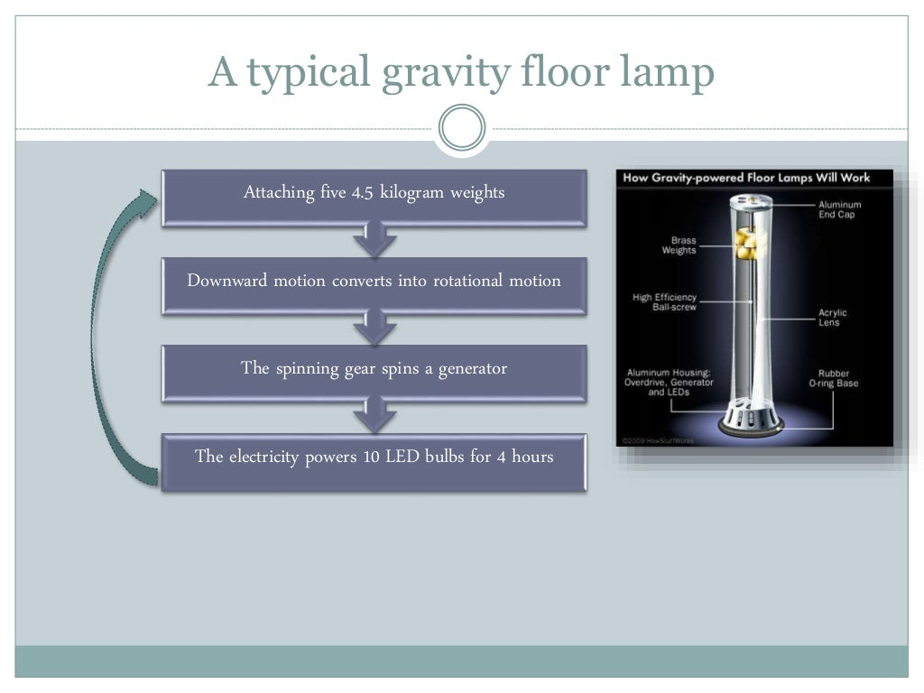

Slide 12
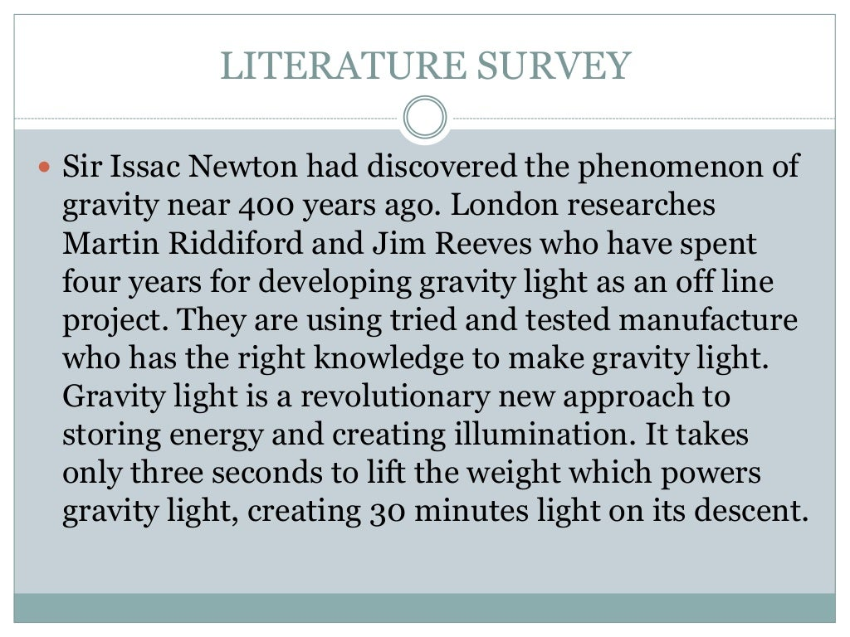

Slide 13
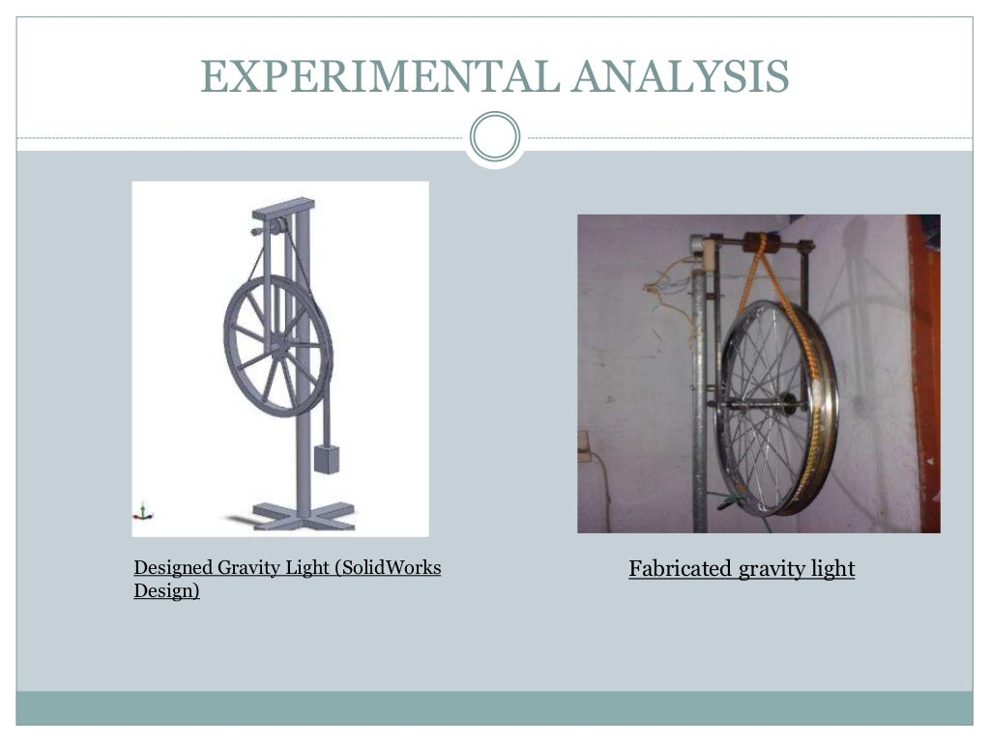

Slide 14
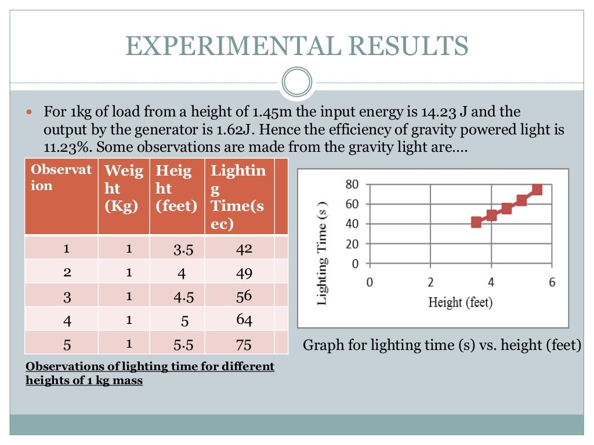

Slide 15
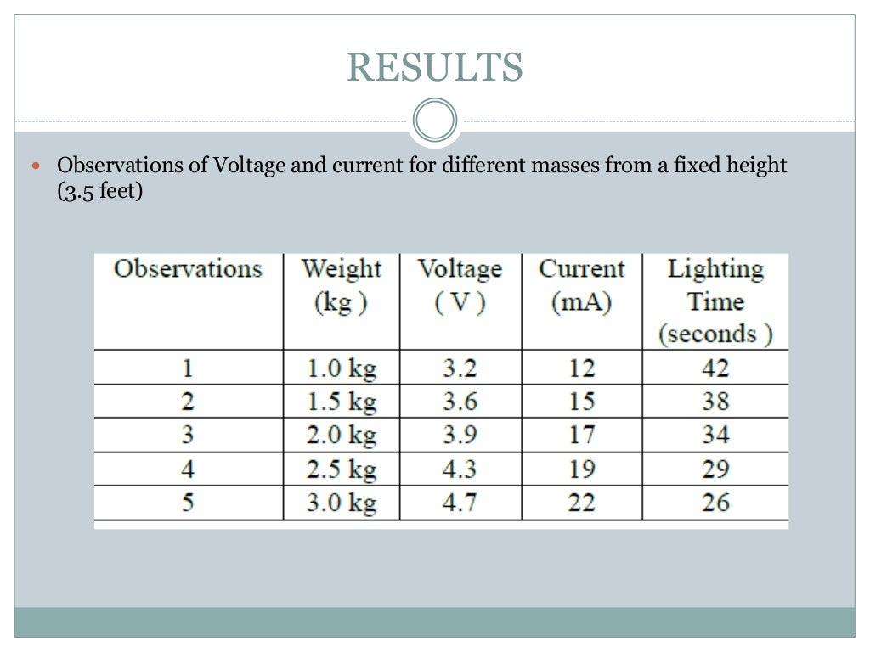

Slide 16
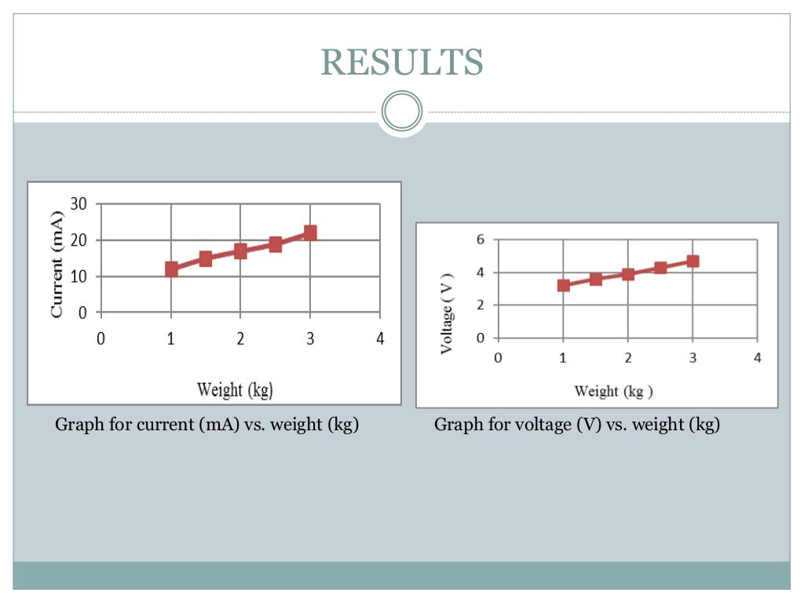

Slide 17
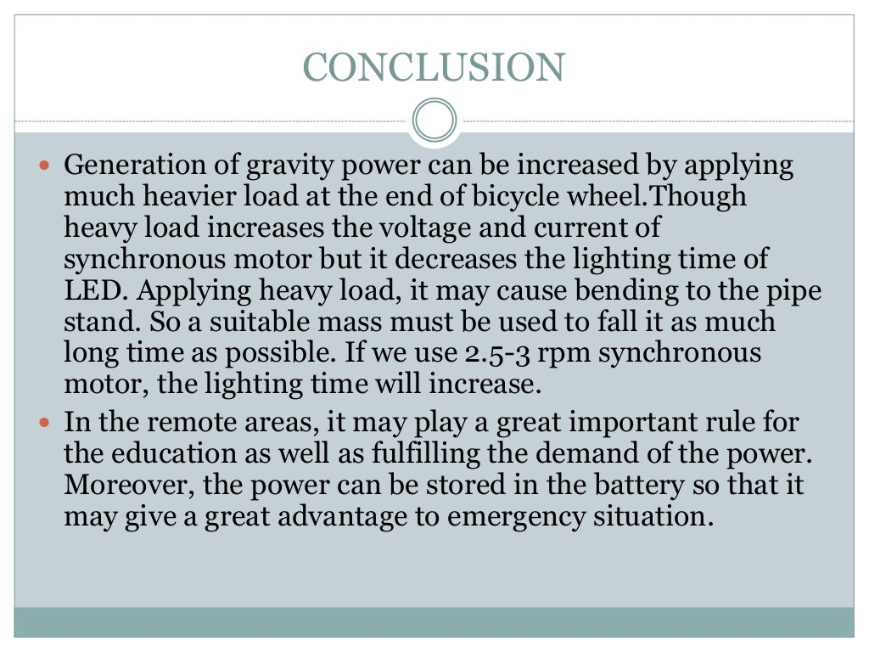

Slide 18


Slide 19


