Slide 1
An Empirical Study on the Evolution of Open Source JavaScript Projects
Everton da S. Maldonado
Shahriar Rostami Dovam
Department of Computer Science and Software Engineering
Concordia University
Montreal, Canada

Slide 2
Research Goal
Thus far, there are few studies in the evolution of script languages.
Our goal is to compare how JavaScript projects evolves in comparison with Java projects.

Slide 3
Why JavaScript ?
Notes:
Shar Shar , put the important point of java script where

Slide 4
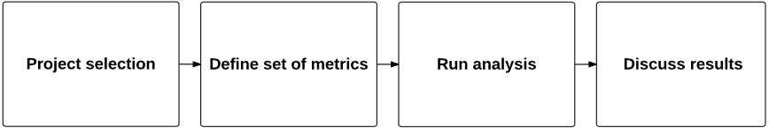
Research Overview
Notes:
Put the graph overview here.

Slide 5
Research questions
RQ1 - How JavaScript language projects evolve in comparison with projects written in compiled languages?

Slide 6
Research questions
RQ2 - How Technical Debt can influence the change proneness of the source code in the project ?

Slide 7
Research questions
RQ3 - How Technical Debt can influence the bug proneness of the source code in the project ?

Slide 8
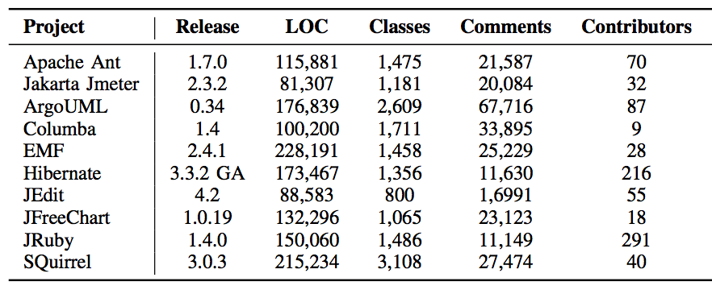
Case study on ten open source projects

Slide 9
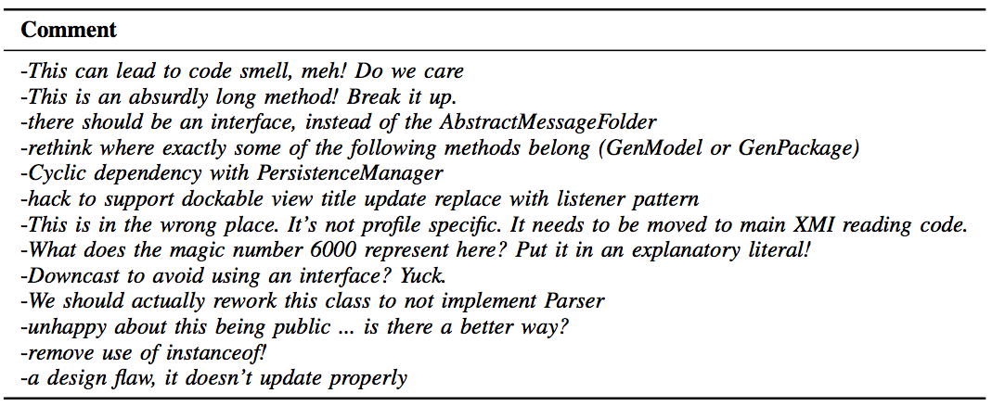
Comments found using our approach

Slide 10
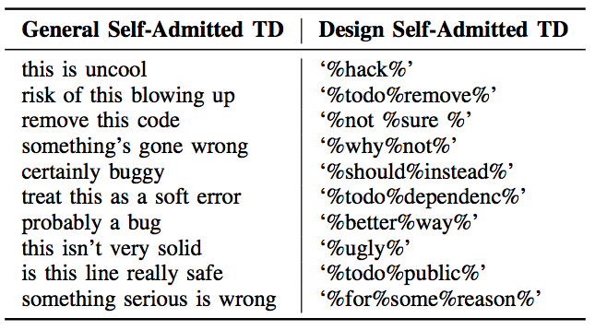
Approach evaluation

Slide 11

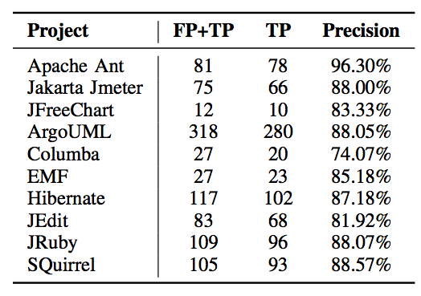
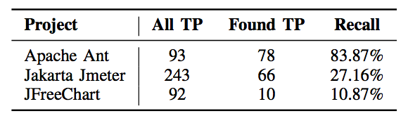
Approach evaluation

Slide 12

Advantages
Developer input/confessions about the system are taken into consideration
Self-admitted design debt could guide the process of refactoring recommendation.
A light-weight approach

