Slide 1
Project Presentation of Industry Oriented Hands on Experience (22CS422)
On
AutoFix - Instant Vehicle Booking Service
Shivam Sharma [2211981367] Kartik Chauhan [2211981193]
Prashant Pathania [2211981270]
Piyush Sankhyan [2211981268]
Supervised By
Dr. Rajat Takkar
Department of Computer Science and Engineering,
Chitkara University, Punjab

Slide 2
INTRODUCTION
AutoFix is a web-based service that makes it easier for people to get their cars fixed and maintained. It makes it simple and quick to find mechanics in your area, schedule service appointments, and handle repair requests online. The system has a user-friendly interface and makes sure that only authorised users can access it safely. AutoFix makes it easy for users and service providers to talk to each other by combining frontend and backend technologies. It makes it easier to find reliable mechanics and cuts down on the time and effort needed to do so. The platform's main goal is to make vehicle service management easier, more open, and more efficient.
2

Slide 3
OBJECTIVE
The goal of this project is to create a web-based platform that is both reliable and easy to use that connects users with mechanics in their area who can fix and maintain their cars. The goal is to make it easier to find, book, and manage service requests using a digital system that works well. The main goals of the project are to make sure that users can log in safely, that the frontend and backend can talk to each other easily, and that the database can handle data correctly. It also wants to make it easier for users to find reliable mechanics by cutting down on the time, effort, and uncertainty they have to deal with. The main goal is to make vehicle service management more convenient, accessible, and open, while also coming up with a solution that can grow and work well.

Slide 4
PROBLEM STATEMENT
Finding trustworthy mechanics who are close by to fix and maintain your car can be hard and take a lot of time in today's fast-paced world. Users often rely on manual searches, personal contacts, or sources that haven't been checked out, which can cause delays, bad service, and a lack of trust in the service providers.
Also, there isn't one central place where people can easily search for, compare, and book vehicle repair services. Not having a good way to handle service requests makes things confusing and wastes time. This shows that we need a digital solution that is open, saves time, and lets us quickly find trusted mechanics.

Slide 5
METHODOLOGY
The development of the AutoFix project is carried out using a structured full stack approach, beginning with requirement analysis and system design. Features such as user login, booking of services and management of requests were identified and designed. The system is built with a three-tier architecture separating the system into frontend, backend, and database to achieve better scalability and performance.
The frontend was developed using React.js to create an interactive and user-friendly interface, while the backend was built using Node.js and Express.js to handle APIs and business logic. MongoDB was used for efficient data storage and handling. The system was tested at different phases to ensure smooth integration, functionality and security providing a solid web based solution.

Slide 6
FEATURES
System for registering and logging in users
JWT for safe authentication Find mechanics near you
Simple System for Booking Services
User Dashboard for Managing Bookings
Handling Service Requests in Real Time
Admin Panel for Controlling Services and Users
An interface that is easy to use and responsive
Using MongoDB for efficient database management and REST APIs for fast communication

Slide 7
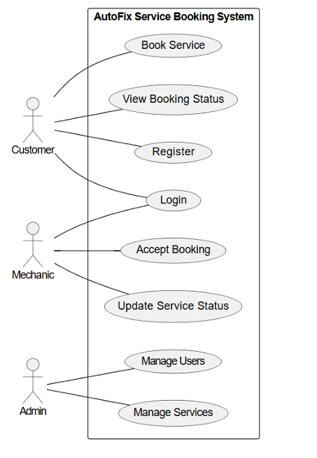

UML DIAGRAM

Slide 8
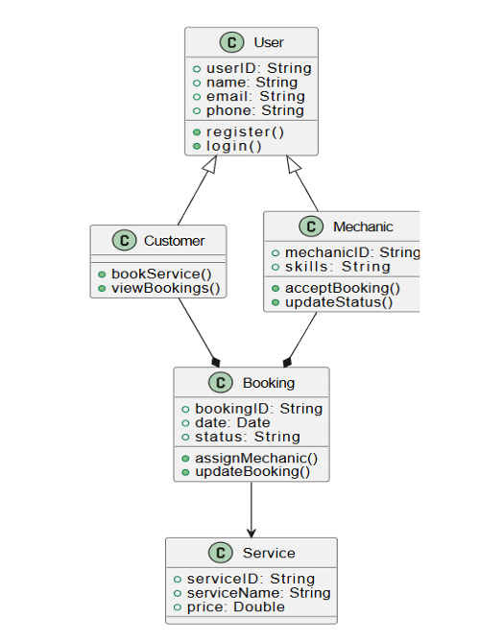
CLASS DIAGRAM

Slide 9
Technology Stack
Frontend: JavaScript, CSS, HTML, and React.js
Backend: Node.js and Express.js
MongoDB is the database.
JSON Web Token (JWT) is used for authentication.
Postman for API Testing
Git and GitHub for version control
Visual Studio Code is a tool for developers.

Slide 10
OUTCOMES
Made a web-based platform for booking vehicle services that works perfectly Made it easier to find and book mechanics in the area Made it easier for users and cut down on the time needed to find service Made sure that user authentication and data management were safe Made it easy for the frontend, backend, and database to work together . Better understanding of the ideas behind full stack development Built a system that can grow and add new features in the future.

Slide 11
FUTURE SCOPE
Integration of online payment systems for smooth transactions
Making a mobile app (for Android and iOS) to make it easier to use
Tracking the mechanic's location and service status in real time
Recommendations for services and nearby mechanics based on AI
A rating and review system to make service more open
GPS integration for accurate location-based services
Growth to support more cities and a bigger user base

Slide 12
CONCLUSION
The AutoFix project meets its goal of creating a platform for car repair and maintenance services that is both reliable and easy to use. It makes it easier for users to find mechanics nearby and book services, which saves them time and effort. The system makes sure that authentication is safe, data is managed well, and communication between the frontend, backend, and database parts is easy. This project effectively used full stack development ideas like API integration, database management, and user interface design. Users will find the platform more convenient, open, and easy to use. It is also scalable and can be made better in the future by adding advanced features like real-time tracking, online payments, and mobile app support. This makes it a useful and valuable solution.

Slide 13
Thank You
13

