Slide 1
CV RESEARCH-REPRODUCTION PROJECT · STAGE 2 & STAGE 3
Reproducing Transfer-Learning & Snapshot-Ensemble
Diabetic Retinopathy Grading on APTOS 2019
Base paper: Chilukoti et al., BMC Medical Informatics and Decision Making 24:37 (2024)
Shivansh · Divyanshi · Vivek · Shubham
github.com/sshivanshg/dr-grading-reproduction
Notes:
Introduce the team and the task: five-class DR grading on APTOS 2019. Today we present Stage 2 (choosing and auditing a base paper) and Stage 3 (reproducing its baseline and explaining the gap).

Slide 2
ROADMAP
Where we are in the project
1
2
3
4
5
6
Literature survey
Pick base paper
Reproduce
Hypothesis
Implement & ablate
Analyse & write
10+ papers, gaps identified
Reproducibility checklist
Re-run method, explain gap
One change + prediction
Measure what moved
IEEE paper + defence
▲ TODAY
Stage 1 take-aways (our literature review)
Research question we are building towards
Class imbalance remains unresolved: Severe NPDR & PDR are rare
Accuracy can be misleading; per-class recall and QWK are needed
Ordinal nature of grades (0→4) is under-used
Can class-balanced, ordinal-aware learning improve Severe NPDR and PDR recognition while reducing large grading errors?
Stages 2–3 build the reproducible baseline to test it on.
Diabetic Retinopathy Grading · Reproduction of Chilukoti et al. (2024) · Stage 2 & 3
2
Notes:
Stage 1 was the literature survey. Today covers Stage 2 and Stage 3. Stage 4 (hypothesis) is next.

Slide 3
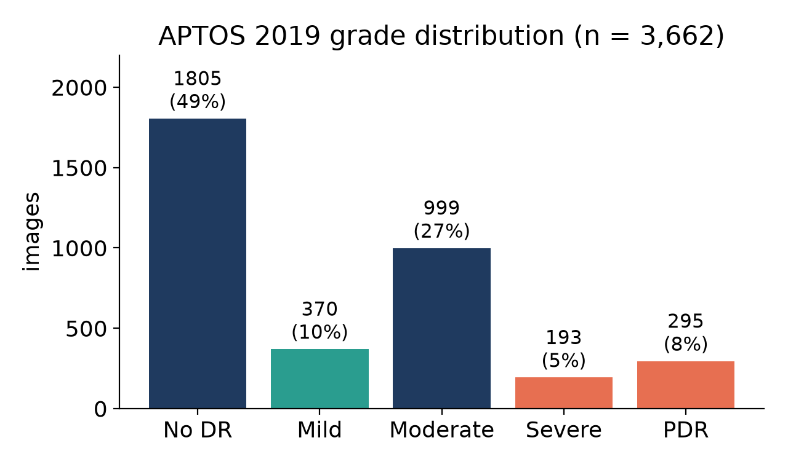
PROBLEM
Task: five-class DR grading on APTOS 2019
Dataset
3,662 colour fundus photographs, Aravind Eye Hospital (rural India)
Graded 0–4 by clinicians (ICDR scale)
Split (stratified, seed 42)
70 / 15 / 15 → 2,562 train · 550 val · 550 test
Same proportions the paper used for EyePACS
Why it is hard
Severe NPDR = 5%, PDR = 8% of images
Adjacent grades look alike (Mild↔Moderate, Severe↔PDR)
Grades are ordinal, so error size matters → QWK
Diabetic Retinopathy Grading · Reproduction of Chilukoti et al. (2024) · Stage 2 & 3
3
Notes:
APTOS 2019: 3,662 fundus photos from Aravind Eye Hospital, graded 0-4. Heavily imbalanced: No DR is half the data; Severe is only 5%. Grades are ordinal, so QWK is the standard metric.

Slide 4
STAGE 2 · SELECTION
Base paper: Chilukoti et al. (2024)
Fundus image
CLAHE + Gaussian blur
EfficientNet-B3
3-layer head
Snapshot vote
APTOS 2019
contrast + denoise, 300 px
ImageNet-pretrained, fine-tuned
512 → 512 → 5, dropout 0.5/0.25
10 saved epochs, majority
Dark boxes = the paper's two claimed contributions
Reported on APTOS 2019 | QWK
ImageNet init, single model | 0.954
EyePACS init, single model | 0.956
EyePACS init + snapshot ensemble | 0.967
Training recipe stated in the paper
Adam, learning rate 1e-3, weight decay 1e-4
Gradient clipping 0.1
Strategy 2: CLAHE + blur at 300 × 300, weights saved at 10 intervals
QWK as the primary metric
Our target: 0.954 (ImageNet init). EyePACS pre-training needs 35k extra images, beyond our compute.
Diabetic Retinopathy Grading · Reproduction of Chilukoti et al. (2024) · Stage 2 & 3
4
Notes:
Walk through the pipeline left to right. The two claimed contributions are CLAHE + blur preprocessing and the computationally cheap snapshot ensemble. Reported QWK: 0.954 single model, 0.967 with EyePACS pre-training plus the ensemble.

Slide 5
STAGE 2 · SELECTION
Why we chose this paper
Same dataset & task
Ordinal metric
Feasible compute
Five-class grading on APTOS 2019, the course-recommended dataset
Uses QWK as primary metric, matching our Stage 1 finding
Transfer learning from one pretrained CNN, no heavy ensemble of models
Leaves our gaps open
Strong claim to test
Clear method text
No imbalance-aware or ordinal loss, so there's room for one clean change
0.954–0.967 QWK is state-of-the-art level, worth verifying
Architecture and optimiser are described well enough to re-implement
Diabetic Retinopathy Grading · Reproduction of Chilukoti et al. (2024) · Stage 2 & 3
5
Notes:
Selection logic: it is on our chosen dataset, uses an ordinal metric, fits free hardware, and leaves exactly the gaps from our literature review open, which makes it a clean base for a one-variable hypothesis.

Slide 6
STAGE 2 · CHECKLIST
Reproducibility checklist
Checklist item | Our answer | Status
Public code? | No repository linked or found; re-implemented from the paper text | ✗
Dataset public & size? | APTOS 2019, 3,662 images, ~8.9 GB (full-res mirror on Hugging Face) | ✓
Fits free GPU? | Expected yes on Colab T4 at 300 px; locally (M2, 8 GB) only at 224 px | ~
Code usable / last commit? | N/A; our code: PyTorch 2.14 + timm 1.0.30, resumable training | —
Metric defined? | QWK (primary) + accuracy, precision, recall, F1, AUC | ✓
Split defined? | Only for EyePACS (70/15/15); not for APTOS | ~
Hyper-parameters? | Optimiser, lr, decay, clipping given; batch size, loss, epochs, CLAHE params not | ~
✓ available ~ partially specified ✗ missing
Diabetic Retinopathy Grading · Reproduction of Chilukoti et al. (2024) · Stage 2 & 3
6
Notes:
Be upfront: no public code exists, so everything is our own re-implementation. Several key details are missing; slide 7 lists our choices for each.

Slide 7
STAGE 2 · CHECKLIST
Filling the gaps: our implementation choices
Not stated in paper | Our choice | Why
Loss function | Cross-entropy | Softmax output implies it
“Gradient clipping 0.1” | Global L2-norm clip at 0.1 | Most common reading
CLAHE settings | Clip 2.0, 8×8 tiles, on LAB luminance | Standard; keeps colour
Blur | 5 × 5 Gaussian, after CLAHE | Order as written in paper
APTOS split | Stratified 70/15/15, seed 42 | Paper's EyePACS proportions
Final or best model? | Report both + both ensembles | Avoid cherry-picking
Red flags in the paper
Table 3: precision = recall = QWK = 0.867 exactly
Constant predictors report macro AUC 0.196 (a constant predictor gives 0.5)
Table 6: accuracy, precision, recall, F1 all within 0.01 on imbalanced data
APTOS split unspecified → possible leakage
We treat 0.954 as a claim to test, not ground truth.
Diabetic Retinopathy Grading · Reproduction of Chilukoti et al. (2024) · Stage 2 & 3
7
Notes:
Each missing detail gets a documented, defensible choice. Also mention the red flags: some reported numbers are internally inconsistent, so 0.954 may itself be unreliable.

Slide 8
STAGE 3 · PROTOCOL
Data audit: APTOS contains duplicate images
123
30
29 / 550
±0.001
groups of byte-identical images
groups with conflicting grades
test images with a copy in train
QWK change when removed
What we did
What it means
SHA-1 hash of every raw image file
Perceptual hashing rejected: every fundus is a bright disc on black, giving thousands of false matches
Re-scored each model on the 521 test images without a training copy
Leakage does not explain our gap (QWK 0.827 → 0.828)
Leaked images were predicted worse (65.5% acc.), because of conflicting labels
Label noise exists in APTOS itself (e.g. the same image graded Moderate and PDR)
Diabetic Retinopathy Grading · Reproduction of Chilukoti et al. (2024) · Stage 2 & 3
8
Notes:
We hashed every image's raw bytes. 123 groups are exact copies; in 30 of them the same picture has two different grades. Under a random split like the paper's, 29 test images have a copy in training. We later show this has almost no effect on QWK.

Slide 9
STAGE 3 · PROTOCOL
Implementation under hardware limits
Setting | Paper | Ours | Reason
Backbone / head / optimiser | EffNet-B3, 3-layer, Adam 1e-3 | Identical | —
Pre-processing | CLAHE + blur | Identical | —
Resolution | 300 × 300 | 224 × 224 | 300 px exceeds 8 GB memory
Epochs / snapshots | 60 / 10 | 30 / 10 (every 3) | ~4 min per epoch locally
Batch size | not stated | 8 | largest without swapping
EyePACS pre-training | yes (for 0.967) | no | 35k images, out of budget
Benchmarked on M2
B3 @ 300 px: swaps, 25–45 s / step
B3 @ 224 px, bs 8: 2.8 GB, 12.4 img/s
Mixed precision: no speed-up
Engineering
Pre-processed cache (memory-mapped)
Resumable checkpoints every epoch
Seeded: bit-identical across launches
Colab notebook for exact protocol
Diabetic Retinopathy Grading · Reproduction of Chilukoti et al. (2024) · Stage 2 & 3
9
Notes:
We trained locally on an Apple M2 with 8 GB of shared memory. B3 at 300 px swapped to disk even at batch 8 (25-45 s per step), so we used 224 px. Everything else follows the paper. The exact protocol is one flag change and ships as a Colab notebook.

Slide 10
STAGE 3 · RESULTS
Results: reproduction vs. paper
Configuration | Prediction | QWK | Acc. | Macro-F1 | AUC | Severe rec. | PDR rec.
Paper settings (lr 1e-3) | single model | 0.827 | 0.771 | 0.473 | 0.897 | 0.00 | 0.30
Paper settings (lr 1e-3) | 10-snapshot vote | 0.788 | 0.767 | 0.412 | 0.913 | 0.00 | 0.00
Only change: lr 1e-4 | single model | 0.887 | 0.815 | 0.630 | 0.894 | 0.31 | 0.55
Only change: lr 1e-4 | 10-snapshot vote | 0.887 | 0.822 | 0.613 | 0.930 | 0.10 | 0.59
Paper (reported) | single / ensemble | 0.954 / 0.967 | 0.942 | 0.944 | — | — | —
−0.127
+0.060
0 → 0.31
48 → 24
QWK gap with paper settings
QWK from lr change alone
Severe NPDR recall
errors of ≥ 2 grades
Diabetic Retinopathy Grading · Reproduction of Chilukoti et al. (2024) · Stage 2 & 3
10
Notes:
Headline: with the paper's settings we get 0.827, a gap of about 0.13. Changing only the learning rate gives 0.887. Point at the Severe column: zero with the paper's settings.

Slide 11
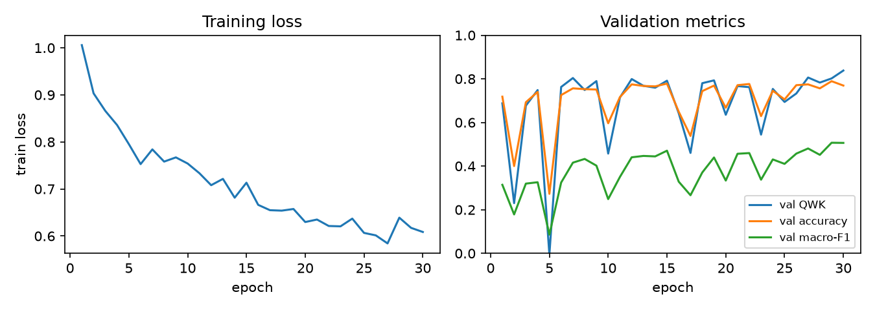
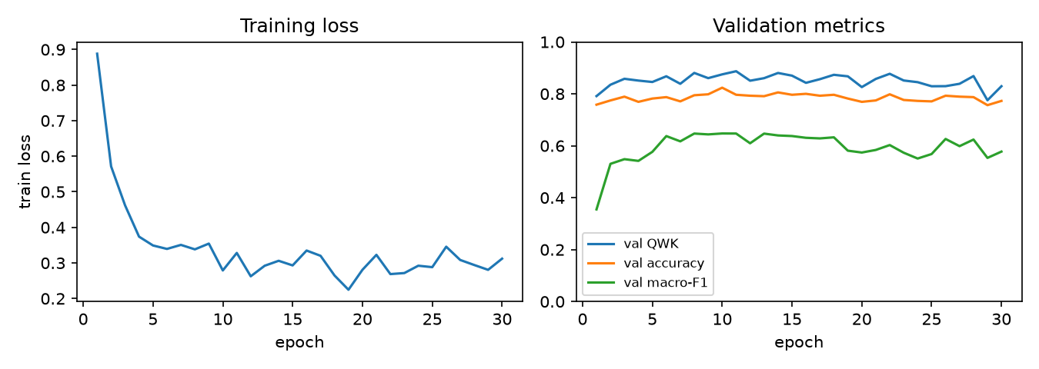
STAGE 3 · ANALYSIS
Why: training at lr 1e-3 is unstable
Paper settings: lr 1e-3
Only change: lr 1e-4
Symptoms
Explanation
Validation QWK collapses 5 times (down to −0.006 at epoch 5)
Training loss still 0.61 after 30 epochs: under-fitting, not over-fitting
Adam at 1e-3 over-writes pretrained features in full fine-tuning
Small batch (8) adds noisy batch-norm statistics
Paper's own Table 3 shows VGG/ResNet collapsing to class 0
Diabetic Retinopathy Grading · Reproduction of Chilukoti et al. (2024) · Stage 2 & 3
11
Notes:
Left: paper settings. Validation QWK crashes at epochs 2, 5, 10, 17 and 23; at epoch 5 the model predicts almost one grade. Loss is still 0.61 after 30 epochs. Right: lr 1e-4, smooth, loss ~0.3.

Slide 12
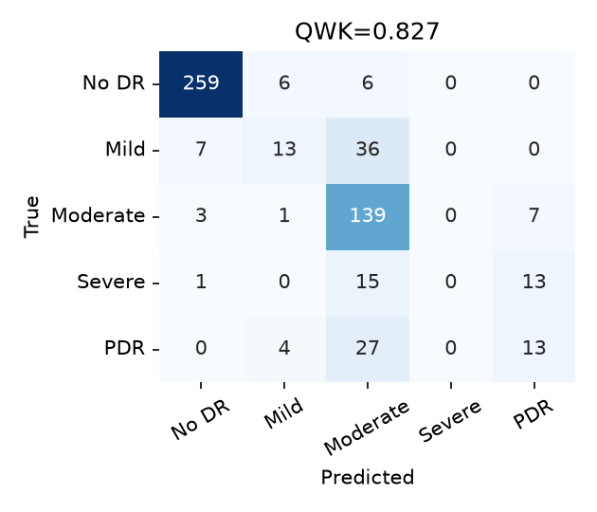

STAGE 3 · ANALYSIS
QWK hides minority-grade failure
Read-out
Severe NPDR: 0 / 29 correct at lr 1e-3
27 / 44 PDR called Moderate
Mild mostly → Moderate
Errors are adjacent, so QWK stays ≈ 0.83
Per-class recall is essential
Paper settings (lr 1e-3)
lr 1e-4
At lr 1e-4: Severe 9 / 29 correct, PDR 24 / 44; large errors halve. Severe remains the hardest grade, which is the target for Stage 4.
Diabetic Retinopathy Grading · Reproduction of Chilukoti et al. (2024) · Stage 2 & 3
12
Notes:
Left: with the paper's settings Severe is never predicted; 15 of 29 go to Moderate and 13 to PDR. QWK stays at 0.83 because these errors are adjacent. This is exactly the 'accuracy can be misleading' gap from our literature review.

Slide 13
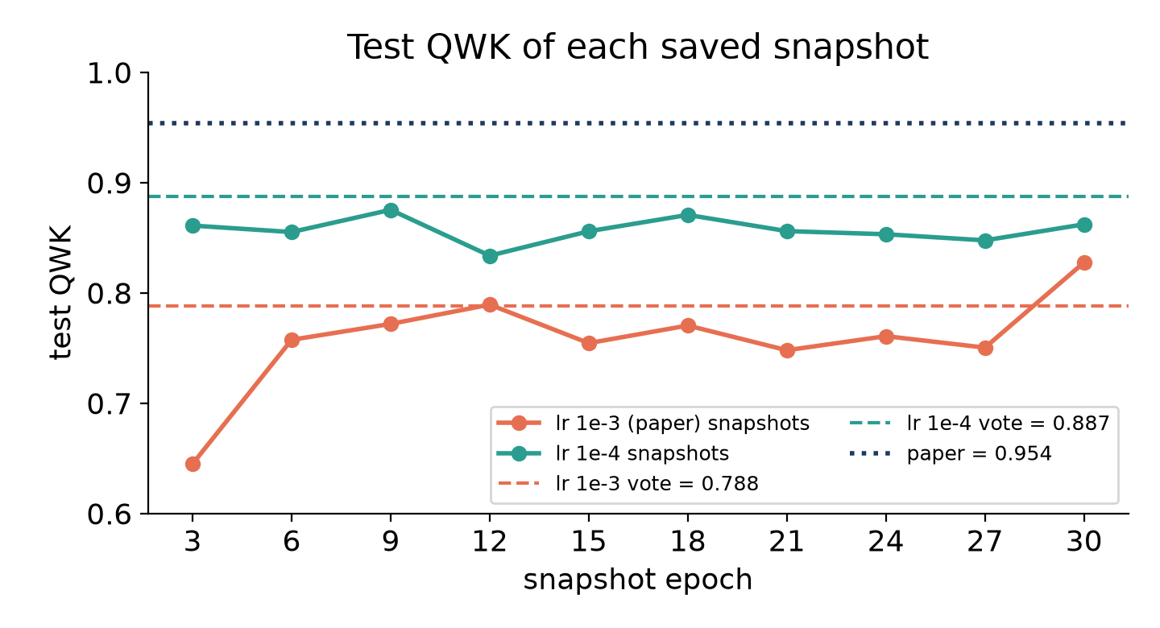
STAGE 3 · ANALYSIS
The snapshot ensemble only works when training is stable
Paper settings (lr 1e-3)
Snapshot QWK 0.65 – 0.79, last one 0.83
Majority vote = 0.788, worse than single model
Severe & PDR recall in vote: 0.00
Stable training (lr 1e-4)
Every snapshot 0.83 – 0.88
Vote = 0.887, above all snapshots
Ensemble helps only with good, diverse members (Huang et al., 2017)
Diabetic Retinopathy Grading · Reproduction of Chilukoti et al. (2024) · Stage 2 & 3
13
Notes:
Each dot is one saved epoch. Paper settings (coral): only the last snapshot is good, so the vote of ten is dragged down to 0.788. lr 1e-4 (teal): every snapshot is 0.83-0.88 and the vote, 0.887, beats every individual snapshot. Snapshot ensembles assume comparably good members.

Slide 14
STAGE 3 · GAP ANALYSIS
Explaining the reproduction gap (0.827 vs 0.954)
Candidate cause | Evidence | Verdict
Learning rate 1e-3 (paper's setting) | Changing only lr → +0.060 QWK, stable training | Main cause
224 px / 30 epochs (hardware) | Small lesions less visible; not tested yet (Colab notebook ready) | Likely part
Unstated details (split, batch, loss) | Each can move QWK a few points on 550 test images | Possible
Duplicate leakage | QWK 0.827 → 0.828 without the 29 leaked images | Ruled out
Reliability of reported numbers | Internally inconsistent tables (slide 7) | Open question
The single change of learning rate closes about half the gap; the rest is consistent with our lower resolution and shorter schedule.
Diabetic Retinopathy Grading · Reproduction of Chilukoti et al. (2024) · Stage 2 & 3
14
Notes:
Order by strength of evidence: the learning rate is proven experimentally; resolution and missing details are plausible; leakage is ruled out; the paper's own numbers are questionable.

Slide 15
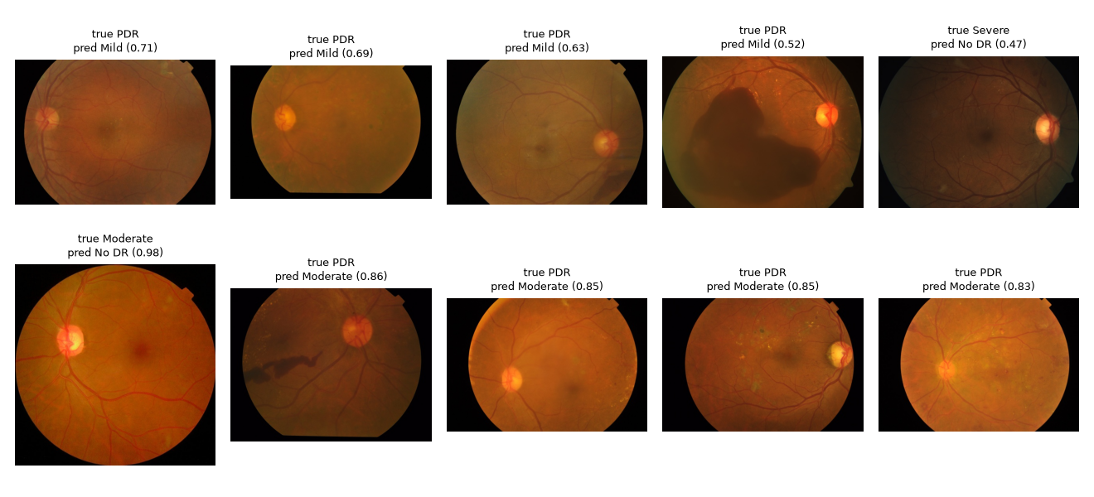
STAGE 3 · ANALYSIS
Failure cases
Mostly PDR → Mild/Moderate (incl. a large pre-retinal haemorrhage); several are dim, low-contrast or cropped. Neovascularisation is hard to see at 224 px.
Diabetic Retinopathy Grading · Reproduction of Chilukoti et al. (2024) · Stage 2 & 3
15
Notes:
The ten most confidently wrong predictions of the paper-settings model. Mostly PDR predicted as Mild or Moderate, including one with a large haemorrhage. Several are dim, low-contrast or cropped.

Slide 16
STAGE 3 · LIMITATIONS
Limitations (and what we are honest about)
Experimental
Process
Single dataset (APTOS), single seed, no external validation
224 px / 30 epochs instead of 300 px / 60 epochs
EyePACS-pretrained setting (0.967) not reproduced
Only 29 Severe and 44 PDR test images: 1 image ≈ 3 recall points
Paper's strategy 1 (150 px) skipped: reported on EyePACS only
Headline run interrupted (disk full) and resumed from epoch 13 checkpoint
The lr 1e-4 run is our diagnostic, not the paper's protocol
No public code, so some choices are our interpretation
No clinical claims: this is a reproduction study
Diabetic Retinopathy Grading · Reproduction of Chilukoti et al. (2024) · Stage 2 & 3
16
Notes:
Raise these before the examiners do.

Slide 17
LOOKING AHEAD
Next: Stage 4 hypothesis (predicted before coding)
Hypothesis
Replacing cross-entropy with a class-balanced, ordinal-aware loss on the stable lr 1e-4 baseline will improve Severe NPDR and PDR recognition and reduce large grading errors.
Mechanism
Metric | Baseline | Predicted
Severe recall | 0.31 | +0.10 to +0.20
Minority recall | 0.43 | increase
Errors ≥ 2 grades | 24 | < 24
QWK | 0.887 | 0 to +0.02
Accuracy | 0.815 | may dip 1–2 pts
Class weights raise the gradient contribution of rare grades
Ordinal term penalises errors by distance from the true grade
Targets both gaps from our literature review
Diabetic Retinopathy Grading · Reproduction of Chilukoti et al. (2024) · Stage 2 & 3
17
Notes:
One variable (the loss), a direction, a magnitude, and a mechanism, as the course requires. Built on the stable lr 1e-4 baseline.

Slide 18
TAKE-AWAYS
Summary
1
Reproduced from scratch
No public code. With the paper's settings: QWK 0.827 vs 0.954 claimed.
2
Found the main cause
lr 1e-3 makes training unstable; lr 1e-4 alone gives 0.887.
3
Ensemble claim is conditional
Snapshot vote hurts when unstable (0.788) and helps when stable.
4
QWK is not enough
Severe NPDR was never detected at QWK 0.83: report per-class recall.
Code, logs, figures & report: github.com/sshivanshg/dr-grading-reproduction · Questions?
Diabetic Retinopathy Grading · Reproduction of Chilukoti et al. (2024) · Stage 2 & 3
18
Notes:
Close with the four messages and invite questions. Point to the repo for code, logs and figures.

