Slide 1


DS – 670: Capstone Big Data & Business Analytics
WEEK – 2
Prof. Reda Mastouri
DS – 670 – Reda Mastouri

Slide 2
Week 2: Agenda
Syllabus: Overview
Course Learning Objectives
Research Approach: Qualitative Vs Quantitative Research in Data Science
Quantitative Methods Procedures
Review of Literature
Peer-reviewed research
Reference Management tools
Project planning
Project management tools
Code-as-a-Service approaches: Github vs Gitlab vs Bitbucket
Weekly deliverables
DS – 670 – Reda Mastouri

Slide 3
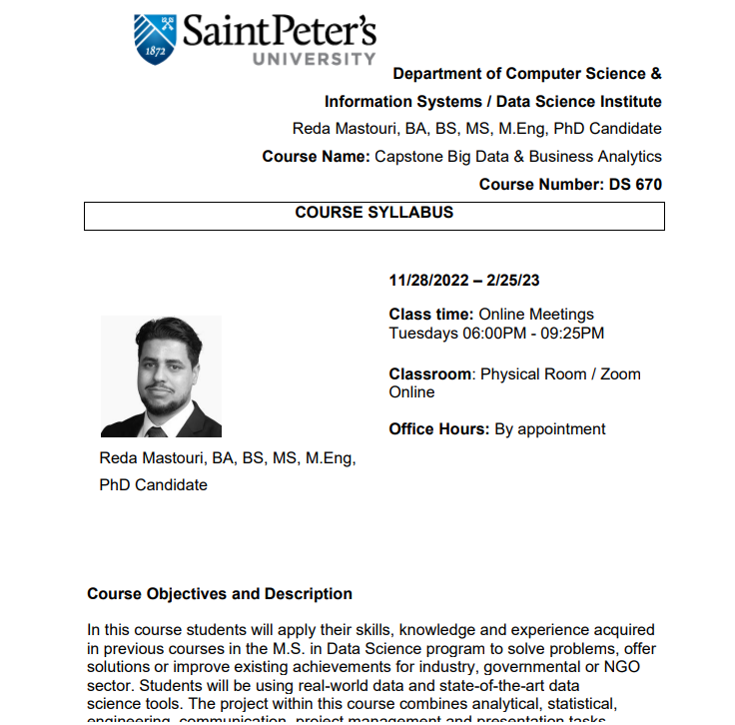
1. Syllabus: Overview
Syllabus
DS – 670 – Reda Mastouri

Slide 4
2. Course Learning Objectives
At the completion of this course, students will be able to:
Describe data using visual techniques.
Segment data using clustering analysis and interpret the output.
Explain the retrieval model and the vector space model for text-processing applications.
Apply the vector space model and major heuristics in designing a retrieval function for ranking documents with respect to a query; implement an information retrieval system (e.g., a search engine), including an inverted index and scoring documents quickly for a query.
Analyze and mine text data to discover interesting patterns, extract useful knowledge, and support decision-making, focusing on statistical approaches that can be generally applied to arbitrary text data in any natural language with minimal human effort.
Apply basic methodologies and applications of data mining with an emphasis on pattern discovery and phrase mining. Practice scalable pattern discovery methods on massive transactional data, discussing pattern evaluation measures and methods for mining diverse patterns, including sequential and sub-graph patterns.
Discover basic concepts of cluster analysis, evaluate typical clustering methodologies, algorithms, and applications using methods like k-means, BIRCH, and DBSCAN/OPTICS. Validate clustering and evaluate clustering quality. - Implement Machine Learning Operations (MLOps) to operationalize machine learning models efficiently.
Work with Big Data technologies to handle large-scale data processing.
Develop Full Stack Machine Learning project solutions using tools like Panel, Streamlit, Django, and AngularJS.
Deploy projects on GitLab and GitHub, leveraging these platforms for version control and collaboration.
Prepare for the UBS Pitch Competition 2024, focusing on developing and presenting data-driven project ideas.
DS – 670 – Reda Mastouri

Slide 5

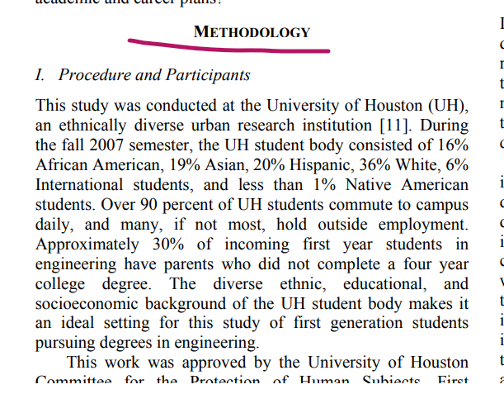
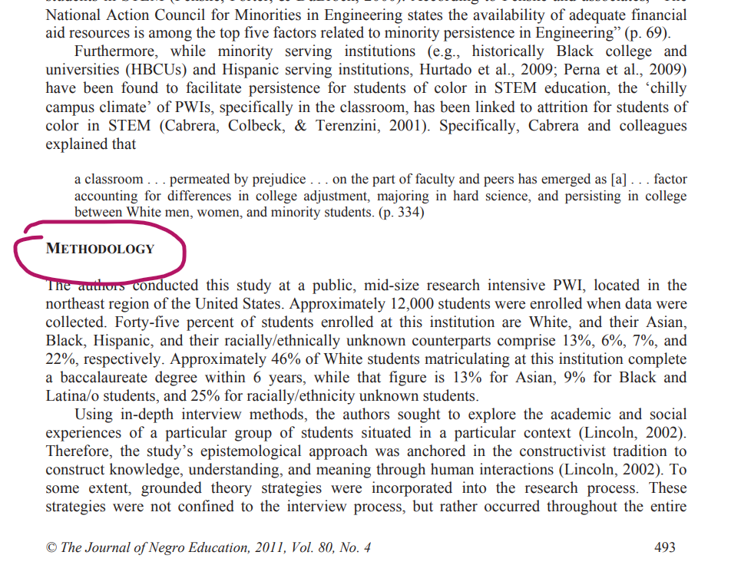
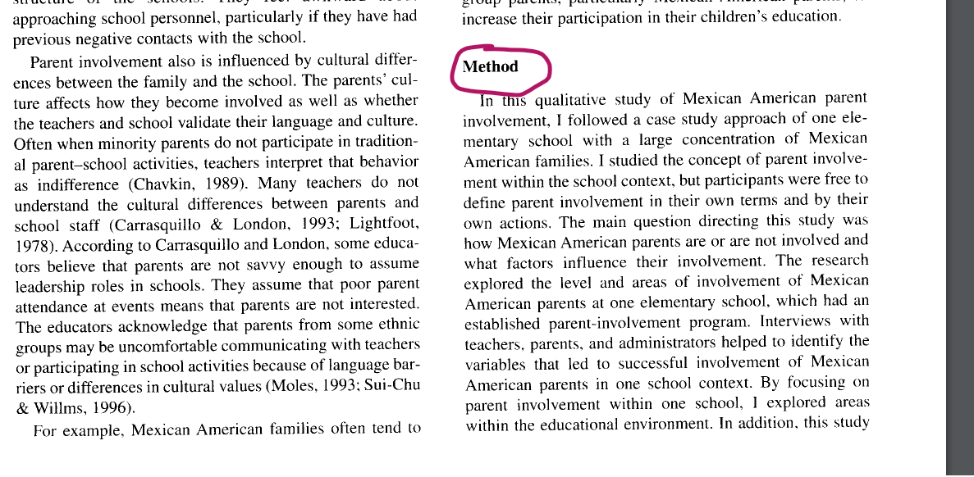
3. Research Approach: Qualitative Research Vs Quantitative Research
DS – 670 – Reda Mastouri

Slide 6
3. Research Approach: What is a Capstone Research Project
A Capstone Research Project is an original contribution to the existing stock of knowledge making for its advancement, in short the search for knowledge through objective and systematic method of finding solution to a problem.
The term capstone research refers to the systematic method consisting of enunciating the problem, formulating a hypothesis, collecting the facts or data, analyzing the facts and reaching certain conclusion.
DS – 670 – Reda Mastouri

Slide 7
3. Research Approach:
Qualitative research
exploring and understanding the meaning individuals or groups ascribe to a social or human problem.
Quantitative research
testing objective theories by examining the relationship among variables.
Mixed methods research
an approach to inquiry that combines or associates both qualitative and quantitative forms.
DS – 670 – Reda Mastouri

Slide 8
3. Research Approach:
Criteria | Qualitative Research | Quantitative Research
Purpose | To understand & interpret social interactions. | To test hypotheses, look at cause & effect, & make predictions.
Group Studied | Smaller & not randomly selected. | Larger & randomly selected.
Variables | Study of the whole, not variables. | Specific variables studied
Type of Data Collected | Words, images, or objects. | Numbers and statistics.
Form of Data Collected | Qualitative data such as open-ended responses, interviews, participant observations, field notes, & reflections. | Quantitative data based on precise measurements using structured & validated data-collection instruments.
DS – 670 – Reda Mastouri

Slide 9
3. Research Approach:
Criteria | Qualitative Research | Quantitative Research
Type of Data Analysis | Identify patterns, features, themes. | Identify statistical relationships.
Objectivity and Subjectivity | Subjectivity is expected. | Objectivity is critical.
Role of Researcher | Researcher & their biases may be known to participants in the study, & participant characteristics may be known to the researcher. | Researcher & their biases are not known to participants in the study, & participant characteristics are deliberately hidden from the researcher (double blind studies).
Results | Particular or specialized findings that is less generalizable. | Generalizable findings that can be applied to other populations.
Scientific Method | Exploratory or bottom–up: the researcher generates a new hypothesis and theory from the data collected. | Confirmatory or top-down: the researcher tests the hypothesis and theory with the data.
DS – 670 – Reda Mastouri

Slide 10
3. Qualitative Research Vs Quantitative Research
Funding
Curiosity
Quality of
Life
Utility of
Applications
Advancement of
Technology
Amount of
knowledge
Application
Development
Applied Research
Basic Research
DS – 670 – Reda Mastouri

Slide 11
4. Quantitative Methods Procedures
The Rationalistic Method
Derive knowledge through reasoning
Basketball players are tall. Haresh is a basketball player. Therefore, Haresh is tall.
The Empirical Method
Describes data or a study that is based on objective observation
Relies on observation or experience, capable of being verified by experiment
DS – 670 – Reda Mastouri

Slide 12
4. Quantitative Methods Procedures: Methods and Techniques
TYPE | METHODS | TECHNIQUES
Library Research | (i)Analysis of historical records (ii)Analysis of documents | Recording of notes, Contents analysis, Tape and listening and analysis. Statistical compilation and manipulations, references and abstract guides, contents analysis.
2. Field Research | (i) Non-participant direct observation (ii) participant observation (iii) Mass observation (iv) Mail questionnaire (v) Opinionnaire (vi) Personal interview (vii) Focused interview (ix) Telephone survey (x) Case study and life history | Observational behavioral scales, use of score cards, etc. Interactional recording possible use of tape recorders, photo graphic techniques. Recording mass behavior, interview using independent observers in public places Identification of social and economic background of respondents Use of attitude scales, projective techniques, use of sociometric scales. Interviewer uses a detailed schedule with open and closed questions Interviewer focuses attention upon a given experience and its effects Used as a survey technique for information and for discerning opinion may also be used as a follow up of questionnaire Cross sectional collection of data for intensive analysis, longitudinal collection of data of intensive character
3. Laboratory Research | Small groups study of random behavior, play and role analysis | Small groups study of random behavior, play and role analysis
DS – 670 – Reda Mastouri

Slide 13
5. Review of Literature: Peer-reviewed research
Getting published in peer-reviewed (also called “refereed”) academic journals usually involves three or four steps.
Submit an article manuscript for consideration.
Journal editors will send the submission to other scholars who do similar work and who are qualified to review the article. Generally, editors will send submissions to be reviewed by three other scholars.
Editors will evaluate the reviews and decide whether to reject or accept the submission. Usually, the response is either a rejection or an acceptance contingent on the author making revisions.
If the author is asked to make revisions, they are to edit and resubmit the article for another round of reviews. Sometimes the article is accepted at this point and other times authors are asked to make further revisions.
DS – 670 – Reda Mastouri

Slide 14
5. Review of Literature: Peer-reviewed research
Scholars write academic articles to share their ideas with their peers, usually within their own academic discipline (e.g., physics, literature, psychology).
Articles fall under the realms of:
research reports: presentation of an original study or studies
literature review articles: discusses existing research about a problem and suggests paths for future studies
theoretical articles: discusses existing theories that explain observation, and often proposes new theories or a new perspective on theories
Because they already share a highly specialized background, they often assume that their readers already understand some of the fundamental knowledge of the field as well as the jargon.
Jargon requires on-going attention.
DS – 670 – Reda Mastouri

Slide 15
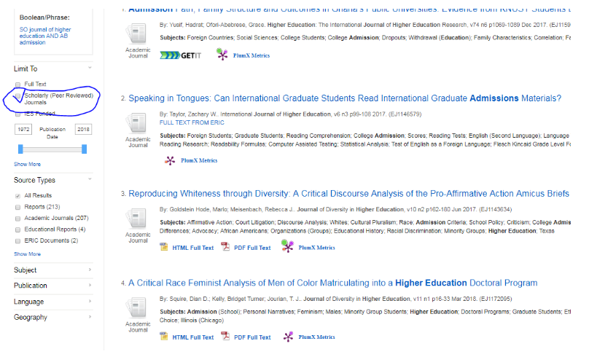
5. Review of Literature: Peer-reviewed research
When you run a library database search, you will see in the left column SCHOLARLY (PEER REVIEWED JOURNALS). By limiting to scholarly journals,all the results will show scholarly articles only.
Or, you can visit a website of the journal you are trying to get articles from. For example,
About Campus, http://aboutcampus.myacpa.org/about/
Is not a scholarly journal, as its website claims. Non scholarly journal has its editorial board. Editorial board does not mean it is a scholarly journal.
DS – 670 – Reda Mastouri

Slide 16
5. Review of Literature: Reference Management tools
Your personal research library:
Organize,
Search,
Download and archive PDF articles
On a Mac computer or on iPhone
Annotate PDFs
Generate Bibliographies in Word and OpenOffice
Build your network of fellow researchers
Collaborate, share and discover
Explore research trends and statistics
You can even edit documents and insert citations collaboratively.
The easiest way to do this is to add all relevant documents to a Shared Collection and cite them from there.
DS – 670 – Reda Mastouri

Slide 17
6. Project planning: Project management tools
Visibility and other properties are specified in:
Field Configuration
Field Configuration Scheme
Field
Visualized by placing it on:
Is mapped to Issue Operation by:
Is associated to a:
Screen Scheme
Issue Type Screen Scheme
PROJECT
Is mapped to Issue Types by:
Screen
Is mapped to Issue transition (Open Close …) by:
Workflow
Workflow Scheme
DS – 670 – Reda Mastouri

Slide 18
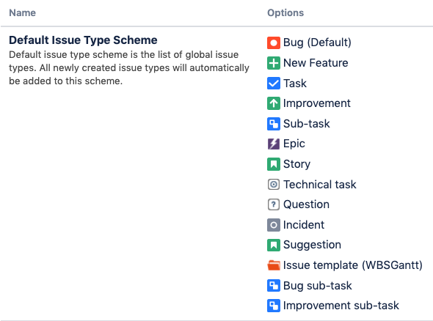
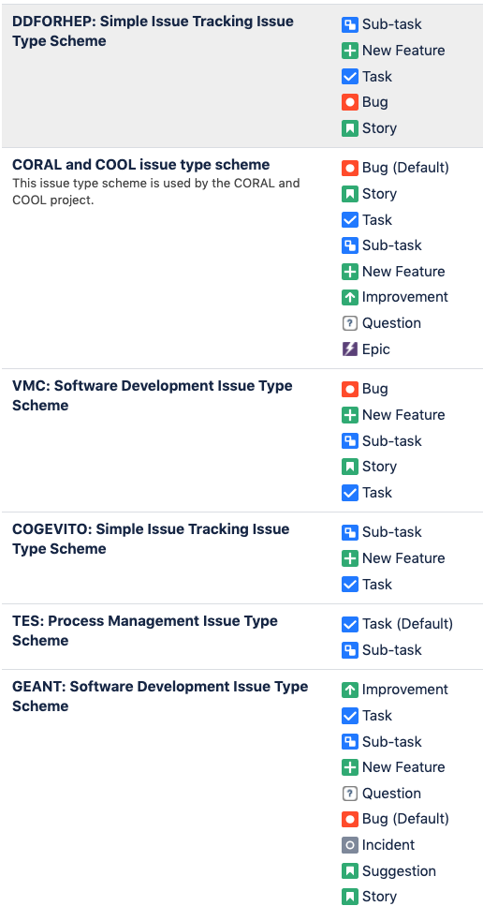
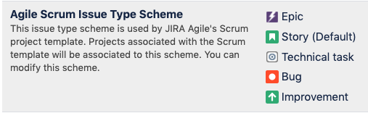
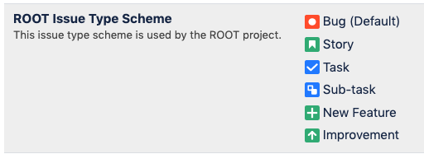
6. Project planning: Project management tools
An Issue scheme in Jira is a collection of different types of Jira Issues
DS – 670 – Reda Mastouri

Slide 19
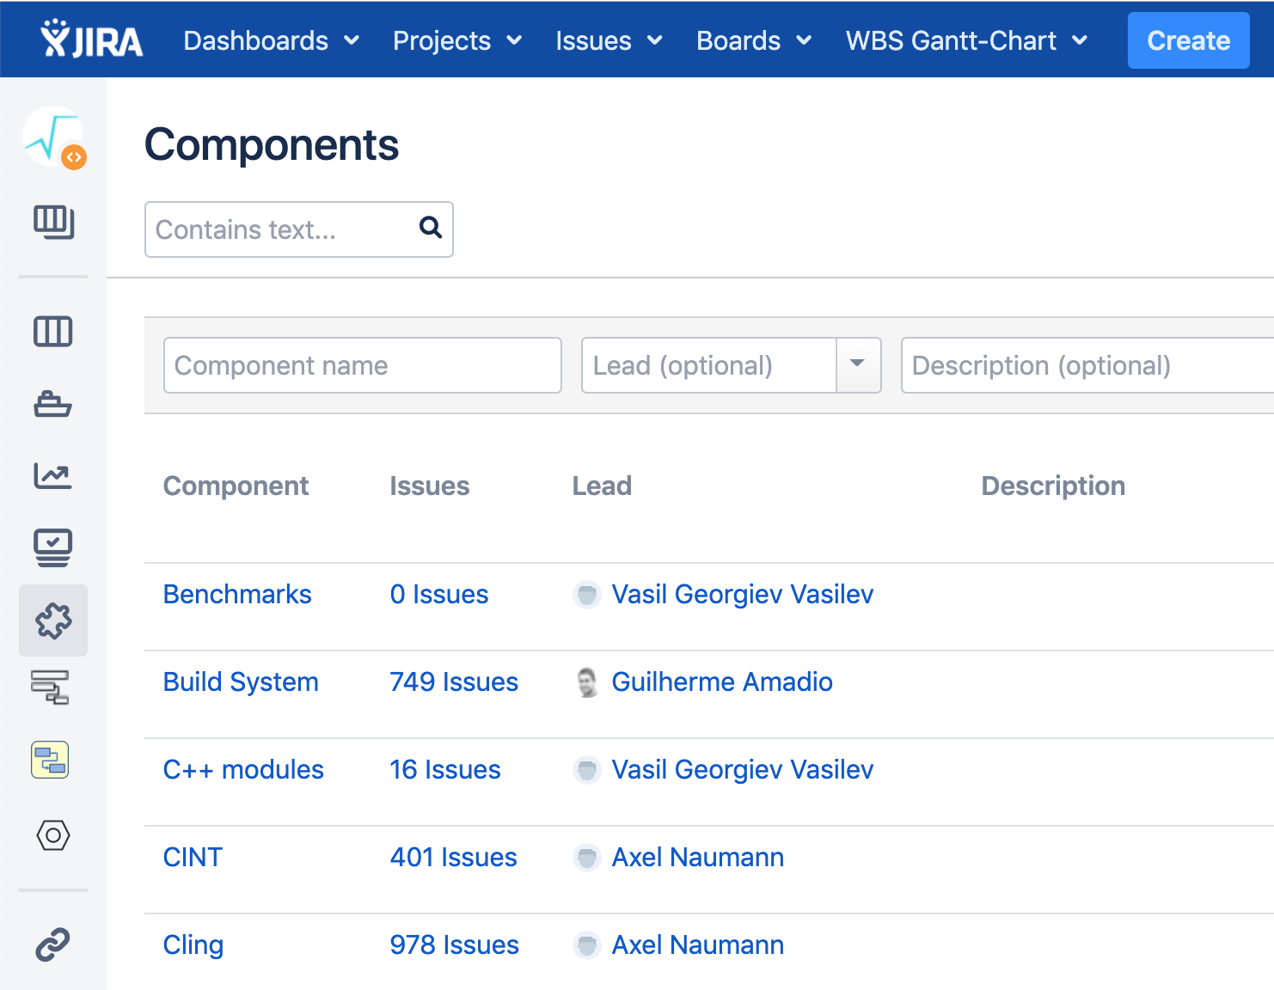
6. Project planning: Project management tools
Components are sub-sections of a project; they are used to group issues within a project into smaller parts.
Components add some structures to the projects, breaking it up into features, teams, modules, subprojects and more.
Using components you can generate reports, collect statistics, and display it on dashboards and so on.
To add new components, as shown in the screen below, you can add name, description, component lead and default assignee.
DS – 670 – Reda Mastouri

Slide 20

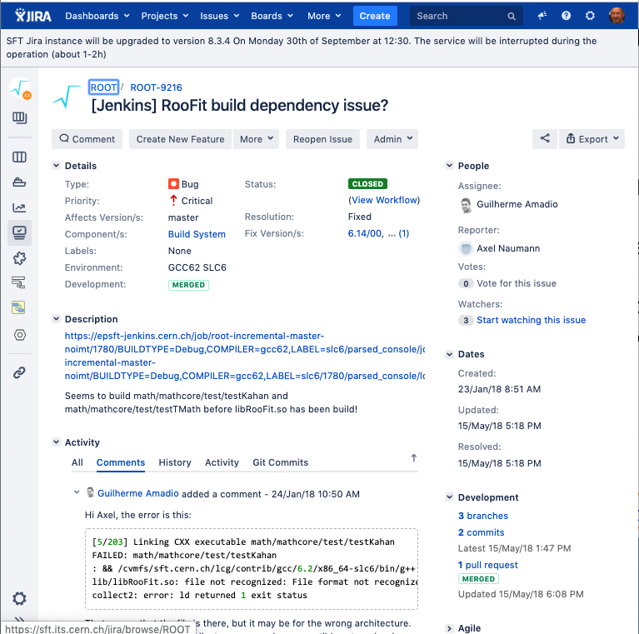
6. Project planning: Project management tools
Connect Jira Cloud to GitHub
When GitHub is linked to JIRA Software, branches, commit messages and pull requests are all seamlessly referenced in JIRA Software issues.
This allows JIRA Software to display information about your development activity in the corresponding issue
https://confluence.atlassian.com/adminjiracloud/connect-jira-cloud-to-github-814188429.html
DS – 670 – Reda Mastouri

Slide 21

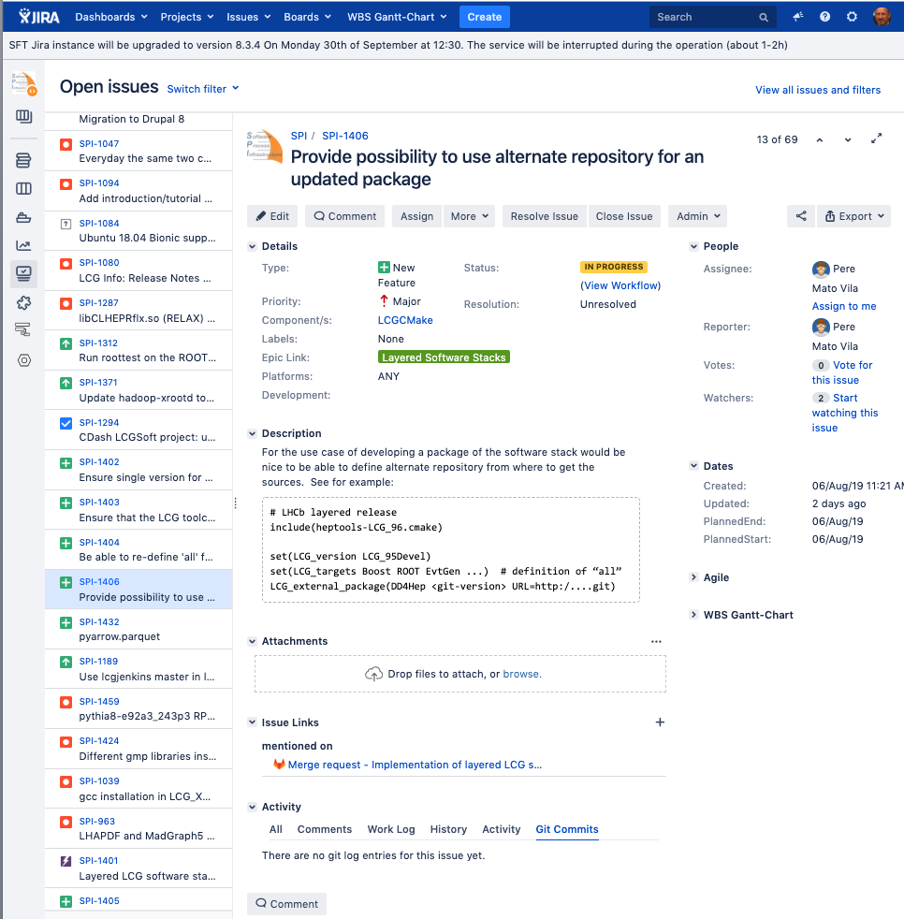
6. Project planning: Project management tools
GitLab Jira integration
Once the GitLab project is integrated with the Jira instance, its possible to automatically detect and cross-reference activity between the GitLab project and any of project in Jira.
This includes the ability to close or transition Jira issues when the work is completed in GitLab.
https://support.atlassian.com/jira-cloud-administration/docs/integrate-gitlab-with-jira/
DS – 670 – Reda Mastouri

Slide 22
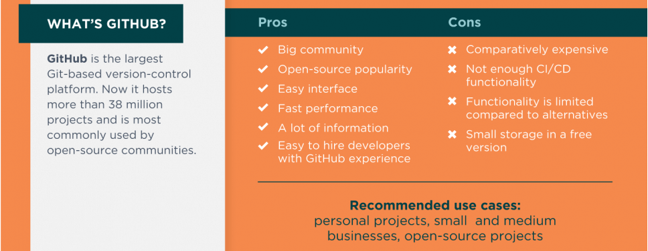
6. Project planning: Code-as-a-Service approaches: Github vs Gitlab vs Bitbucket
DS – 670 – Reda Mastouri

Slide 23
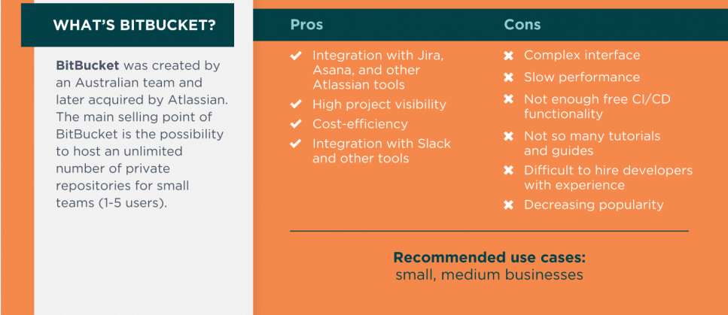
6. Project planning: Code-as-a-Service approaches: Github vs Gitlab vs Bitbucket
DS – 670 – Reda Mastouri

Slide 24
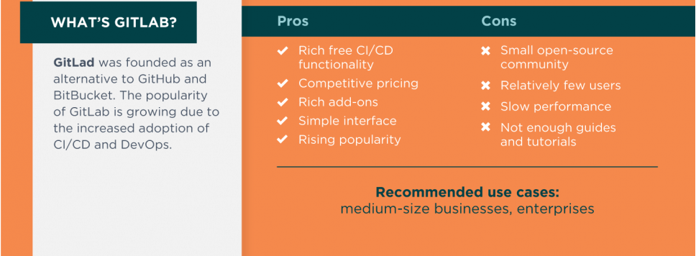
6. Project planning: Code-as-a-Service approaches: Github vs Gitlab vs Bitbucket
DS – 670 – Reda Mastouri

Slide 25
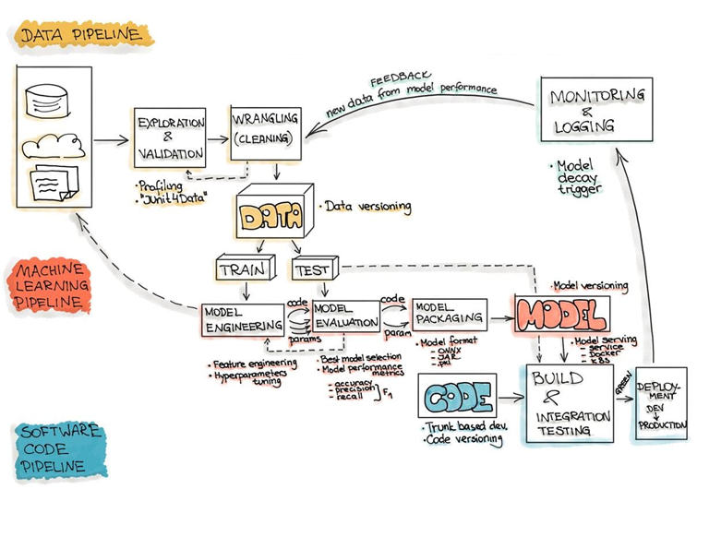
7. Weekly deliverables
Problem Statement:
How did your research emerge? (why people have to care about your research topic?)
Introduce and briefly review the literature on your topic to show what is already known.
Research Question/Purpose of the Study
What are your research questions? (what do you want to know?)
Significance of the Study
Why is it important/significant? (who cares about your research? why?)
Business Need:
Research Survey
Compilation of the finding: Discussion of the results
Research Advancement as per the Data Sciences ML Ops pipeline ➔
DS – 670 – Reda Mastouri

Slide 26
Thank you
DS – 670 – Reda Mastouri

