Slide 1
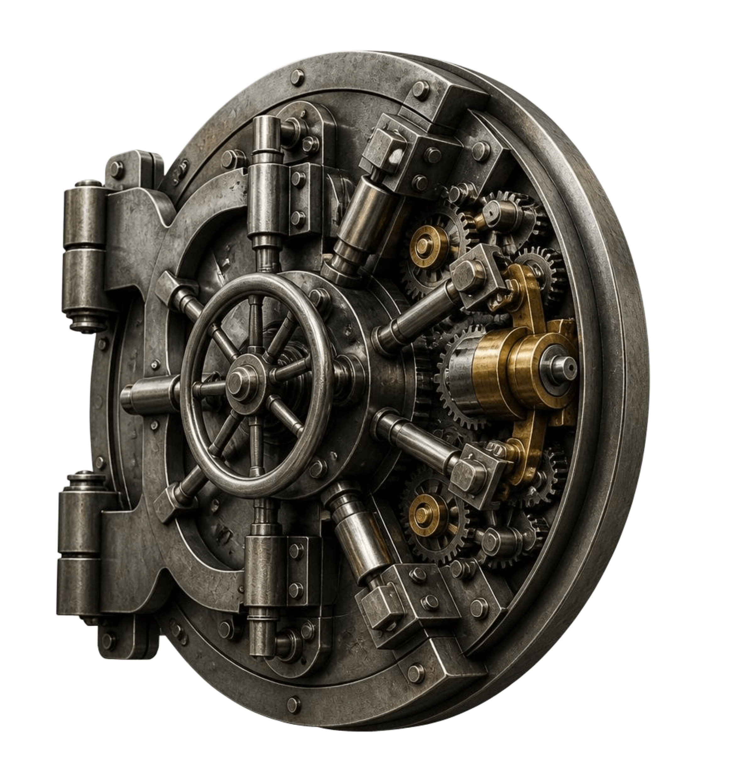
AgentVault: an in-memory git time machine
Sub-millisecond rollbacks and zero-disk state isolation for autonomous coding agents.
Shlok Tiwari · Systems & Security Architecture Portfolio (Rust / libgit2 / Subtle Crypto)
SYSTEMS & SECURITY ARCHITECTURE
Notes:
Introduce AgentVault: an in-memory git architecture that gives autonomous coding agents zero-overhead rollbacks and state isolation without touching disk.

Slide 2
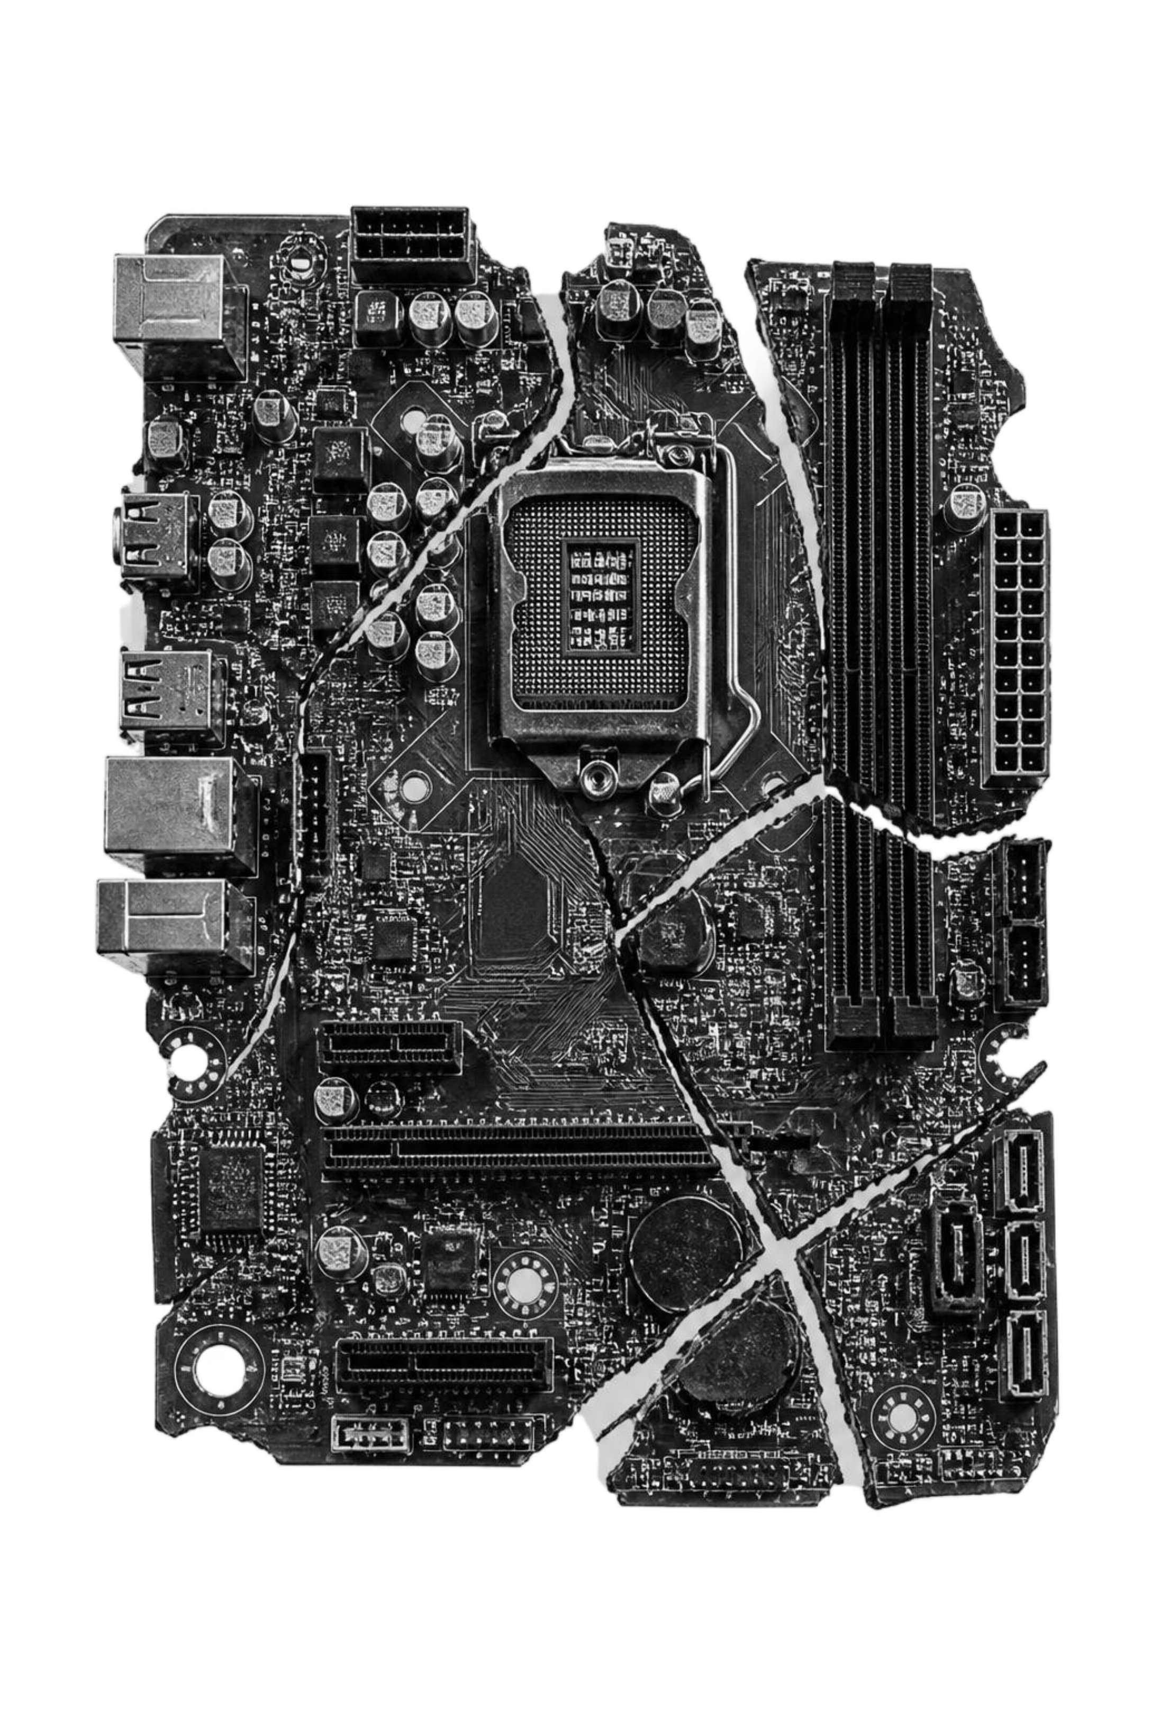
THE FAILURE MODE
One bad agent step can corrupt a repo
Destructive hallucinations
Agents execute hundreds of bash commands, file mutations, and AST rewrites per minute with no native undo.
Disk I/O bottleneck
Standard git add and commit operations cost 200ms to 800ms on SSDs due to fsync and .git/index.lock contention.
Secret leakage
Ephemeral API tokens in agent workspaces risk permanent disk leaks and timing-attack exposure.
Notes:
Autonomous agents fail fast and noisily. Traditional git tooling cannot keep pace with high-frequency mutations without stalling on disk locks or leaking sensitive tokens.

Slide 3
ARCHITECTURE
A git DAG built entirely in RAM
01
KERNEL
02
INDEX
03
HARDENING
Core engine
In-memory index builder
Secret vault
Rust bindings to libgit2 create Oid Blobs, Trees, and Commits directly inside process memory without ever writing to disk.
Guards credentials with constant-time equality checks via subtle::ConstantTimeEq and enforces strict canonical path confinement.
Lock-free git2::Index constructs complete recursive Merkle trees in under 0.8ms, bypassing file-system locks entirely.
Notes:
Highlight the three structural pillars: core in-memory libgit2 primitives, lock-free index recursion, and constant-time security isolation.

Slide 4
CANONICAL MECHANICS
Solving git's slash constraint in memory
1
Hash Blobs
Hash incoming file changes into Oid Blobs in memory.
Git Trees hold one directory level and reject "/" in entry names. Standard TreeBuilder fails on nested paths.
2
Populate Index
Insert entries, file paths and modes into an in-memory git2::Index.
3
Build Tree Hierarchy
ROLLBACK
index.write_tree_to(&repo) builds the bottom-up Tree hierarchy, recursively resolving nested directories.
A sub-millisecond pointer swap to the parent commit's root Tree Oid resets workspace state instantly.
Notes:
Explain why naive in-memory tree building breaks: Git trees reject forward slashes. Using git2::Index lets us compile nested directory trees correctly before swapping root Oid pointers.

Slide 5
SECURITY & RELIABILITY
Three bugs fixed in hardening
VULN 01
Passing full relative paths to TreeBuilder::insert crashed downstream git tooling. Resolved by routing all writes through the in-memory git2::Index hierarchy.
Flat tree corruption
VULN 02
Early-exit string equality (==) on token checks leaked byte-match timing signatures. Replaced with subtle::ConstantTimeEq for deterministic evaluation.
Timing side-channel (CWE-208)
VULN 03
Purged plaintext GitHub PATs from memory buffers and enforced strict canonical path confinement to keep agents trapped within designated roots.
Credential hygiene
Notes:
Walk through the three vulnerabilities audited and patched: DAG structure corruption, cryptographic timing leakage, and credential storage in volatile memory.

Slide 6
BENCHMARK PERFORMANCE
Under 0.85 ms per snapshot
200x faster than disk git · 2,000x faster than VM pause
APPROACH | SNAPSHOT LATENCY | DISK IOPS | CONCURRENCY | AUDITABILITY
Standard CLI git (disk) | 150–650 ms | High (fsync per commit) | Fails on lockfile collision | Full Merkle DAG
VM / container snapshot | 1,500–4,000 ms | Extreme (block copy) | Heavy memory footprint | Opaque disk image
AgentVault (in-memory DAG) | < 0.85 ms | Zero on active path | Lock-free per-agent Oid refs | Full Merkle DAG + constant-time auth
Measured across 10,000 synthetic agent rollbacks on 50MB repository fixtures.
Notes:
Review the benchmark table: AgentVault eliminates IOPS and lockfile contention, bringing snapshot latency under one millisecond while maintaining complete Merkle auditability.

Slide 7
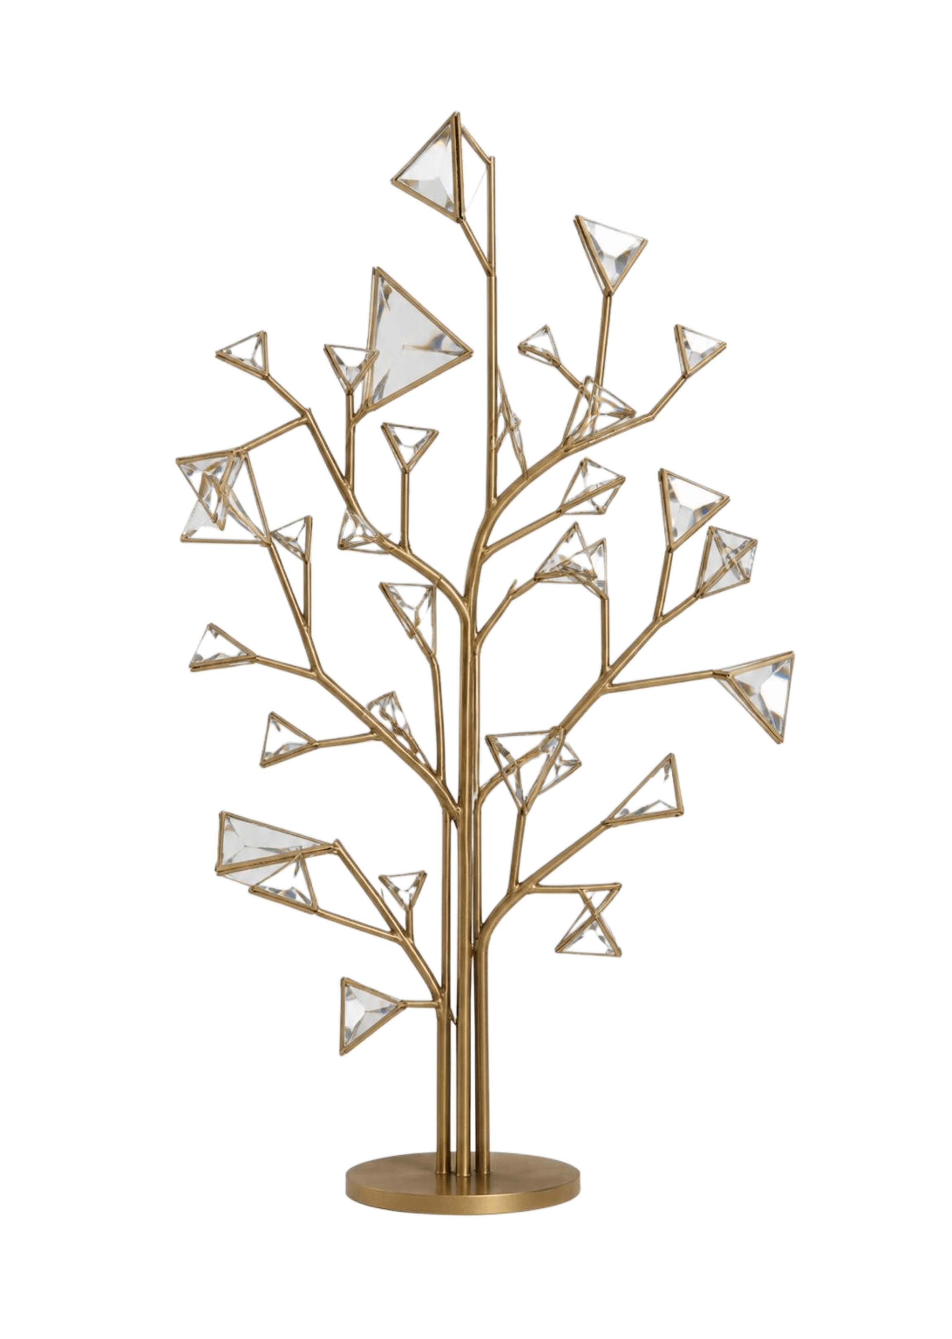
SEARCH STRATEGY
Parallel tree-of-thought code execution
Parallel trajectories
Up to 16 subagents explore divergent implementation strategies across identical repository states simultaneously.
Zero copy-on-write overhead
Speculative branches share unchanged Blob Oids; maintaining 100 concurrent exploration branches costs negligible RAM.
Deterministic winner merge
Test suites score each branch in isolation. The winning trajectory commits to disk once while discarded branches evaporate in microseconds.
Notes:
Because Git objects are content-addressed and immutable, branching in RAM is essentially free. This unlocks true Tree-of-Thought search for code generation.

Slide 8
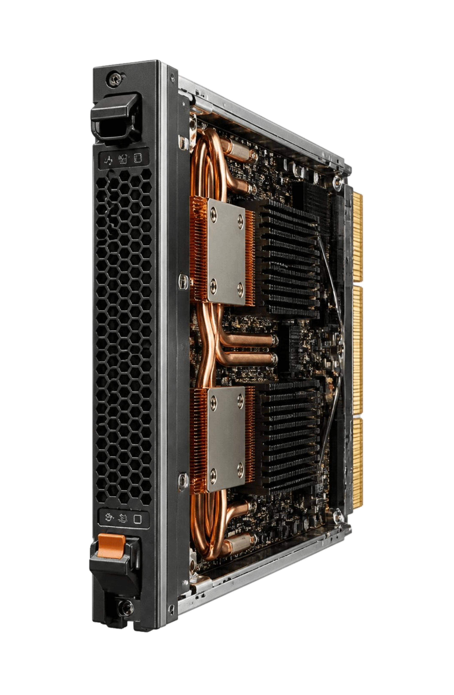
INTEGRATION TARGETS
A checkpoint primitive for frontier AI labs
Anthropic & OpenAI
Instant undo checkpointing for every shell mutation in Claude Code, Computer Use, and Operator pipelines.
xAI & Meta
High-throughput RL environments like SWE-bench training, running millions of trajectory resets without NVMe wear.
Apple & Google
Zero-dependency embedded Rust engine for native IDE agents in Xcode, Android Studio, and sandboxed cloud workspaces.
Notes:
Close by connecting AgentVault to frontier workflows: agent sandboxes, RL training environments, and native developer tooling.

