Slide 1
[ARCH.SPEC]
CORE::ENGINE::LSM
STRATA_V1.SYS
Shlok Tiwari
Distributed storage and systems architecture portfolio
GO · SKIPLIST · CONCURRENCY · NON-BLOCKING
Strata
High-throughput concurrent LSM storage engine
ZERO-RANDOM-WRITE INGESTION · LOCK-DECOUPLED SSTABLE FLUSHING · MULTI-TIERED READS
Notes:
Introduce Strata: a high-throughput, concurrent LSM storage engine written in Go. Highlight the core architectural achievements: zero-random-write disk ingestion, lock-decoupled flushing, and multi-tiered reads.

Slide 2
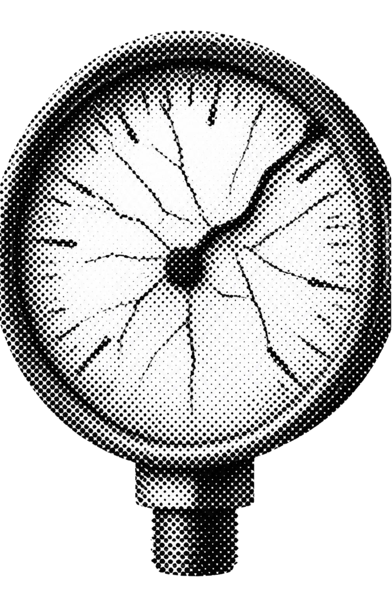
[BOTTLENECK_ANALYSIS.LOG]
Heavy write workloads break traditional storage
IN-PLACE UPDATES AND NAIVE SYNCHRONIZATION COLLAPSE UNDER SCALE
FAILURE_MODES.TXT
Random I/O penalty: B-Trees update pages in place, causing write amplification and seek bottlenecks under event logging and training telemetry.
Compaction stall hazard: naive LSM trees hold a global mutex while flushing, so writes stall when memory fills.
Durability vs. throughput: ACID crash safety at sub-millisecond writes needs tightly coordinated WAL and memory rotation.
Notes:
Break down why conventional architectures collapse under heavy write loads: in-place B-Tree page splits induce random I/O, naive LSM engines block writers during disk flushes, and traditional write-ahead logging struggles to maintain sub-millisecond durability.

Slide 3
ARCHITECTURE OVERVIEW
Strata writes sequentially and reads in layers
STRATA_PIPELINE.FLOW
01
02
03
04
WRITE PATH
MEMORY TIER
BUFFER TIER
DISK TIERS
Write-Ahead Log
Active MemTable
Immutable MemTable
Leveled SSTables
Append-only sequential disk log. Guarantees ACID crash durability before write acknowledgement.
In-memory concurrent SkipList absorbing dynamic Put mutations and tombstone Deletes in O(log N).
Frozen snapshot (immTable) queued for background serialization without locking incoming writes.
Immutable sorted string tables paired with in-memory Bloom filters and sparse block indexes to eliminate blind seeks.
READ TRAVERSAL: MEMTABLE → IMMTABLE → L0 SSTABLES → LEVELED SSTABLES (BLOOM FILTER VERIFIED)
Notes:
Walk through the four core structural layers: WAL for crash recovery, the active concurrent SkipList MemTable, the frozen immTable snapshot buffer, and the leveled disk SSTables equipped with Bloom filters and sparse index blocks.

Slide 4
SYNCHRONIZATION PRIMITIVES
A microsecond pointer swap removes the write stall
DB_ROTATION.GO
READ_HIERARCHY.SEQ
At threshold (4MB), lock only for pointer exchange (< 2μs):
Tier 1 · Active MemTable
db.mu.Lock()
db.immTable = db.memTable
db.memTable = NewMemTable()
db.mu.Unlock()
Fastest memory read, catches newest writes.
Tier 2 · immTable
Asynchronous worker drains immTable to disk unblocked: go db.flushWorker(db.immTable)
Concurrent read while background flush serializes immTable to an SSTable without blocking readers or writers.
The global mutex db.mu protects pointer reassignment only. Disk I/O executes outside the critical path, isolating writer threads from flash latency.
Tier 3 · SSTables
Newest to oldest, gated by Bloom filters, then block index.
Notes:
Explain the critical synchronization mechanism: holding db.mu only long enough to swap pointers between the active MemTable and immTable, while the background goroutine writes the SSTable concurrently.

Slide 5
CASE STUDY & BENCHMARKS
Case study: eliminating the flush deadlock
THE DEADLOCK
THE FIX
THE PROOF
Global lock stall
Decoupled I/O pipeline
Zero race conditions
In the naive engine, the multi-megabyte SSTable write ran inside db.mu.Lock(). File system fsync latency froze incoming writes and concurrent reads for 100ms–500ms, collapsing throughput.
Disk serialization was separated from the state mutex in db.go. Readers check an immTable fallback tier during flushing, while compaction workers synchronize via dedicated channel signals.
Stress tested with go test -v -race ./... under concurrent saturation: verified zero data races, zero lost mutations, and a flat P99 write latency profile across continuous flush cycles.
TEST HARNESS: 16 CONCURRENT WRITER GOROUTINES · 10M KEYS · CONTINUOUS FLUSH VERIFICATION
Notes:
Describe the specific debugging case study: identifying the global mutex fsync stall, refactoring db.go to decouple disk I/O, and validating with the Go race detector under heavy concurrent load.

Slide 6
EMPIRICAL BENCHMARKS
Strata keeps P99 writes under 1.2 ms
ENGINE_COMPARISON.TBL
Engine | Write pattern | P99 under heavy writes | Read performance | Crash recovery
B-Tree (in-place) | Random disk seeks | Latency spikes (page splits) | O(log N) direct index | Page journaling
Naive LSM (locked flush) | Sequential WAL | 100ms-500ms global stall | Linear SST scan | WAL replay
Strata LSM (decoupled immTable) | Sequential WAL | < 1.2 ms non-blocking | Bloom filter + block index | Deterministic WAL replay
WORKLOAD: 100K OPS/SEC SUSTAINED WRITE VOLUME · 1KB PAYLOAD · 95% WRITE / 5% POINT READ
Notes:
Present the direct architectural comparison table. Highlight how Strata matches the sequential write advantages of LSMs while removing the tail latency spikes typical of naive implementations.

Slide 7
STORAGE RECLAMATION
Deletes and compaction reclaim space without overwrites
TOMBSTONE_MARKER.TXT
COMPACTION_MERGE.TXT
DELETE SEMANTICS
COMPACTION PASS
Tombstones avoid seeks
Leveled merge-sort
Deleting a key writes an in-memory tombstone marker to the active MemTable and WAL. No disk seeks occur at delete time.
Background workers execute an iterator merge-sort, folding overlapping Level-0 tables into non-overlapping higher-level SSTables.
The tombstone immediately shadows older values during reads across upper tiers until compaction physically purges the key.
Bounds read amplification, drops shadowed versions, and discards expired tombstones without blocking user threads.
Notes:
Explain how space reclamation works in an append-only architecture: tombstones mask obsolete records without immediate disk seeking, and leveled background compaction consolidates ranges while bounding read amplification.

Slide 8
SYSTEMS APPLICATIONS
Why this matters to frontier AI labs
GOOGLE AND META
First-principles grasp of the engines behind Bigtable, Spanner and RocksDB.
Core infrastructure
OPENAI, ANTHROPIC AND XAI
Fits high-velocity RLHF feedback ingestion, training telemetry and checkpoint cataloging.
AI training systems
APPLE
Compact, zero-dependency pattern for on-device indexing, CoreData WAL tuning and CloudKit edge services.
On-device & edge
SHLOK TIWARI · SYSTEMS ARCHITECTURE PORTFOLIO · DISTRIBUTED STORAGE ENGINE TRACK
Notes:
Summarize the broader relevance of this systems work: from large-scale foundation model training telemetry and RLHF ingestion pipelines to compact edge storage architectures.

