Slide 1


PREDICTING ENERGY CONSUMPTION IST687: INTRODUCTION TO DATA SCIENCE
Group 13
PROJECT MEMBERS:
SRUSHTI SHOBHANE
RUSHIKESH SHINDE
SIDDHI KALE
KHUSHI SHAH

Slide 2

SELECTING VISUAL AIDS
AGENDA
Obtaining Data
Scrubbing Data (Data Cleaning)
Exploring Data
Modeling Data
Interpreting Analysis
ENHANCING YOUR PRESENTATION

Slide 3
Introduction
We are currently working with eSC, an energy company that specializes in providing services to residential properties in South Carolina.
Our team has been assigned a project focusing on energy consumption for the upcoming summer season. We will be utilizing the following datasets:
Static House Data
Energy Usage Data
Metadata
Weather Data
Our primary objective is to focus on 3 neighboring counties and certain sqft of buildings.
We will be predicting 3 variables that affected the total energy consumption the most after the temperature increase in the month of July.

Slide 4
DataFrames
County 1 Anderson G4500710
County 2 Abbeville G4500810
County 3 Greenwood G4500850
in.sqft
> 1690 & <3301

Slide 5
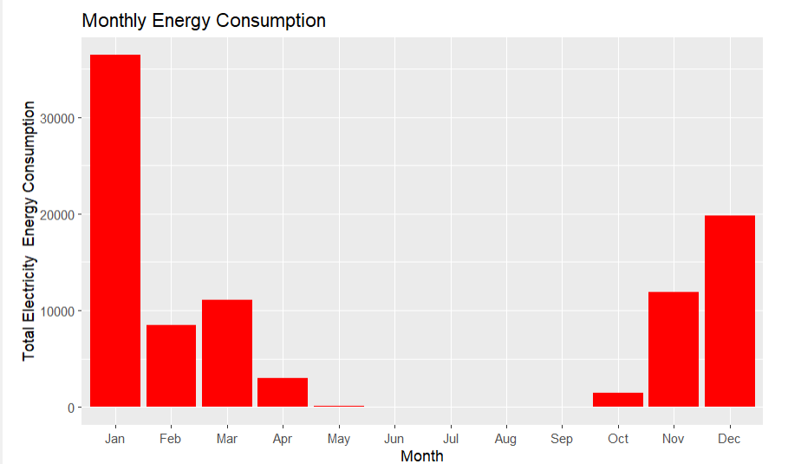
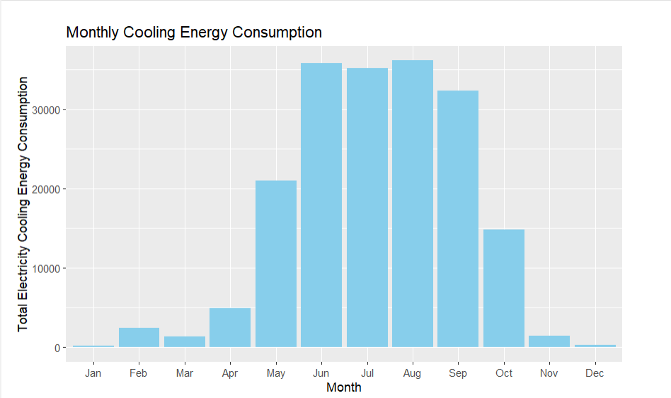
Monthly Heating energy consumption
Monthly Cooling energy consumption

Slide 6
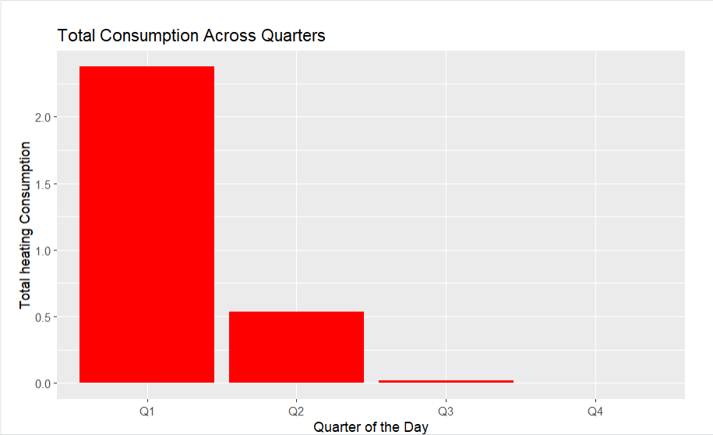
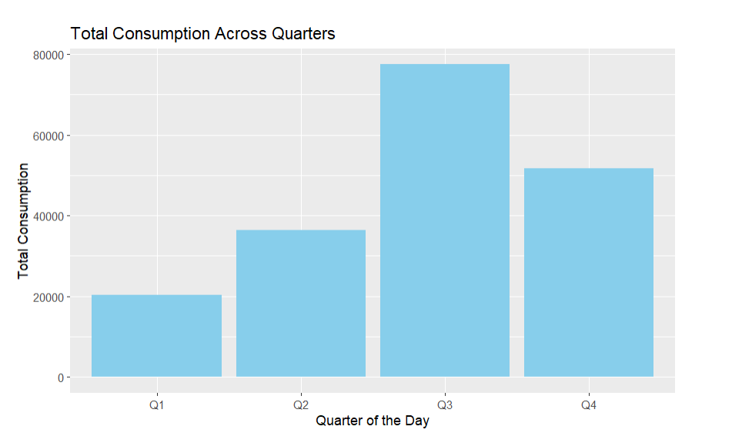
Total heating/ Cooling consumption throughout 4 quarters

Slide 7
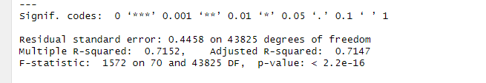
LM Model results:

Slide 8
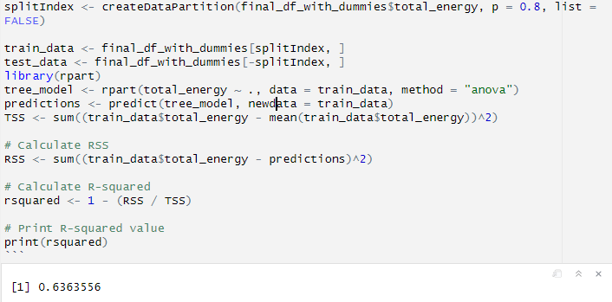
Tree Model results:

Slide 9
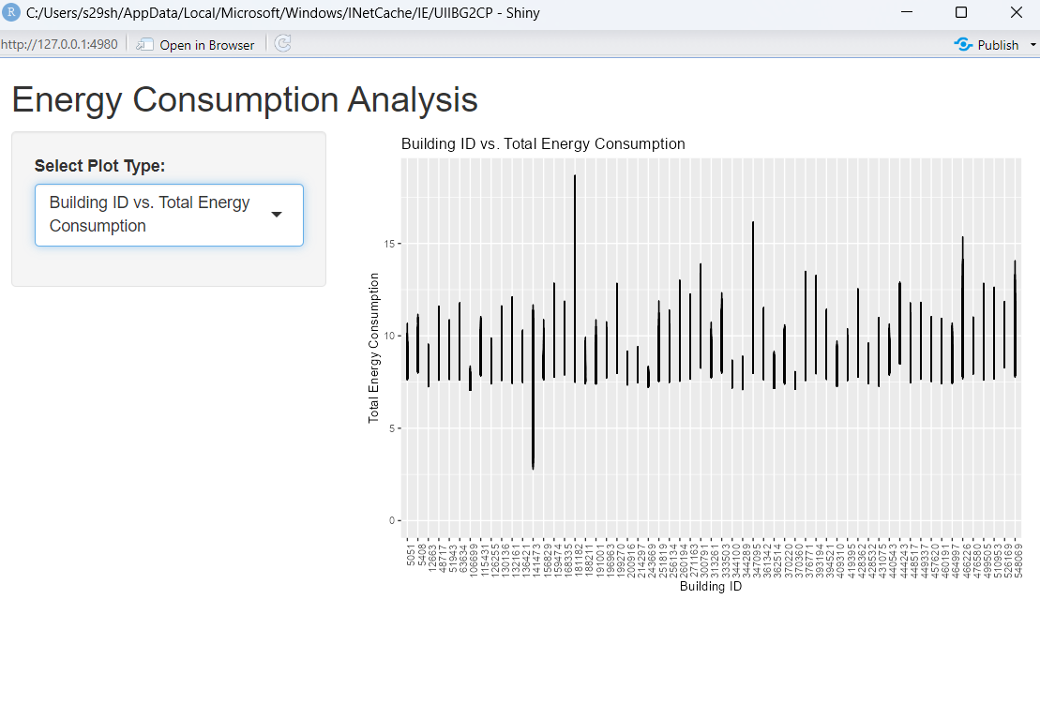

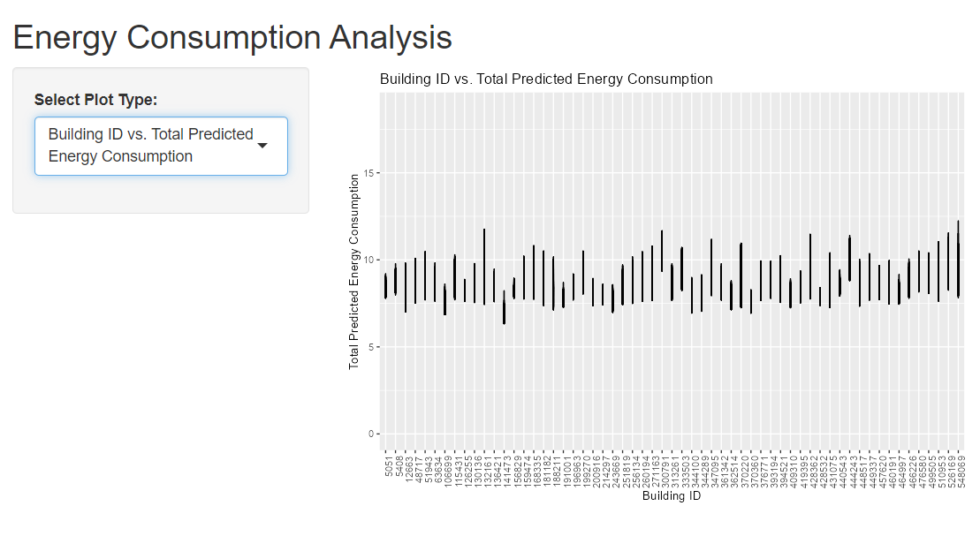
Total energy consumption (Building id)
SHINY APP
Prediction

Slide 10
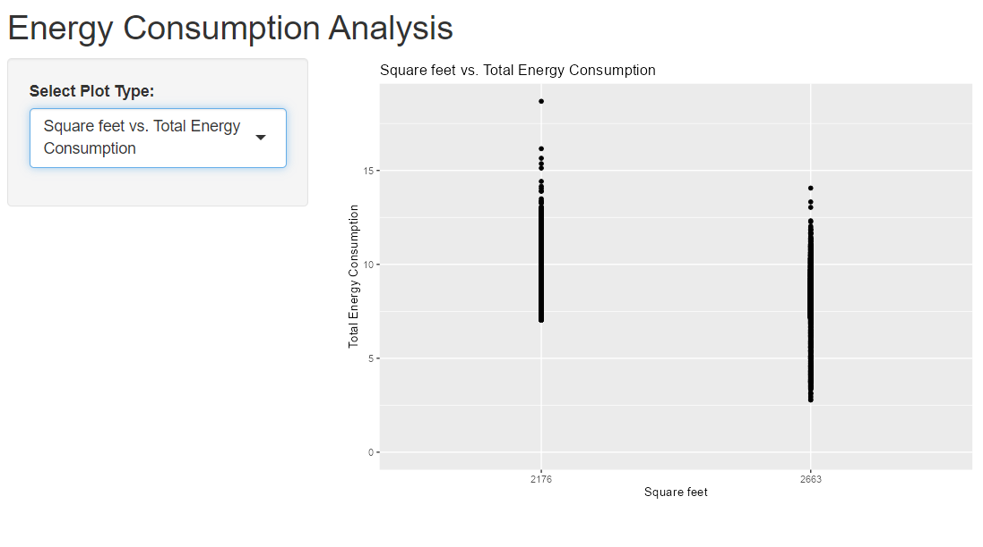
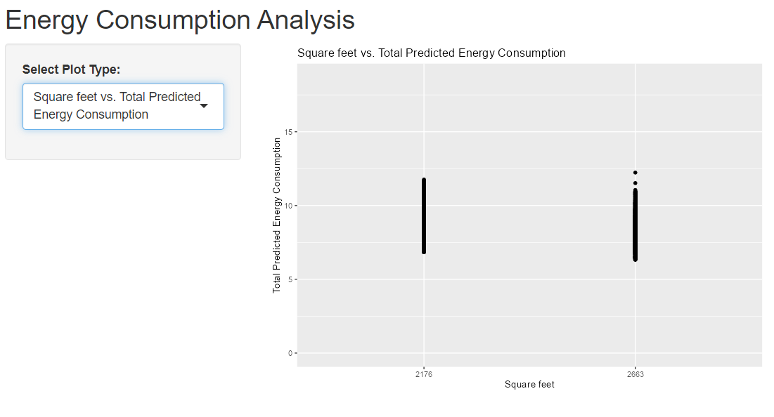
Total energy consumption (SQFT)
Prediction

Slide 11
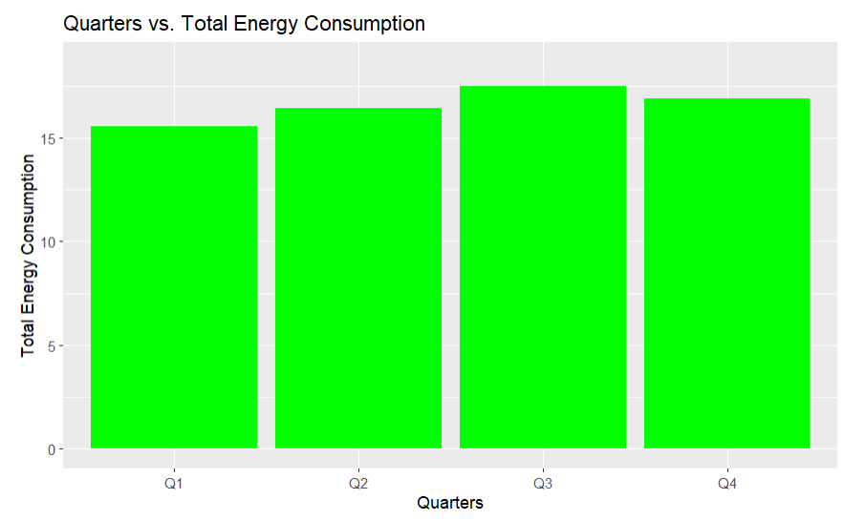
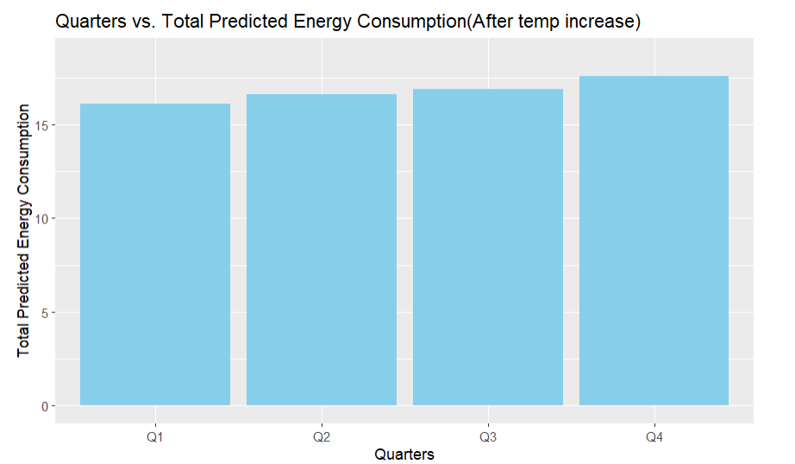
Total consumption throughout 4 quarters

Slide 12
Interpretations
These are the four variables in interpretation that affects the energy consumption the most when we change the july temp by 5 degrees :
Variable importance out.electricity.cooling.energy_consumption 28 Dry.Bulb.Temperature...C. 10 Global.Horizontal.Radiation..W.m2. 8 Relative.Humidity.... 8
The percent change in the predicted energy consumption is 13.19% , accuracy 87.17% and rmse 0.445534

Slide 13

THANK YOU

