Slide 1

SHARDA UNIVERSITY
//01
Plant Monitoring System
Shaan Raj Pradhan
Mukul Rajput
Shubham Gupta
Shray Sharma
2018010540
2018013543
2018006327
2018008770

Slide 2
Contents
ABSTRACT
03
INTRODUCTION
04
OBJECTIVES
05
CASE DIAGRAM
06
WORKING DESCRIPTION
07
PROJECT PHOTOS
08
CONCLUSION
09
//02

Slide 3
ABSTRACT
The aim of this project is to develop an IOT based Plant Monitoring System using different modules such as Arduino UNO, moisture sensor. Plant monitoring is seen as one of the most important tasks in any farming or agriculture-based environment. During certain situations it is very difficult to monitor the plant as human interaction cannot be available 24/7 To overcome this problem, the Moisture sensor sense the soil is dry or wet and the sensor values are given to ADC to get processed by microcontroller. The moisture sensor detects the water level and converts it into an analog signal, which is used in a small controller via ADC. An analog signal is converted to digital format by an analog-to-digital converter (ADC) and supplies the water if it rises above the threshold value. This IoT device allows the farmer or gardener to have a clear sense of mind, as the sensor will automatically display the amount of moisture content in the soil.
//03

Slide 4
About
The Plant Monitoring System
INTRODUCTION
The aim of this project is to develop a Plant Monitoring System that measures the moisture content of the soil of the plant and according to the moisture content the water is supplied through the solenoid valve. The work emphasizes on measuring the moisture, giving input to the microcontroller, giving output to the 5V 4-Channel Relay. Throughout the development of this project, best of the algorithms working in the domain of plant monitoring system were studied. The focus was on selecting an algorithm that gives us a good balance the time taken for processing and supplying water to the plant. This proposed work is made to help the farmers and make their harvest economical by helping them in security purpose travelling side, college and for every bodies etc. By this work, the wastage of water and the consumption of power by motor can be reduced so that they are conserved for the future use. This system provides complete monitoring action of sensors in fields that is very easy to control the field. It also provides huge security to the plants.
//04

Slide 5
//05
OBJECTIVES
MOTIVE
AFFORDABILITY
FEEDBACK
ACTION
The main objective of this project is to develop an Embedded System for plant monitoring using Internet of Things, Arduino as Processor, and sensors for moisture content in the soil.
Low cost smart monitoring device so that maximum amount of the population can afford.
To measure and display the amount of moisture content in the soil.
After measuring the moisture content in the soil, water is supplied with the help of solenoid valve.

Slide 6
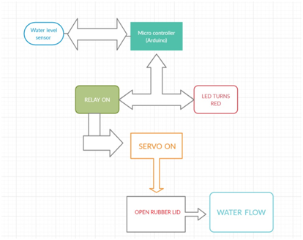
//06
CASE DIAGRAM

Slide 7
//07
WORKING DESCRIPTION
In this model we are automating the watering process of the plant:
In this Plant Monitoring system, Soil Moisture sensor SEN13322 will be embedded in the soil of the pot .
The moisture sensor is programmed with a threshold.
The LED on the relay will blink in red color. If the red LED is ON then it indicates that the threshold value is not met and if the green LED is ON then it means that the threshold value assigned is met .
Once the Threshold value is met then the micro controller sends a signal to the 5V 4-Channel relay
The relay then sends a signal to the power supply to turn on the solenoid valve through which the water is supplied to the plant.
As the water is being supplied to the plant the moisture sensor detects if its threshold value is met, if so then the micro controller sends the signal to the relay.
The relay receives the signal and turns the power supply off.

Slide 8
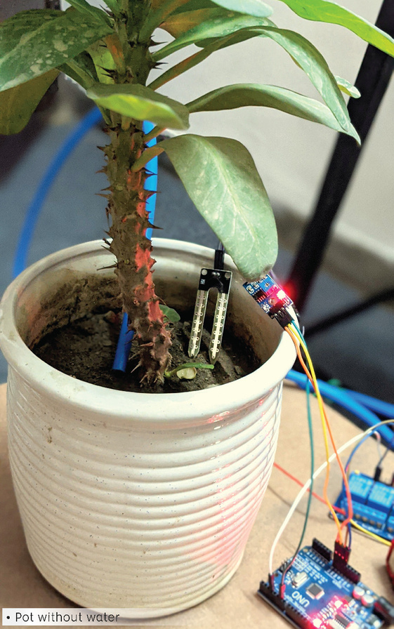
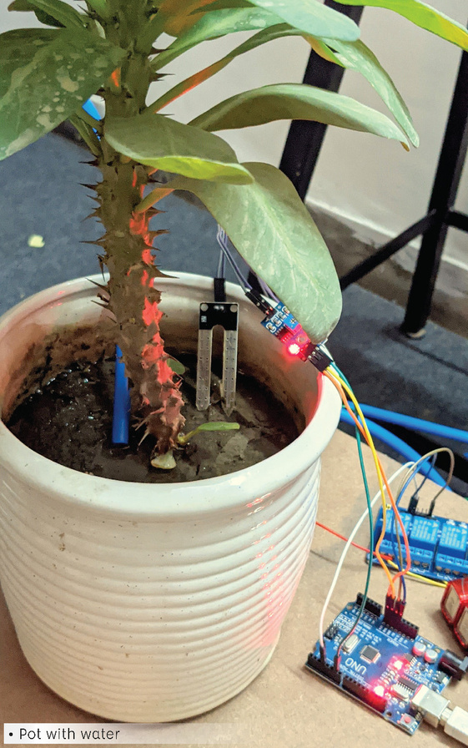
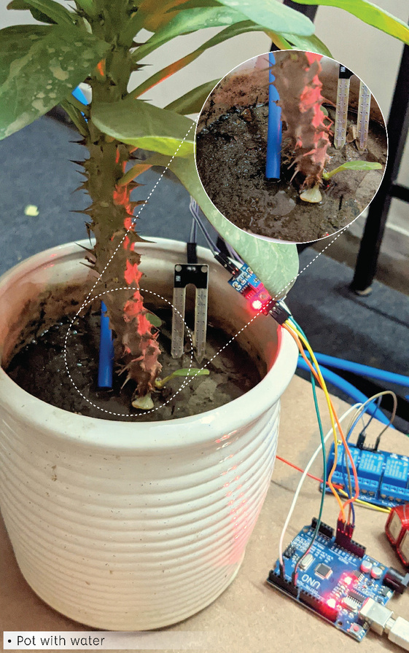
//08
POT WITHOUT WATER
POT WITH WATER
POT WITH WATER

Slide 9
//09
CONCLUSION
The aim of this project is to develop a Plant Monitoring System that measures the moisture content of the soil of the plant and according to the moisture content the water is supplied through the solenoid valve. The work emphasizes on measuring the moisture, giving input to the microcontroller, giving output to the 5V 4-Channel Relay. Throughout the development of this project, best of the algorithms working in the domain of plant monitoring system were studied. The focus was on selecting an algorithm that gives us a good balance the time taken for processing and supplying water to the plant. This proposed work is made to help the farmers and make their harvest economical by helping them in security purpose travelling side, college and for every bodies etc. By this work, the wastage of water and the consumption of power by motor can be reduced so that they are conserved for the future use. This system provides complete monitoring action of sensors in fields that is very easy to control the field. It also provides huge security to the plants.

Slide 10
THANK YOU

