Slide 1
INTRODUCTION Library Management System is an application which refers to library systems which are generally small or medium in size. It is used by librarian to manage the library using a computerized system where he/she can record various transactions like issue of books, return of books, addition of new books, addition of new students etc. Books and student maintenance modules are also included in this system which would keep track of the students using the library and also a detailed description about the books a library contains. With this computerized system there will be no loss of book record or member record which generally happens when a non computerized system is used. In addition, report module is also included in Library Management System. If user’s position is admin, the user is able to generate different kinds of reports like lists of students registered, list of books, issue and return reports. All these modules are able to help librarian to manage the library with more convenience and in a more efficient way as compared to library systems which are not computerized.

Slide 2
PROJECT AIMS AND OBJECTIVES
The project aims and objectives that will be achieved after completion of this project are discussed in this subchapter. The aims and objectives are as follows:
Online book issue
Request column for librarian for providing new books
A separate column for digital library
Student login page where student can find books issued by him/her and date of return.
A search column to search availability of books
A teacher login page where teacher can add any events being organized in the college and important suggestions regarding books.

Slide 3
PROBLEM STATEMENT
The problem occurred before having computerized system includes:
File lost when computerized system is not implemented file is always lost because of human environment. Sometimes due to some human error there may be a loss of records.
File damaged when a computerized system is not there file is always lost due to some accident like spilling of water by some member on file accidentally. Besides some natural disaster like floods or fires may also damage the files. Library Management System Division of Computer Science and Engineering Page 10
Difficult to search record when there is no computerized system there is always a difficulty in searching of records if the records are large in number.
Space consuming after the number of records become large the space for physical storage of file and records also increases if no computerized system is implemented.
Cost consuming as there is no computerized system the to add each record paper will be needed which will increase the cost for the management of library.

Slide 4
SOFTWARE AND HARDWARE REQUIREMENTS
• Operating system- Windows 7 is used as the operating system as it is stable and supports more features and is more user friendly
• Turbo C++ to implement the base of the program library management
• Development tools and Programming language- • Turbo C/C++ to implement the base of the program library management by the use of language C#
• Intel core Pentium is used as a processor because it is fast than other processors and provide reliable and stable and we can run our pc for longtime.
• By using this processor we can keep on developing our project without any worries. Ram 1gb is used as it will provide fast reading and writing capabilities and will in turn support in processing.

Slide 5
Benefits
• Improvement in control and performance the system is developed to cope up with the current issues and problems of library .The system can add user, validate user and is also bug free.
• Save cost after computerized system is implemented less human force will be required to maintain the library thus reducing the overall cost.
• Save time Librarian is able to search record by using few clicks of mouse and few search keywords thus saving his valuable time.
Option of online Notice board Librarian will be able to provide a detailed description of workshops going in the college as well as in nearby colleges
• Data can’t be lost through any natural or human disaster.

Slide 6
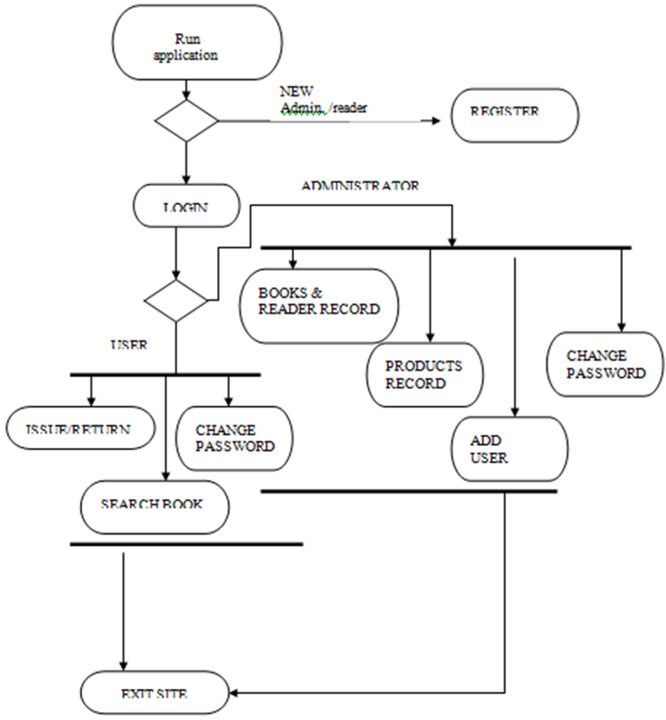
Activity Diagram (ER MODEL)

Slide 7
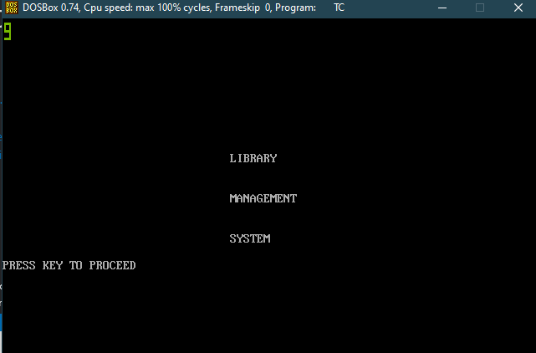
Program

Slide 8
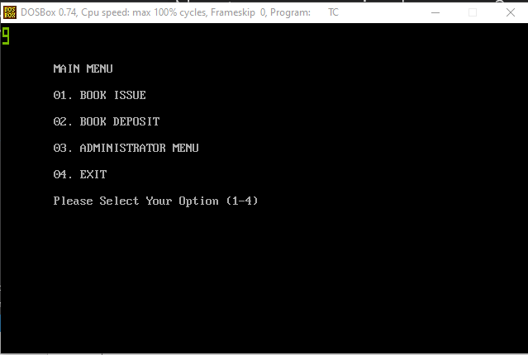

Slide 9
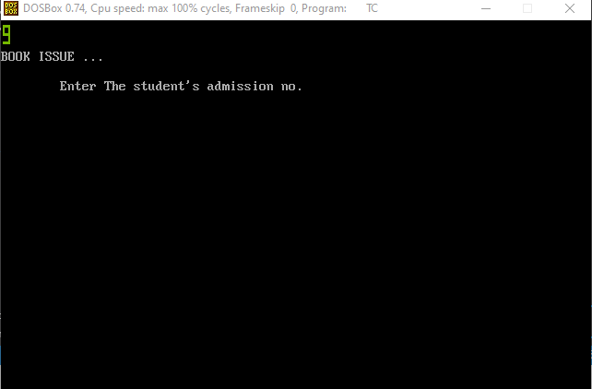

Slide 10
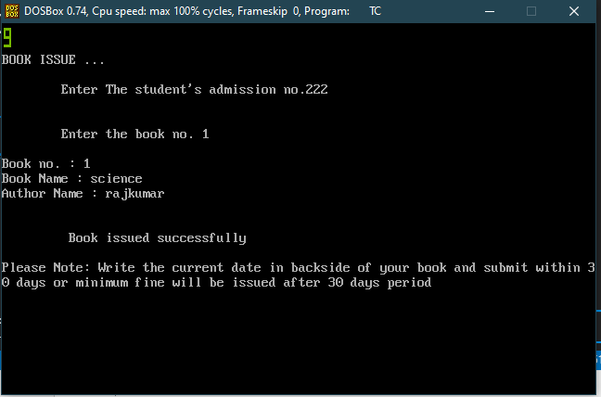

Slide 11
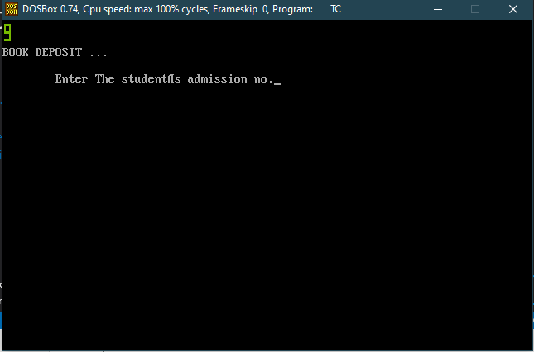

Slide 12
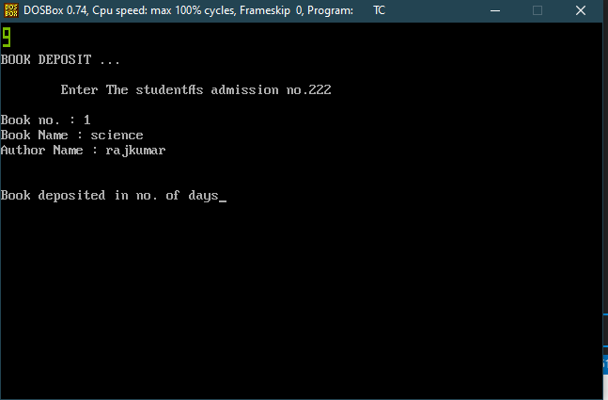

Slide 13
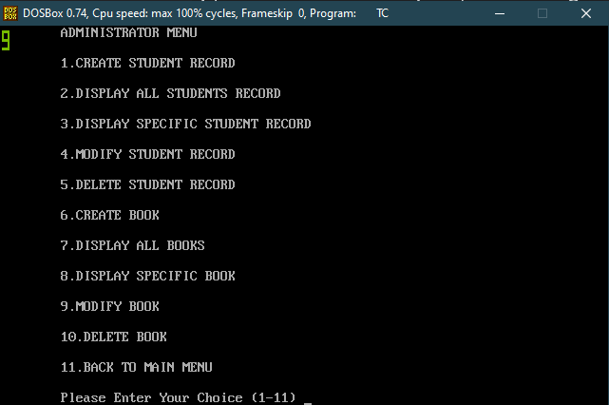

Slide 14
THANK YOU
By - Vishvender Raj Baisley
CSE-B,180101374

