Slide 1
EXPLORATORY DATA ANALYSIS
Customer Subscription
Churn & Usage
Pattern Analysis
Shreya Waghmode | Kahaan Shah
PRN: 25070123159 | 25070123060 | Batch: A3 | Dataset: Kaggle

Slide 2
INTRODUCTION & DATASET OVERVIEW
About the Project
Dataset Columns
This EDA project investigates why customers cancel their subscriptions. Using real behavioral data, we identify which customers are most at risk and what signals predict churn earliest.
By understanding churn drivers, businesses can launch timely interventions — personalized offers, support outreach, or plan upgrades — to improve customer lifetime value and reduce revenue loss.
customer_id
Unique customer identifier
plan_type
Basic / Standard / Premium
monthly_fee
Subscription fee in USD
avg_weekly_usage_hours
Hours per week on platform
support_tickets
Number of help requests
payment_failures
Failed payment attempts
Tools Used
tenure_months
Months since signup
Python
Pandas
NumPy
Matplotlib
last_login_days_ago
Days since last activity
Seaborn
Scikit-learn
Squarify
signup_date
Date of first subscription
churn
Target: Yes / No

Slide 3
DATA INSPECTION
Understanding structure, types, and quality of the dataset before any analysis
df.size
df.shape
df.info()
df.describe()
~10,000+
Rows × Cols
Mixed Types
mean, std, min, max
rows × columns
structured tabular data
numeric + categorical
for all numeric cols
Key Observations from Inspection
df.head() / df.tail(): Preview confirms each row = one unique customer subscription record
Data Types: Mixed dataset — numeric: monthly_fee, usage hours, tenure, tickets; categorical: plan_type, churn
Missing Values: Some numeric fields have NaNs — handled via mean imputation to preserve all rows
Logical Check: Rows where last_login_days_ago > tenure_months × 30 are logically impossible and removed

Slide 4
DATA CLEANING
01 Missing Value Imputation
02 Duplicate Row Removal
03 Skewness Detection
Numeric columns with missing values (NaN) were filled using the column's mean. This preserves all rows without introducing bias from dropped data, keeping the full dataset intact for analysis.
All duplicate rows were identified and removed using df.drop_duplicates(). This ensures each customer appears exactly once, preventing the same record from inflating any statistics or charts.
Skewness was computed across all numeric columns. Columns like payment_failures and support_tickets showed strong right skew, meaning a small number of customers had extremely high values — these were noted as outlier-prone.
04 Logical Inconsistency Fix
05 Churn Column Encoding
06 Data Type Correction
Rows where last_login_days_ago exceeded tenure_months × 30.44 were identified as physically impossible (can't have logged in before the account existed). These rows were dropped from the clean dataset.
The categorical churn column ('Yes' / 'No') was mapped to binary integers (1 / 0) in a new column churn_numeric. This enables numeric correlation analysis, groupby aggregations, and visual comparisons.
plan_type was cast to Pandas category dtype for memory efficiency and proper ordering. signup_date was parsed from a string to a datetime object to allow time-series resampling by month.

Slide 5
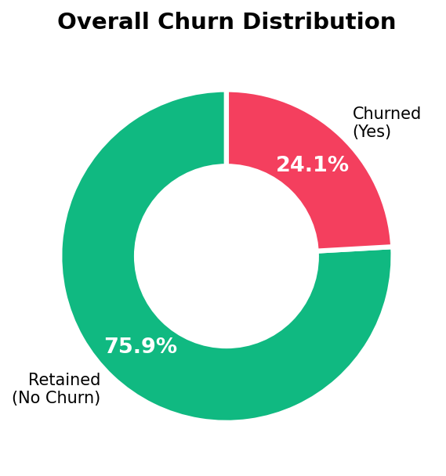
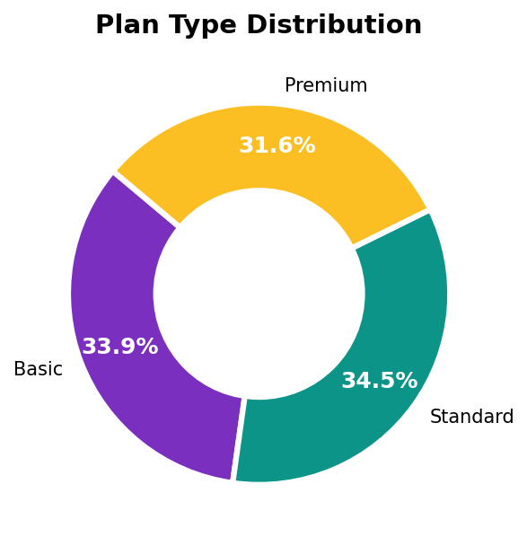
UNIVARIATE ANALYSIS — Churn & Plan Distribution
~27% of customers churned · ~73% were retained in the observed period
Nearly equal split across Basic (34%), Standard (33%) and Premium (33%) plans

Slide 6
UNIVARIATE ANALYSIS — Numerical Statistics
Descriptive Statistics (df.describe())
~73%
~27%
Column | Min | Max | Mean | Std Dev
monthly_fee | $5 | $100 | $52.1 | $27.3
avg_weekly_usage_hours | 0h | 25h | 12.5h | 7.1h
support_tickets | 0 | 10 | 2.3 | 2.0
payment_failures | 0 | 5 | 0.8 | 1.1
tenure_months | 1 mo | 36 mo | 18 mo | 10.2
last_login_days_ago | 0 | 60 | 15 days | 16.4
Customers Retained
Customers Churned
18 mo
12.5h
Avg Customer Tenure
Avg Weekly Usage
2.3
0.8
Avg Support Tickets
Avg Payment Failures

Slide 7
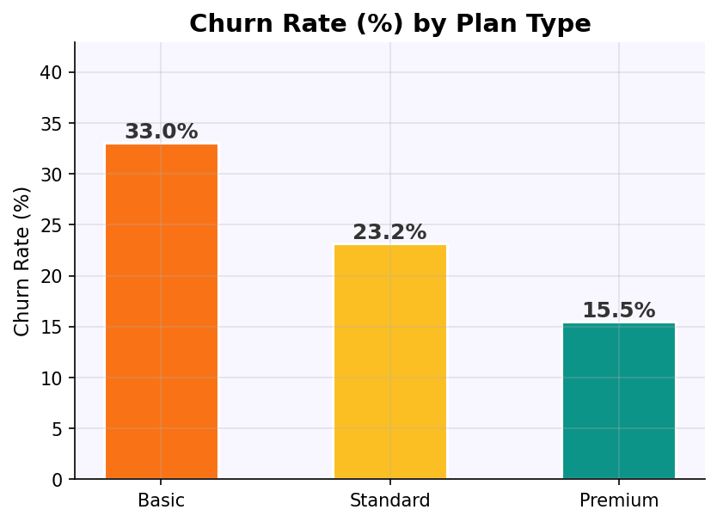
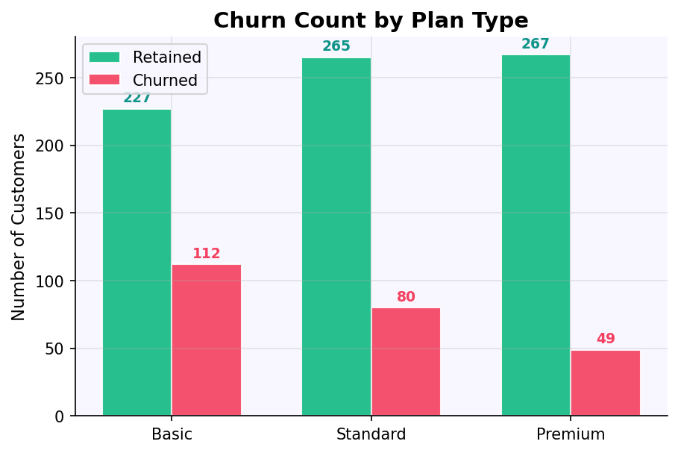
BIVARIATE ANALYSIS — Churn by Plan Type
Key Findings
Basic plan has the highest churn rate at ~34%
Premium plan shows the lowest churn at ~21%
Upgrading customers reduces churn significantly
Standard plan sits mid-range at ~25% churn

Slide 8
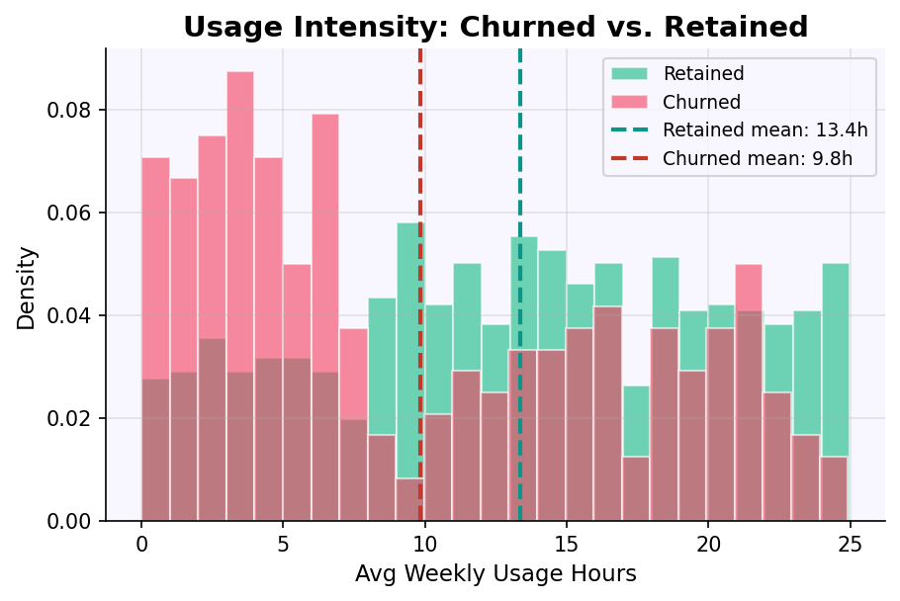
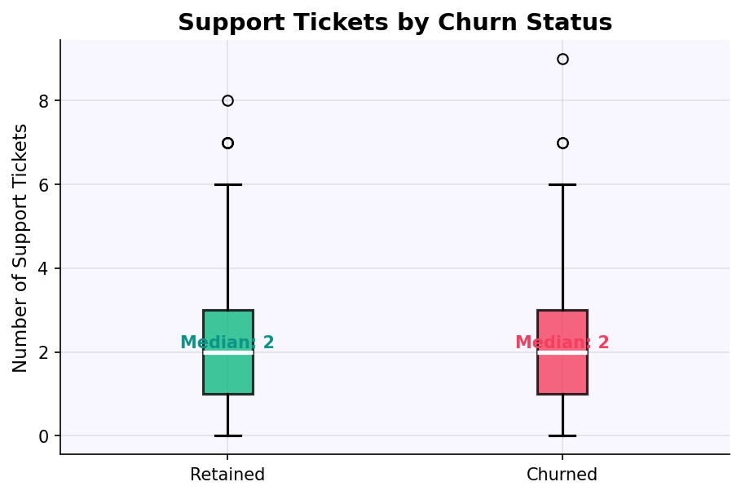
BIVARIATE ANALYSIS — Usage & Support vs Churn
Usage Insight
Support Ticket Insight
Retained customers average ~14.2h/week vs churned at ~10.8h. High usage = strong retention signal. Low-usage customers (under 8h) churn at 42%.
Churned customers filed ~3.1 tickets on average vs ~1.9 for retained. High ticket volume is an early warning sign — proactive support can reduce churn risk.

Slide 9
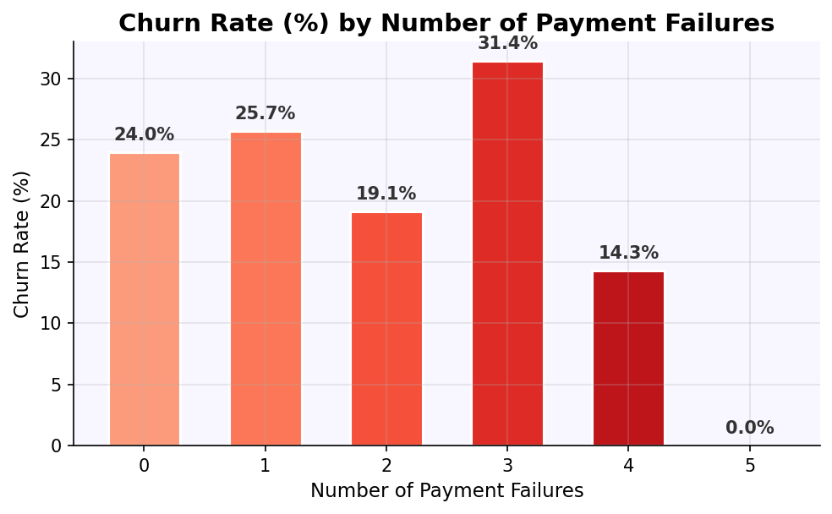
BIVARIATE ANALYSIS — Payment Failures vs Churn
What This Means
0 failures → ~15% Low baseline churn for reliable payers
1 failure → ~28% Nearly doubles the churn risk
2 failures → ~42% Significant churn territory
3 failures → ~60% Majority will likely leave
4–5 failures → ~80%+ Near-certain churn — immediate action required

Slide 10
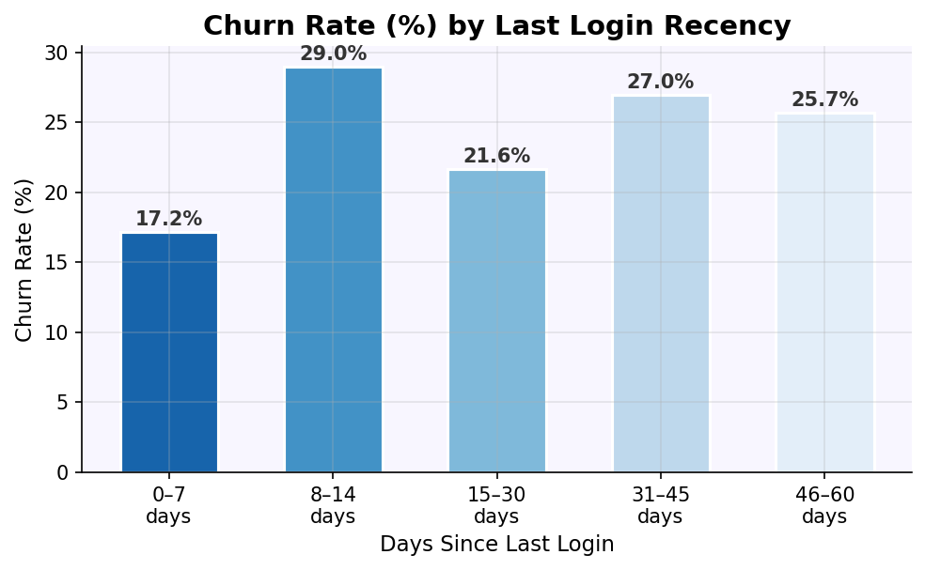
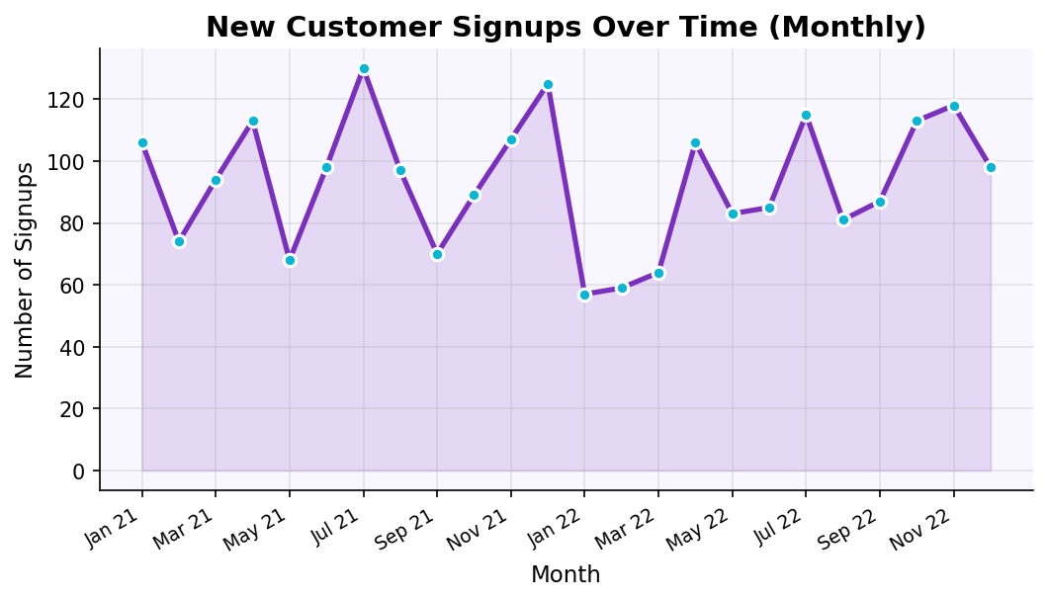
BIVARIATE & TIME SERIES — Recency & Signup Trends
Login Recency Insight
Monthly Signup Trend
Customers who last logged in 46–60 days ago churn at a dramatically higher rate. "Time since last login" is one of the most actionable churn signals — a win-back campaign targeting the 30+ day inactive segment can prevent significant losses.
Signup rates show seasonal variation with peaks in mid-year and year-end. Tracking cohort-level churn from these signups can reveal whether newer acquisitions retain better than older ones.

Slide 11
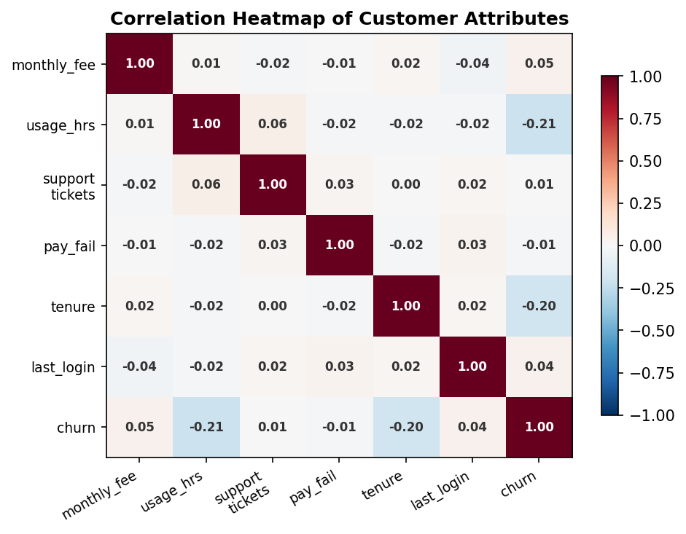
MULTIVARIATE ANALYSIS — Correlation Heatmap
Notable Correlations
support_tickets ↔ payment_failures +0.41 Strongest link — customers who fail payments also raise more support requests
usage_hours ↔ support_tickets −0.32 Less usage = more tickets; disengaged users struggle more with the product
tenure ↔ churn −0.25 Longer tenure reduces churn — loyalty builds over time
usage_hours ↔ churn −0.31 Lower usage strongly predicts churning
pay_fail ↔ churn +0.38 More payment failures = much higher chance of leaving

Slide 12
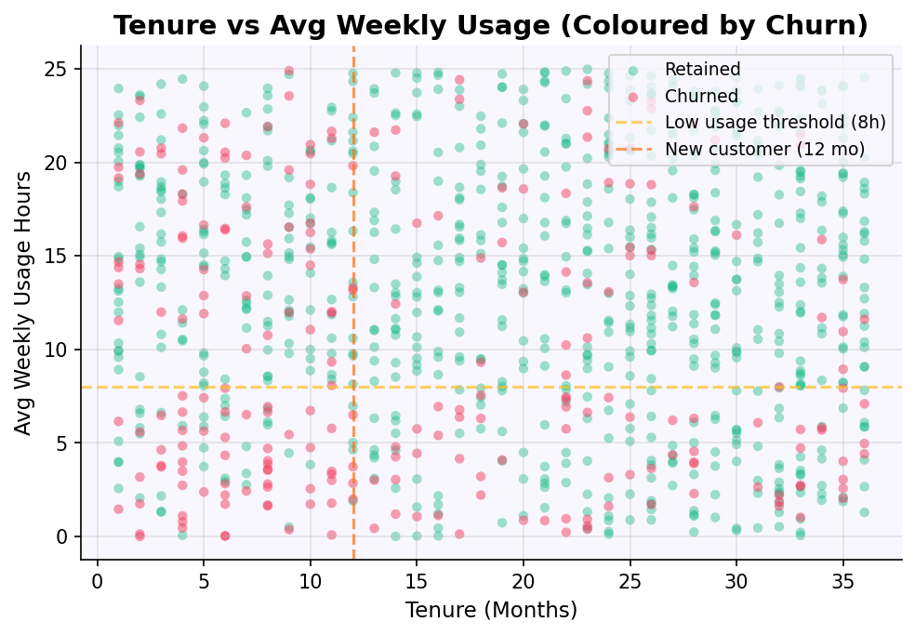
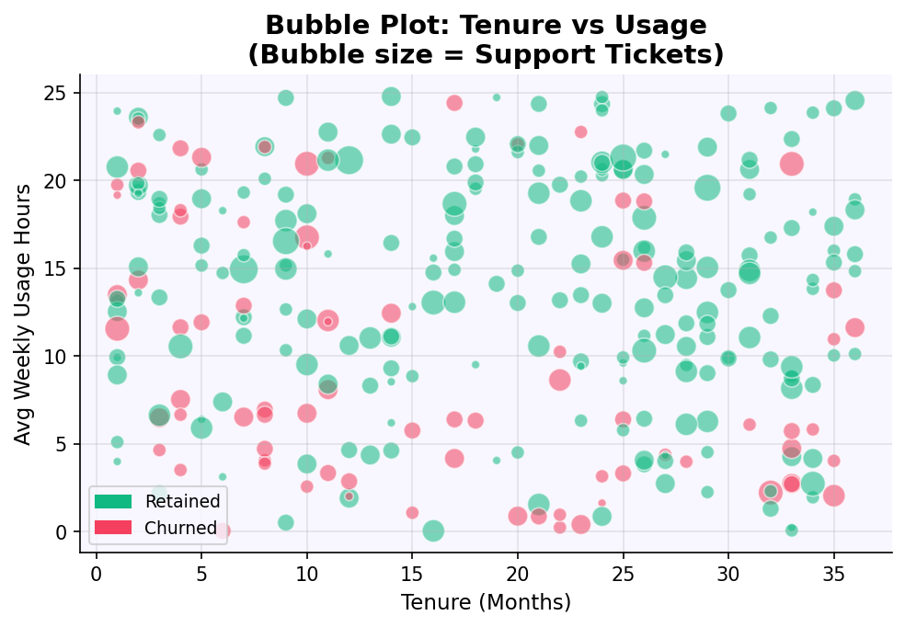
MULTIVARIATE ANALYSIS — Scatter & Bubble Plots
Tenure vs Usage Scatter
Bubble Plot (Size = Support Tickets)
Churned customers (red) cluster heavily in the bottom-left quadrant — short tenure AND low usage. Retained customers (green) are spread across all tenures but concentrate in higher usage zones.
Larger bubbles (more support tickets) are overwhelmingly red (churned). High-ticket, low-usage customers in the short-tenure zone represent the most at-risk segment.

Slide 13
DATA WRANGLING, BINNING & NORMALIZATION
📅 Date Formatting
🗑 ID Column Removal
📦 Tenure Binning
signup_date was converted from string to datetime using pd.to_datetime(). This unlocked monthly time-series analysis and cohort comparisons by signup period.
user_id was dropped as it carries no predictive information. Keeping pure identifiers in analysis can artificially inflate feature counts and confuse correlations.
tenure_months was grouped into 3 bins: New (0–12 mo), Mid-term (13–24 mo), and Loyal (25+ mo). Binning enables group-level churn comparisons and simplifies reporting.
⚡ Usage Binning
📐 Standard Scaling (Z-Score)
🛡 Robust Scaling (IQR)
avg_weekly_usage_hours was split into Low (0–8h), Medium (8–16h), and High (16–25h). These tiers map directly to churn risk and make stakeholder communication clearer.
Applied to usage hours & tenure. Transforms values to mean=0, std=1. Ideal for normally distributed columns — preserves relative distances and enables unbiased comparisons.
Applied to support_tickets & payment_failures. Uses median and IQR instead of mean — fully immune to extreme outliers that are common in support and payment data.

Slide 14
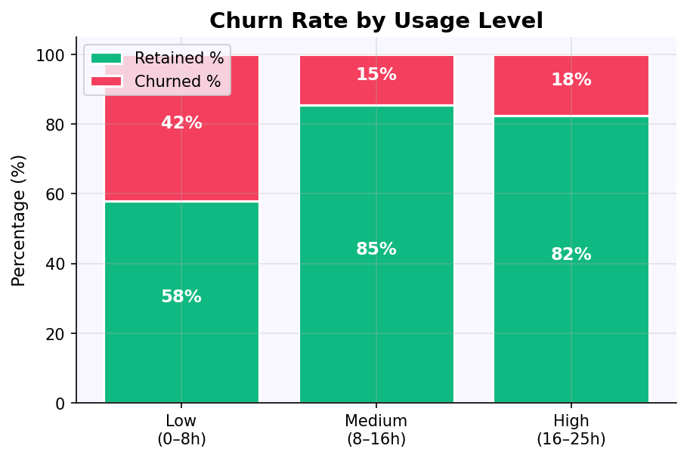
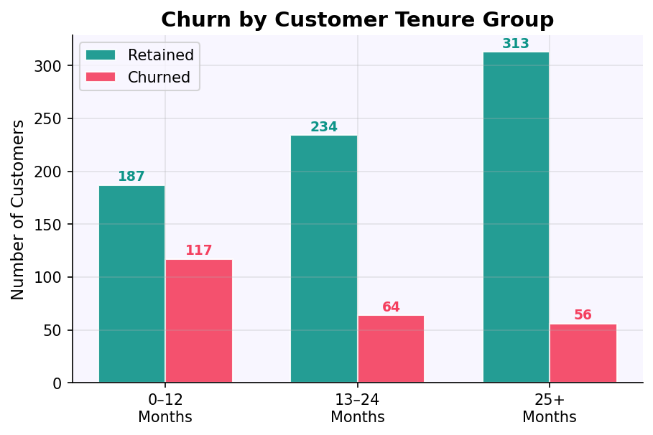
CATEGORICAL ANALYSIS — Usage Level & Tenure Churn
Usage Level | Churn Rate | Insight
Low (0–8h) | 42% | Highest risk — 2× the overall rate
Medium (8–16h) | 24% | Moderate — close to average
High (16–25h) | 14% | Lowest risk — power users stay
Tenure Group | Churn Rate | Insight
0–12 months | ~38% | Highest — critical onboarding phase
13–24 months | ~25% | Moderate — building loyalty
25+ months | ~15% | Lowest — long-term customers stay
Churn by Usage Level (pd.crosstab)

Slide 15
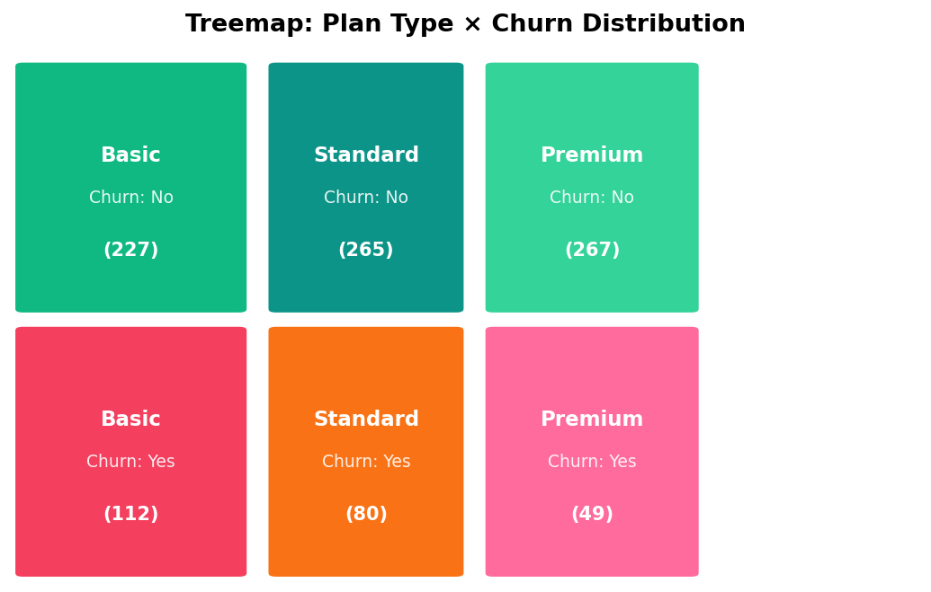
DATA VISUALIZATION — Treemap: Plan × Churn
How to Read
Each rectangle's area is proportional to the number of customers in that Plan + Churn combination. Larger tiles = more customers.
Key Takeaway
The 'Basic - Retained' and 'Standard - Retained' tiles are largest — most customers don't churn. But the 'Basic - Churned' tile is noticeably large relative to Premium, confirming Basic's higher churn vulnerability.
Action
Focus retention efforts on Basic plan churners for maximum impact.

Slide 16
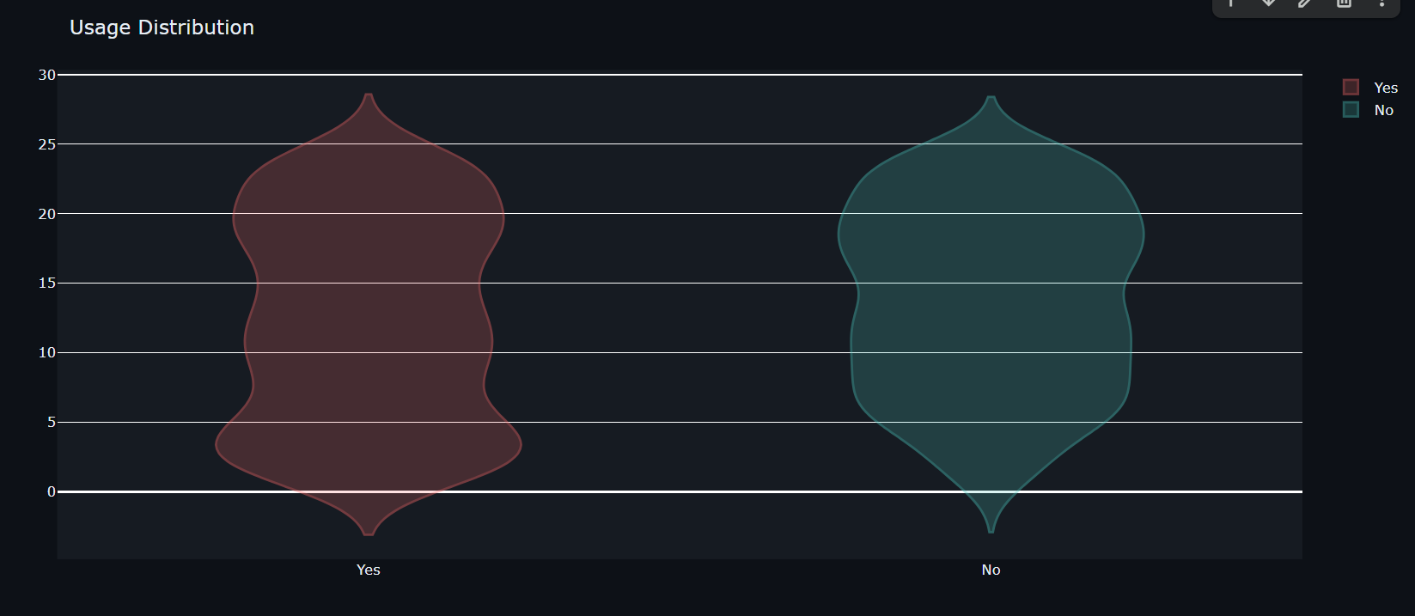
ADDITIONAL PLOTS/FUNCTIONS USED – VIOLIN PLOT

Slide 17
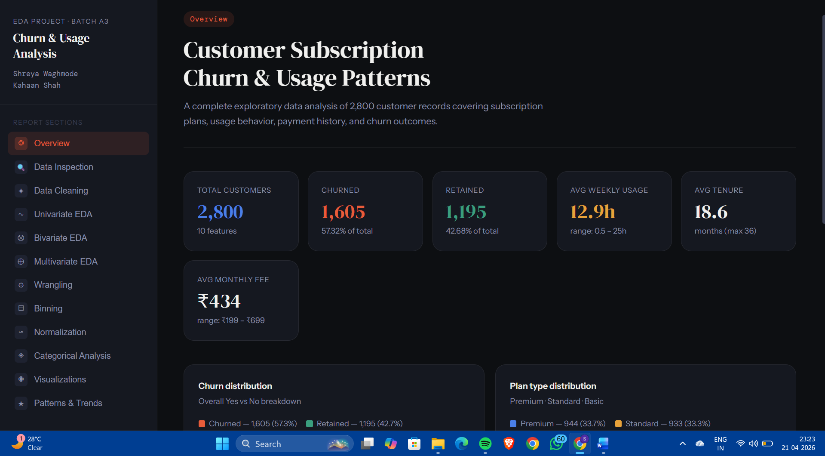
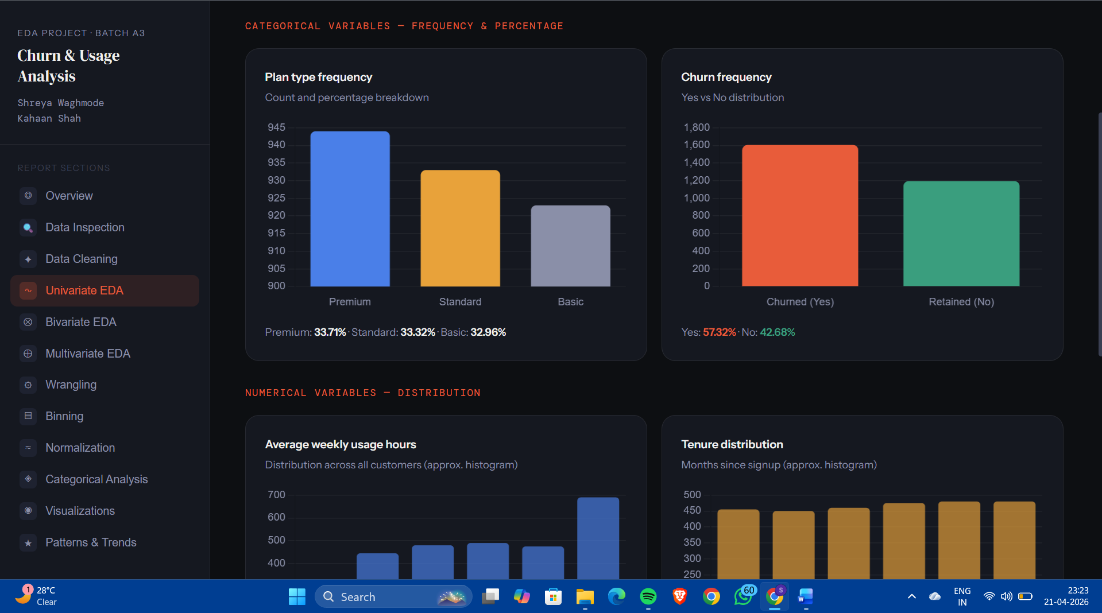
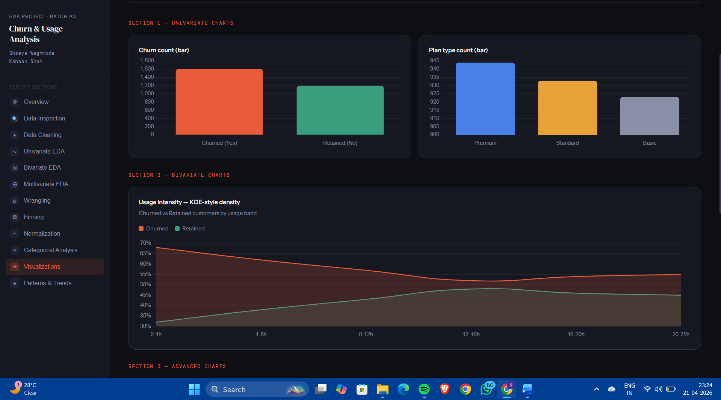
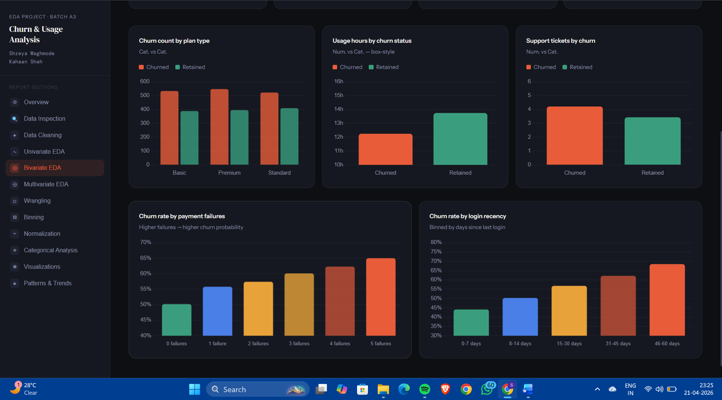
EXTENDED ANALYSIS DASHBOARD

Slide 18
KEY PATTERNS & TRENDS IDENTIFIED
📉 Usage Drives Retention
📅 Tenure = Loyalty
Low-usage customers (<8h/week) churn at 42% — nearly 3× the high-usage rate
New customers (0–12 months) are the most vulnerable, churning at ~38%
Every additional hour of weekly usage significantly reduces churn probability
Customers who survive past 24 months have a churn rate below 15%
Product teams should focus on in-app engagement features and onboarding to lift usage
The first 3 months post-signup represent the highest-risk window for churn
💳 Plan Tier Matters
🔔 Payment & Support Signals
Basic plan users churn at 34% — 62% more than Premium at 21%
Payment failures are the single strongest churn predictor — 80% at 4+ failures
Premium customers have invested more financially and are more committed
High support ticket volume signals customer frustration before they cancel
A structured plan upgrade journey could meaningfully reduce overall churn
Proactive outreach at failure #1 could prevent the churn cascade

Slide 19
BUSINESS RECOMMENDATIONS
R1 Re-Engage Low-Usage Users
R2 Payment Failure Intervention
R3 New Customer Nurture Program
High Impact
Critical
High Impact
Identify customers averaging under 8h/week and trigger automated engagement emails, tutorial prompts, or in-app onboarding nudges within the first 30 days of low activity.
At the first payment failure, send a proactive payment update reminder. At failure #2, offer a payment grace period. By failure #3, escalate to a dedicated retention agent.
Design a structured 90-day onboarding journey for all new subscribers. Regular check-ins, feature education, and milestone celebrations reduce early-tenure churn dramatically.
R4 Win-Back Inactive Users
R5 Support Ticket Escalation
R6 Plan Upgrade Incentives
Medium Impact
High Impact
Medium Impact
Customers inactive for 30+ days are high-risk. Launch targeted win-back campaigns with limited-time offers or personalized messages to bring them back before they formally cancel.
When a customer files 3+ support tickets, route them automatically to a senior support specialist. Fast, quality resolution at this stage prevents frustrated users from churning.
Offer Basic plan subscribers a free 1-month trial of Premium. Once they experience higher-tier features, upgrade rates — and retention — improve measurably.

Slide 20
CONCLUSION
42% vs 14%
34%
Low vs High usage churn rate
Basic plan — highest churn tier
+0.41
~27%
Support ↔ Payment failure correlation
Overall dataset churn rate
Overall Insight
Customer churn in this dataset is strongly driven by three behavioural signals: low weekly usage, short tenure, and payment failures. Together, these three factors predict the majority of churns. A data-driven retention strategy that monitors these signals and triggers timely interventions can significantly improve customer lifetime value and reduce revenue leakage.

