Slide 1

Lending Club Case Study
Shrinivas Bhat

Slide 2
What is a Lending Club
Lending club is a credit marketplace facilitating various kinds of loans like personal loans, business loans , financing for medical procedures , debt repayment etc to borrowers which is enabled by investors in exchange for earning interest.
Its Main Functions
1. Providing the borrowers a way to apply for the loan
2. Having a environment for investors to fund these loans.
Parties involved in the Lending Club
1. Borrower - Who applies for a loan for the specific purpose
2. Lending Club - Based on the category,purpose,grades,sub-grades..etc approves the loan amount which may be less than or equal to the applied loan from the borrower. It also decides on the interest rates for the various kinds of loans.
3. Investor - Who decides to invest in the specific loan portfolio's with various risk categories. Investor may decide on investing in the loan amount equal to or less than the approved loan amount from the lending club.

Slide 3
Problem Statement
To Identify DRIVING FACTORS (or driver variables) behind loan default, i.e. the variables which are strong indicators of default. The company can utilise this knowledge for its portfolio and risk assessment.
Understand the Consumer Attributes and Loan Attributes and analyze its influence on the tendency of default. The customers labelled as 'charged-off' in loan status are the 'defaulters'.
Identify patterns to indicate the person defaulting , which may be further used to take decisions like denying the loan , reducing the loan amount, higher interest rates to risky applicants.

Slide 4
Scope
Data Cleaning
Data Manipulation and creation of derived columns
Exploratory Data Analysis
Observations, Insights and Recommendations

Slide 5
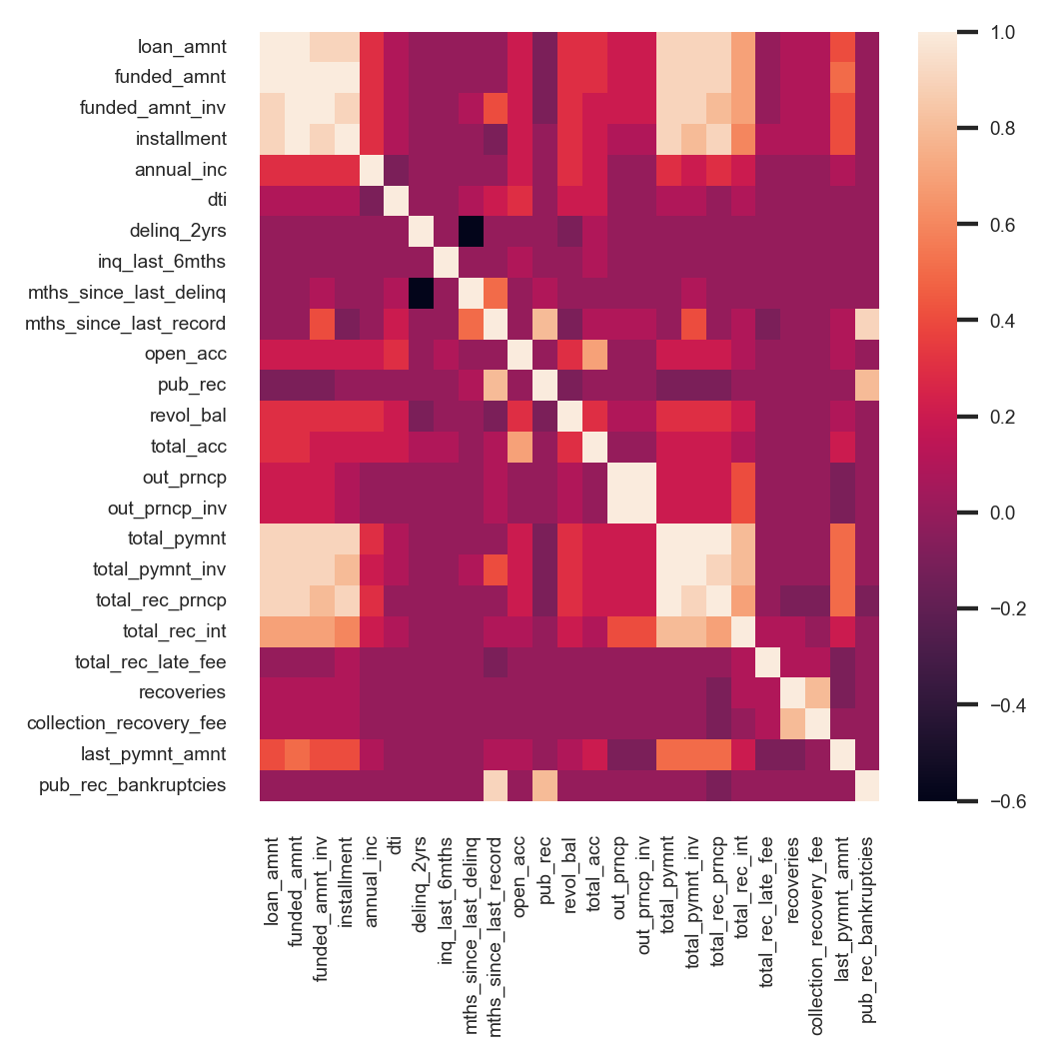
Data Cleaning
All the columns having more than 80% nan and only one value(no variations in value) were removed. This reduced the number of columns to about 48 from 111.
Further by performing the correlation the correlated columns like ‘funded_amnt’ ‘collection_recovery_fee’,’total_rec_prncp’..etc can be reomved.
Columns like 'desc','url’,’emp_title’,’title’..removed as they don’t seem to impact the borrowers tendency to default.
For new customer's the columns which signify the customer behavior variables is assumed to be not available and hence cannot be used in the model. Hence from the data we will remove those data. This rule eliminates significant amounts of columns from the dataset.
Borrower behavioral data was divided into two forms 1) General data where the columns come from historic public/private data 2) The lending club specific data which is related to the associated loan amount from the lending club.
Data like ‘delinq_2yrs','earliest_cr_line','inq_last_6mths’, 'mths_since_last_delinq' 'mths_since_last_record','open_acc’,..etc falls in the General behavior category where as data like 'out_prncp’, 'out_prncp_inv','total_pymnt', 'total_pymnt_inv','total_rec_prncp','total_rec_int','total_rec_late_fee which are specific to the loan taken by the borrower.
Finally after removing all the behavioral data we are left with only 19 prominent attributes or columns which can be considered for further analysis.

Slide 6
Data Manipulation and creation of derived columns
Some of the major data-manipulations and derived column’s done in the case-study
‘emp_length’ post-processed to convert to a continuos variable by replace 10+ years and <1 to 10 and 0 respectively.
Removing % character from the interest variable.
Pre-processing the zip code to consider only first 3 characters into numeric variable.
Creating a new attribute which indicates the % of funded loan amount from the investor.
Converting the continuous numeric annual income , interest rates , dti (debt to income) to categorical range variables for easier visualization and analysis of borrowers tendency to default based on these variables.

Slide 7
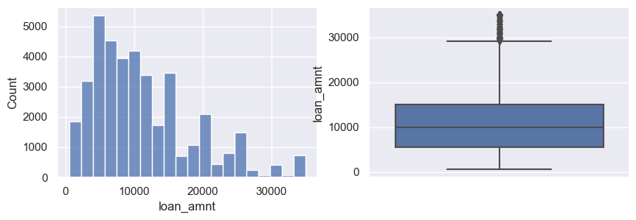
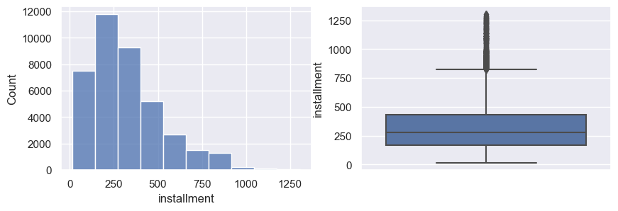
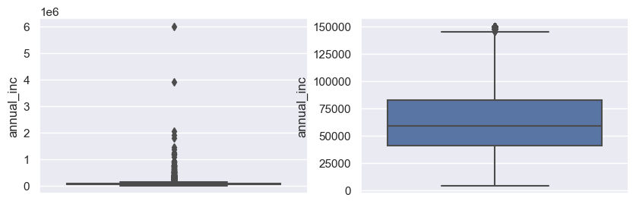
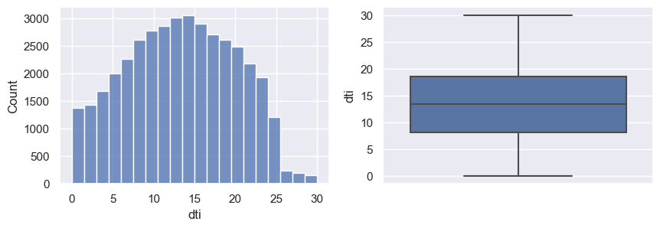
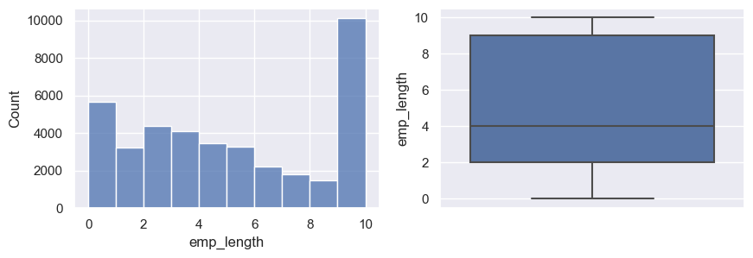
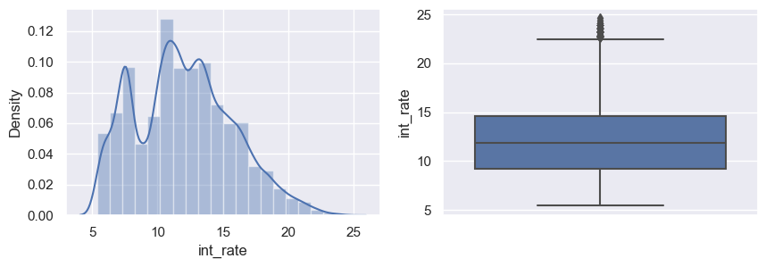
EDA (Rank-Frequency Analysis of driving variables.)
After annual_inc capped to 150K$
 | loan_amnt | funded_amnt_inv | installment | emp_length | annual_inc | dti | int_rate_pp | funded_loan_perc
count | 39717.00 | 39717.00 | 39717.00 | 39717.00 | 39717.00 | 39717.00 | 39717.00 | 39717.00
mean | 11219.44 | 10397.45 | 324.56 | 4.84 | 65469.93 | 13.32 | 12.02 | 93.90
Std | 7456.67 | 7128.45 | 208.87 | 3.61 | 33256.90 | 6.68 | 3.72 | 17.16
min | 500.00 | 0.00 | 15.69 | 0.00 | 4000.00 | 0.00 | 5.42 | 0.00
25% | 5500.00 | 5000.00 | 167.02 | 2.00 | 40404.00 | 8.17 | 9.25 | 98.00
50% | 10000.00 | 8975.00 | 280.22 | 4.00 | 59000.00 | 13.40 | 11.86 | 100.00
75% | 15000.00 | 14400.00 | 430.78 | 9.00 | 82300.00 | 18.60 | 14.59 | 100.00
Max | 35000.00 | 35000.00 | 1305.19 | 10.00 | 150000.00 | 29.99 | 24.59 | 100.00

Slide 8
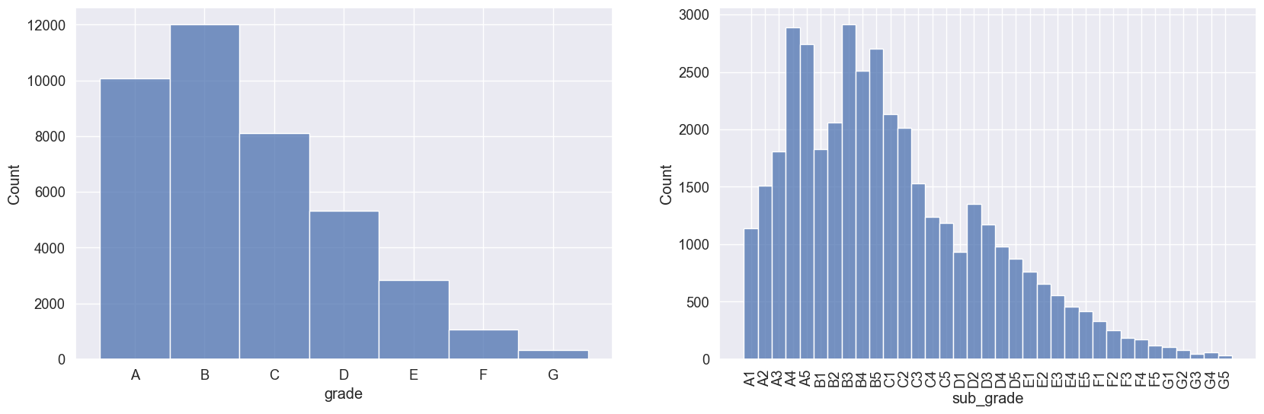
EDA (Rank-Frequency Analysis of driving variables.)

Slide 9
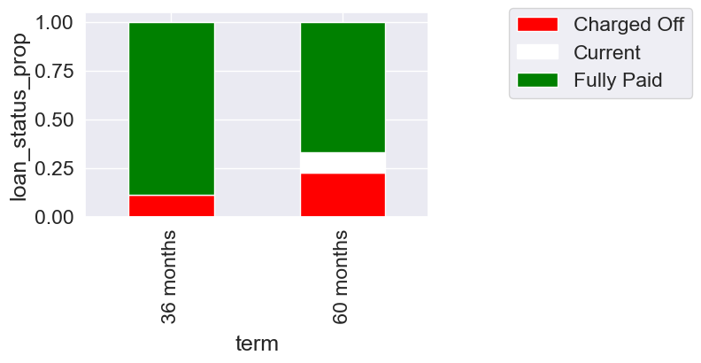
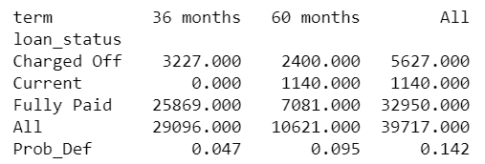
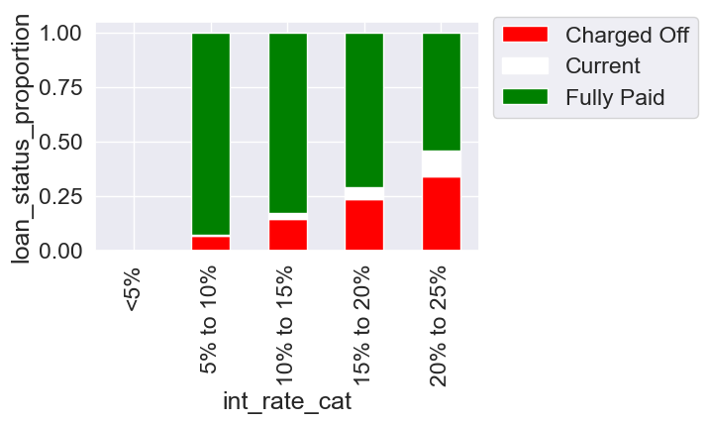
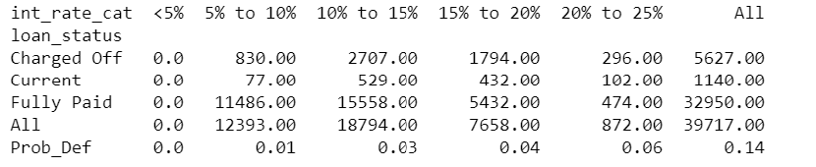
EDA (Loan term and Interest rates)
The borrower with the 60 month loan term are twice as likely to default compared to the borrowers with the 36 month loan term.
The borrowers with the annual income of 10K to 15K are more likely to default compared to the borrowers in the other income group.
Borrowers with interest rate of 20-25% are more likely to default compared to the other interest rate borrowers. Also the interest rates show a increasing trend with borrowers tendency to default.
It can be clearly seen that the variable ‘term’ and ‘interest rates’ show a strong trend in borrowers tendency to default.

Slide 10
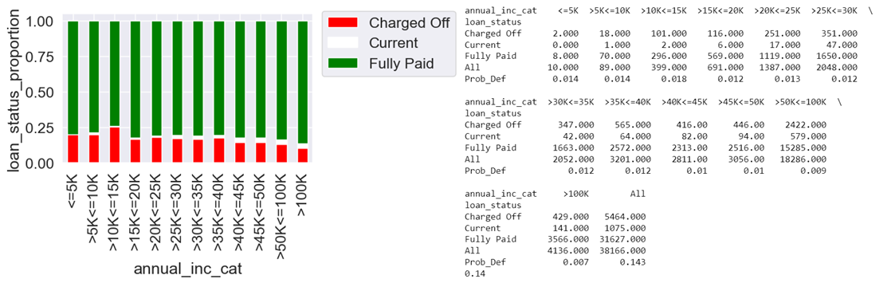
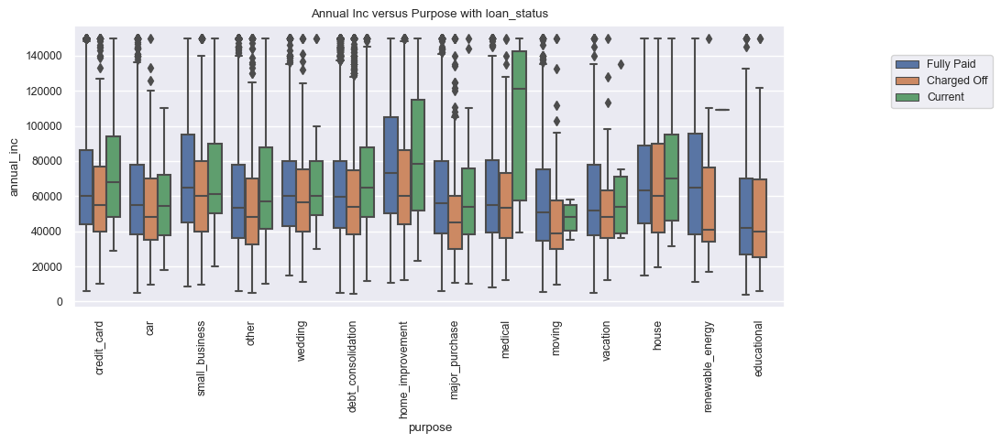
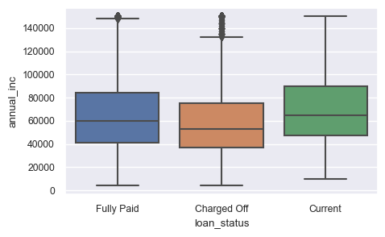
Annual income
The borrowers with the annual income of 10K to 15K are more likely to default compared to the borrowers in the other income group. But there is no clear trend seen in annual income and borrowers tendency to default.
When annual income is seen jointly with purpose of the loan it can be seen that some of the categories like “home improvement” , “debt consolidation” ,”renewable energy” ,”major purchase” the overall annual income of the borrowers who default is less that that of other borrowers.
The overall annual income of the borrowers who default have lower median income compared to the other borrowers.

Slide 11
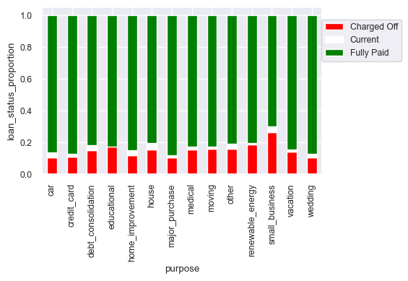
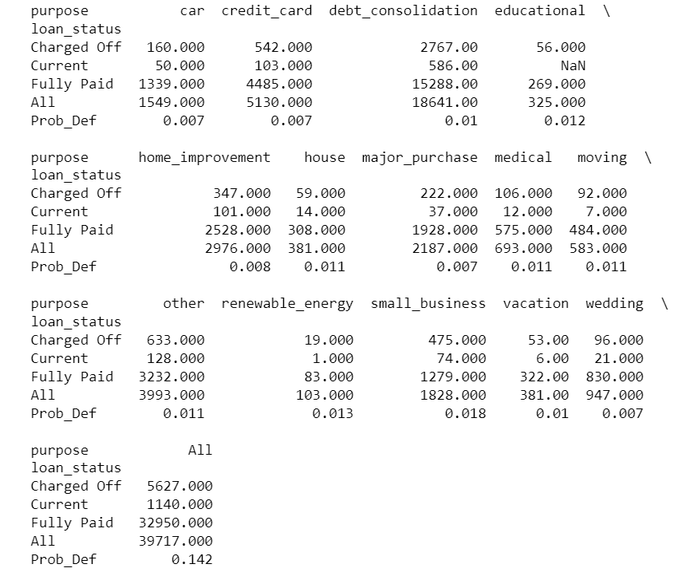
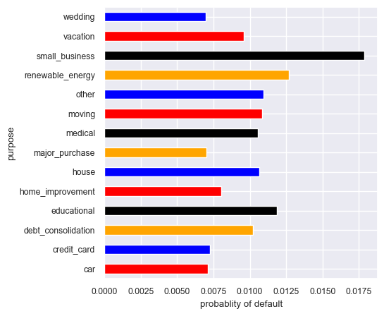
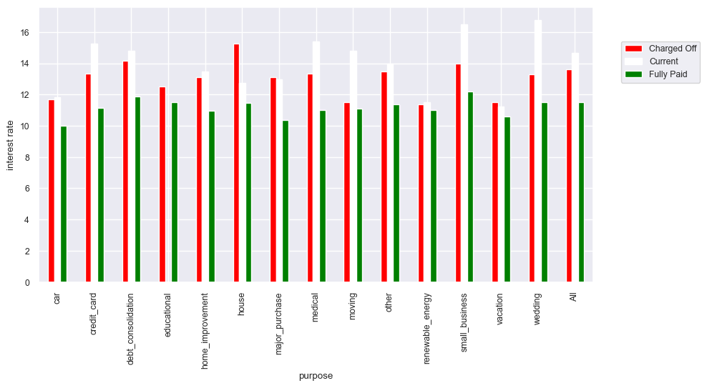
Purpose of Loan
Loan taken for purposes of "small business" , "renewal energy" , "education" seems to have higher default tendency compared to rest of the purposes.
It is also seen that interest rates for "small business", "wedding" ,"medical", "credit card" etc have >14% median interest rates.
Reduction of interest rates for "small business" may help in reducing the tendency to default. This may also increase the amount of applicants towards the "small business"
Since the loan taken for "renewable energy" purpose is lower and tendency of default is higher, the interest rates can be increased further to reduce the applicants for this purpose

Slide 12
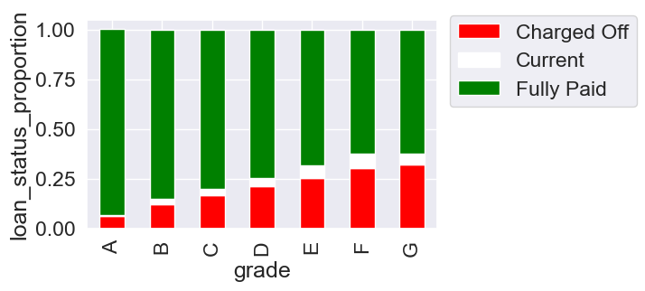
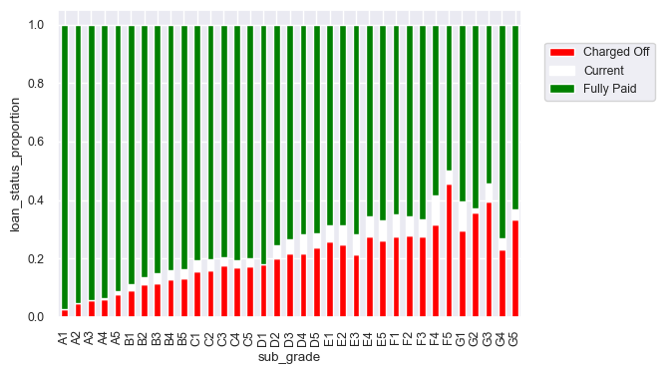
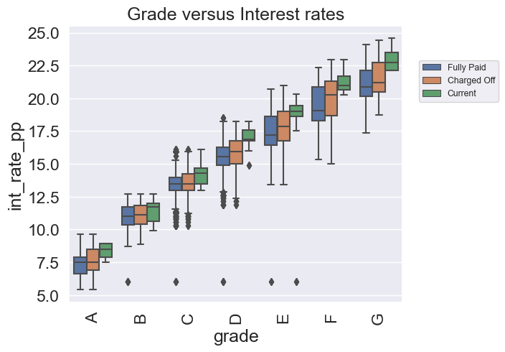
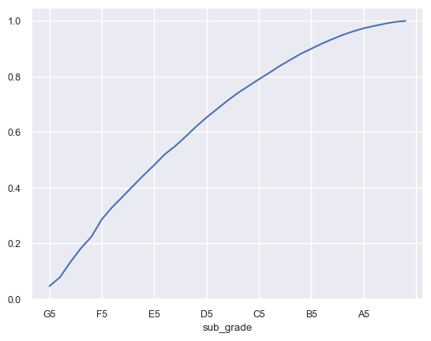
Grades and Sub-grades
There is a significant trend seen in the LC graded for the borrower and borrowers tendency to default.
Higher grade borrowers are less likely to default compared to lower grade borrowers (where grade 'A' is higher than 'B' is higher than 'C' and so on)
Higher sub-grade borrowers are less likely to default compared to lower grade borrowers (where grade 'A1'>'A2'>'A3'...'B1'>'B2'.......'G4'>'G5' and so on)
The borrowers with sub-grades 'B4' to 'G5' have are 90% likely to default compared to borrowers between 'A1' to 'B3'.
The median interest rates seem to increase according to the borrowers grade.

Slide 13
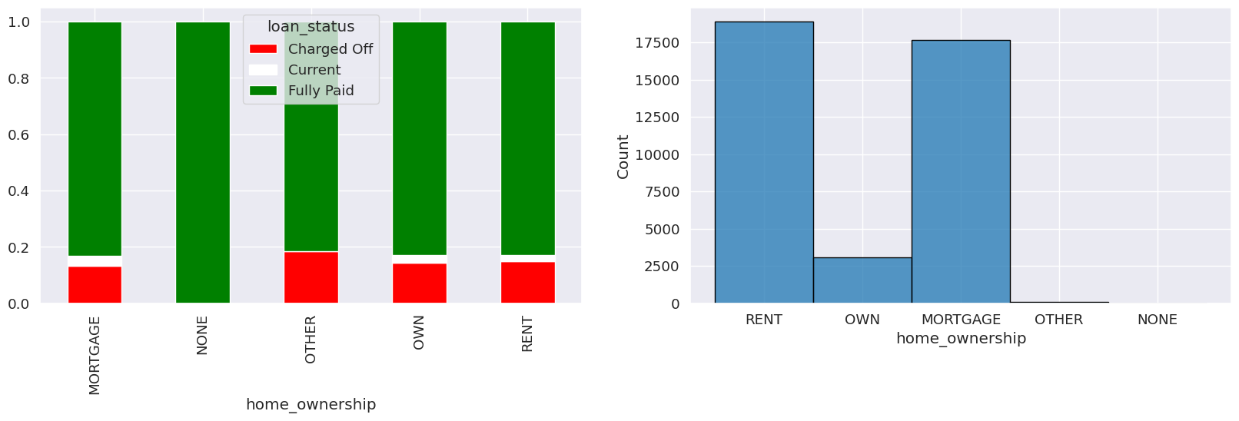
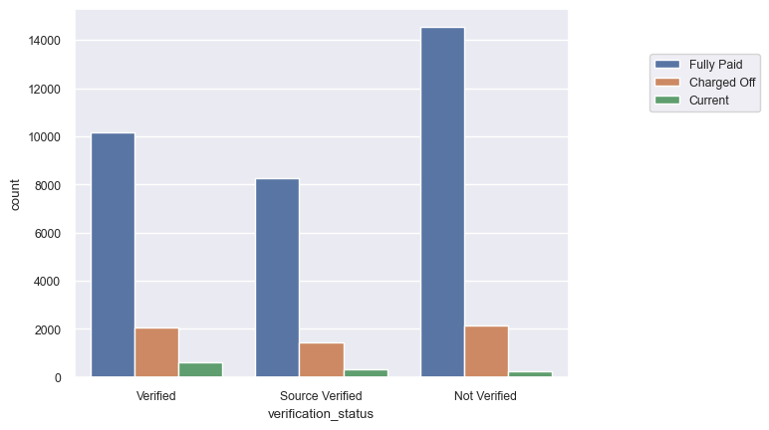
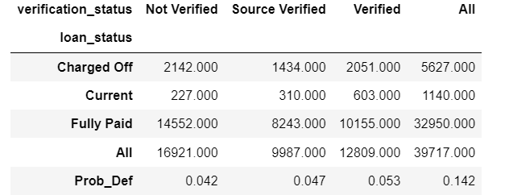
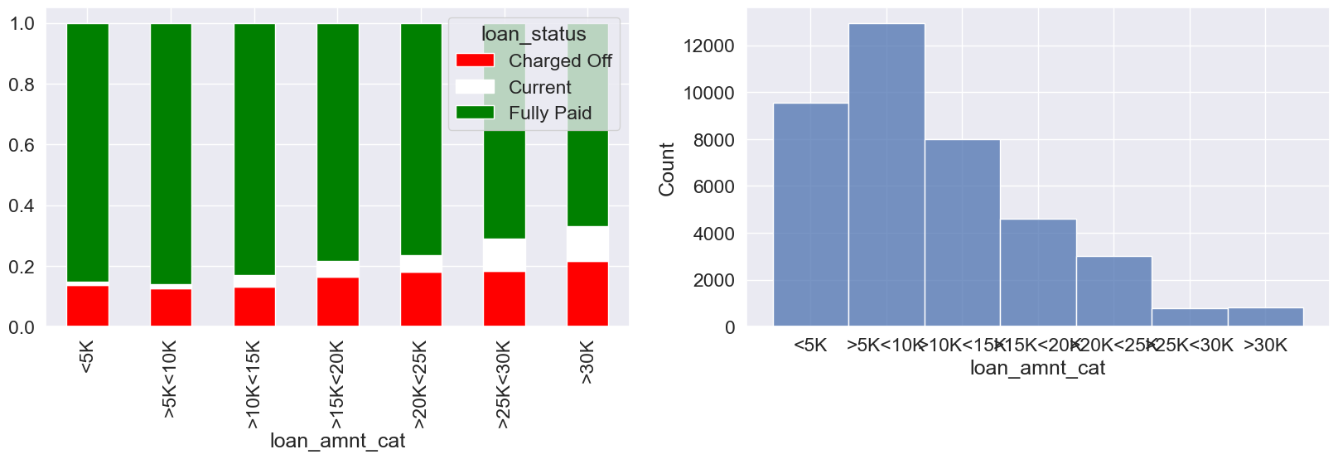
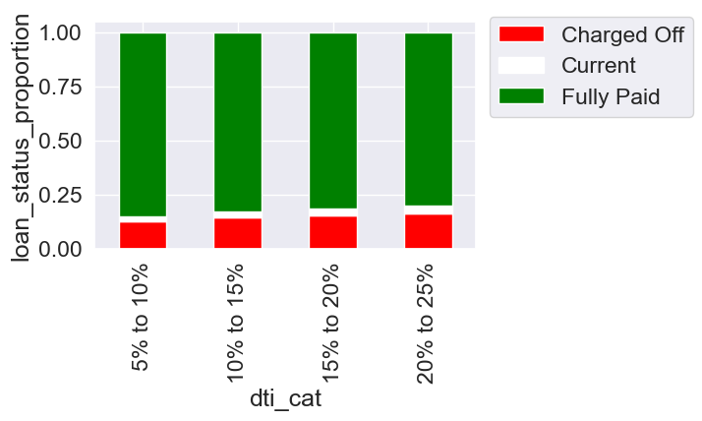
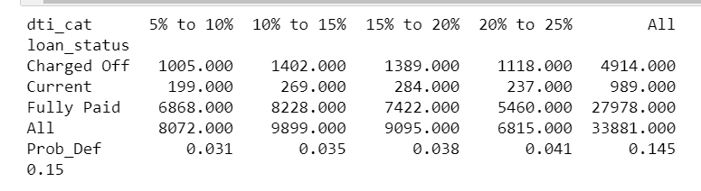
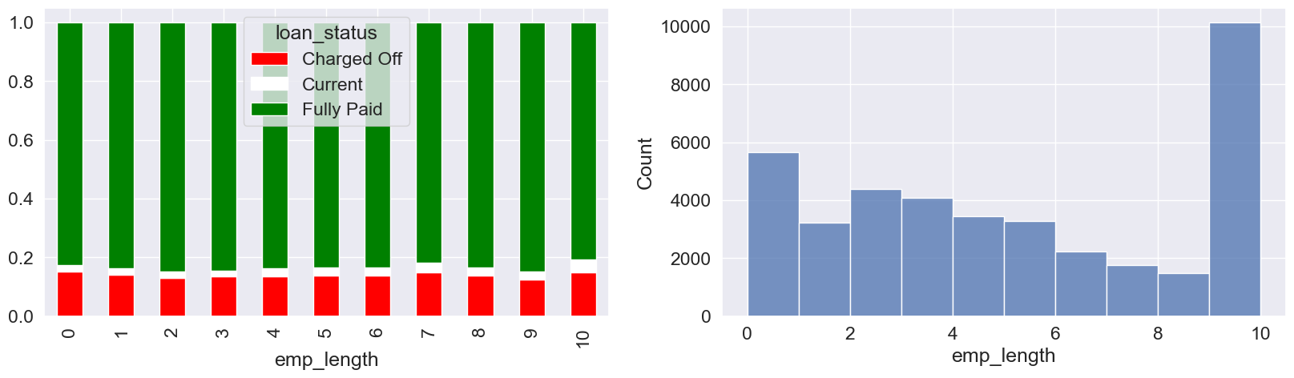
Weak trend variables
The variables like verification status , dti , empl_length, home ownership and loan_amnt are showing no trends or rather weak trend or dependency towards the borrowers tendency to default.

Slide 14
Conclusion :Driving Variables
It can be seen that the variables like ‘grades’,’sub_grades’,’annual_inc’,’interest rates’,’purpose’ seem to have influence the borrowers tendency to default. These variables can considered as the major driving variables for the ML model for the optimized lending strategy.
The variables like verification status , dti , empl_length and home ownership are showing no or little bearing on borrowers tendency to default.
Apart from the above variables additional general behavioural variables like 'delinq_2yrs','earliest_cr_line','inq_last_6mths', 'mths_since_last_delinq' 'mths_since_last_record','open_acc’ etc. are also analysed for curiosity and the insights are covered in the Jupiter notebook.

