Slide 1
Project Title: Breast Cancer Detection
Predict whether the cancer is Benign or Malignant: Supervised- Classification Task
Presented By: Sarika Shrivastava
sarika.s100@gmail.com

Slide 2

1. Breast cancer is the second leading cause of cancer death in women. (Only lung cancer kills more women each year.)
2. The chance that a woman will die from breast cancer is about 1 in 39 (about 2.5%).
3. In recent years, incidence rates have increased by 0.5% per year.
4. Breast cancer is the most common cancer in women in the United States, except for skin cancers.
5. It is about 30% (or 1 in 3) of all new female cancers each year.
6. Early detection and awareness are the key factors in increasing survival rate.
7. To enhance and implement understanding of topics covered in this course

Slide 3
Checklist for Machine Learning Projects
Frame the problem and look at the big picture
Get the data
Explore the data to gain insights
Prepare the data for Machine Learning algorithms
Explore many different models and short-list the best ones
Fine-tune model
Present the solution
Launch, monitor, and maintain the system

Slide 4
Problem Statement:
Predict whether the cancer is Benign (B) or Malignant(M)
Type: Supervised- Binary Classification Task
Performance Measures: Accuracy, F1 Score, Precision, Recall
Github : https://github.com/sshrivastava100/DSProject

Slide 5
Wisconsin Diagnostic Breast Cancer (WDBC) Dataset:
***************************************
Features are computed from a digitized image of a fine needle aspirate (FNA) of a breast mass. They describe characteristics of the cell nuclei present in the image. A few of the images can be found at: http://www.cs.wisc.edu/~street/images/
This database is also available through the UW CS ftp server: ftp ftp.cs.wisc.edu
cd math-prog/cpo-dataset/machine-learn/WDBC/
It can also be found on UCI Machine Learning Repository: https://archive.ics.uci.edu/ml/datasets/Breast+Cancer+Wisconsin+%28Diagnostic%29
****************************************
Number of instances: 569
Number of attributes: 32 (ID, diagnosis, 30 real-valued input features)
All feature values are recoded with four significant digits.
Missing attribute values: none
Class distribution: 357 benign, 212 malignant

Slide 6
Wisconsin Diagnostic Breast Cancer (WDBC) Dataset:

Slide 7
Wisconsin Diagnostic Breast Cancer (WDBC) Dataset:
Attribute information
1) ID number
2) Diagnosis (M = malignant, B = benign)
3-32)
Ten real-valued features are computed for each cell nucleus:
a) radius (mean of distances from center to points on the perimeter)
b) texture (standard deviation of gray-scale values)
c) perimeter
d) area
e) smoothness (local variation in radius lengths)
f) compactness (perimeter^2 / area - 1.0)
g) concavity (severity of concave portions of the contour)
h) concave points (number of concave portions of the contour)
i) symmetry
j) fractal dimension ("coastline approximation" - 1)

Slide 8
Load Data
#Import Modules
Load Dataset
import numpy as np
import pandas as pd
import matplotlib.pyplot as plt
import seaborn as sns
import warnings
warnings.filterwarnings("ignore")
from sklearn.model_selection import train_test_split
from sklearn.preprocessing import StandardScaler
#import ML model modules
from sklearn.ensemble import RandomForestClassifier
from sklearn.ensemble import AdaBoostClassifier
from sklearn.neighbors import KNeighborsClassifier
from sklearn.model_selection import GridSearchCV
from sklearn.linear_model import SGDClassifier
from sklearn.svm import SVC
#import metric module
from sklearn.metrics import classification_report,ConfusionMatrixDisplay
df = pd.read_csv('project/breast_cancer_data.csv’)
# display first five rows
df.head()
#Data Cleaning: drop irrelevant columns
#We can drop column Unnamed: 32 as it contains no values 'NaN'
df.drop('Unnamed: 32', axis=1, inplace=True)
df.head()

Slide 9
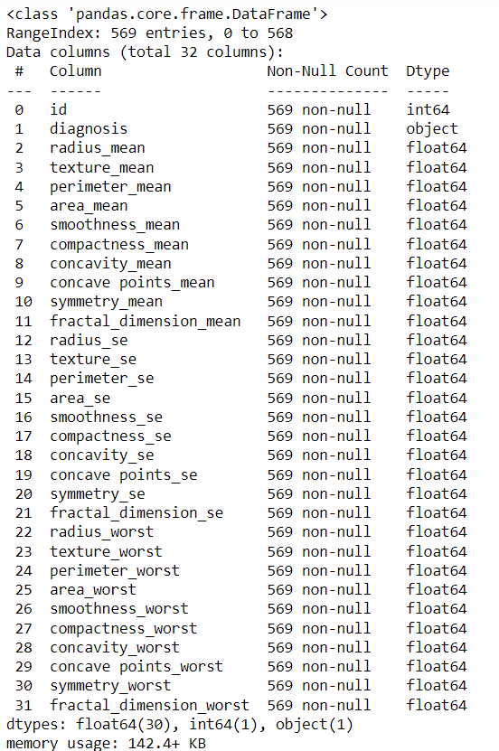
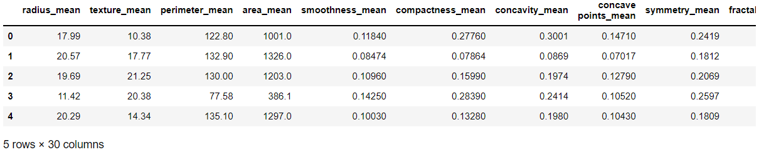
#dataframe information: df.info()
No Null Values in data so we do not need to fill null values
create X and y (# y includes our labels and X includes our features)
X = df.drop(['id','diagnosis'],axis=1)
y = df['diagnosis’]
Features
X.head()

Slide 10
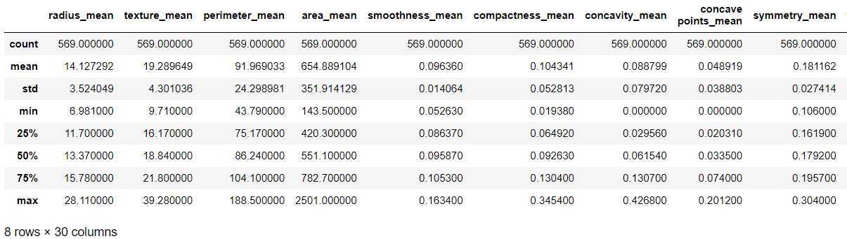
#Labels(y)
#Feature Info(X):
df['diagnosis'].value_counts() B 357
M 212
Name: diagnosis, dtype: int64
Find variance, standart deviation, number of sample (count) or max min values
X.describe()
Do we need Standardization / Normalization?
Yes, as Max values range between 0.16(smoothness_mean) to 2501(area_mean)

Slide 11
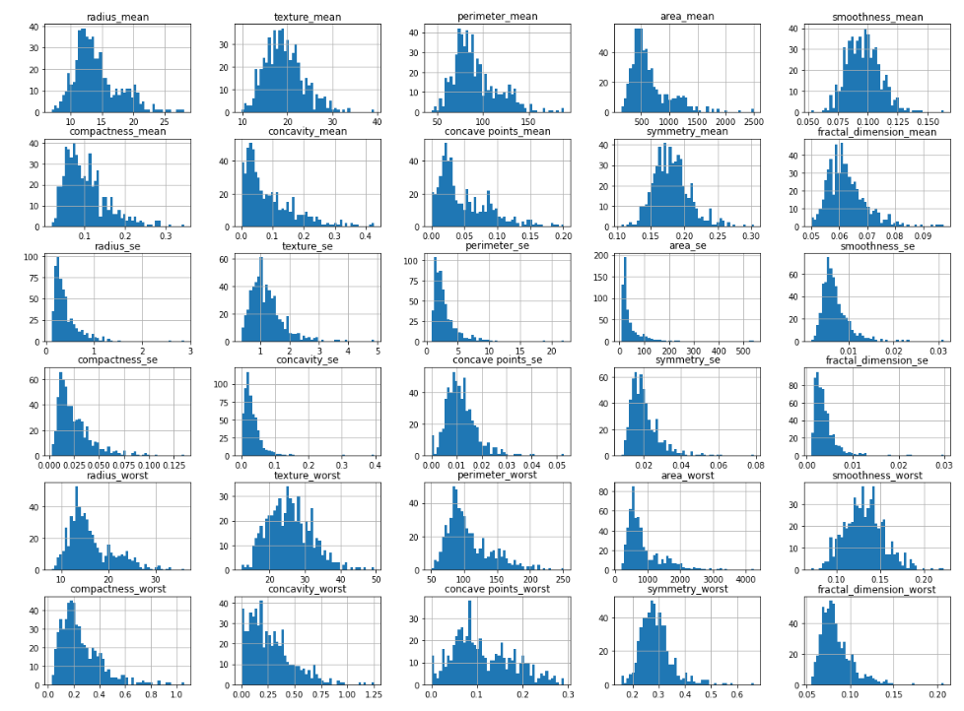
Explore the data to gain insights
Plot Histogram:
X.hist(bins=50, figsize=(20,15))
plt.show()

Slide 12
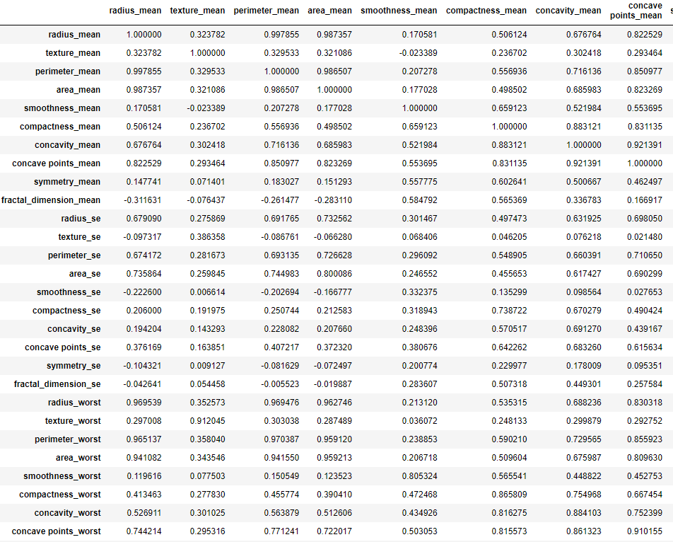
Explore the data to gain insights
View Co-relation:
X.corr()

Slide 13
Feature Selection
As it can be seen above radius_mean, perimeter_mean and area_mean are correlated with each other so we will use only area_mean. We can find other correlated features and look accuracy with random forest classifier.
Compactness_mean, concavity_mean and concave points_mean are correlated with each other.Therefore I only choose concavity_mean.
Apart from these, radius_se, perimeter_se and area_se are correlated and I only use area_se.
radius_worst, perimeter_worst and area_worst are correlated so I use area_worst.
Compactness_worst, concavity_worst and concave points_worst so I use concavity_worst.
Compactness_se, concavity_se and concave points_se so, I use concavity_se.
texture_mean and texture_worst are correlated, and I use texture_mean.
area_worst and area_mean are correlated, I use area_mean.
Visualize correlation with the scatter_matrix():
pd.plotting.scatter_matrix(X[['area_mean','concavity_mean','area_se','area_worst','concavity_worst','concavity_se','texture_mean']],figsize = (12,10))

Slide 14
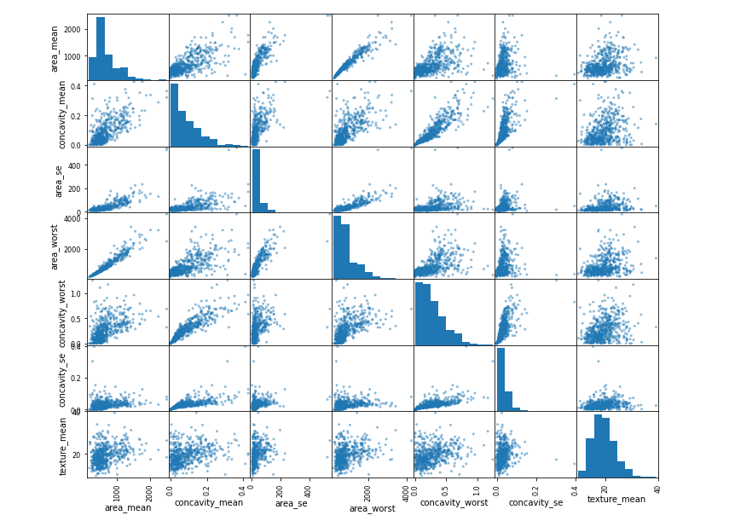
Visualize correlation with the scatter_matrix():

Slide 15
Test / Train Split
Split data in 80/20 ratio for training and testing:
from sklearn.model_selection import train_test_split
Xtrain, Xtest, ytrain, ytest = train_test_split(X, y, test_size=0.20, random_state=42)
print("After Test / Train Split:", Xtrain.shape, Xtest.shape,ytrain.size, ytest.size)
After Test / Train Split: (455, 30) (114, 30) 455 114
Prepare Data for ML Algorithms: scaling data
Since this is classification problem will be using Standardization (how many standard deviation value is away from mean)
from sklearn.preprocessing import StandardScaler
scaler = StandardScaler()
scaled_Xtrain = scaler.fit_transform(Xtrain)
scaled_Xtest = scaler.transform(Xtest)
X_mean = scaler.mean_
X_std = scaler.scale_

Slide 16
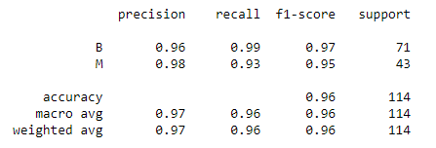
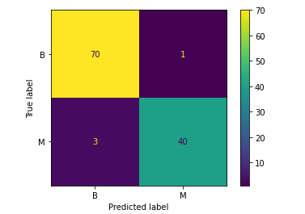
Random Forest Classifier
from sklearn.ensemble import RandomForestClassifier
# creating the parameter grid
n_estimators = [100, 200, 300]
max_features = [5 ,10, 15, 20]
bootstrap = [True, False]
oob_score = [True, False]
criterion = ['gini', 'entropy', 'log_loss']
param_grid = {'n_estimators':n_estimators,
'max_features':max_features,
'bootstrap':bootstrap,
'oob_score':oob_score,
'criterion':criterion}
# creating instances
rdfc = RandomForestClassifier(random_state=42)
grid = GridSearchCV(rdfc, param_grid)
# fit on model
grid.fit(scaled_Xtrain,ytrain)
# the best parameters
grid.best_params_
# y predictions
ypred = grid.predict(scaled_Xtest)
# Classification report ---> accuracy, f1 score, precision and recall
print(classification_report(ytest,ypred))
# Plotting Confusion matrix
ConfusionMatrixDisplay.from_estimator(grid,scaled_Xtest,ytest)

Slide 17
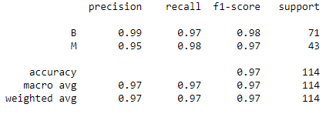
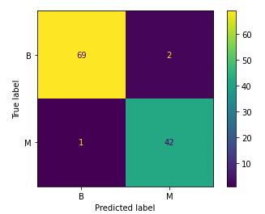
Stochastic Gradient Descent (SGD) Classification
from sklearn.linear_model import SGDClassifier
sgdc = SGDClassifier(max_iter=1000, tol=0.01)
print(sgdc)
sgdc.fit(scaled_Xtrain, ytrain)
score = sgdc.score(scaled_Xtrain, ytrain)
print("Training Score: ", score)
SGDClassifier(tol=0.01) Training Score: 0.967032967032967
ypred2 = sgdc.predict(scaled_Xtest)
# Classification report ---> accuracy, f1 score, precision and recall
cr = classification_report(ytest, ypred2)
print(cr)
# Plotting confusion matrix
ConfusionMatrixDisplay.from_estimator(grid,scaled_Xtest,ytest)

Slide 18
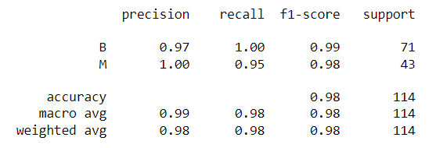
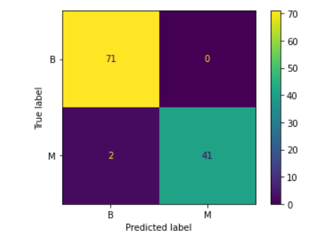
In [58]:
Linear SVC
# Classification report ----> accuracy, f1 score, precision and recall
print(classification_report(ytest,ypred3))
#from sklearn.svm import SVC
param_grid3 = {'C':[0.001, 0.01, 0.1, 1, 10],
'kernel':['linear','rbf']}
svm = SVC()
grid2 = GridSearchCV(svm, param_grid3)
grid2.fit(scaled_Xtrain,ytrain)
grid2.best_estimator_.get_params
grid2.best_score_
0.9758241758241759
ypred3 = grid2.predict(scaled_Xtest)
print(classification_report(ytest,ypred3))
# Plotting confusion matrix: ConfusionMatrixDisplay.from_estimator(grid2,scaled_Xtest,ytest)

Slide 19
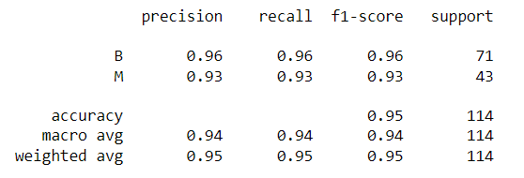
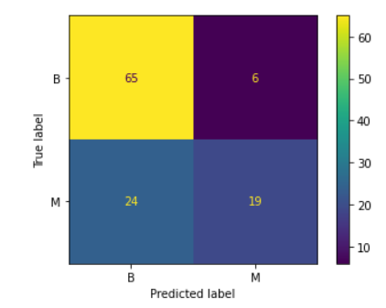
KNN Classifier
#from sklearn.neighbors import KNeighborsClassifier
k_values = list(range(1,20))
knn = KNeighborsClassifier()
operations = [('scaler',scaler),('knn',knn)]
param_grid2 = {'knn__n_neighbors': k_values}
# creating pipeline
from sklearn.pipeline import Pipeline
pipe = Pipeline(operations)
full_cv_classifier = GridSearchCV(pipe,param_grid2,cv=5,scoring='accuracy’)
full_cv_classifier.fit(Xtrain,ytrain)
full_cv_classifier.best_estimator_.get_params
#Final Model
knnc7 = KNeighborsClassifier(n_neighbors=7)
operations2 = [('scaler',scaler),('knn7',knnc7)]
pipe2 = Pipeline(operations2)
pipe2.fit(Xtrain,ytrain)
pipe_pred = pipe2.predict(Xtest)
# Classification report ---> accuracy, f1 score, precision and recall
print(classification_report(ytest,pipe_pred))
# Plotting confusion matrix:
ConfusionMatrixDisplay.from_estimator(pipe2,scaled_Xtest,ytest)

Slide 20
Model Selection
References:
Based on performance measures Linear SVC model seems to be performing better than all others!!
UCI Machine Learning Repository
CloudXLab
Scikit learn API
kaggle.com
Cancer.org

