Slide 1
Social Media Report
Notes:
Month at a glance
Web Stats – convert to 1 page
Social Results – convert to 1 page
Add page for TashRizzo: Omnichannel
Add Page for SUAS Linkedin Discussion

Slide 2




Top Posts for June 2021 LinkedIn
555
Impressions
21
Clicks
7
Reactions
6.67%
Engagement
539
Impressions
16
Clicks
5
Reactions
5.19%
Engagement
514
Impressions
30
Clicks
4
Reactions
8.17%
Engagement

Slide 3




Top Posts for June 2021 Facebook
2.1K
People Reached
2
Clicks
72
Engagement
1.7K
People Reached
4
Clicks
72
Engagement
1.5K
People Reached
6
Clicks
63
Engagement

Slide 4
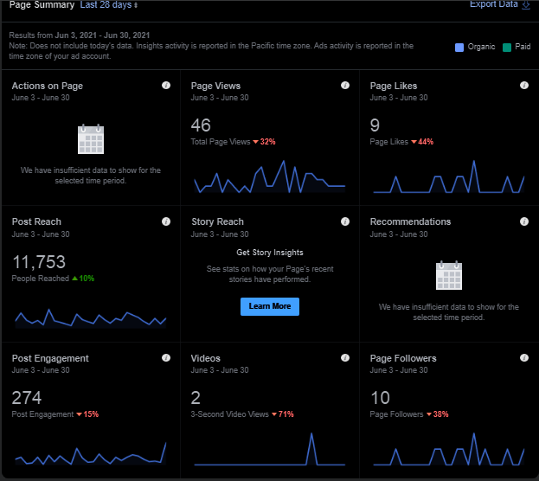
Facebook page insights

Slide 5

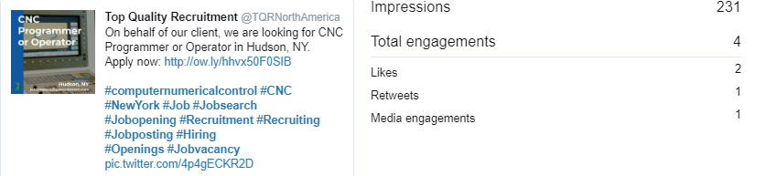
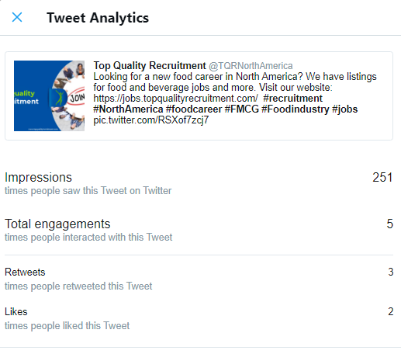
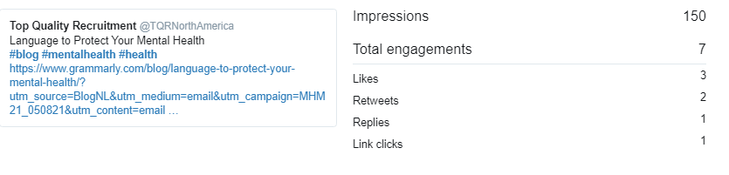
Top Posts for June 2021 Twitter

Slide 6
