Slide 1

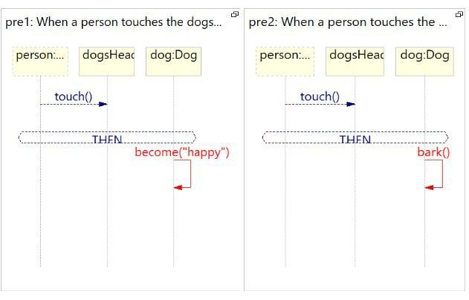
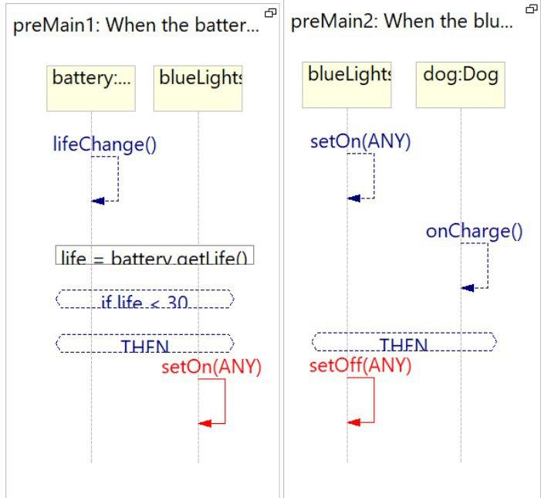
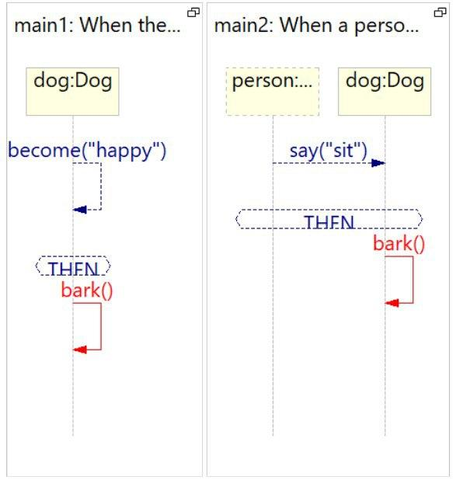
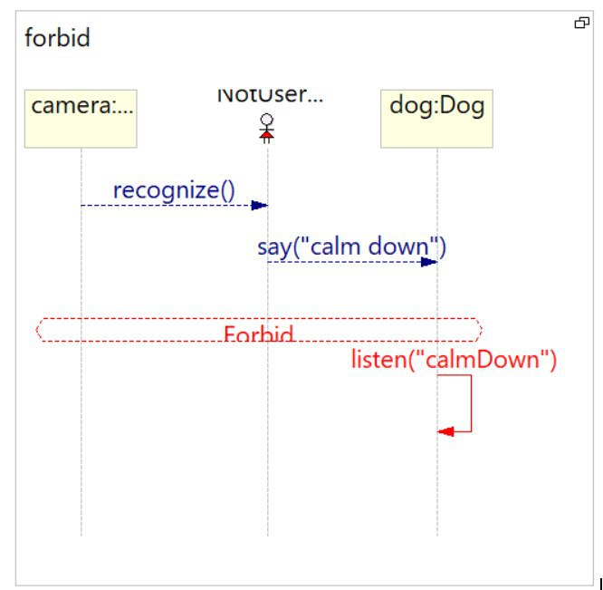
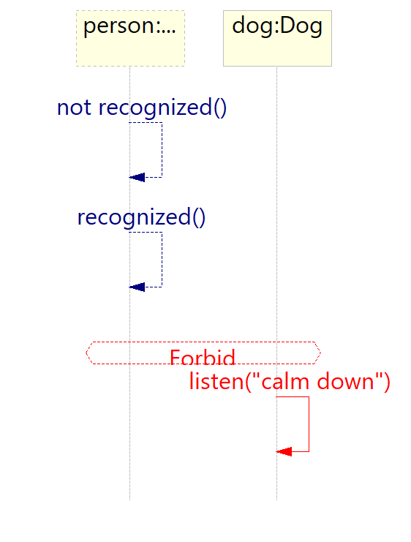
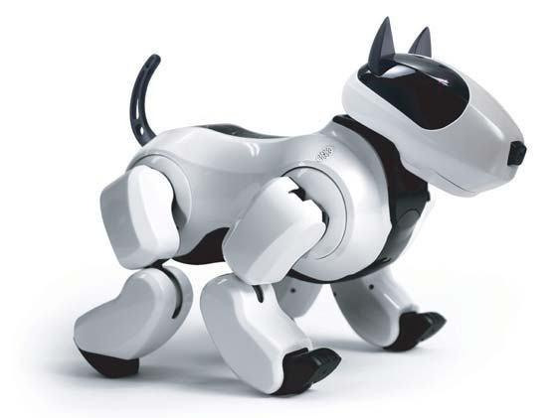
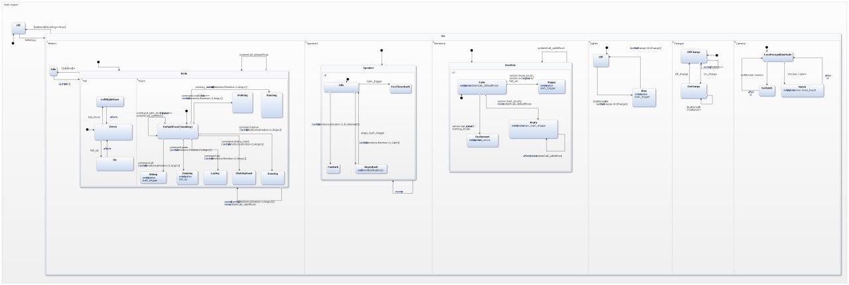

קורס תכנות ויזואלי למערכות ריאקטיביות
Robot Dog Genibo
סבטה שטרך שובל אברהם, מדעי מחשב
סמסטר ב', תש"פ
ד"ר מיכל גורדון
Project Description
LSC
Robot puppy is for people that have no time for walking dogs. Genibo uses a nose-mounted camera and onboard software to recognize its owner's face, and will happily greet and follow him or her around the house. Also it is capable of responding to touches, tricks like jumping, dancing etc. It also could express variety of feelings: happiness, excitement, anger, calmness depends on the situation.
The users interacts with Genibo with voice commands and dog’s body sensors. Every time the dog hear a voice command like sit, jump, dance etc, it should implement the command.
Every time user touches dog’s particular sensor then follows set of reactions that usually includes some body movements or some kind of barking or both.
When the battery is low, the blue colored lights are visible in the robot's eyes.
The robot growls when its back is touched and becomes angry.
The robot responds to voice commands like sit, stand, walk etc. and execute it (moves its paws, tail etc.).
When the camera on the robot's nose recognize its owner, the robot barks and moves its tail(to show happiness).
The system consists of six main states that are motion, speaker, emotions, lights,
camera, charger. They are all active
together inside state On(while state On
is active) and represent concepts like orthogonality, hierarchy, broadcasting and guards.
LSC
LSC diagrams were made using PlayGo. There are 7 diagrams in total. In order to demonstrate general LSC concepts there are 3 kinds of unification and 1 forbidden scenario.
Why it’s reactive?
Statecharts
Summary
This course gave us a new perspective on programming, as well as provided with tools and concepts for creating LSC and statechart diagrams for reactive systems. We believe it’s important principles to know in order to design systems better, i.e. consider
different possible
scenarios.
Find all additional information about the project on GitHub->

