Slide 1



Slide 2
Liberating Programming: System Development for Everyone

Slide 3
Students details
Sveta Shtrakh, id 336136312
Shoval Avraham, id 313262362
Advisor: Dr. Michal Gordon
Visual Programming and Reactive Systems Final Project
Notes:
4.1.3

Slide 4
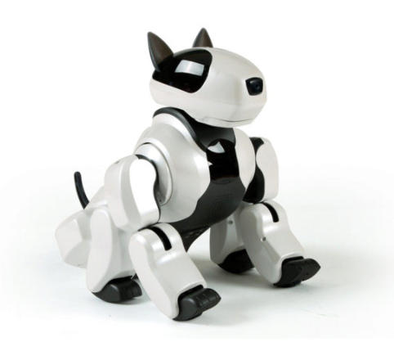
Robot dog (Genibo)
Robot puppy is for people that have no time for walking dogs. Genibo uses a nose-mounted camera and onboard software to recognize its owner's face, and will happily greet and follow him or her around the house. Also it is capable of responding to touches, tricks like jumping, dancing etc. It also could expresse variety of feelings: happiness, excitement, anger, calmness depends on situation.
Notes:
4.1.3

Slide 5
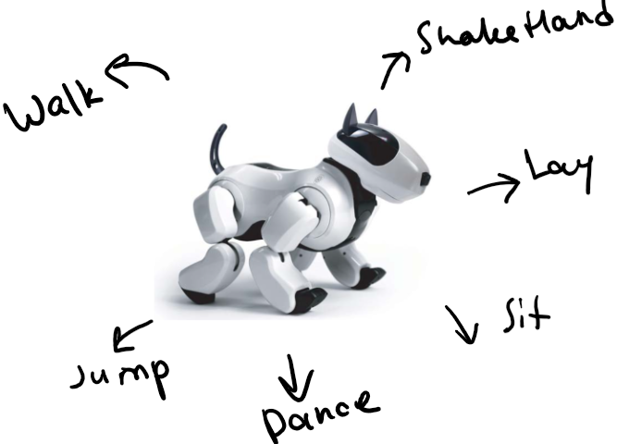
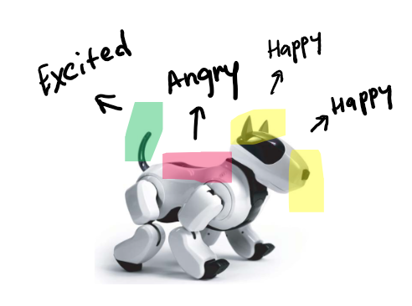
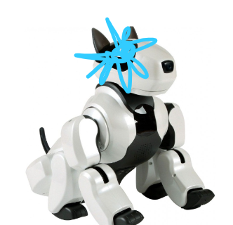
Inputs and Outputs
The users interacts with Genibo with voice commands and dog’s body sensors. Every time the dog hear a voice command like sit, jump, dance etc, it should implement the command.
Every time user touches dog’s particular sensor then follows set of reactions that usually includes some body movements or some kind of barking or both.

Slide 6
Why it’s reactive?
When the battery is low, the blue colored lights are visible in the robot's eyes.
The robot growls when its back is touched and becomes angry.
The robot responds to voice commands like sit, stand, walk etc. and execute it (moves its paws, tail etc.).
When the camera on the robot's nose recognize its owner, the robot barks and moves its tail(to show happiness).
Notes:
4.1.3

Slide 7
Statecharts
Notes:
4.1.3

Slide 8
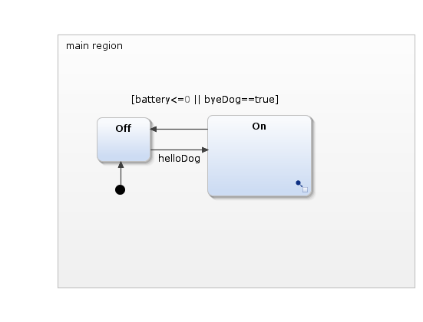
Main
Notes:
שאלה, דוגמת השעון:
Type: Multiple choice, 1 attempt
Q: When the screen is off and B is pressed, what state does the system transition into?
Possible Answers
Display Time
Display Date
Display Calendar
Screen On
Answer: Display Calendar, there is a transition directly from screen off to display calender with the event B pressed

Slide 9
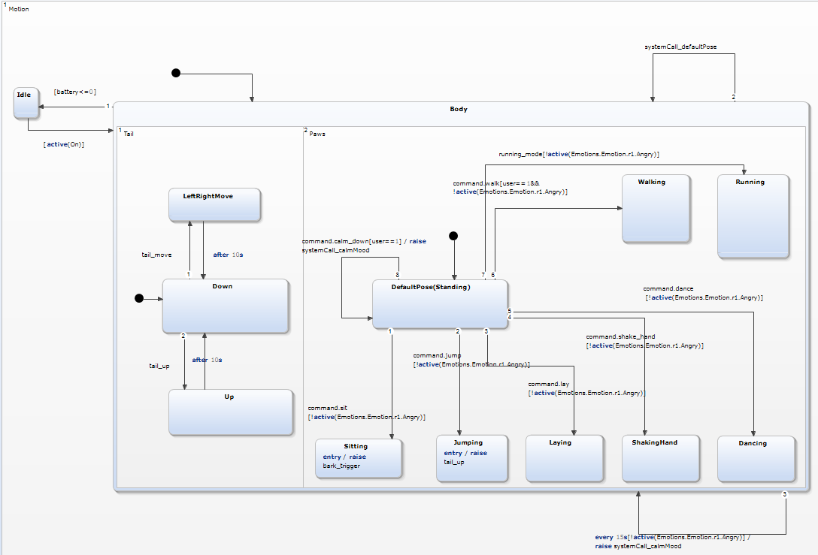
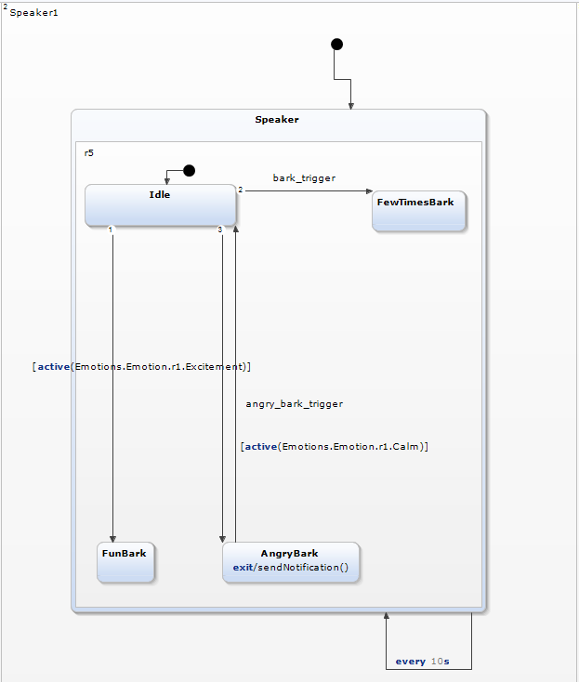
State On Part 1
Notes:
שאלה, דוגמת השעון:
Type: Multiple choice, 1 attempt
Q: When the screen is off and B is pressed, what state does the system transition into?
Possible Answers
Display Time
Display Date
Display Calendar
Screen On
Answer: Display Calendar, there is a transition directly from screen off to display calender with the event B pressed

Slide 10
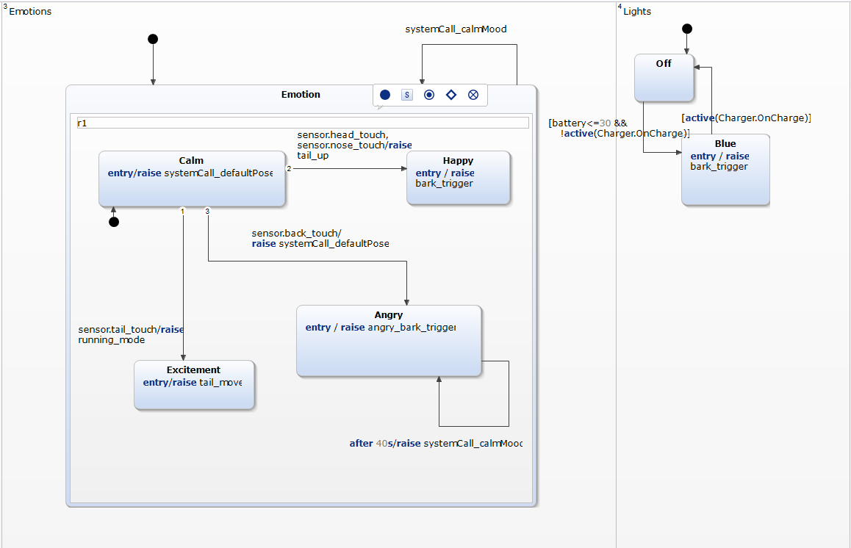
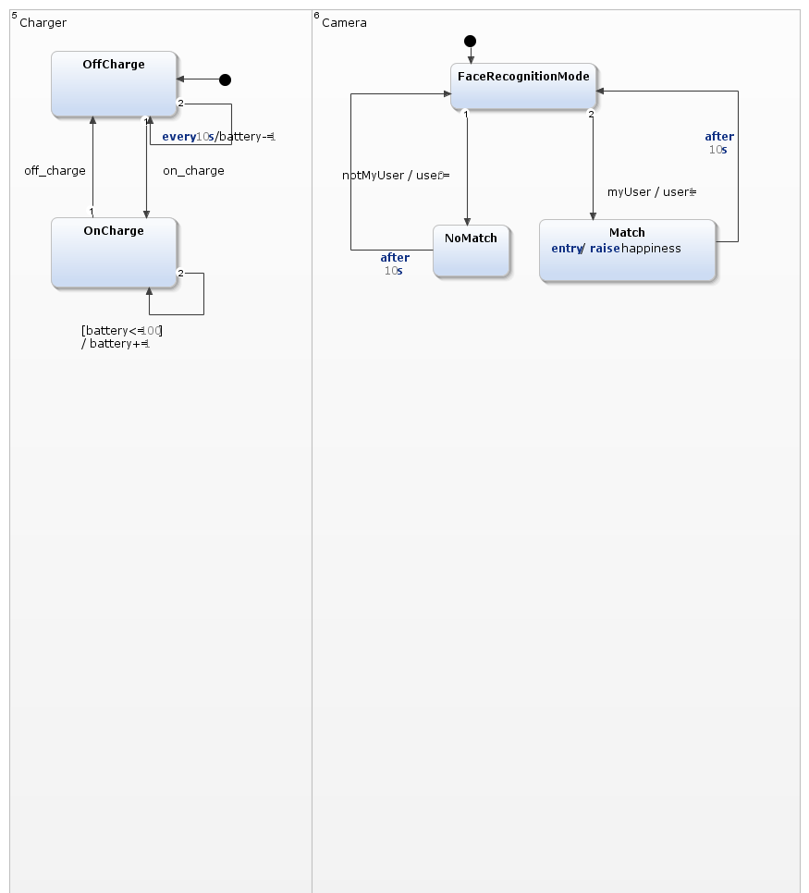
State On Part 2
Notes:
שאלה, דוגמת השעון:
Type: Multiple choice, 1 attempt
Q: When the screen is off and B is pressed, what state does the system transition into?
Possible Answers
Display Time
Display Date
Display Calendar
Screen On
Answer: Display Calendar, there is a transition directly from screen off to display calender with the event B pressed

Slide 11
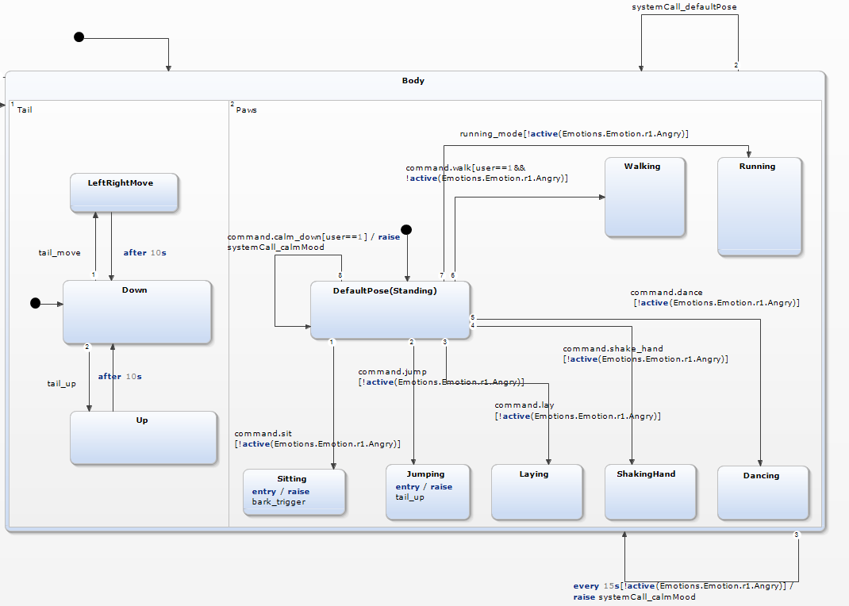
State Body
Notes:
שאלה, דוגמת השעון:
Type: Multiple choice, 1 attempt
Q: When the screen is off and B is pressed, what state does the system transition into?
Possible Answers
Display Time
Display Date
Display Calendar
Screen On
Answer: Display Calendar, there is a transition directly from screen off to display calender with the event B pressed

Slide 12
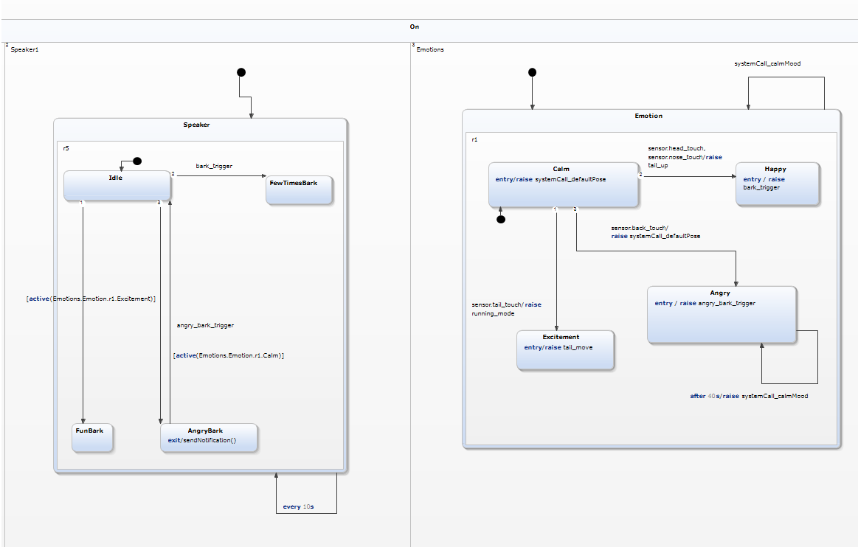
Hierarchy
Here we see the hierarchy. State “On” is composed of two states, that are “Speaker” and “Emotions”(that states are also composite i.e. contain another states inside).
Notes:
שאלה, דוגמת השעון:
Type: Multiple choice, 1 attempt
Q: When the screen is off and F is pressed, what state does the system transition into?
Possible Answers
Display Time
Display Date
Display Calendar
Screen On
Answer: Display Time, there is a transition from screen off to screen on with the event “F pressed”. The start state inside screen on is display time

Slide 13
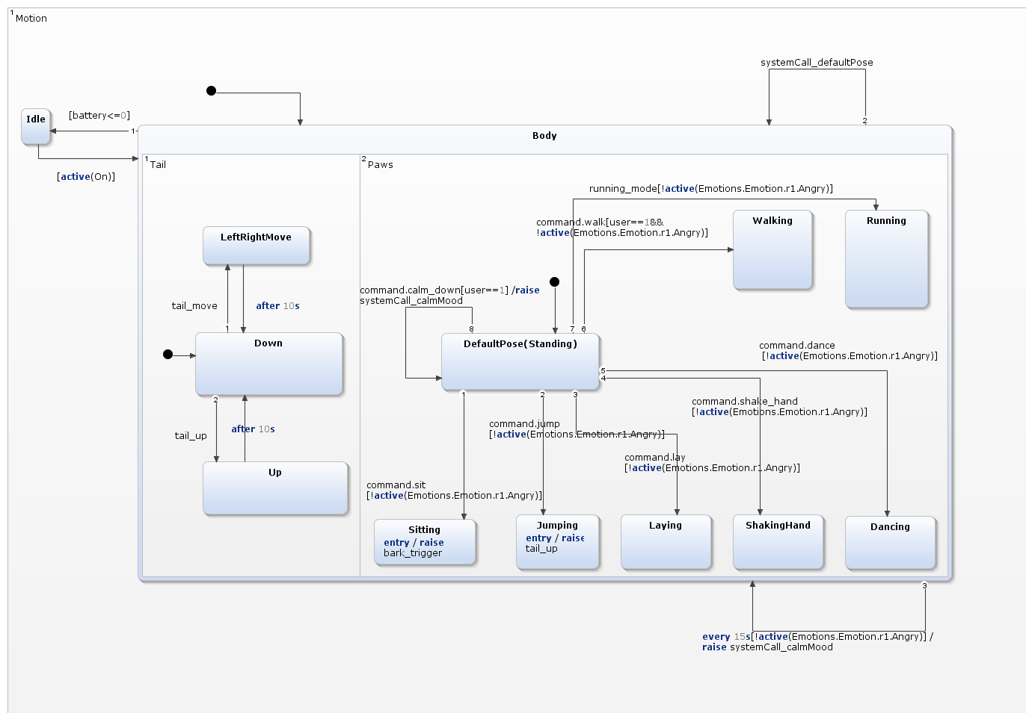
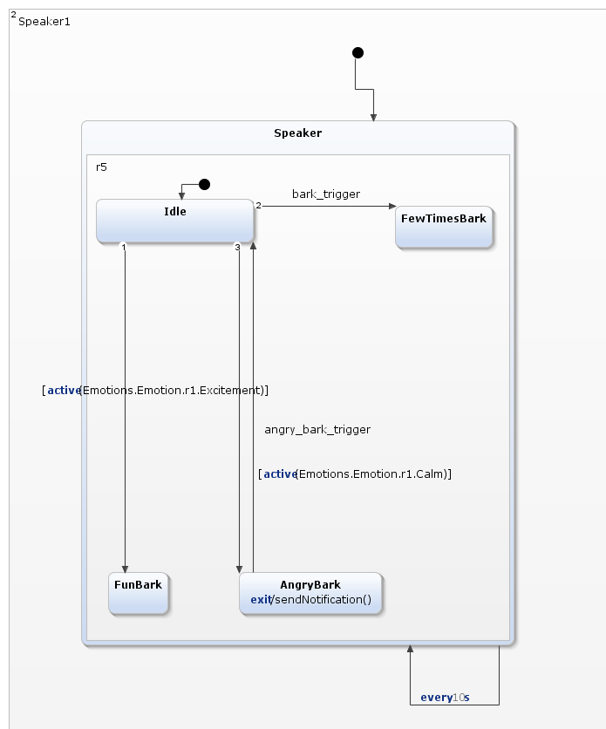
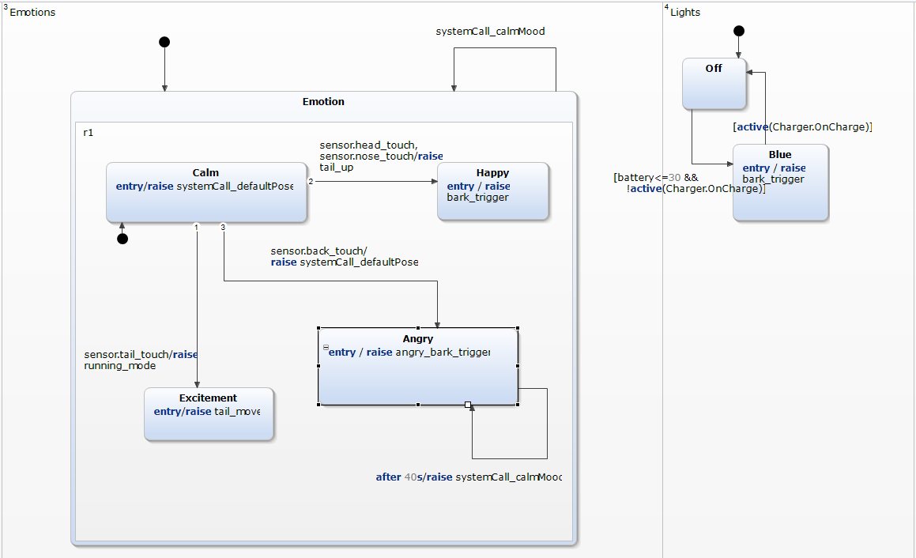
Orthogonality
“Motion”, “Speaker”, “Emotions”, “Lights”, “Charger” and “Camera” are orthogonality regions. The dog be happy and barks at the same time.
Notes:
Noa – let’s add in video question only on light. High 3 seconds no swipe weak signal, charging, 3 seconds, swipe left.
Gal- Needs animation
Q: Let’s look only on light: Current state is high. If there were no swipes for three seconds- mark the next state
A: Medium
Q: What would be the next state, if there is a weak signal?
A: Low
Q: The watch is now charging. What would be the next state?
A:High
Q: Again, there were no swipes for 3 seconds, and then the user swiped left. What are the states he passed?
A: Medium, High

Slide 14
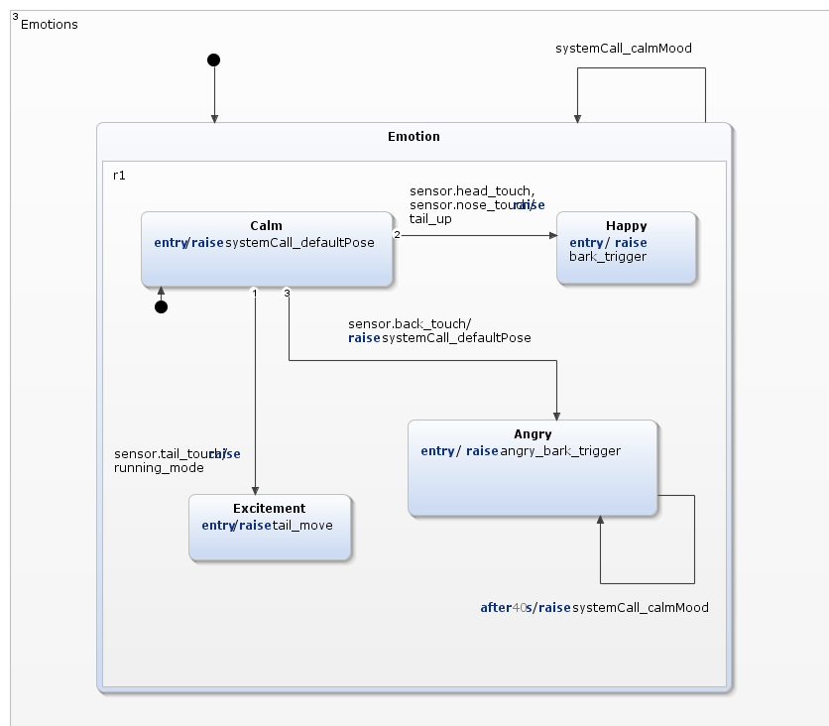
Broadcasting
Mood state switch (from “Calm” to another) triggers dog to bark and also to move its tail. Also every 40 seconds system returns the dog
to default mood i.e. “Calm”.
Notes:
Q: is there anything broadcast in this diagram?
Lower music from Lullaby Volume to Normal Volume
lower music from sleeping to awake.
Sensor waking up from sleeping to awake
Lower music from Normal Volume to Lullaby Volume
Question – What will happen when the music is in normal volume, the baby is awake and the sensor sends a sleeping signal(sensor sleeping event)?
Options (or can be check boxes to make it harder)
1 – Nothing
2 – Baby monitor will change to sleeping
3 – Music on will change to off
4 – Normal volume will change to off
Answer – 2

Slide 15
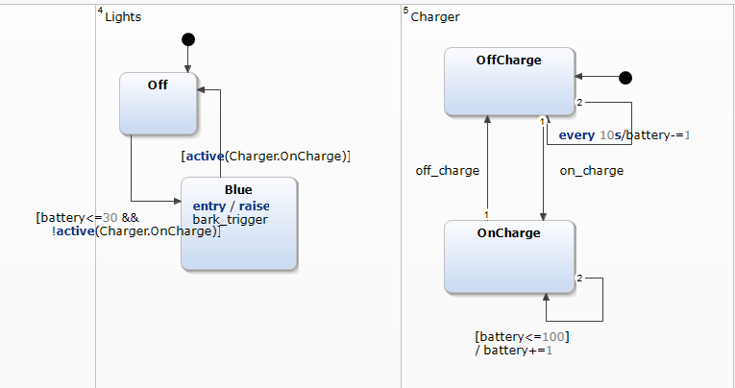
Guards
Regions “Lights” and “Charger” are based on guards. In both regions there is a battery power
checking. Also if state “OnCharge” is active the blue lights turn off.
Notes:
רצף שאלות אמריקאיות על התרשים
Q: What states will the system change to when the event “sensor sleeping” arrives from the marked states (Normal Volume and Awake)?
Lullaby Volume and Sleeping
Normal Volume and Sleeping
Off and Sleeping
Nothing will happen
Answer: off and sleeping
Q: What states will the system change to when the event “sensor sleeping” arrives from the marked states (Lullaby Volume and Awake)?
Lullaby Volume and Sleeping
Normal Volume and Sleeping
Off and Sleeping
Nothing will happen
Answer: off and sleeping
Q: What states will the system change to when the event “sensor waking up” arrives from the marked states (Off and Sleeping)?
Lullaby Volume and Awake
Normal Volume Awake
Off and Awake
Nothing will happen
Answer: off and Awake
Q: What states will the system change to when the event “sensor waking up” arrives from the marked states (Normal Volume Volume and Sleeping)?
Lullaby Volume and Awake
Normal Volume Awake
Off and Awake
Nothing will happen
Answer: Volume and Awake

Slide 16
LSCs
Notes:
4.2.1

Slide 17
Requirements for LCS:
When a person touches the dog's head then the dog become happy. (same as statecharts)
When a person touches the dog’s head then the dog barks. (same as statecharts)
When the battery is under 30 presents then the blue lights turn on. (same as statecharts)
When the blue lights turn on and the dog is on charge then the blue lights turn off. (same as statecharts)
When the dog becomes happy then the dog barks. (same as statecharts)
When a person says “sit” then the dog barks. (same as statecharts)
Notes:
4.2.1

Slide 18
Requirements for LCS:
7. When the camera recognizes that it’s not the user, and the person who is not the user say “calm down” then should forbid to listen the voice command “calm down” during some period of time. (same as statecharts)
8. When a person says “jump” then the dog jump, and his tail goes up. (same as statecharts)
9. When a person touches the dog’s tail then the dog becomes excited, and his tail moves. (same as statecharts)
10. When a person raises the dog then the dog becomes angry, and the dog barks.

Slide 19
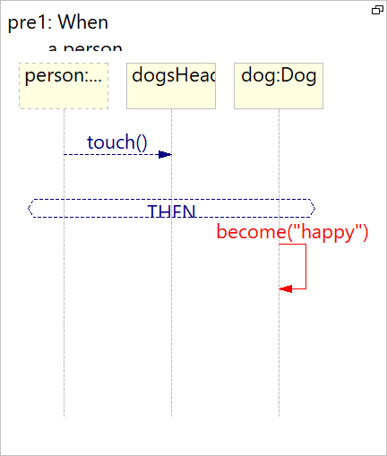
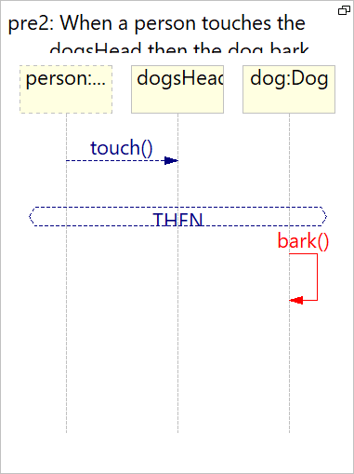
LCS 1&2: Unification 1
When a person touches the dog's head then the dog become happy.
When a person touches the dog’s head then the dog barks.
Notes:
4.2.1

Slide 20
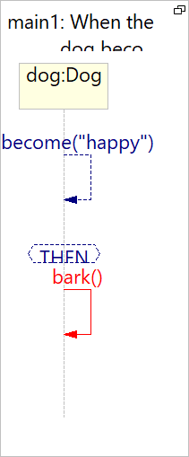
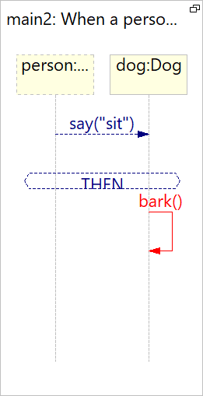
LCS 3&4: Unification 2
3. When the battery is under 30 presents then the blue lights turn on.
4. When the blue lights turn on and the dog is on charge then the blue lights turn off.
Notes:
4.2.1

Slide 21
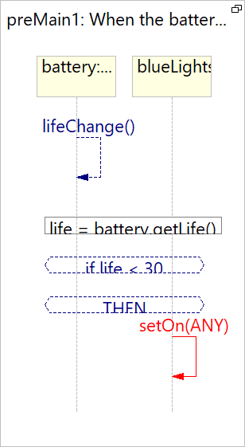
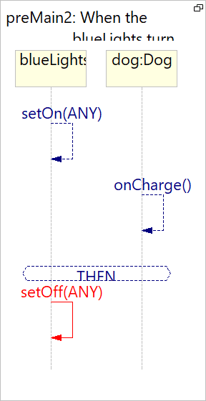
LCS 5&6: Unification 3
5. When the dog becomes happy then the dog barks.
6. When a person says “sit” then the dog barks.
Notes:
4.2.1

Slide 22
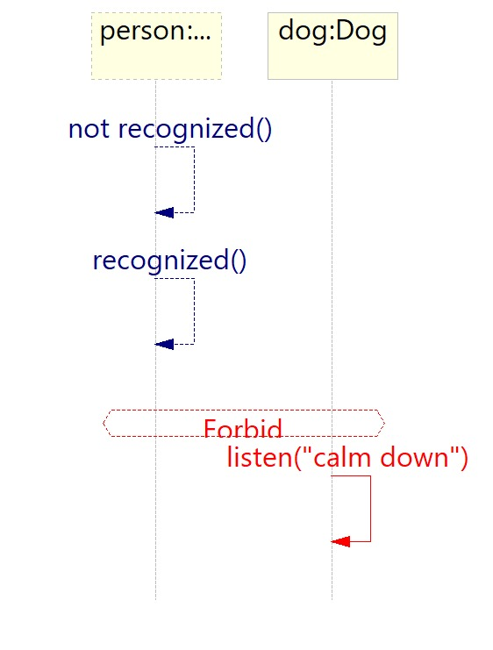
LCS 7: Forbidden Scenario
7. When the camera recognizes that it’s not the user, and the person who is not the user say “calm down” then should forbid to listen the voice command “calm down”.
Notes:
4.2.1

Slide 23
Course reflection-Sveta:
I found this course interesting and flexible. First, the content was new for me as well as tools: Yakindu and PlayGo. The insight into the concepts of LSCs and statecharts gave me new perspective on programming and system design. Plus, It’s convenient to study from home in your own personal temp and that made my student routine easier. My main part
was statecharts and there is a challenge to find yakindu examples that really demonstrate
different code variations (in yakindu documentation examples are too easy, and could help only at the begging of work). Second challenge is forbidden scenarios. Me and Shoval always helped each other out, tested our diagrams together, and shared thoughts about the project.
Course reflection-Shoval:
This course provides programmers with useful tools for system development. It makes you think about different possible scenarios and ways to manage them right. I really liked learning from the website and the videos were short and clear, the exercises helped to understand. We worked together and made sketch before working on the software. My main part was the LSC, and of course we helped each other out.
The only difficulty I encountered was with the forbid.
Notes:
4.2.1

Slide 24
Thank you!

