Slide 1
Predicting a Good or Bad Decision
And why both are valuable
Notes:
Welcome everyone, thank you for coming in today.
My name is Sage Huseas, I am a data scientist and have been working with large scale financial data since July 2017
I earned a Bachelor of Science in Physics and have long been interested in the application of probability as it relates to systemic patterns in human behavior .
I was given the opportunity to apply what I’ve learned over the past few months in a context where a good or bad decision has significant ramifications.
Specifically, my project focuses on the decisions certain hedge fund managers made at any given time, and how profitable those trades faired.

Slide 2
The Idea
Conventional Approach – ML to predict the stock market
Notes:
Within a financial context, the orthodox approach sought to answer “How can we use ML to predict the stock market?”
As it stands, several methods include using recursive neural networks to model and predict stock prices using historical stock data
This approach is relatively straightforward, and the data is widely available online.

Slide 3
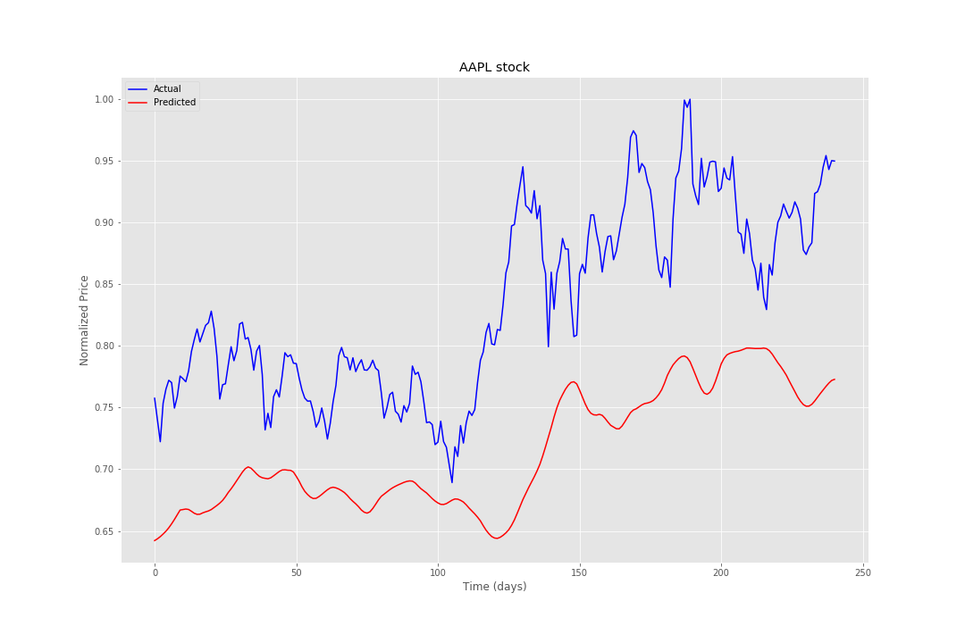
Notes:
SHOW VISUALIZATION
This is a model of predicted stock prices using a type of nn called Long-Short-Term-Memory
The model was trained using 1000 days of historical stock prices of Apple from 2007 to 2011
As one can see, there are two noticeable trends happening.
From a ML perspective, the model did a fairly good job at predicting stock prices
The overall trend follows the actual trend of the stock price.
This begs the question, “Can a machine built using publicly available data outperform a hedge fund manager?”
Not quite.
There is noticeable lag between the predicted and actual stock price – that means as the actual stock prices change, especially drastically, it takes the model several DAYS to catch up
Such a significant lag would lead to a massive loss of money.
If I were to use this predicted model to make financial decision(which I will refer to now as a position), I would lose approximately 30%
The BETTER question is, “How do we use ML to predict human behavior within a financial context? Do people make predictable reactions to the stock market, and how do we use THAT to make business decisions?”
ANALOGY: I’m not a very good black jack player, but I have some friends that are really quite good. If I was watching my friends play against the house in Vegas,
And I knew their patterns and behaviors so well, that I could predict whether or not they’d make good or bad bets, I could use that information for my own benefit.
I wouldn’t be playing with them and betting against the dealer, rather I’d lean to the guy watching the game next to me and bet on my friends’ performance.
Ie. “Friend 1 is a phenom and can count cards, so I’m betting his decisions are better than the others.”
Ie. ”Friend 2 just lost a large bet and is now tilted – he’s going to continue making bad decisions and lose a lot.”
Ie. “Friend 3 was doing well, but tends to lose a lot after 3 drinks. He just ordered his 4th drink, so I’m betting he’s going to lose.”
When a hedge fund manager’s behaviors strongly influence their decisions, AND ML can identify those behaviors, things get interesting.

Slide 4
The Data – Disclaimer
FUND/PORTFOLIO summary DATA
Total Number of PMs (Full Dataset) | 45
Median PMs/Month | 27
Leverage (Avg) | 2.5
Returns (Annualized) | 6.7%
Median Position Length | 10 days
Median Position Size ($USD) | 1.27M
Position Sizing (% of Portfolio) | 1.88%
Net exposure | 19.4%
Win Percentage | 53%
FUND/PORTFOLIO summary DATA
Total Number of PMs (Full Dataset) | 45
Median PMs/Month | 27
Leverage (Avg) | 2.5
Returns (Annualized) | 6.7%
Median Position Length | 10 days
Median Position Size ($USD) | 1.27M
Position Sizing (% of Portfolio) | 1.88%
Net exposure | 19.4%
Win Percentage | 53%
Notes:
Before we get into the model, proper structuring of the data is required
The data was collected from a company that does large scale analysis in the financial industry
The data itself contains HIGHLY sensitive personal information, so when there are moments where I am being vague,
It is to protect the identities of the men, women, and corporations mentioned within the dataset.
Here is what I can say about the data:
Financial in nature
Covers 5 years of correspondence between a hedge fund manager and their associates
Number of positions held for the given portfolio manager
Total profit and loss for each position
In fact, there are hundreds of other variables as the dataset is massive –
In total, the amount of text data alone is equivalent to 10X the word volume of every single annual report from a publicly traded company since 1980
Considering the conventional model, when there are large swings in stock price, the algorithm does terribly
But human beings make money in those moments – the people that do this for a living can (more often than not) detect those changes and react accordingly.
These people that do this for a living capture things that the price model can’t – so there’s something about human behavior that is valuable****
There’s something that they’re doing that makes them systematically good at trading.
And that something is systematically captured by their behavior – they practice over and over again – which makes them wildly predictable.
And that’s the type of data we’re exploring in this project

Slide 5
The Model
-- Text Algo
-- Top 5 PMs
-- Fund Avg
Notes:
This model was built using an open source neural network library called Keras, among a wide variety of other analytical libraries in python.
The model was run over the course of several days, considering up to 500 variables selected through feature extraction techniques.
Let’s see how the behavioral model compared to the top 5 portfolio managers.
They’re pretty close at the beginning – not much happening after the market tanked in 2008
However, as the model continually picks up on the trends and behaviors of each portfolio manager, it begins to exceed in performance.
So, what am I saying?
Well, I AM NOT PREDICTING STOCK price
I AM PREDICTING PEOPLE THAT PREDICT STOCKS –

Slide 6
The Implication
Importance – Now what?
Next Steps
Notes:
Why this is so important:
No longer bad to have an underperforming PM
You can use that information to leverage against that individuals decision and still make money off it
A quick caveat – you must make sure they aren’t aware the algorithm predicted they made a good/bad decision
Similar to observation quantum theory, people behave differently when they know their actions are observed
Looking forward: I didn’t have enough time to go into all the modeling techniques that led me to id these behavioral signals, but a lot of them started from a theoretical perspective about what people would likely be influenced by, and how that would reflect in their decision making
The stock market may never be accurately modeled using historical stock data
But a person that spends their professional life studying and reacting to the market, or any kind of person for that matter,
Is far more predictable than a flip of a coin.
If you have any questions about my project, I’d love to chat with you about it afterwards during the social hour following the presentations.
Thank you

