Slide 1

Apache HBASE
It is HDOOP database.
It is distributive.
It is scalable.
A no SQL store for Big Data.
Open Source written in Java.
Sree Vishnu Satarajupalli
16162426

Slide 2
Use HBASE when:
You need real time read/write access to Big Data.
A large tables are used.
Data is in billions of rows.
No need of extra features of RDBMS.
Enough hardware resources. Eg 5+ nodes on HDFS

Slide 3
Difference between HBASE and HDFS
HDFS does not provide fast lookups of the records.
Hbase puts the data internally in StoreFiles on HDFS for fast lookups.

Slide 4
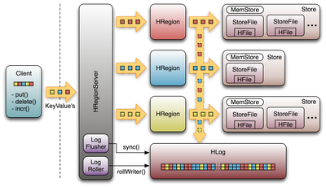
Hbase Architecture
Ref:http://www.bing.com/images/search?q=hbase+architeture&FORM=HDRSC2#view=detail&id=4768CC805B093790050EB40DE5666CA9E696C3BE&selectedIndex=13

Slide 5
Hbase uses HADOOP for distributive storage.
Data is stored across different region servers.
Region server data is spread across HDFS data nodes.
To record the changers a write ahead log is used.

Slide 6
Sorted Map DataStore
Not a relational database.
Very light Schema.
Tables consists of rows , each of which has primary key(row key)
Each row has number of columns like a Map<byte[],byte[]>.
Rows are stored in sorted order.

Slide 7
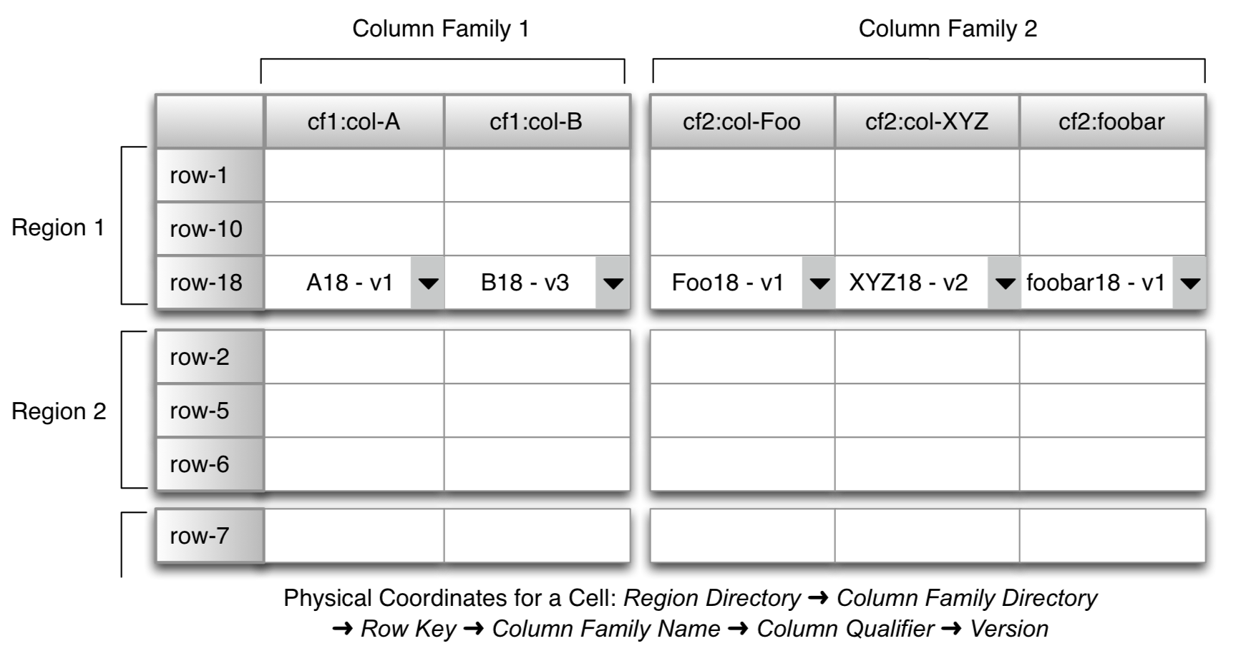
Schema of HBase
Ref: http://www.bing.com/images/search?q=hbase+schema&FORM=HDRSC2#view=detail&id=CB62709743CF1001832C7D6F643B491FEB8E4E3D&selectedIndex=12

Slide 8
Hbase API
get(row)
put(row,Map<column,row>
Scan(key range,filter)
Increment(row,columns)
Checkput()
Delete()

Slide 9
Deamons
Regions: A subset of tables rows
Regions Servers : is a slave and serves data for reads and writes.
Master: responsible for coordinating the slaves, assign regions, detect failures of region servers, functions as a admin.

Slide 10
Demo Application
Written the java code and Still Debugging

Slide 11
References:
Bing images
Cloudera.com
Apache.org

