Slide 1
SOFTWARE DETAIL DESIGN
Assignment1: TripBooking
Group 5 includes:
Lê Thị Thu Hà
Thân Thị Trang
Dương Nam Phương
Nguyễn Hữu Phước
Đặng Xuân Thành
Lê Xuấn Thành

Slide 2
Content
Architecture Style
Design Pattern
UML Diagrams
Use Case Diagram
Class Diagram
Activity Diagram
Booking Function
Login Function
Create Trip Function
Update Trip Function
Delete Trip Function
Create Route Function
Delete Route Function
Create Station Function
Update Station Function
Delete Station Function

Slide 3
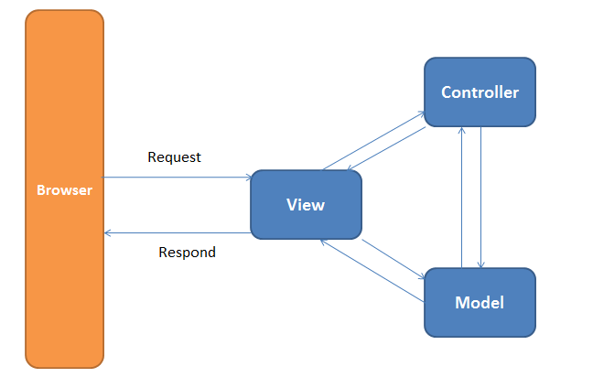
Architecture Style
MVC Model

Slide 4
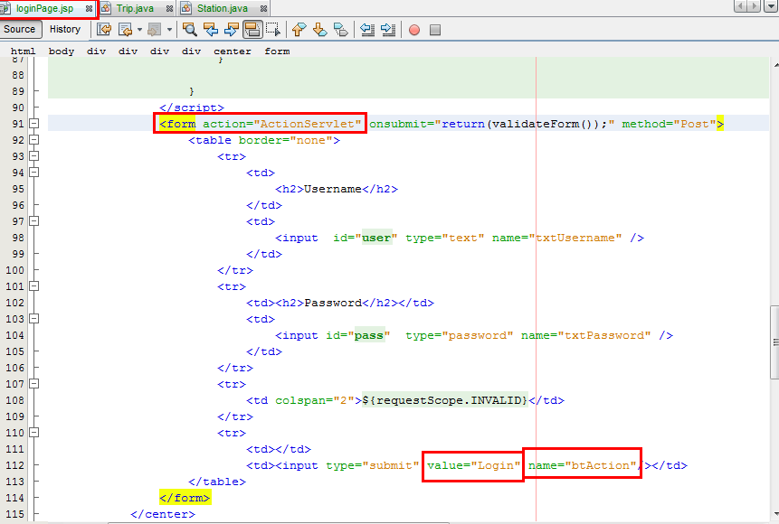
Design Pattern: Mediator Pattern

Slide 5
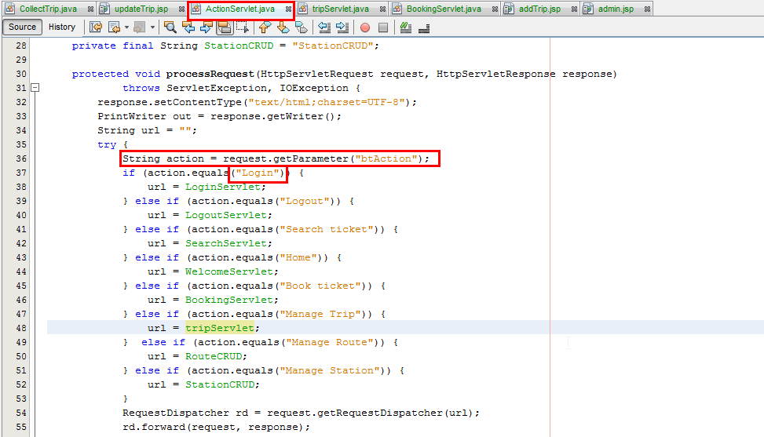

Slide 6
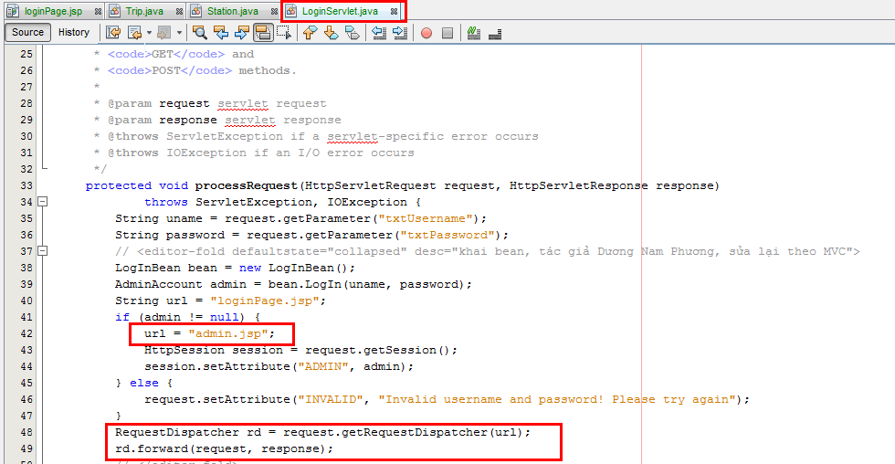

Slide 7
UML Diagrams
Use case Diagram
Class Diagram
Activity Diagram

Slide 8
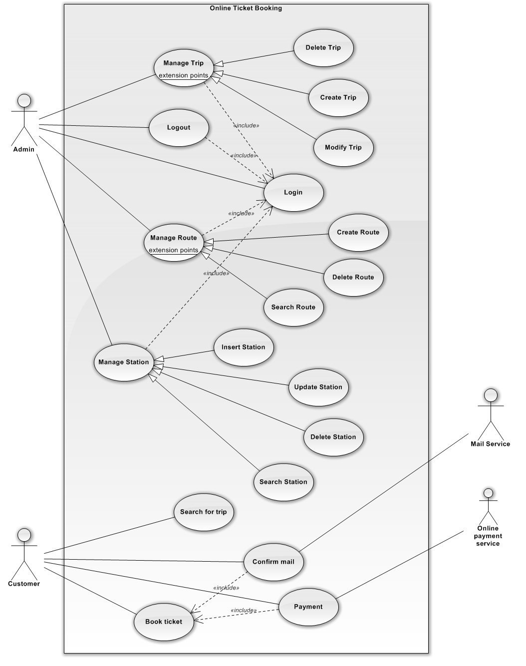
Use case diagram

Slide 9
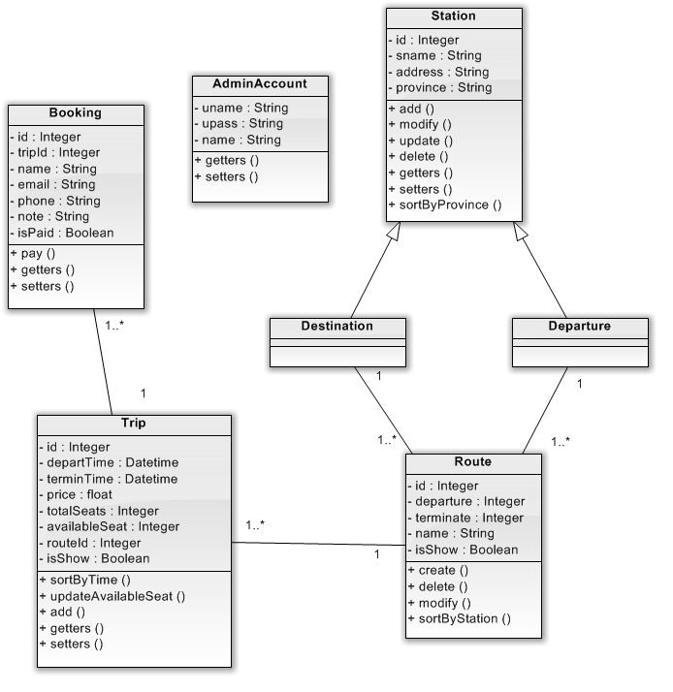
Class diagram

Slide 10
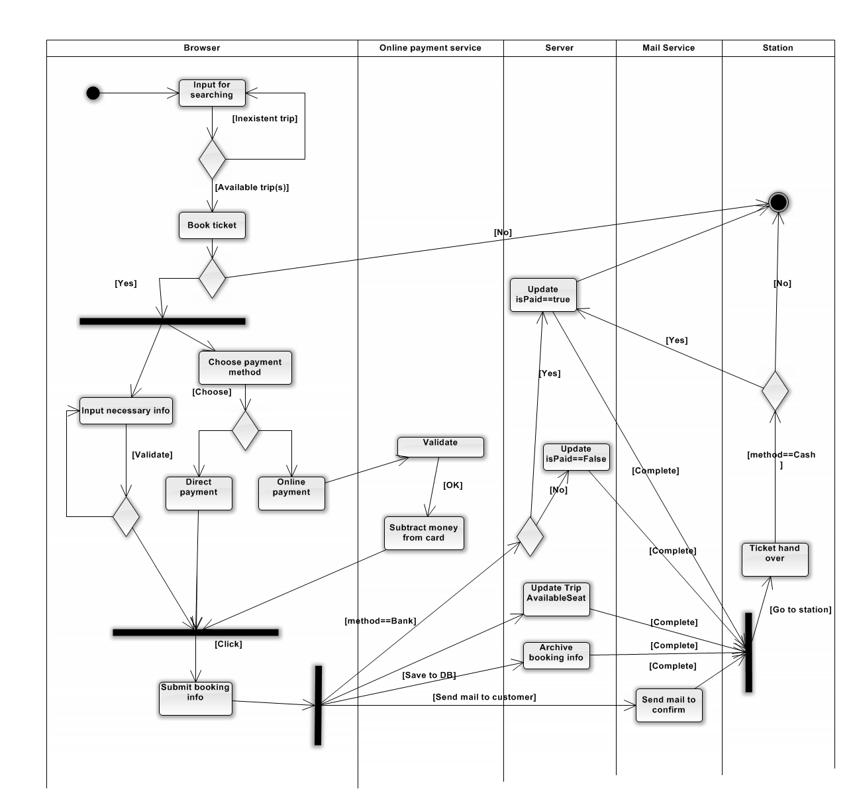
Activity diagram
->Booking Function

Slide 11
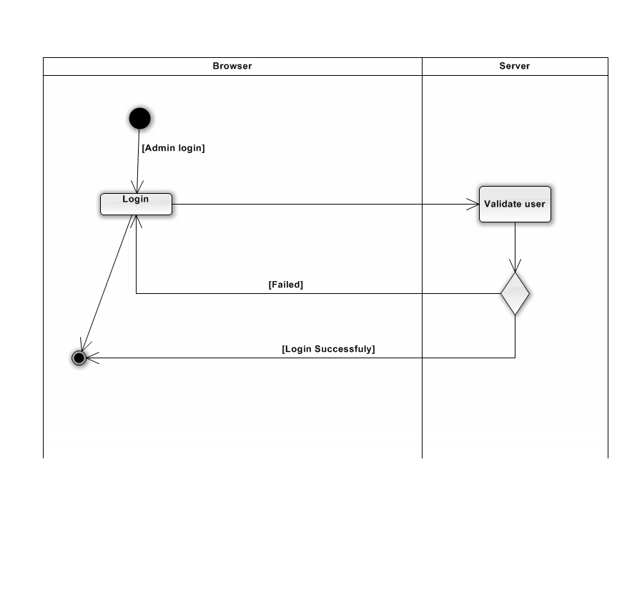
Activity diagram
->Login Function

Slide 12
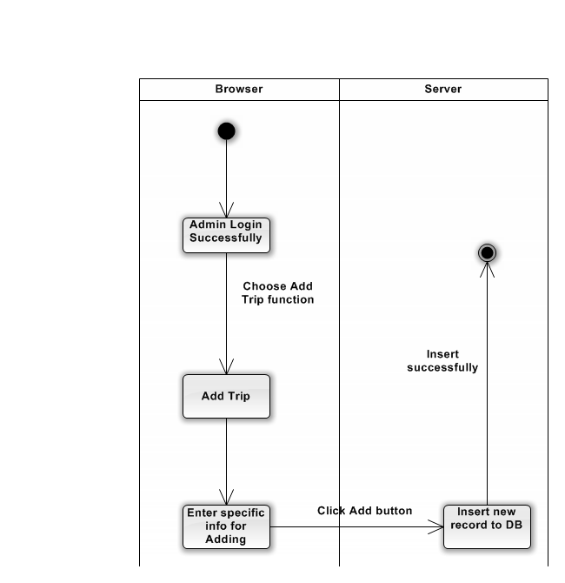
Activity diagram
->Create Trip Function

Slide 13
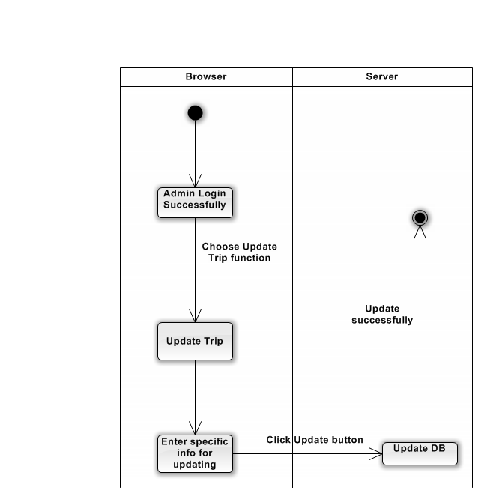
Activity diagram
->Update Trip Function

Slide 14
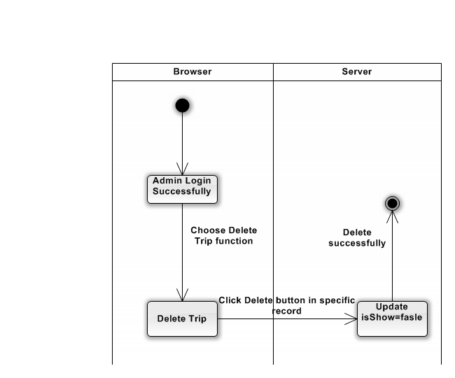
Activity diagram
->Delete Trip Function

Slide 15
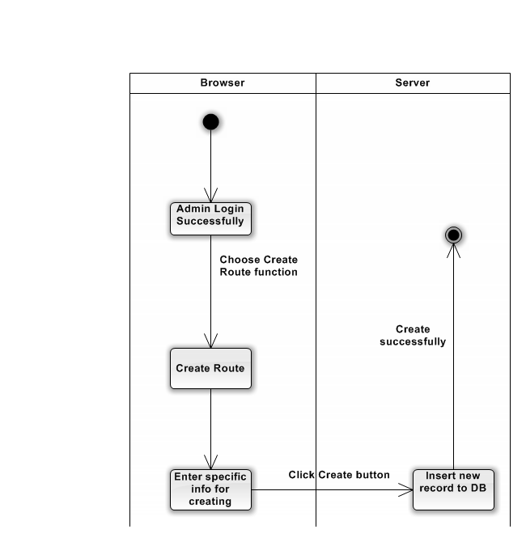
Activity diagram
->Create Route Function

Slide 16
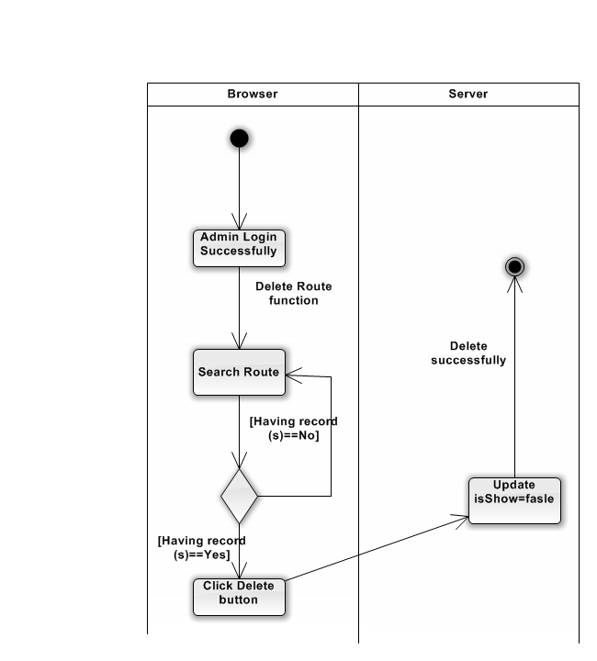
Activity diagram
->Delete Route Function

Slide 17

Activity diagram
->Create Station Function

Slide 18
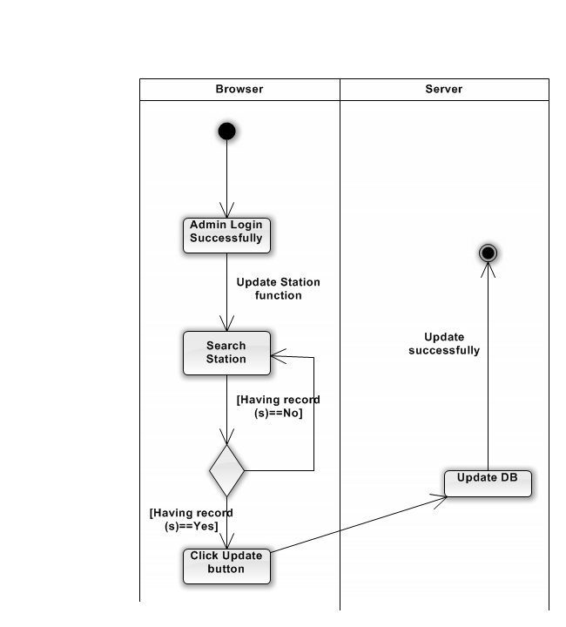
Activity diagram
->Update Station Function

Slide 19

Activity diagram
->Delete Station Function

Slide 20
Thank for your attention

