Slide 1
List Each Film Category Within the Family Movie Group and the Number of Rentals
The following categories are considered family movies: Animation, Children, Classics, Comedy, Family and Music.
The data shows Animation and Family are the most popular with Music being last.

Slide 2
What is the rental duration of family friendly film categories ranked within quartiles to the set of all family friendly movies?
Animation has the highest overall rental duration consistent among the quartiles.

Slide 3
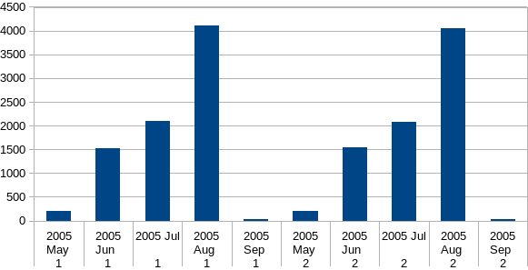
Find Out How The Two Stores Compare In Their Count Of Rental
Orders During Every Month For All Years
The two stores are comparatively equal in their rental rates and both follow a consistent pattern over the months.

Slide 4
Who are the top 10 customers being the most delinquent in returning movies?
These are the top 10 customers that consistently return movies late. While they will incur late fees they also prevent other customers from renting the same movies.

