Slide 1
Banking Term Deposit Exploratory Analysis
Based on Portuguese Bank Marketing Dataset
Exploratory Data Analysis Only

Slide 2
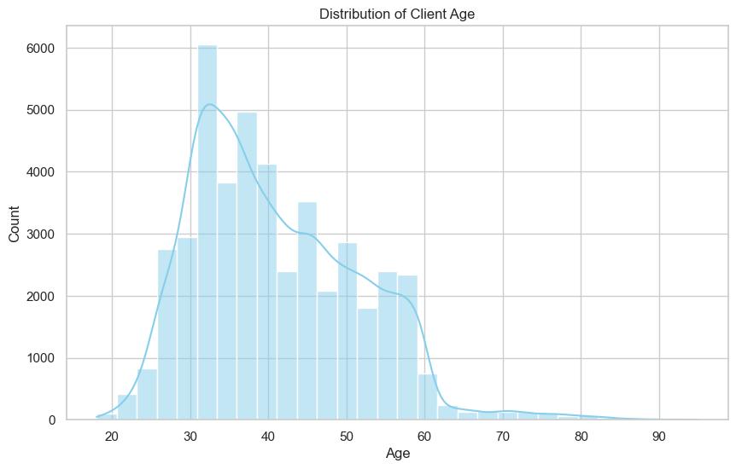
Exploratory Analysis Plot

Slide 3
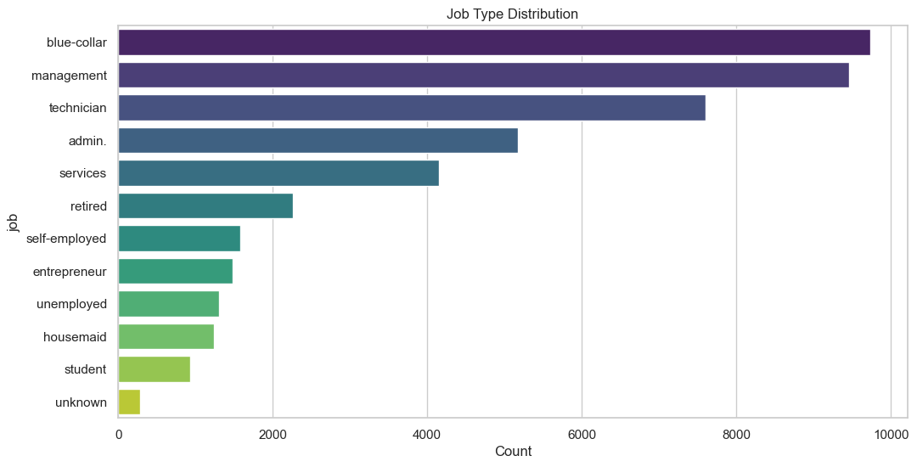
Exploratory Analysis Plot

Slide 4
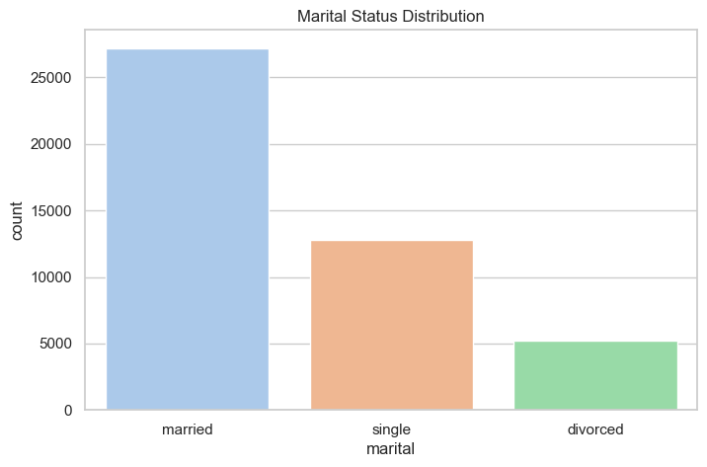
Exploratory Analysis Plot

Slide 5
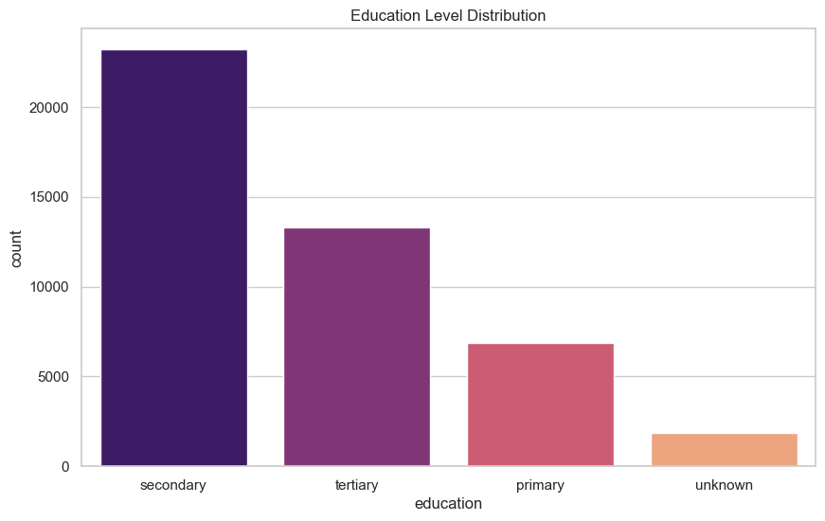
Exploratory Analysis Plot

Slide 6
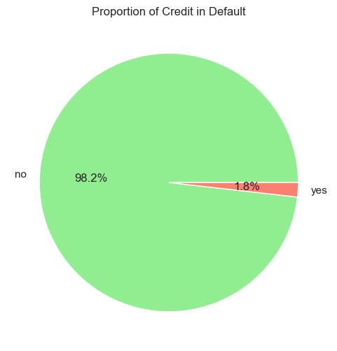
Exploratory Analysis Plot

Slide 7
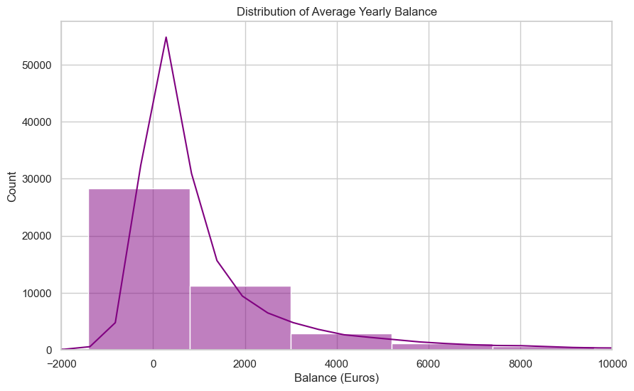
Exploratory Analysis Plot

Slide 8
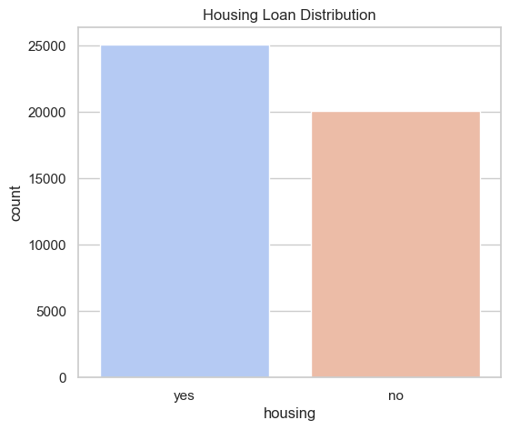
Exploratory Analysis Plot

Slide 9
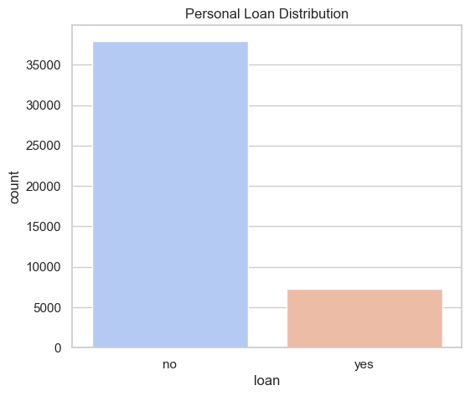
Exploratory Analysis Plot

Slide 10
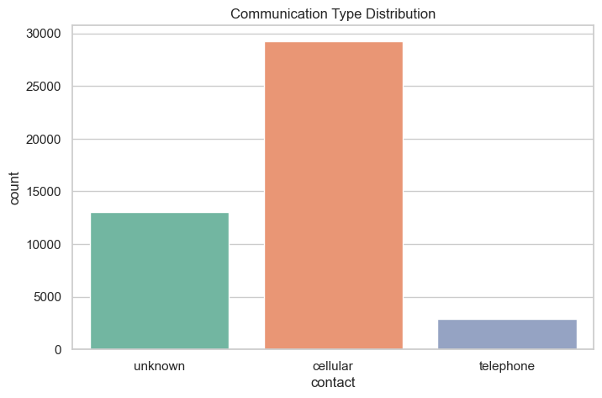
Exploratory Analysis Plot

Slide 11
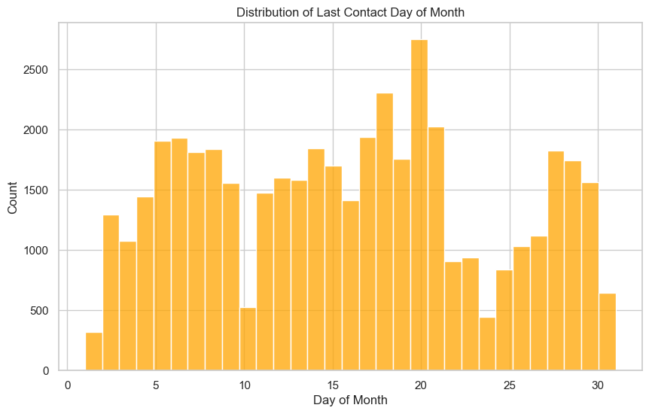
Exploratory Analysis Plot

Slide 12
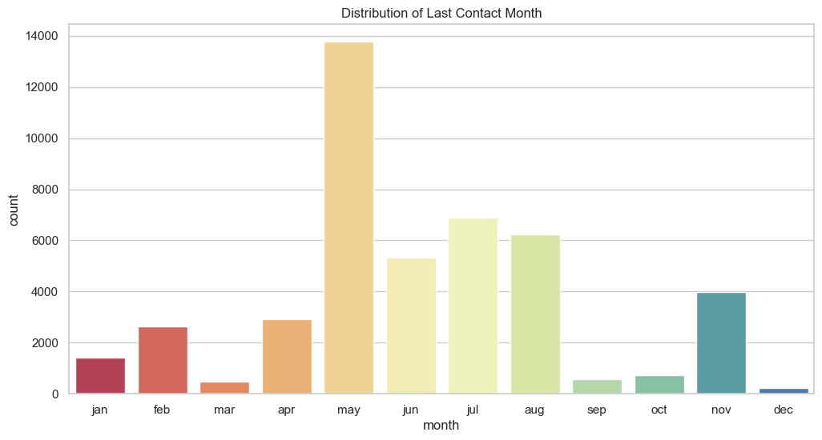
Exploratory Analysis Plot

Slide 13
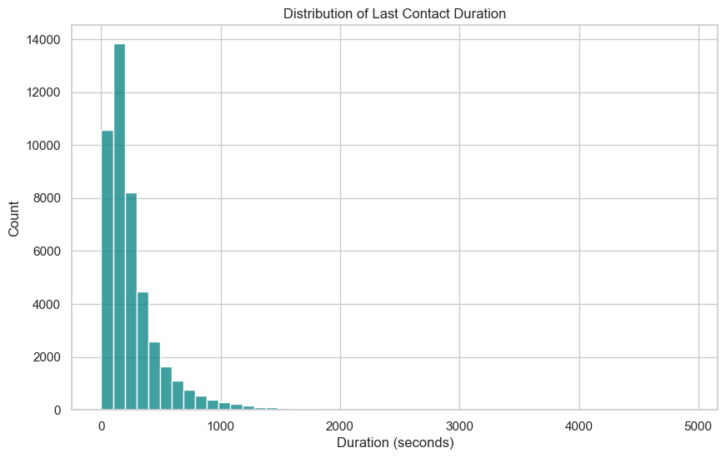
Exploratory Analysis Plot

Slide 14
Thank you

