Slide 1
ATLCrimeAnalytics
File created on: 5/13/2024 12:13:25 AM

Slide 2
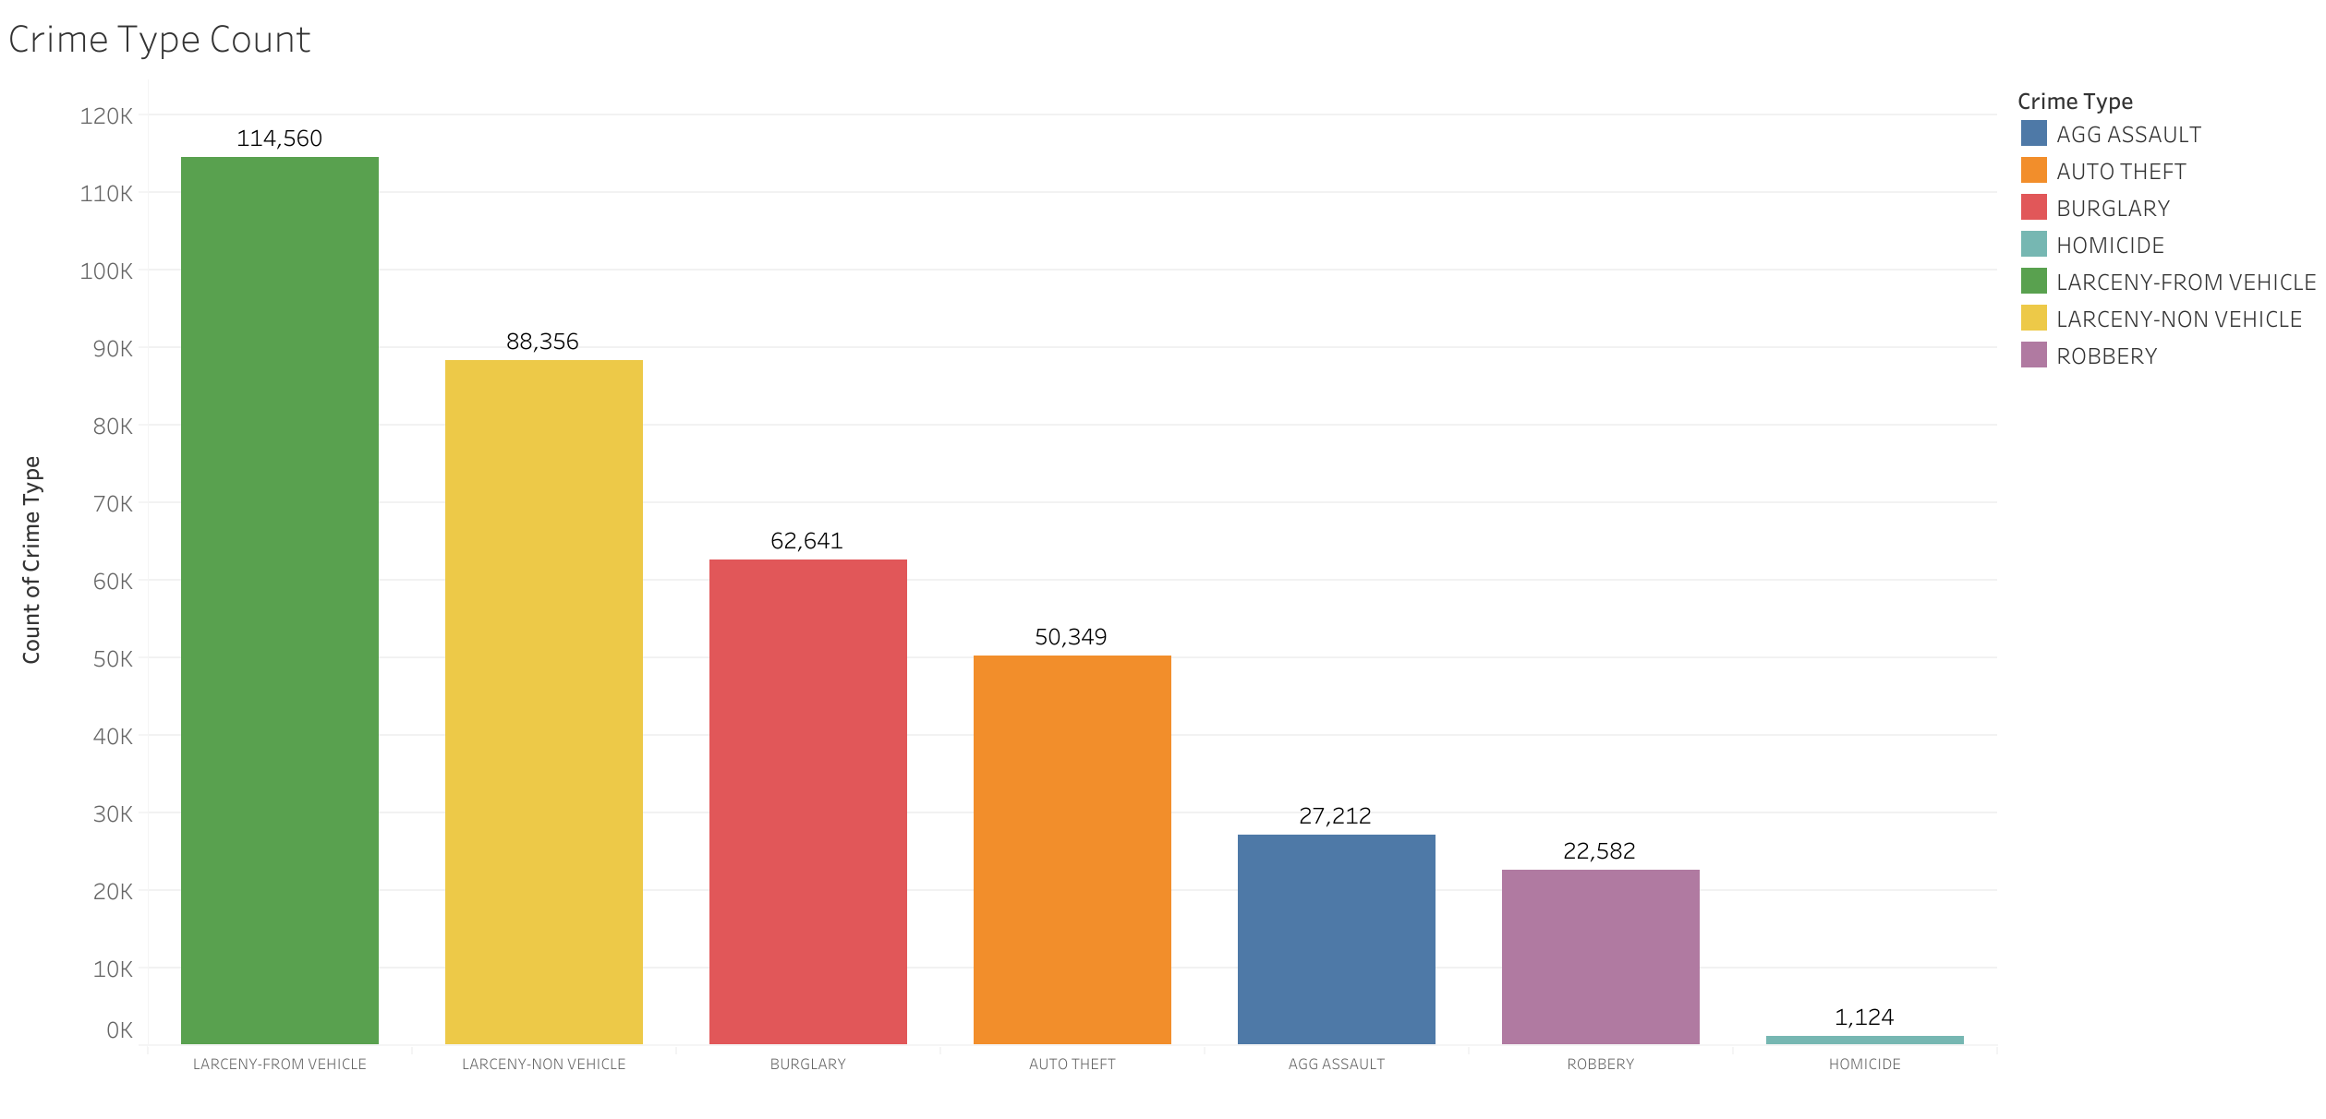

Slide 3
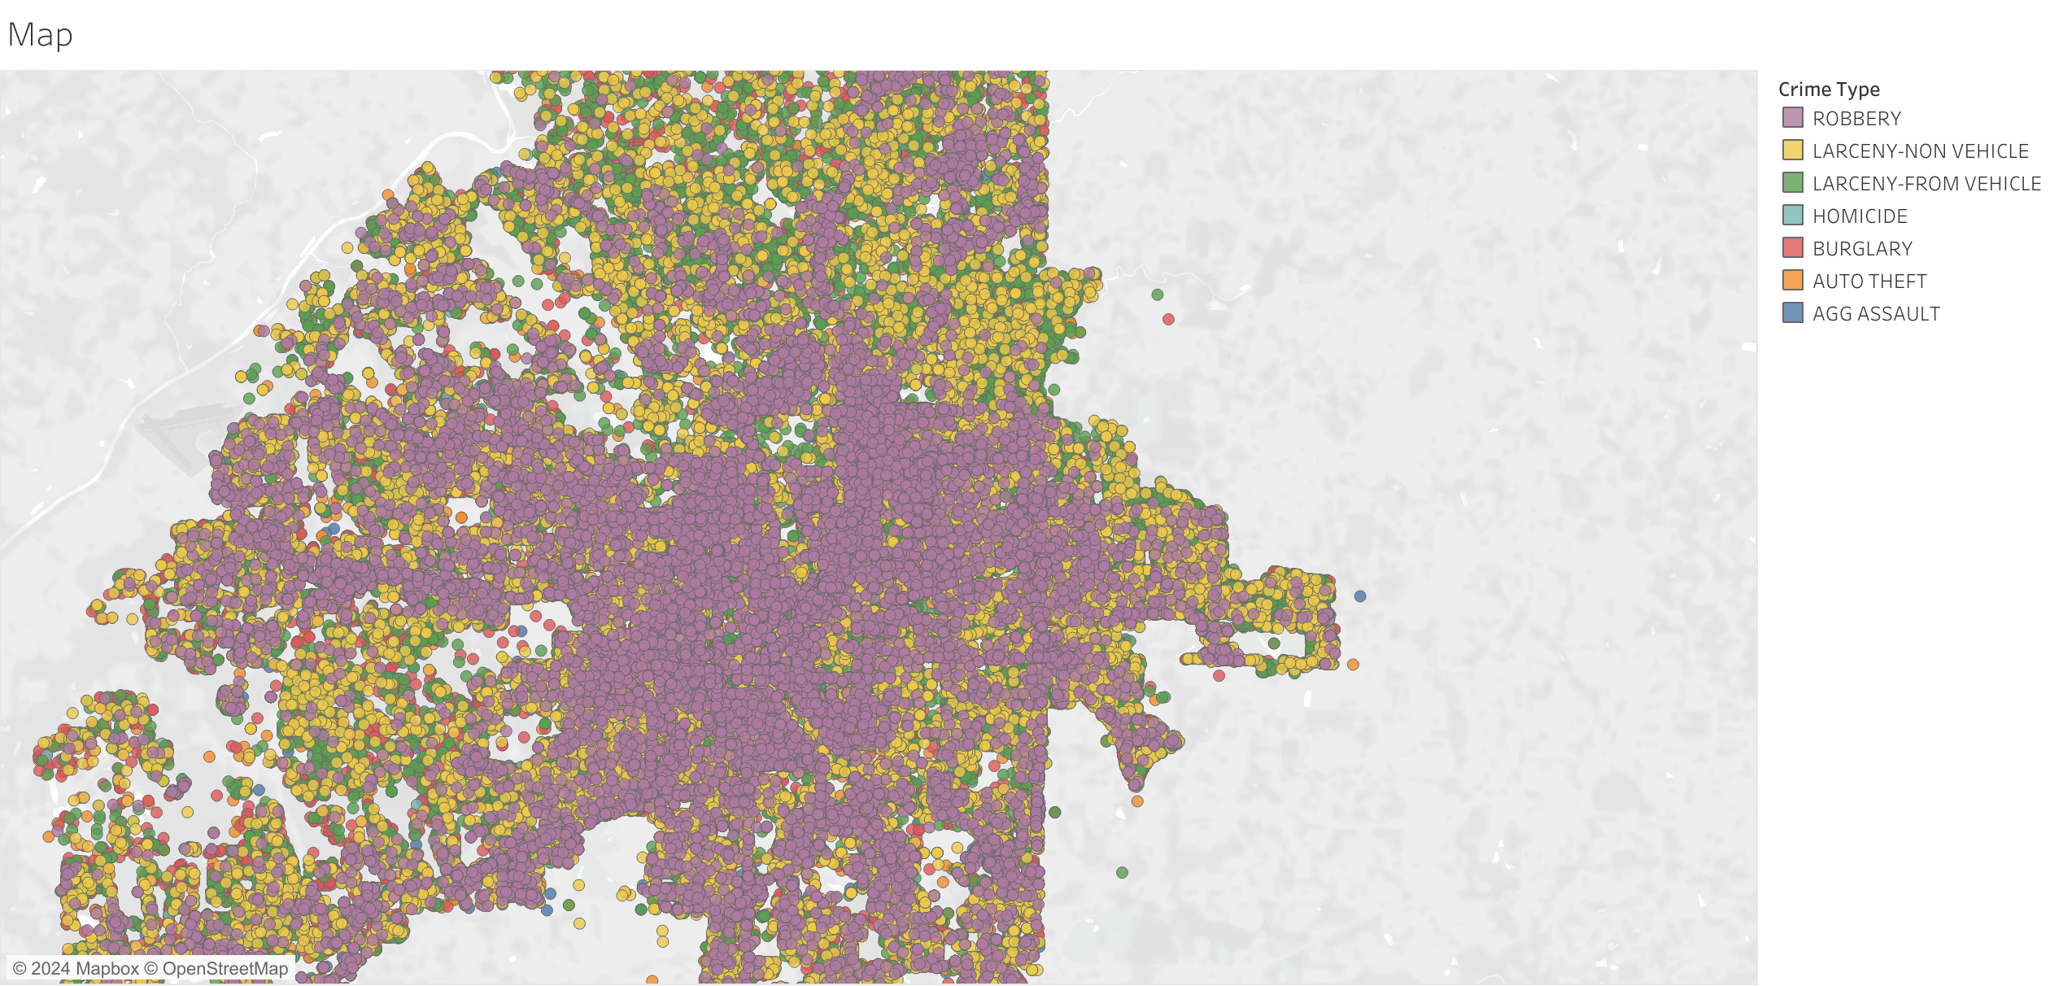

Slide 4
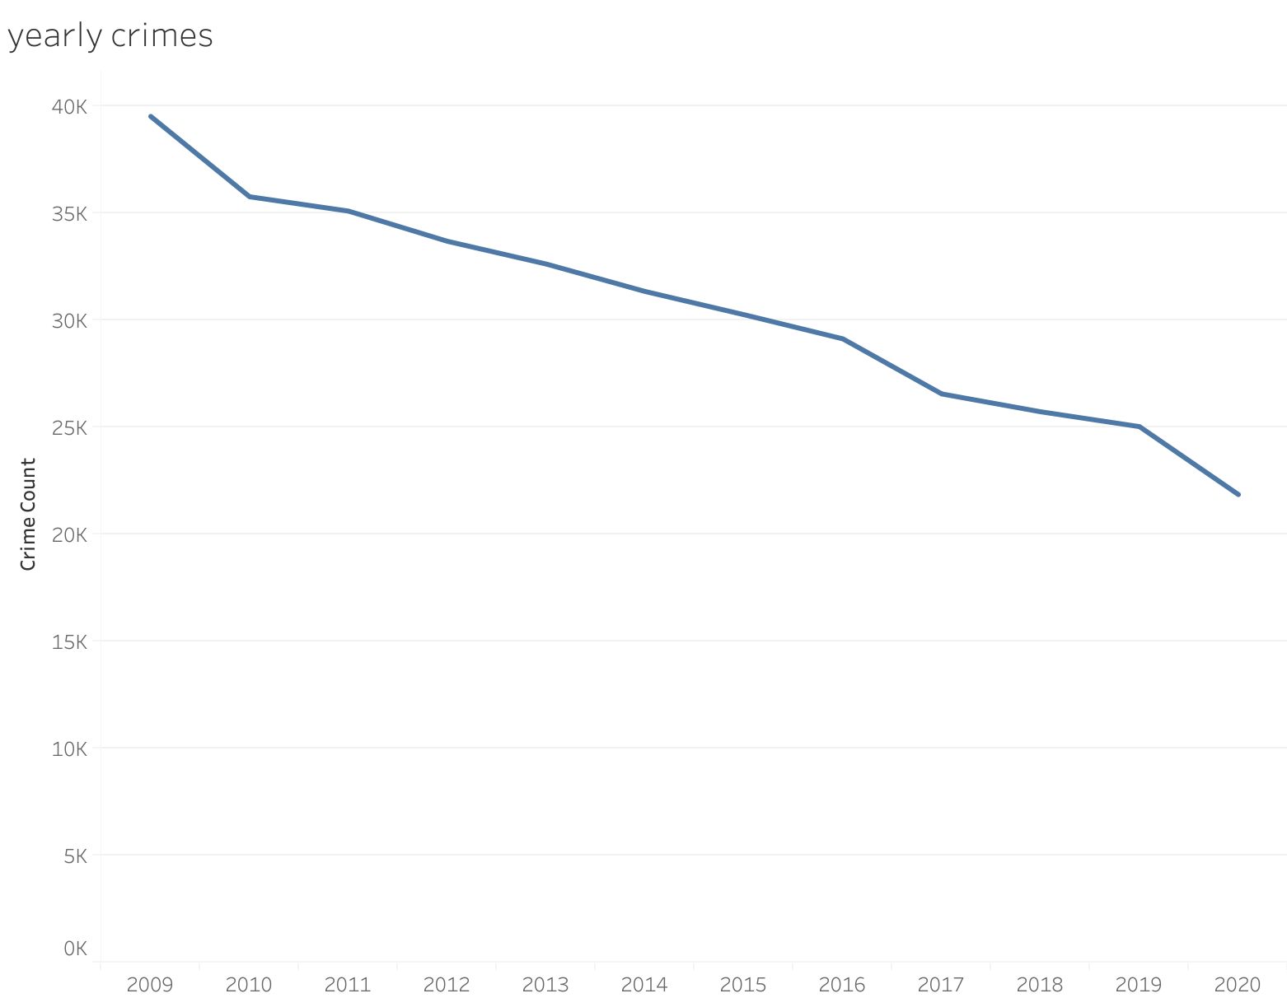

Slide 5
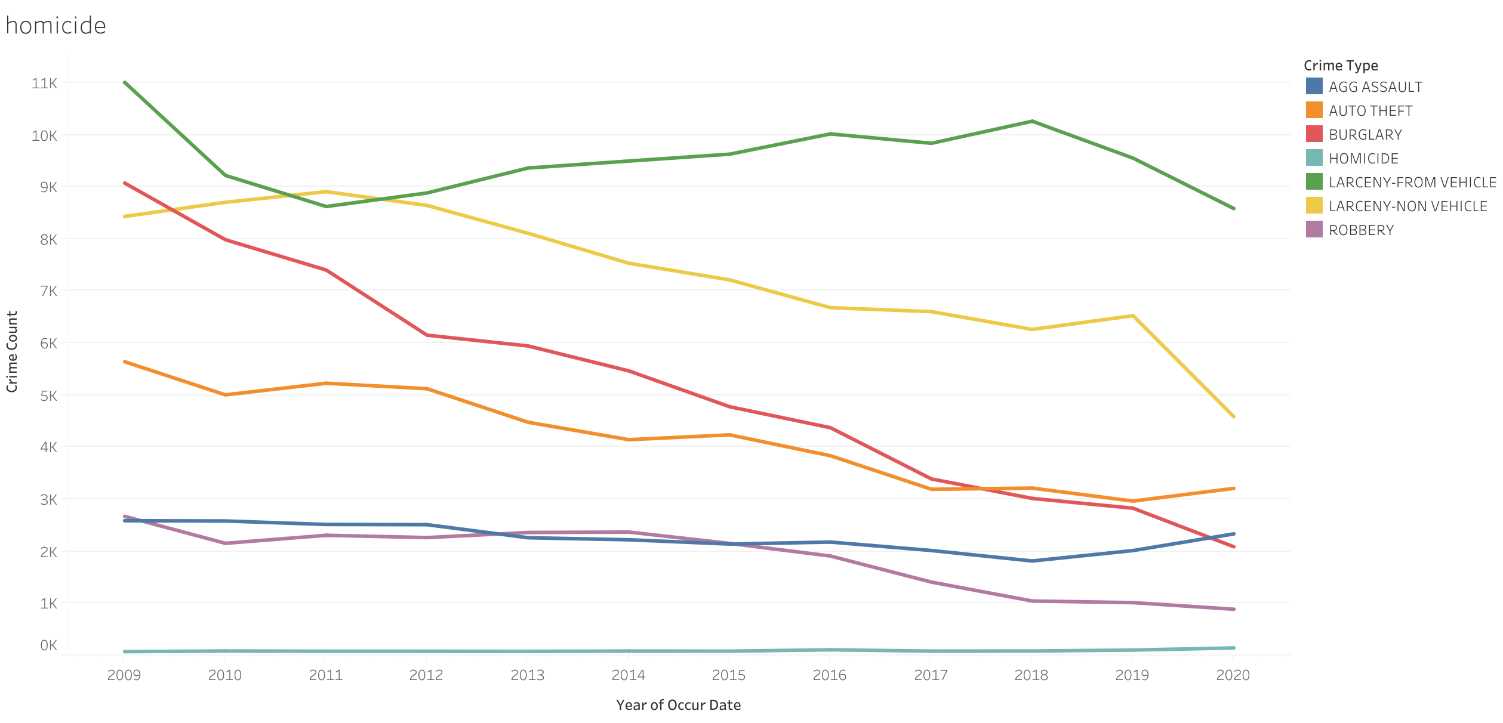

Slide 6
