Slide 1
ARTICLE SUMMARIZATION AND RECOMMENDATION ENGINE

Slide 2

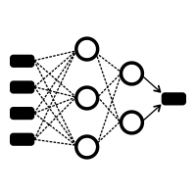





BASIC ARCHITECTURE
INPUT
NEURAL NETWORK
OUTPUT
CLUSTERS
RECOMMENDATIONS
SUMMARIZATION
PROCESS
CLUSTERING
PROCESS
RECOMMENDATION PROCESS
DATA PROCESSING

Slide 3



DATA PROCESSING
create-csv.ipynb
initial_dataset.csv

Slide 4
SUMMARIZATION & RECOMMENDATION PROCESS
initial_dataset.csv
Summaries.csv
Recommendations.csv
Custom_Text_Summarization.ipynb
Pretrained_Text_Summarization.ipynb
Pretrained_Text_Summarization.ipynb

Slide 5


BACK-END PROCESS
1
Summaries.csv
mysql_articles_update.py
‘articles’ Database
2
Recommendations.csv
mysql_recommendations_update.py
‘recommendations’ Database

Slide 6




FRONT-END PROCESS
‘articles’ Database
‘recommendations’ Database

Slide 7
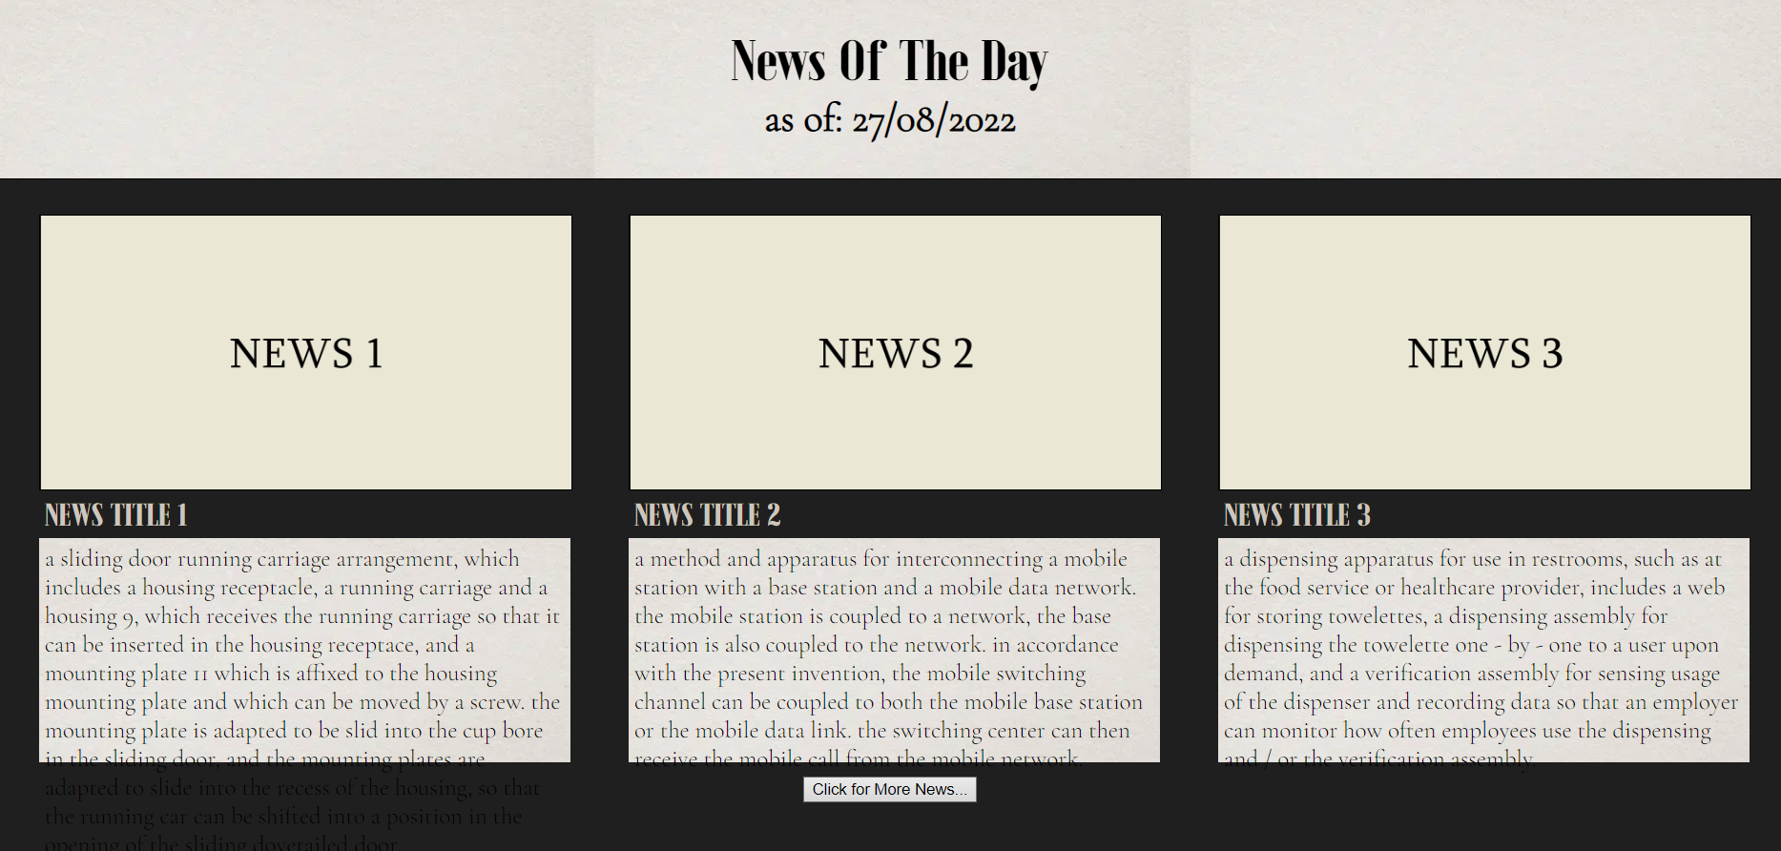
BUSINESS USE CASE

Slide 8
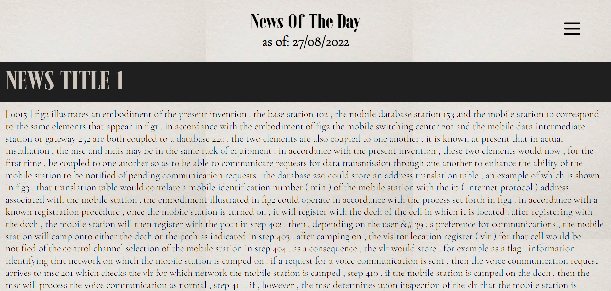

Slide 9
