Slide 1
Specifying consistency and isolation using a generalized syntax
Subhajit Sidhanta
INESC ID
Joint work with:
Ricardo Dias, Rodrigo Rodrigues
To be submitted to PODC 2017

Slide 2
Consistency Models
A Consistency Model : a contract (order among observed results) between the storage and the client (processor).
Conventions we will use
: j^{th} write on object o with value
: k^{th} read on object o that returned value
Isolation Levels
An Isolation level: constraints the manner in which results of operations performed from a transaction is visible from other concurrent transactions.
Conventions
: j^{th} write from transaction on object o with value
: k^{th} read from transaction on object o returned value

Slide 3
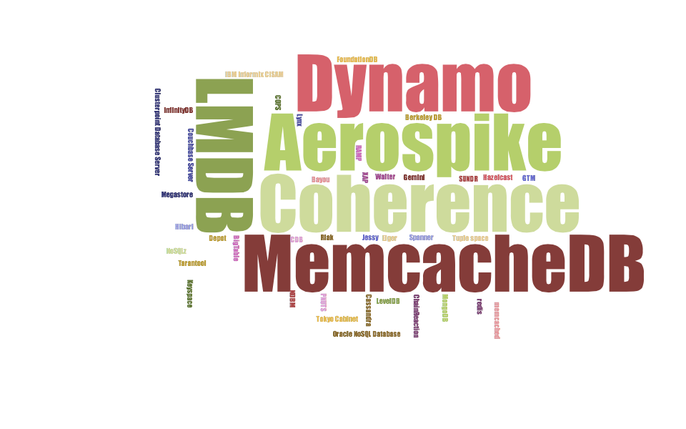

Slide 4
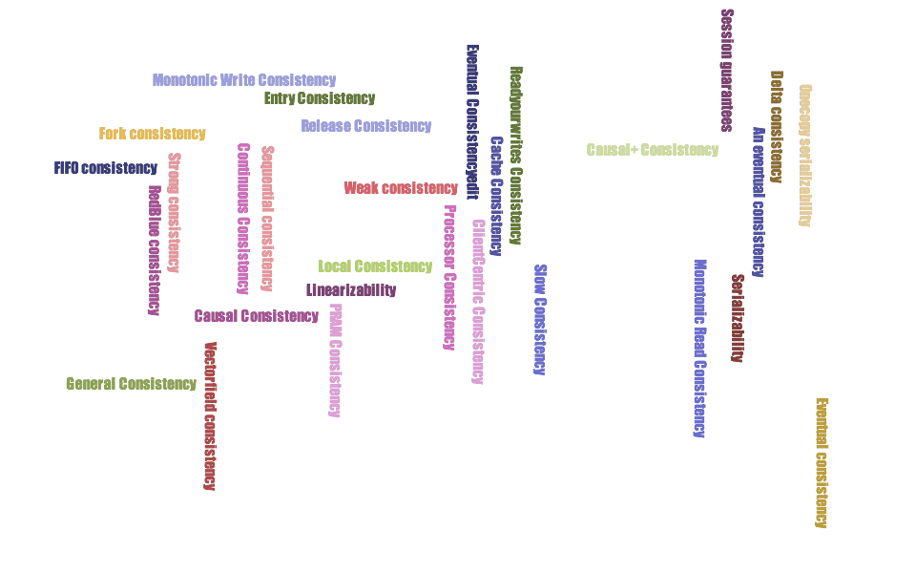

Slide 5
The consistency jungle
Large number of different models
Defined using different formalisms
Community-specific terms and definitions
How do they compare?
“The causal+ consistency (…) falls between sequential and causal consistency” [COPS]
“FJC implies a number of (…) session guarantees” [Depot]

Slide 6
Towards an unifying specification n syntax
Goal: find a unified way to specify consistency ad isolation levels that is:
Simple and intuitive
Unifies consistency and isolation level definitions using a common syntax
Directly applicable to automated verification systems
Enables straightforward comparisons of levels
Allows for efficient verification of implementations

Slide 7
Starting point: Adya’s PhD thesis + Chockler’s DISC 2000 Paper
→ Chockler’s consistency definitions
→ descriptive (informal) specifications
→ equivalent legal serialization
→ Adya’s Generalized isolation levels
→ Similar goal applied to isolation levels
Graphs derived from trace of the execution
Nodes = transactions
Edges = order between transactions (ww/wr/rw)
follow from version numbers
Isolation levels defined by precluded cycles
Cycles represent “anomalies” (bad behaviors)

Slide 8
Example: Snapshot isolation
Transaction t reads from a consistent snapshot, reflecting writes from transactions that committed before t began
T can commit iff it does not have a write-write conflict with any concurrent transaction

Slide 9
Lost update anomaly (disallowed by SI)
ww-x
T₁
T₂
rw-x

Slide 10
Moving from Adya’s formalism to LTL
Reasons for the shift to LTL:
Graph-based definitions specified in terms of Implicit and Explicit dependencies of various types
Requires prior understanding of meaning of each type of dependency
Implicit dependencies → defined in terms of explicit dependencies
Difficult to make this derivation uniform across definitions
Much complicated representation
→ complex graphs
Removing versioning from spec
→ make the definitions truly implementation-independent (already achieved by Ricardo)

Slide 11
Why LTL
Consistency and Isolation
→ restrictions on temporal order in which results of operations can be observed
Easier to understand and read
Easier to build automated tools
→ a wide array of available automated verification tools

Slide 12
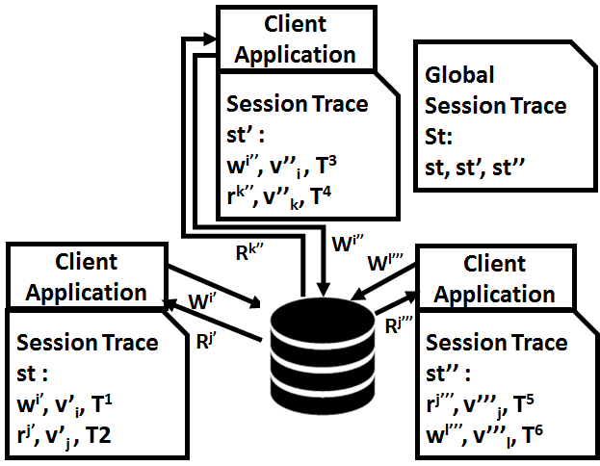
System Model
Session trace st → client application
Global Session trace St → Set of session traces

Slide 13
ConSpec Specification Syntax
A serialization (Ser) is a sequence in which a group of storage operations are executed on a datastore.
A serialization is said to be legal if every read operation returns the value written by the latest write operation preceding it in the serialization.

Slide 14
ConSpec Specification Format
Form-1
Form-2

Slide 15
ConSpec Specification Components

Slide 16
ConSpec Specification Components (contd.)

Slide 17
ConSpec Specifications (Consistency)
RYW (Read Your Write)
MR (Monotnic Read)
Causal
Strict Serialization

Slide 18
ConSpec Specifications (Isolation Levels)
PL-1: Proscribes directed cycles consisting entirely of write-dependency (ww) edges.

Slide 19
Violating Examples: RYW

Slide 20
Violating Examples: PL-1

Slide 21
Application: Tools
Building of Automated Verification Tools
→ TLA+ based prototype (under construction)
Implications WRT CAP theorem
E.g., what are the consistency and the isolation levels that support an A+P implementation?
→ RYW, MR, WFR, Causal
Can be expressed as a property of the LTL conditions that are supported
→ constraints on all operations performed by each client (total order)
Implications and Insights

Slide 22
Extending CAP Theorem
St, S (comprises all operations from all clients)
S_{c} (comprises all operations from one given clients)
MW, Strict Serializabilty, PC, TSO → CAP
S S_{c} St St
It is impossible to satisfy a consistency model that enforces Constraints on the precedence and relation among all or no operations performed by each client composed in the global execution or an equivalent legal serialization, while simultaneously providing high Availability and Partition tolerance.

Slide 23
Future Work (contd.)
Do all combinations make sense?
Other advantages of LTL based definitions?
Automated Verification Tool for verifying system against consistency and isolation specs
Analyze the implications for system developers

Slide 24
Conclusions
A unified, simple specification that formalizes consistency and isolation in an uniform syntax
ConSpec seamlessly combines consistency and isolation using common syntax
E.g., natural definition for transactions with consistency level X and isolation level Y
Can leverage existing automated verification tools (Model Checkers/SAT solvers) to verify whether a storage system satisfies a claimed consistency model or isolation level
Equivalence to previous definitions
Extension of CAP

Slide 25

Thanks!
Questions ?

