Slide 1
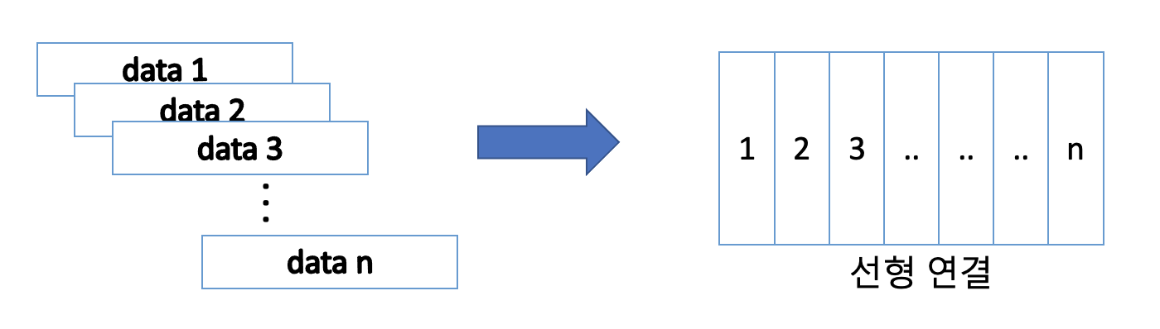

Slide 2
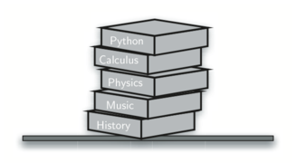

Slide 3
8.4
Top
True
“dog”
4
Base

Slide 4
8.4
4th
1st
True
2nd
3rd
“dog”
2nd
3rd
4
1st
4th
8.4
True
“dog”
4
4
“dog”
True
8.4
Original Order
Reversed Order

Slide 5
Most recent open matches first close
( ( ) ( ( ) ) ( ) )
First open may wait until last close

Slide 6
1
Push remainders
Pop remainders
1
1
233//2=116 rem=1
0
116//2=58 rem=0
1
29//2=14 rem=1
14//2=7 rem=0
0
7//2 = 3 rem = 1
0
3//2=1 rem=1
1//2=0 rem=1
1

Slide 7
( A + ( B * C ) )

Slide 8
( A + ( B * C ) )

Slide 9
(A+B) * C – (D-E) * (F+G)
(((A+B) * C) – ((D-E) * (F+G)))
Prefix
Postfix
-*+ABC*-DE+FG
AB+C*DE-FG+*-

Slide 10
A*B+C*D
A
*
B
+
C
*
D
*
*
*
*
*
*
+
+
+
+
+
+
A
B
*
C
D
*
+
AB*CD*+

Slide 11
Left to Right Evaluation
4
5
6
*
+
push
Pop twice and
push
push
do math
Pop twice and
6
do math
5
5
30
4
4
4
4
34

Slide 12
7
8
+
3
2
+
/
2
8
3
3
5
7
7
15
15
15
15
3

Slide 13
rear
8.4
True
“dog”
4
front
Items

Slide 14
back/rear
front
r
a
d
a
r
remove from back
remove from front
Items
r
r
Remove from front and back

Slide 15
rear
front
add to rear
add to front
"pear"
4
“apple”
True
remove from rear
remove from front
Items

Slide 16
Bill
Pass to next person
After 5 passes,
Brad is eliminated
Brad
David
Until predefined counting constant
And so on
Kent
Susan
Jane

Slide 17
rear
Brad
Kent
Jane
Susan
David
Bill
front
Go to the rear
(Pass the potato)
enqueue
dequeue
rear
Bill
Brad
Kent
Jane
Susan
David
front

Slide 18
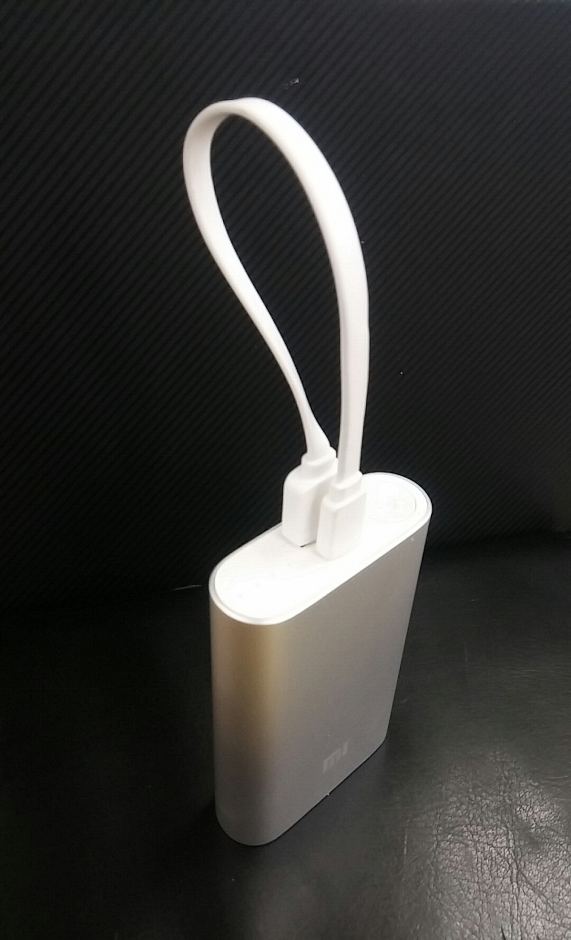

Slide 19
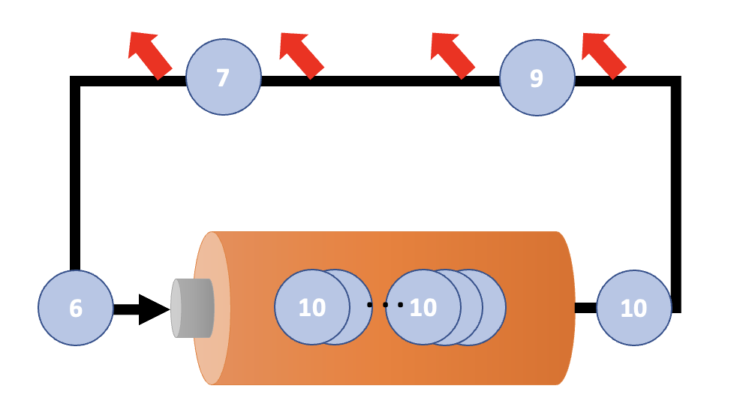
8
9
9
9

Slide 20
17
31
26
54
93
77

Slide 21
17
31 (End)
26
Head
54
93
77

Slide 22
temp
temp
next
93

Slide 23
temp
93

Slide 24
my_list
head

Slide 25
my_list
head
54
26
93
17
77
31

Slide 26
head
93
17
77
31
Step 2
Step 1
26
temp

Slide 27
No external reference
head
93
17
77
31
26
temp

Slide 28
traversal
current
current
current
current
current
current
current
head
54
26
93
17
77
31

Slide 29
traversal
current
current
current
current
head
54
26
93
17
77
31

Slide 30
previous
current
head
54
26
93
17
77
31

Slide 31
previous
Step
current
0
head
54
26
93
17
77
31
previous
current
1
head
54
26
93
17
77
31
previous
current
2
head
54
26
93
17
77
31
previous
current
3
head
54
26
93
17
77
31

Slide 32
previous
current
head
54
26
93
17
77
31

Slide 33
previous
current
head
54
26
93
17
77
31

Slide 34
head
17
26
31
54
77
93

Slide 35
current
current
current
current
head
17
26
31
54
77
93

Slide 36
previous
current
head
17
26
54
77
93
Step1
Step2
31
temp

