Slide 1

SSIE 523 Final Project
Modeling Volatility Clustering in Financial Markets Using a Hybrid Agent-Based Model
Grant T. Aguinaldo, Daniel A. Cline, and Christian Lemp
Department of Systems Science and Industrial Engineering
Binghamton University

Slide 2
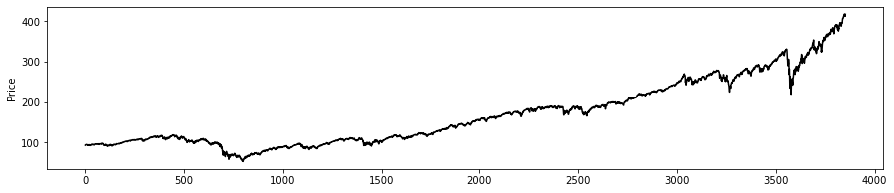
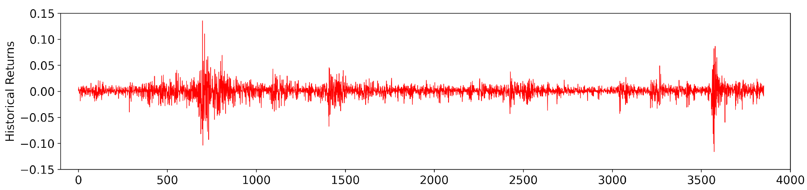
Stock Prices – Stylized Facts
SPY prices from 2006-2021
Volatility clustering
Kurtosis (fat tails)

Slide 3
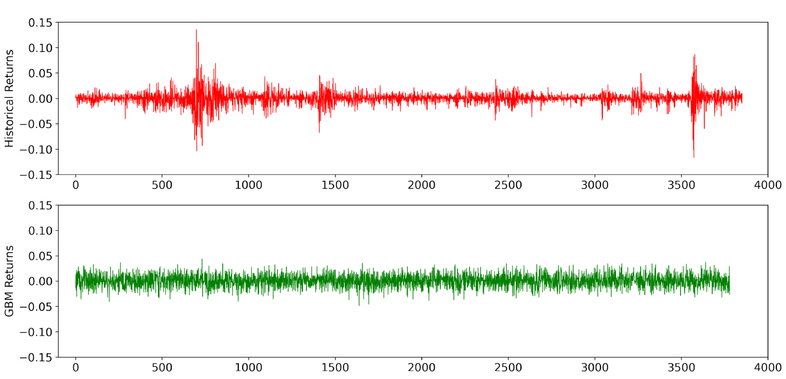
Geometric Brownian Motion
Black-Scholes model
Lognormal returns
No volatility clustering or kurtosis

Slide 4
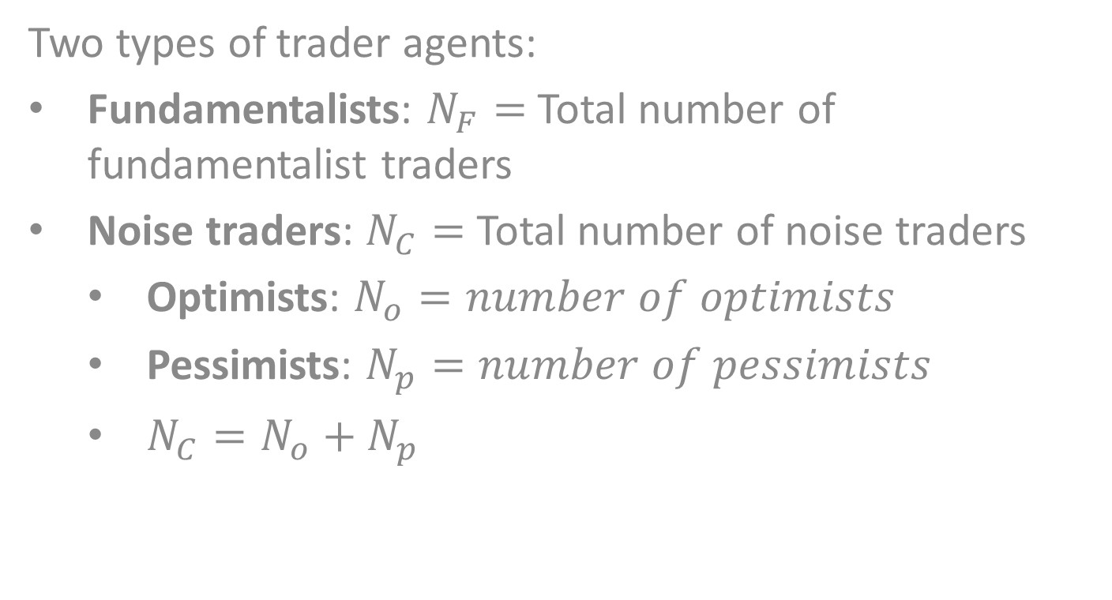
Agent-Based Model
Two types of trader agents:
Fundamentalists: $N_{F}=$Total number of fundamentalist traders
Noise traders: $N_{C}=$ Total number of noise traders
Optimists: $N_{o}=number of optimists$
Pessimists: $N_{p}=number of pessimists$
$N_{C}=N_{o}+N_{p}$

Slide 5
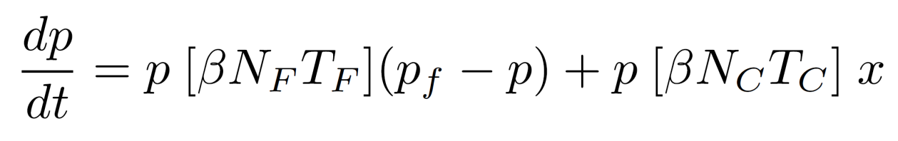
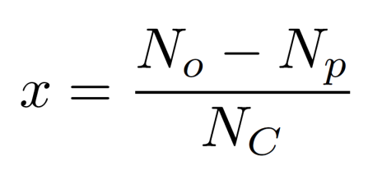
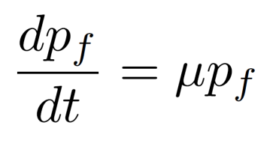

Agent-Based Model
System of ODEs describing the stock price:
$p=$ Stock price
$p_{f}=$ Fundamental (economic) value of the stock
$T_{F}=$ Size of trades initiated by fundamentalists
$T_{c}=$ Size of trades initiated by noise traders
$β=$ Speed of price adjustment
$x=$ Stochastic term with $x∈(−1, 1)$

Slide 6
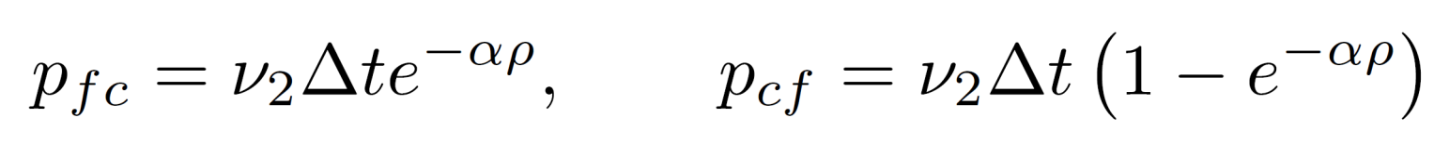
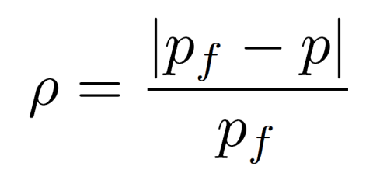
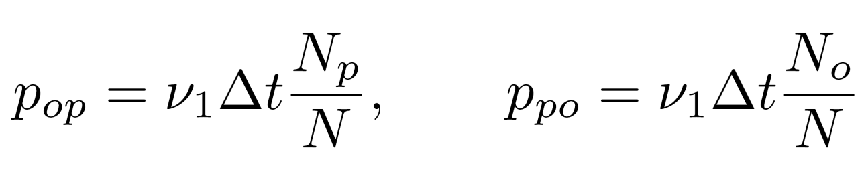
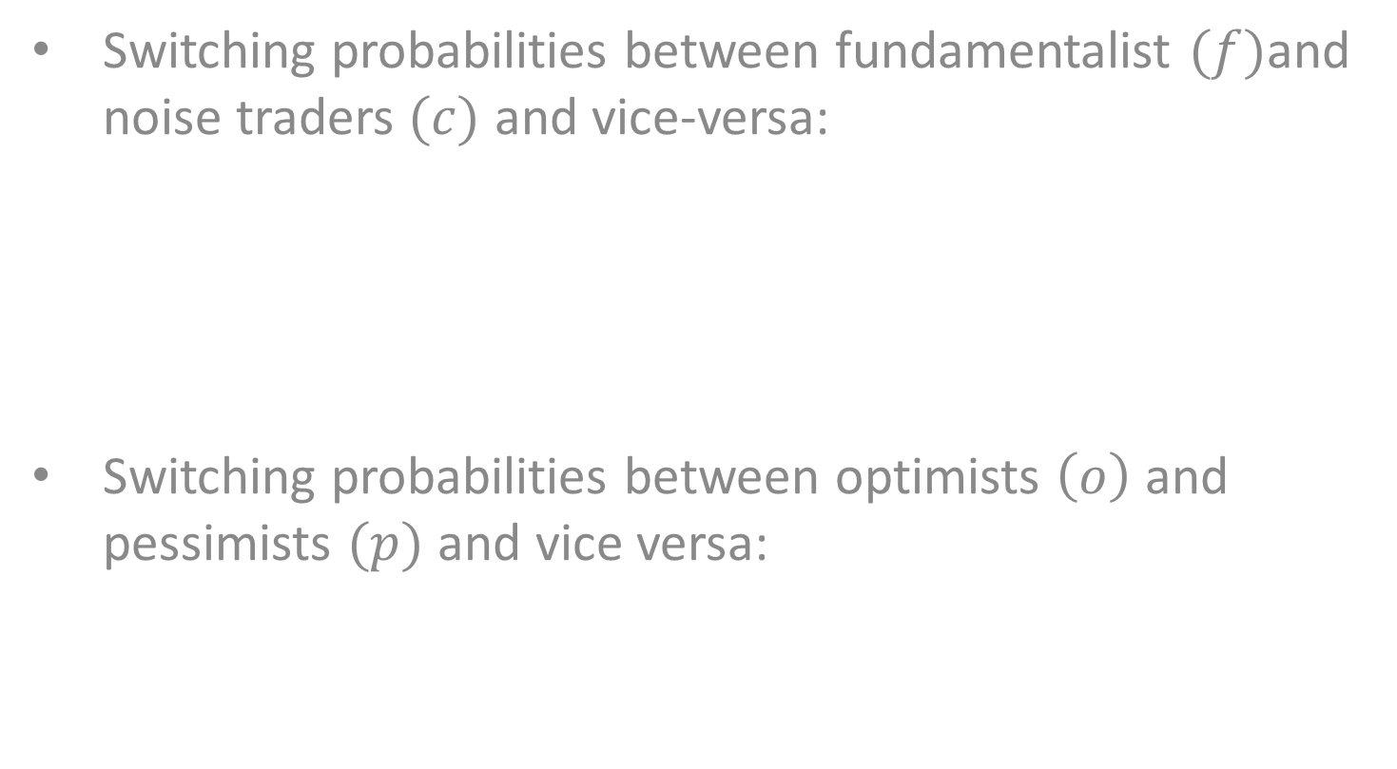
Agent-Based Model
Switching probabilities between fundamentalist $(f)$and noise traders $(c)$ and vice-versa:
Switching probabilities between optimists $\left(o\right)$ and pessimists $(p)$ and vice versa:

Slide 7
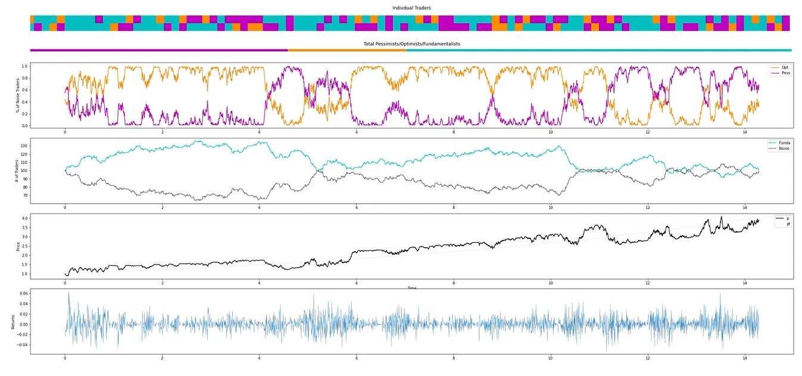
Agent-Based Model

Slide 8
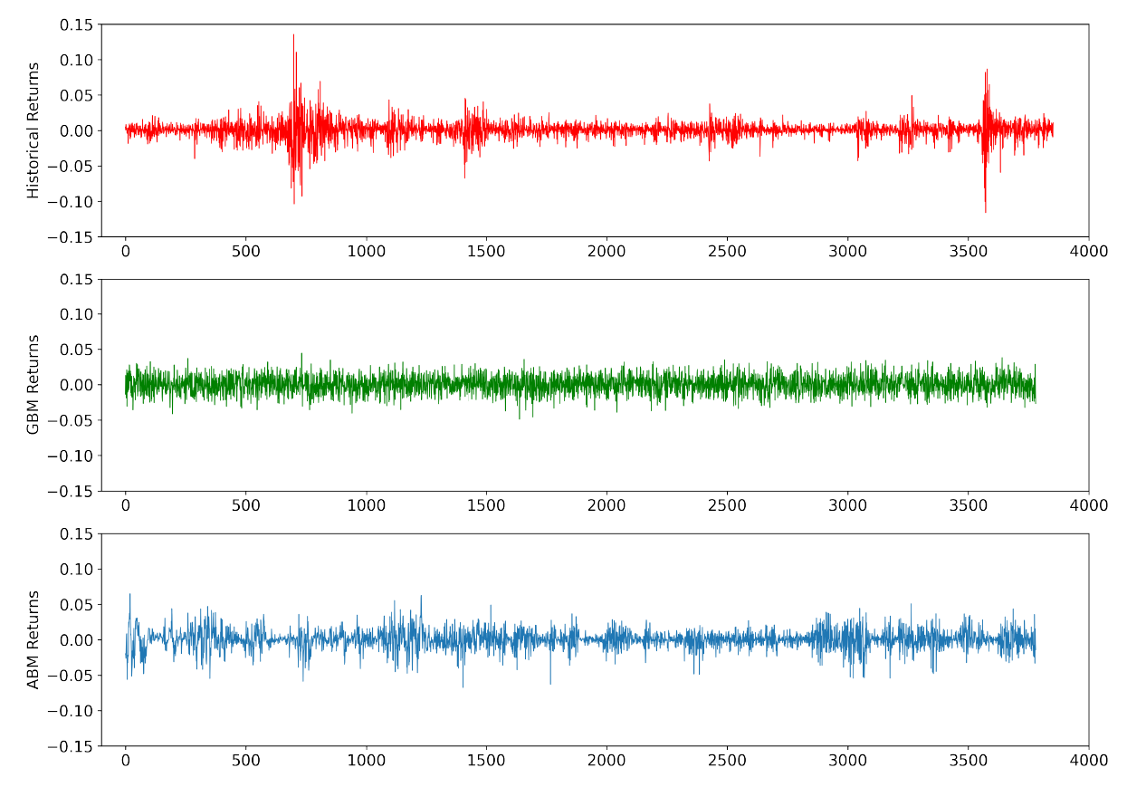
Agent-Based Model
Volatility clustering and kurtosis

Slide 9
Conclusion
Historical returns exhibit volatility clustering and kurtosis.
GBM fails to capture these stylized facts.
ABM captures these stylized facts and provides a behavioral interpretation for them.
Reference: Alfarano, S. and Lux, T. A noise trader model as a generator of apparent financial power laws and long memory. Macroeconomic Dynamics, 11(S1):80–101, 2007.

