Slide 1

INTRODUCTION TO
Python
A friendly, no-experience-needed course for our team
6 chapters • hands-on • zero prior coding needed
Team Python Onboarding
1

Slide 2


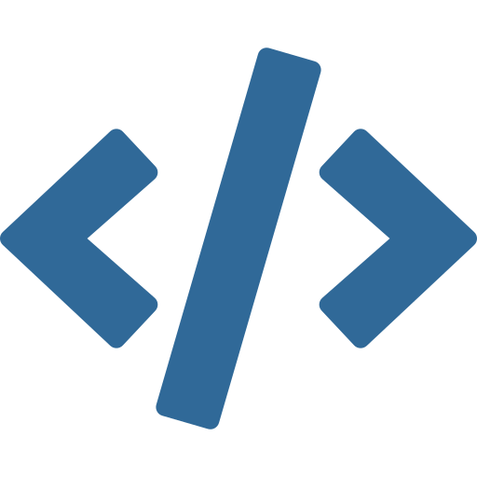


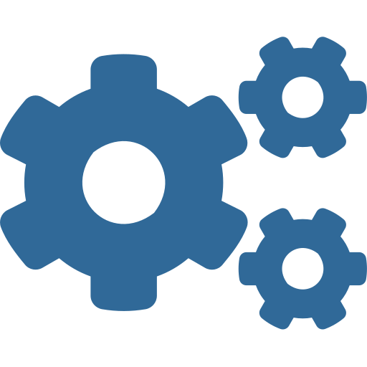
WELCOME
Where we're headed
Six short chapters, from installing Python to knowing what makes it special. No experience required, just curiosity.
CHAPTER 1
CHAPTER 2
CHAPTER 3
Installing Python
What is Python?
Your first program
CHAPTER 4
CHAPTER 5
CHAPTER 6
Libraries & modules
Why Python wins
Good habits to know
Chapter 0 · Welcome
2

Slide 3

LET’S START WITH A QUICK POLL
Raise your hand: where are you starting from?
I have never written a line of code
A
I have dabbled (Excel formulas, a bit of HTML)
B
I know another language, but not Python
C
There is no wrong answer, this course is built to work for all three.
Chapter 0 · Welcome
3

Slide 4
CHAPTER 1
Installing Python
Getting Python onto your machine takes about ten minutes. Let’s do it step by step.
Chapter 1
4

Slide 5


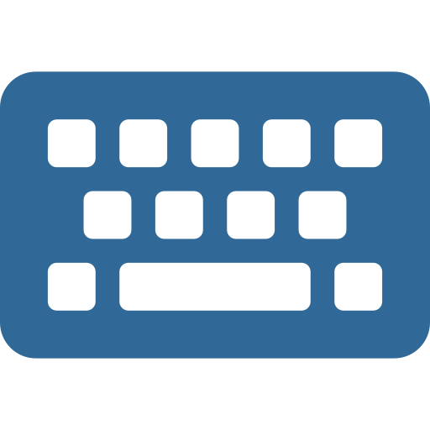
CHAPTER 1
Before you begin
You only need three things. No special hardware, no prior setup.
A computer
An internet connection
10 to 15 minutes
Windows, Mac, or Linux, all are fully supported
Just for the one-time download, about 30 MB
Enough time to download, install, and verify it works
Chapter 1 · Installing Python
5

Slide 6


CHAPTER 1
Installing on Windows
1
Go to python.org and open Downloads, then click the yellow "Download Python" button
2
Run the downloaded .exe file
3
Important: tick the box "Add python.exe to PATH" at the bottom of the first screen
4
Click "Install Now" and wait for the confirmation screen
The checkbox is easy to miss, if you forget it, you can re-run the installer and select "Modify" to add it.
Chapter 1 · Installing Python
6

Slide 7

CHAPTER 1
Installing on Mac
1
Go to python.org, open Downloads, and choose the macOS installer
2
Open the downloaded .pkg file and click through the installer
3
Enter your Mac password when prompted, then finish the install
4
Open the new "Python 3.x" folder in Applications and double-click "Install Certificates.command"
macOS ships with an old Python 2 for internal use only, always install Python 3 yourself from python.org.
Chapter 1 · Installing Python
7

Slide 8

CHAPTER 1
Installing on Linux
1
Open a terminal window
2
On Ubuntu or Debian, run: sudo apt update then sudo apt install python3 python3-pip
3
On Fedora, run: sudo dnf install python3 python3-pip
4
Wait for the install to finish, then move on to verifying below
Most Linux distributions already include Python 3, this step is only needed to confirm or update it.
Chapter 1 · Installing Python
8

Slide 9
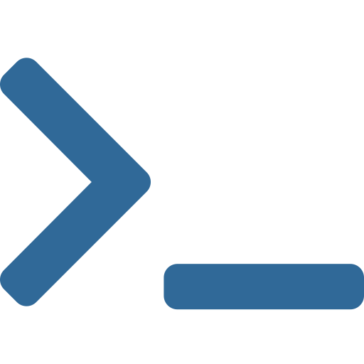
CHAPTER 1
Verify it, then pick an editor
Confirm the install
Pick a place to write code
Open a terminal (Command Prompt, Terminal, or your shell) and type:
VS Code (recommended)
Free, friendly, works on every OS. Add the "Python" extension from Microsoft.
python --version
You should see something like Python 3.12.4. Then check pip, the tool that installs libraries:
IDLE
Installed automatically with Python. No setup, great for your very first script.
pip --version
Jupyter Notebook
Runs code in blocks with instant output. Popular for data and experimentation.
On Mac or Linux, use python3 and pip3 if python alone is not found.
Chapter 1 · Installing Python
9

Slide 10

TRY IT NOW
Two minutes, on your own laptop
Open a terminal (or Command Prompt on Windows)
1
Type python and press Enter, you should land inside ">>>"
2
Type 2 + 2 and press Enter, Python should reply 4
3
Type exit() to leave, then give a thumbs up when you see the 4
4
Stuck? Raise a hand, we will pair up and fix it together before moving on.
Chapter 1 · Installing Python
10

Slide 11
CHAPTER 2
What is Python?
A little history and the traits that make Python different from other languages.
Chapter 2
11

Slide 12
CHAPTER 2
What is Python, really?
Python is a high-level, general-purpose programming language. In plain terms: you write instructions in something close to everyday English, and Python turns them into actions on your computer.
1991
Year it was first released
It was created by Guido van Rossum and first released in 1991. He named it after the British comedy show "Monty Python's Flying Circus," not the snake, which is why you will see jokes and easter eggs about comedy sketches in Python's own culture.
#1
Most popular language, several recent industry surveys
30+
Years of active, ongoing development
Chapter 2 · What is Python?
12

Slide 13

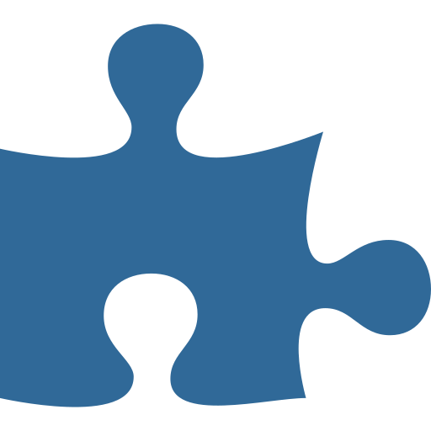
CHAPTER 2
Four traits worth knowing
Interpreted
High-level
Python runs your code line by line. No separate compile step, you save the file and run it right away.
You describe what you want, not how memory or hardware should handle it. Python manages the details for you.
Dynamically typed
General-purpose
You don't declare a variable's type up front. Python figures it out from the value you give it.
Web apps, data analysis, automation, AI, games: the same language works across nearly every domain.
Chapter 2 · What is Python?
13

Slide 14
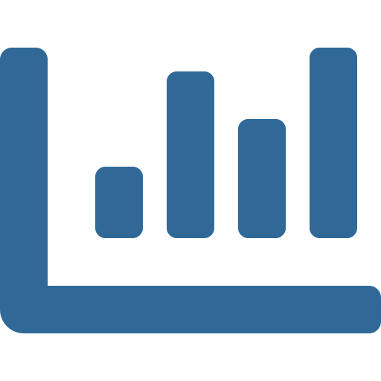
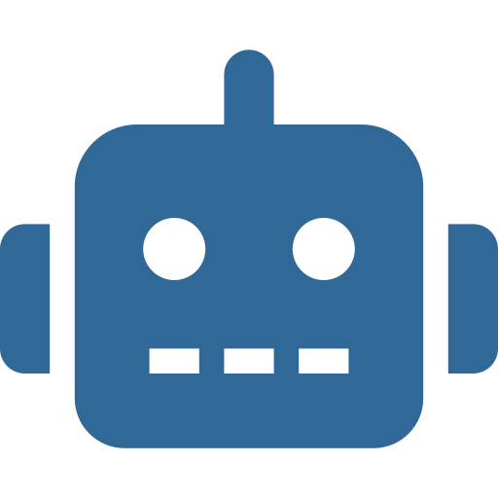


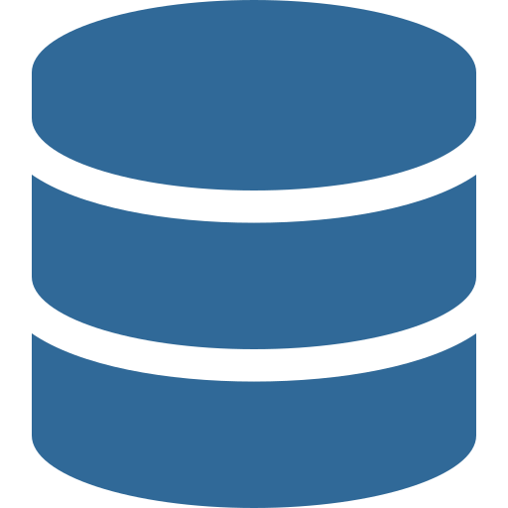
CHAPTER 2
Where Python shows up at work
The same language you are learning today powers all of these fields.
Data & analytics
AI & machine learning
Web development
Cleaning spreadsheets, building reports, dashboards
The leading language for building and training models
Backends for sites like Instagram and Pinterest
Automation & scripting
Scientific computing
Everyday tooling
Renaming files, scraping data, scheduled tasks
Research, simulations, engineering calculations
Internal tools, quick prototypes, glue between systems
Chapter 2 · What is Python?
14

Slide 15

QUICK QUIZ
Which of these use Python?
Instagram
Netflix
Spotify
NASA
Answer: all four! Python shows up almost everywhere large-scale software is built.
Shout out any other companies or apps you think use Python.
Chapter 2 · What is Python?
15

Slide 16
CHAPTER 3
Your First Program
Time to write real Python. We will keep it short and build confidence fast.
Chapter 3
16

Slide 17
CHAPTER 3
Hello, World!
Every programmer's first program prints a greeting. Here is the entire program in Python, one line:
print("Hello, World!")
Notice what's missing
No curly braces, no class wrapper, no import for basic printing, and no semicolon at the end of the line. Python trims away ceremony so you can focus on logic.
That is it, no semicolons, no setup boilerplate, no "main function" required. Save this as hello.py, then run it:
python hello.py
Chapter 3 · Your First Program
17

Slide 18
CHAPTER 3
Variables and data types
A variable is a name that holds a value. Python figures out the type automatically:
CODE
TYPE
WHAT IT MEANS
name = "Amara"
str (text)
Letters and words, wrapped in quotes
age = 29
int (whole number)
A number with no decimal point
price = 19.99
float (decimal)
A number with a decimal point
is_member = True
bool (true/false)
Only ever True or False
Chapter 3 · Your First Program
18

Slide 19

CHAPTER 3
Indentation is not optional
Most languages use curly braces { } to group code. Python uses indentation (spaces) instead, so spacing is part of the syntax, not just style.
This works
This breaks
age = 20
age = 20
if age >= 18:
if age >= 18:
print("You can vote")
print("You can vote")
print("Welcome!")
print("Welcome!")
Chapter 3 · Your First Program
19

Slide 20
TRY IT YOURSELF
Make it personal
name = "Your Name"
print("Hi, I am learning Python, " + name)
1
Open your editor and create a new file called intro.py
2
Type the two lines above, swapping in your own name
3
Run it: python intro.py, and check the message prints correctly
Bonus: can you print a second line that shows your favorite number?
Chapter 3 · Your First Program
20

Slide 21
CHAPTER 4
Libraries and Modules
The real reason Python moves fast: you rarely start from a blank page.
Chapter 4
21

Slide 22
CHAPTER 4
What is a library?
A library (or module) is a collection of pre-written code that solves a common problem, so you don't have to write it yourself.
Without a library
Writing this from scratch takes dozens of lines of math you would need to test yourself.
Think of it like a toolbox. If you need to hammer a nail, you don't forge your own hammer first, you reach for one that already exists. Libraries are the same idea for code: someone already solved the problem, tested it, and packaged it up for anyone to use.
With a library
import math
math.sqrt(64)
You import a library once at the top of your file, then use everything inside it.
# 8.0, done
Chapter 4 · Libraries and Modules
22

Slide 23
CHAPTER 4
Built-in vs. installed libraries
Standard library
Third-party libraries
Comes bundled with Python. No installation needed, just import it.
Written by the community. Install once with pip, Python's built-in package manager:
import math
pip install requests
import random
Then use it in any script:
import datetime
import requests
Examples: math for calculations, random for randomness, datetime for dates and times.
Chapter 4 · Libraries and Modules
23

Slide 24
CHAPTER 4
A few libraries you will hear about
NumPy & Pandas
Matplotlib
Requests
Work with numbers and spreadsheet-style data
Turn data into charts and graphs
Talk to websites and web services
Flask & Django
TensorFlow & PyTorch
openpyxl
Build websites and web applications
Build and train AI models
Read and write Excel files automatically
Chapter 4 · Libraries and Modules
24

Slide 25
GROUP ACTIVITY
Match the library to its job
Pandas
Build a website
Requests
Draw a chart
Matplotlib
Fetch data from a URL
Django
Analyze spreadsheet data
Call it out loud: which pair goes together? (Answers, in order: Analyze data, Fetch from a URL, Draw a chart, Build a website)
Chapter 4 · Libraries and Modules
25

Slide 26
CHAPTER 5
Why Python?
A fair, honest look at what makes Python a great default choice, and when it is not.
Chapter 5
26

Slide 27
CHAPTER 5
Same task, very different amounts of code
Here is "Hello, World!" in three languages. Same result, very different effort.
Java
C++
Python
public class Main {
#include <iostream>
print("Hello, World!")
public static void
int main() {
main(String[] args) {
std::cout <<
System.out.println(
"Hello, World!";
"Hello, World!");
return 0;
}
}
}
7 lines
6 lines
1 line
Chapter 5 · Why Python?
27

Slide 28
CHAPTER 5
Why teams choose Python
FACTOR
PYTHON
MANY OTHER LANGUAGES
Readability
Reads close to plain English
More symbols and boilerplate
Learning curve
Beginners write real code in days
Often takes weeks to get productive
Libraries
Huge ecosystem for almost any task
Varies widely by language
Community
Millions of users, answers everywhere
Smaller or more specialized
Chapter 5 · Why Python?
28

Slide 29
CHAPTER 5
In fairness: not always the right tool
No language is best at everything, and a good developer knows Python's limits too.
Raw speed matters
Mobile apps
Very small footprint devices
Compiled languages like C++ or Rust run faster for heavy, low-level computation such as game engines.
Native iOS and Android apps are usually built in Swift, Kotlin, or a cross-platform framework, not Python.
Some embedded or memory-constrained hardware favors lighter languages like C.
Chapter 5 · Why Python?
29

Slide 30
CHAPTER 6
Good Habits to Know
The small, practical things that will save you time and confusion early on.
Chapter 6
30

Slide 31

CHAPTER 6
Running code, and keeping projects tidy
Three ways to run Python
pip and virtual environments
Terminal
pip installs libraries. A virtual environment is a private, isolated copy of Python for one project, so its libraries don't clash with another project's.
python filename.py, direct and simple
Editor "Run" button
VS Code and most editors run the file for you
python -m venv env
source env/bin/activate
Notebook cells
Jupyter runs one block at a time, great for exploring
pip install requests
(On Windows, activate with: env\Scripts\activate)
Chapter 6 · Good Habits to Know
31

Slide 32
CHAPTER 6
Mistakes almost everyone makes at first
Mixing tabs and spaces
Forgetting the colon
Pick spaces (4 is standard) and let your editor handle it consistently.
Lines like if, for, and def all end with a colon before the indented block.
Comparing with = instead of ==
Wrong indentation level
= assigns a value, == checks whether two things are equal.
Lines in the same block must line up exactly, Python is strict about this.
Chapter 6 · Good Habits to Know
32

Slide 33


CHAPTER 6
Where to keep learning
Official Python docs
Practice sites
This team
docs.python.org, the most reliable reference there is
HackerRank, Codewars, and Python.org's own beginner tutorial
Our next session, plus a shared channel for questions
The fastest way to learn Python is to write it. Aim for 15 minutes a day over a big weekend push.
Chapter 6 · Good Habits to Know
33

Slide 34
RECAP
What we covered today
Installed Python
Learned what Python is
Wrote real code
Explored libraries
Compared it to other languages
Picked up good habits
Let's discuss: what is one thing you want to build with Python once you're comfortable?
Recap & Discussion
34

Slide 35
Thank you!
You installed Python, wrote real code, and learned what makes it special. That is a strong first session.
Next session: writing your first small project
Team Python Onboarding
35

