Slide 1
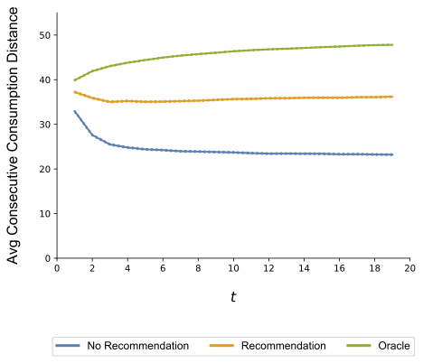
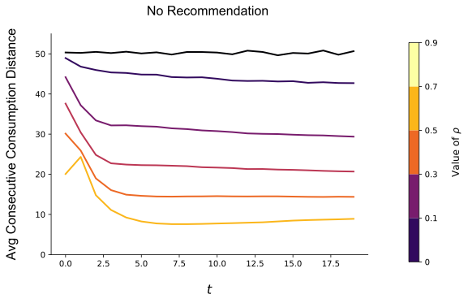
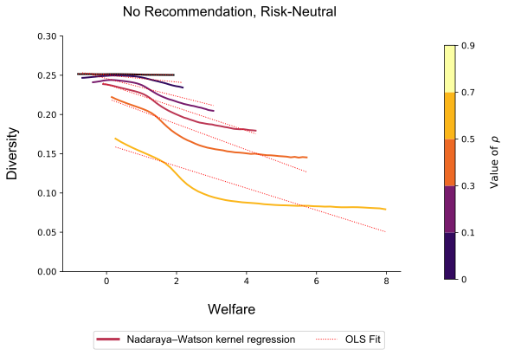
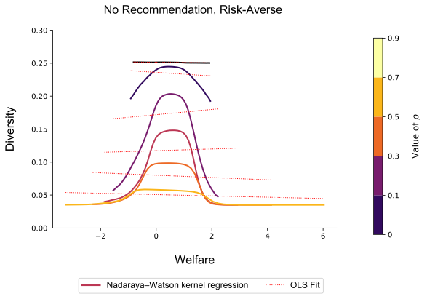
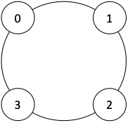
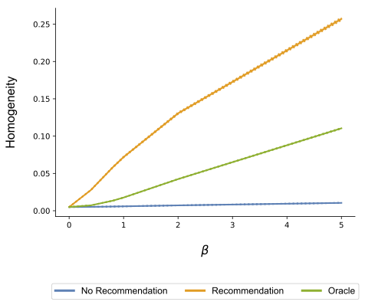
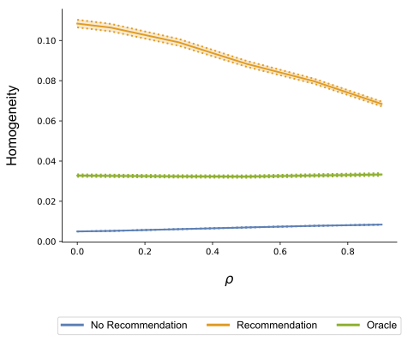
A User-Centric Approach to the Design and Consequences of Recommender Systems
Guy Aridor¹, Duarte Gonçalves¹, Shan Sikdar²
Summary & Goals
Filter Bubble Effect
Recommender systems have increasingly come under focus for negative social consequences:
Filter Bubbles: Individuals consume increasingly similar goods and are isolated from diversity of content
User Homogenization: Individuals consume increasingly similar goods as each other
We look at the extent to which these effects can be attributed to recommender systems as opposed to natural consequences of individual decision-making in markets where recommender systems are deployed.
Track average consumption distance across t
Empirical work (Nguyen, et. al 2014 WWW) has found that filter bubble effects arise without recommendation
Spillovers lead to a natural “narrowing” effect
Model
Welfare and Content Diversity
User Decision-Making:
- N items, users sequentially consume T items
- Realized utility vectors for consumer i:
Xi = Vi + βV, V ~ N(0, Σ), Vi ~ N(V,Σi)
- Users have beliefs over the realized utilities and are risk-averse
- Assume myopic users: no purposeful exploration
Product Space: Products are evenly spaced on a circle
d(n, m) = min{|m−n|,N−|m−n|}, m, n indices
Learning:
- Users employ similarity-based generalization
- Observe realized utilities directly after consumption
- Spillovers: Bayesian update beliefs about other items, but more strongly about value of similar items than about dissimilar items
- Strength of updating controlled by ρ
Recommendation Regimes:
- No Recommendation: users get no information
- Recommendation: information on V and combine with user beliefs
- Oracle: Ex-post (full information) optimal consumption path
Evaluation: Characterization via simulation over populations of users and a grid of relevant parameter values. Results here reported for N = 200, T = 20
Recommendation:
Provides users with information, reducing their uncertainty.
Three regimes:
No Recommendation: users get no information
Recommendation: based on user beliefs
Oracle: Ex-post (full information) optimal consumption path
Diversity = average normalized pairwise distance between consumed products
Does higher “content diversity” imply higher welfare?
Low diversity can come from consumption of many similar high utility goods
High diversity can come from consumption of many different low utility goods
(1)
One Public Card dealt to table
User Homogeneity
Homogeneity = Jaccard index across consumption sets
Recommendation “coordinates” individuals in similar portions of the product space
Without recommendation, no coordination leads to low homogeneity
Conclusions
Filter bubble effects can be generated by a natural model of user decision-making
Homogeneity naturally arises in recommender systems by coordinating consumers in the product space
Understanding user beliefs and user decision-making are important for evaluating recommender systems
¹Department of Economics, Columbia University ²Independent Researcher

