Slide 1
Hopper Stats – 2025 Retrospective

Slide 2
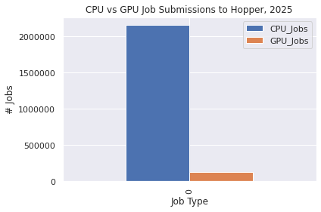
Overall Stats
CPU_Jobs | GPU_Jobs | Total
2159248 | 124073 | 2283321

Slide 3
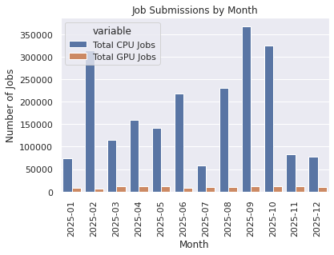
Year_Month | Total CPU Jobs | Total GPU Jobs
2025-01 | 73242 | 8443
2025-02 | 312983 | 6955
2025-03 | 114411 | 11344
2025-04 | 159153 | 12239
2025-05 | 140768 | 11216
2025-06 | 218790 | 8685
2025-07 | 58043 | 9270
2025-08 | 229877 | 9441
2025-09 | 367874 | 11871
2025-10 | 323931 | 11971
2025-11 | 83253 | 11812
2025-12 | 76923 | 10826

Slide 4
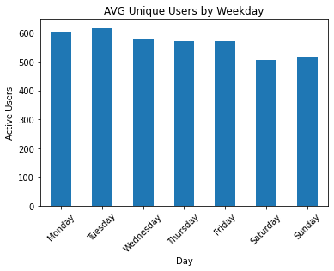
Average Unique Users by Weekday
weekday | AVG Unique Users
Monday | 604
Tuesday | 617
Wednesday | 578
Thursday | 571
Friday | 572
Saturday | 506
Sunday | 514

Slide 5
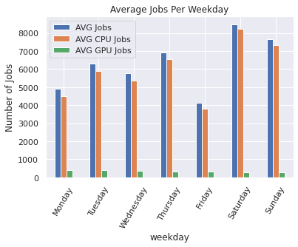
Average Jobs by Weekday
weekday | AVG Jobs | AVG CPU Jobs | AVG GPU Jobs
Monday | 4900.461538 | 4481.461538 | 403.307692
Tuesday | 6310.807692 | 5887.423077 | 409.942308
Wednesday | 5772.096154 | 5359.038462 | 368.692308
Thursday | 6911.307692 | 6562.115385 | 338.096154
Friday | 4136.596154 | 3818.115385 | 312.423077
Saturday | 8481.365385 | 8212.942308 | 263.346154
Sunday | 7641.235294 | 7344.137255 | 295.901961

Slide 6
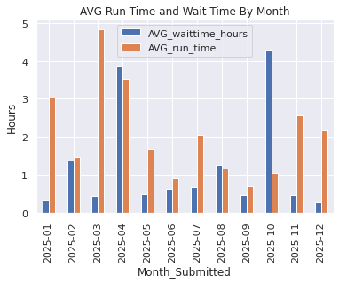
Run Times and Wait Times
Month_Submitted | AVG_run_time | AVG_waittime | AVG_waittime_hours
2025-01 | 3.028034 | 0 days 00:18:48.883508081 | 0.313579
2025-02 | 1.476784 | 0 days 01:21:54.255272038 | 1.365071
2025-03 | 4.845218 | 0 days 00:25:31.966946975 | 0.425546
2025-04 | 3.515971 | 0 days 03:52:18.457474827 | 3.871794
2025-05 | 1.665914 | 0 days 00:29:23.752487933 | 0.489931
2025-06 | 0.894532 | 0 days 00:37:00.052443908 | 0.616681
2025-07 | 2.053166 | 0 days 00:40:50.483931947 | 0.680690
2025-08 | 1.165074 | 0 days 01:15:10.790826834 | 1.252997
2025-09 | 0.705952 | 0 days 00:27:13.557988204 | 0.453766
2025-10 | 1.041229 | 0 days 04:17:32.832265720 | 4.292453
2025-11 | 2.564708 | 0 days 00:27:25.875593542 | 0.457188
2025-12 | 2.174738 | 0 days 00:16:47.226575725 | 0.279785

Slide 7
CPU Stats

Slide 8
Overall CPU Resources
Year_Month | AVG NCPUS | AVG CPUHRS | AVG MEM(GB) | AVG NNODES | Total NCPUS | Total CPUHRS | Total MEM(GB) | Total NNODES
2025-01 | 9.518022 | 47.313613 | 37.191771 | 1.084364 | 697119 | 3.465344e+06 | 2.724000e+06 | 79421
2025-02 | 4.734922 | 13.606608 | 25.236357 | 1.023618 | 1481950 | 4.258637e+06 | 7.898551e+06 | 320375
2025-03 | 4.481772 | 36.232234 | 24.905580 | 1.040486 | 512764 | 4.145366e+06 | 2.849472e+06 | 119043
2025-04 | 3.956124 | 25.272318 | 28.529217 | 1.033798 | 629629 | 4.022165e+06 | 4.540511e+06 | 164532
2025-05 | 6.876478 | 25.294480 | 32.950917 | 1.046914 | 967988 | 3.560653e+06 | 4.638435e+06 | 147372
2025-06 | 4.079857 | 16.185328 | 16.765214 | 1.029709 | 892632 | 3.541188e+06 | 3.668061e+06 | 225290
2025-07 | 17.508468 | 60.987541 | 70.647768 | 1.273969 | 1016244 | 3.539900e+06 | 4.100608e+06 | 73945
2025-08 | 7.040596 | 16.215532 | 46.748036 | 1.016309 | 1618471 | 3.727578e+06 | 1.074630e+07 | 233626
2025-09 | 3.799578 | 10.489074 | 19.470069 | 1.035958 | 1397766 | 3.858658e+06 | 7.162532e+06 | 381102
2025-10 | 7.196239 | 9.093548 | 28.729309 | 1.085821 | 2331085 | 2.945682e+06 | 9.306314e+06 | 351731
2025-11 | 28.995760 | 41.380131 | 118.165443 | 1.219440 | 2413984 | 3.445020e+06 | 9.837628e+06 | 101522
2025-12 | 32.278603 | 39.381752 | 125.403612 | 1.199810 | 2482967 | 3.029363e+06 | 9.646422e+06 | 92293

Slide 9
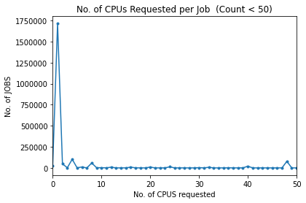
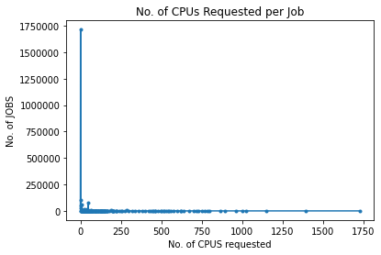
CPU Request Count

Slide 10
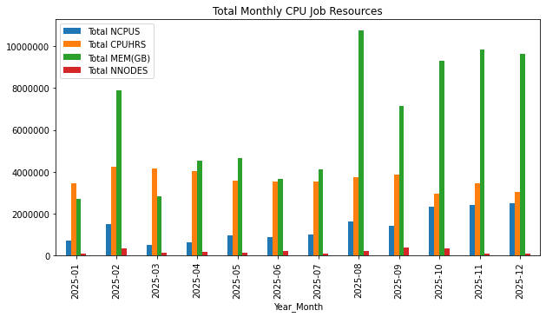
Total Monthly CPU Resources

Slide 11
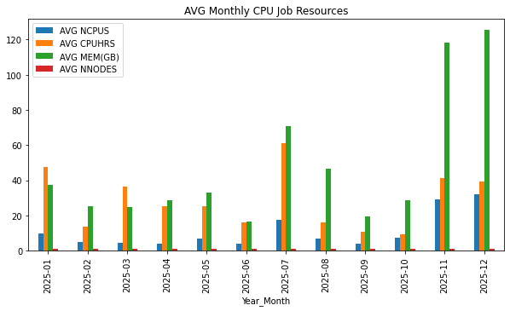
Average Monthly CPU Resources

Slide 12
GPU Stats

Slide 13
Overall GPU Resources
Year_Month | AVG NCPUS | AVG NGPUS | AVG CPUHRS | AVG GPUHRS | AVG MEM(GB) | AVG NNODES | Total NCPUS | Total NGPUS | Total CPUHRS | Total GPUHRS | Total MEM(GB) | Total NNODES
2025-01 | 5.481345 | 1.196494 | 48.675836 | 9.247031 | 70.994109 | 0.889968 | 46279.0 | 10102 | 410970.082222 | 78072.679167 | 5.993323e+05 | 7514.0
2025-02 | 11.271316 | 1.449461 | 80.627396 | 10.464042 | 98.241811 | 0.966930 | 78392.0 | 10081 | 560763.536667 | 72777.413056 | 6.829771e+05 | 6725.0
2025-03 | 9.875088 | 1.411231 | 54.050035 | 7.741525 | 98.121608 | 0.865380 | 112023.0 | 16009 | 613143.595000 | 87819.857500 | 1.112993e+06 | 9816.0
2025-04 | 5.918131 | 1.118555 | 52.893649 | 6.736895 | 67.897101 | 0.874908 | 72432.0 | 13690 | 647365.371111 | 82452.854444 | 8.309926e+05 | 10708.0
2025-05 | 6.164230 | 1.134094 | 62.803965 | 7.586762 | 72.039012 | 0.880974 | 69138.0 | 12720 | 704409.267222 | 85093.119722 | 8.074132e+05 | 9881.0
2025-06 | 6.078181 | 1.255153 | 72.997914 | 8.110552 | 85.370430 | 0.934139 | 52789.0 | 10901 | 633986.884444 | 70440.147778 | 7.414422e+05 | 8113.0
2025-07 | 8.072168 | 1.198274 | 61.688953 | 6.131966 | 79.765814 | 0.880906 | 74829.0 | 11108 | 571856.590000 | 56843.328611 | 7.394291e+05 | 8166.0
2025-08 | 11.486919 | 1.391696 | 90.740495 | 7.540020 | 92.637598 | 0.940684 | 108448.0 | 13139 | 856681.015833 | 71185.332778 | 8.745916e+05 | 8881.0
2025-09 | 8.955438 | 1.331480 | 66.146368 | 7.002865 | 72.060323 | 0.907253 | 106310.0 | 15806 | 785223.531944 | 83131.005833 | 8.554281e+05 | 10770.0
2025-10 | 8.893326 | 1.234233 | 75.297769 | 6.849927 | 85.863963 | 0.937850 | 106462.0 | 14775 | 901389.590833 | 82000.480278 | 1.027878e+06 | 11227.0
2025-11 | 7.620386 | 1.239079 | 78.621395 | 6.888219 | 91.854907 | 0.934135 | 90012.0 | 14636 | 928675.913333 | 81363.643056 | 1.084990e+06 | 11034.0
2025-12 | 7.506835 | 1.179198 | 77.321562 | 6.738296 | 86.952563 | 0.891557 | 81269.0 | 12766 | 837083.232222 | 72948.797500 | 9.413484e+05 | 9652.0

Slide 14
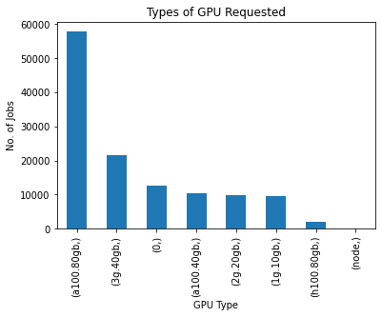
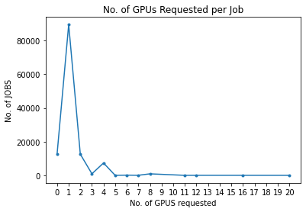
GPU Requests
GPUType | Requests
a100.80gb | 57832
3g.40gb | 21670
0 | 12594
a100.40gb | 10400
2g.20gb | 9979
1g.10gb | 9672
h100.80gb | 1920
node | 6

Slide 15
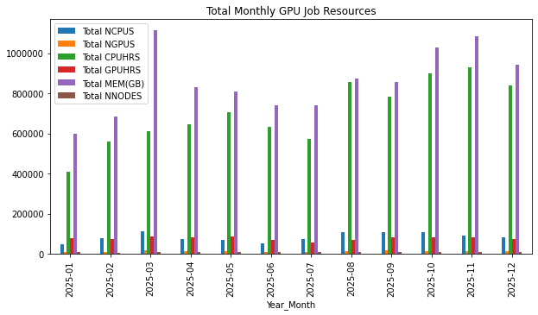
Total Monthly GPU Resources

Slide 16
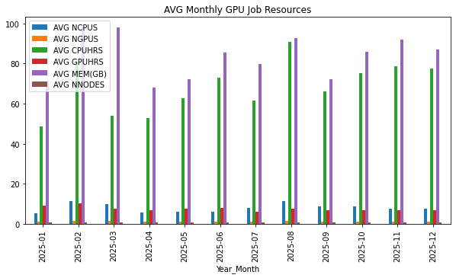
Average Monthly GPU Resources

Slide 17
Usage by College and Department

Slide 18
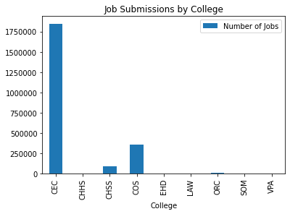
Usage By College
College | Number of Jobs
CEC | 1847607
CHHS | 301
CHSS | 83548
COS | 350785
EHD | 2
LAW | 95
ORC | 3401
SOM | 1279
VPA | 36

Slide 19
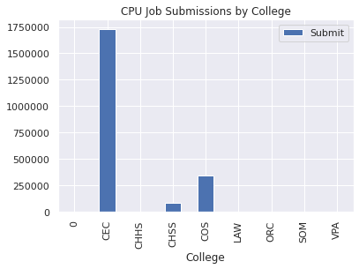
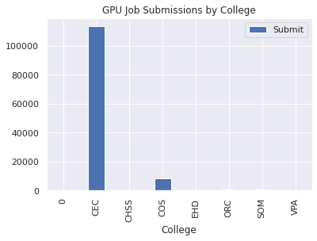
CPU vs GPU Jobs by College
College | CPU Jobs | GPU Jobs
0 | 956 | 350
CEC | 1731014 | 113566
CHHS | 301 | 357
CHSS | 83191 | 8304
COS | 342096 | 2
LAW | 95 | 644
ORC | 1130 | 834
SOM | 445 | 16
VPA | 20 | 350

Slide 20
CEC Breakdown

Slide 21
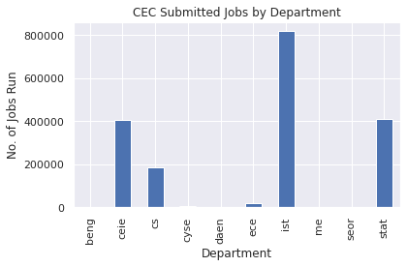
Overall CEC Jobs
Dept | Submit
beng | 2599
ceie | 404490
cs | 185704
cyse | 5575
daen | 482
ece | 20089
ist | 818885
me | 696
seor | 1168
stat | 407919

Slide 22
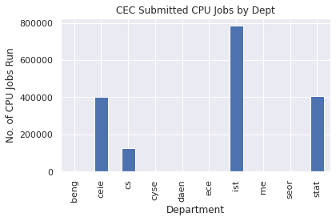
CEC CPU Jobs
Dept | No. of CPU Jobs Submitted | CPU Hrs | AVG CPU Hrs | MEM(GB) | AVG MEM(GB)
beng | 2062 | 72519.47 | 35.17 | 311830.00 | 151.23
ceie | 403909 | 7592789.35 | 18.80 | 14244531.80 | 35.27
cs | 128234 | 4044583.22 | 31.54 | 4437875.21 | 34.61
cyse | 2138 | 298125.52 | 139.44 | 473931.00 | 221.67
daen | 337 | 68950.76 | 204.60 | 16494.00 | 48.94
ece | 3339 | 679437.41 | 203.49 | 108727.30 | 32.56
ist | 785603 | 417913.51 | 0.53 | 3224156.47 | 4.10
me | 474 | 217120.83 | 458.06 | 68168.00 | 143.81
seor | 88 | 470.20 | 5.34 | 1047.00 | 11.90
stat | 404830 | 2598905.13 | 6.42 | 5383631.94 | 13.30

Slide 23
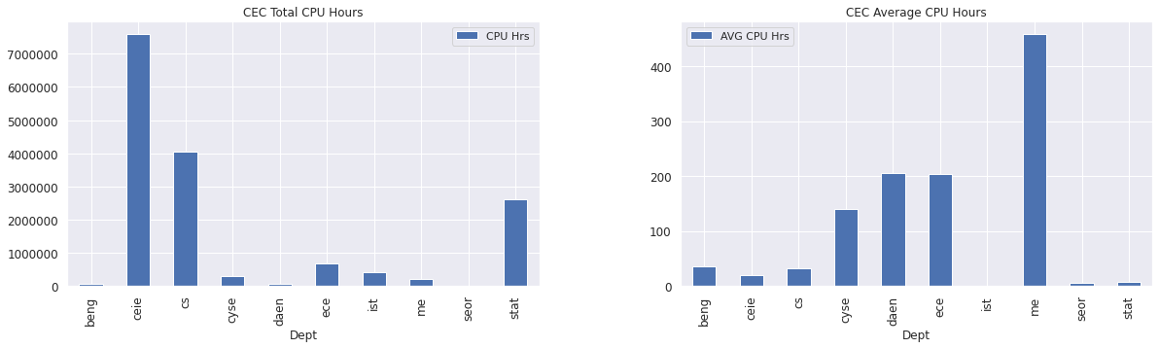
CEC CPU Hours

Slide 24
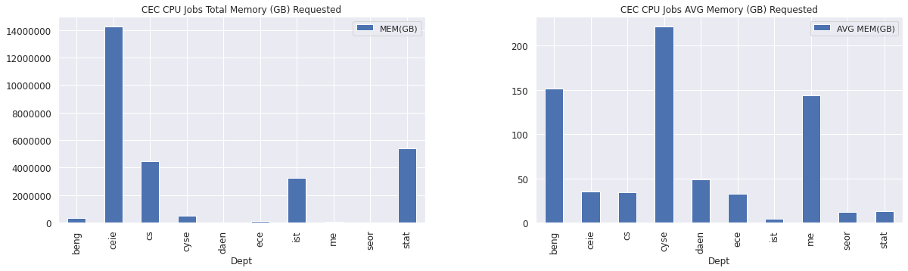
CEC CPU Memory

Slide 25
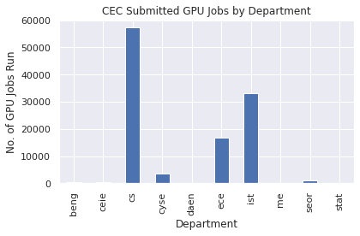
CEC GPU Jobs
Dept | No. of GPU Jobs Submitted | CPU Hrs | AVG CPU Hrs | GPU Hrs | AVG GPU Hrs | MEM(GB) | AVG MEM(GB)
beng | 537 | 1481.06 | 2.76 | 1481.06 | 2.76 | 11203.00 | 20.86
ceie | 576 | 93389.59 | 162.13 | 5465.83 | 9.49 | 32474.00 | 56.38
cs | 57388 | 2689278.67 | 46.86 | 424339.74 | 7.39 | 4543997.11 | 79.20
cyse | 3437 | 36496.97 | 10.62 | 7003.43 | 2.04 | 309877.72 | 90.16
daen | 145 | 35390.00 | 244.07 | 3809.35 | 26.27 | 9220.00 | 63.59
ece | 16750 | 559803.42 | 33.42 | 74278.77 | 4.43 | 700947.37 | 41.85
ist | 33244 | 2899977.88 | 87.23 | 220620.37 | 6.64 | 3684835.42 | 110.84
me | 222 | 9440.23 | 42.52 | 708.89 | 3.19 | 13888.00 | 62.56
seor | 1077 | 306811.36 | 284.88 | 25688.44 | 23.85 | 93199.52 | 86.54
stat | 190 | 23805.23 | 125.29 | 4359.83 | 22.95 | 6133.42 | 32.28

Slide 26
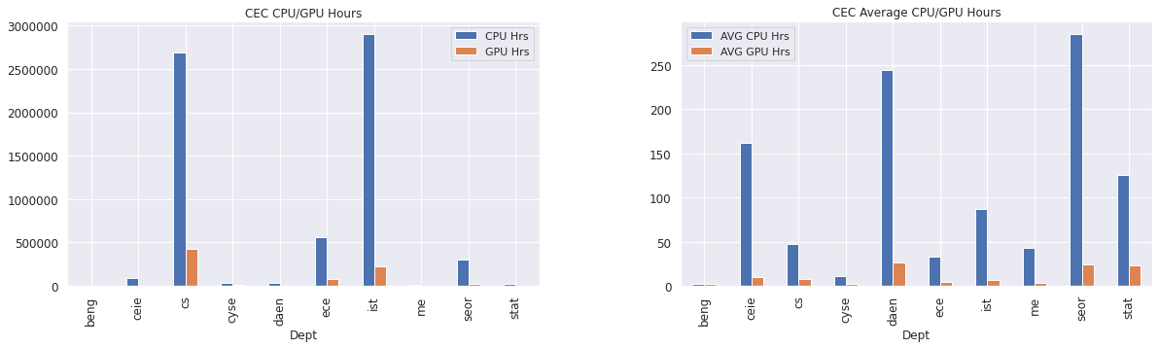
CEC GPU Hours

Slide 27
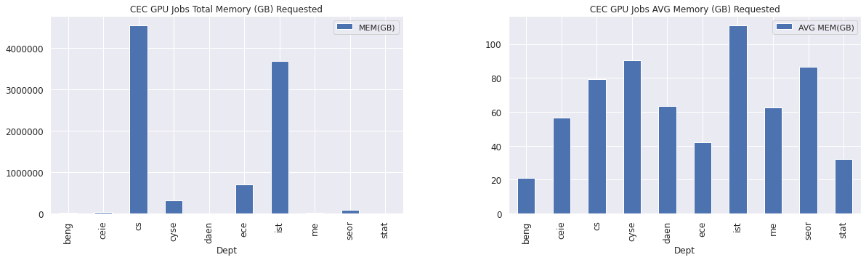
CEC GPU Memory

Slide 28
COS Breakdown

Slide 29
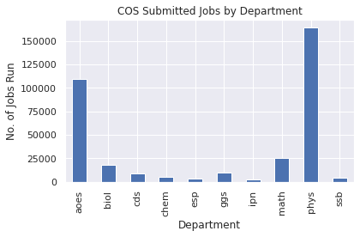
Overall COS Jobs
Dept | Submit
aoes | 109233
biol | 18244
cds | 9155
chem | 4744
esp | 2919
ggs | 9653
ipn | 2731
math | 25505
phys | 164625
ssb | 3976

Slide 30
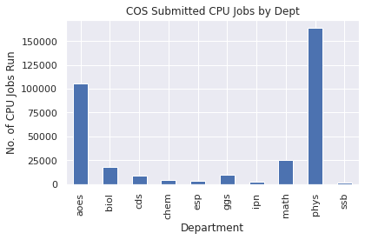
COS CPU Jobs
Dept | No. of CPU Jobs Submitted | CPU Hrs | AVG CPU Hrs | MEM(GB) | AVG MEM(GB)
aoes | 105579 | 5106174.92 | 48.36 | 26880067.19 | 254.60
biol | 18187 | 525899.47 | 28.92 | 2001875.56 | 110.07
cds | 8587 | 751942.11 | 87.57 | 236857.22 | 27.58
chem | 4439 | 1146580.49 | 258.30 | 838196.08 | 188.83
esp | 2916 | 166798.86 | 57.20 | 75242.00 | 25.80
ggs | 9192 | 877813.74 | 95.50 | 2094253.00 | 227.83
ipn | 2731 | 53915.56 | 19.74 | 97501.00 | 35.70
math | 25265 | 2686842.51 | 106.35 | 1383968.68 | 54.78
phys | 164088 | 15371947.56 | 93.68 | 13746805.63 | 83.78
ssb | 1112 | 80277.96 | 72.19 | 62416.00 | 56.13

Slide 31
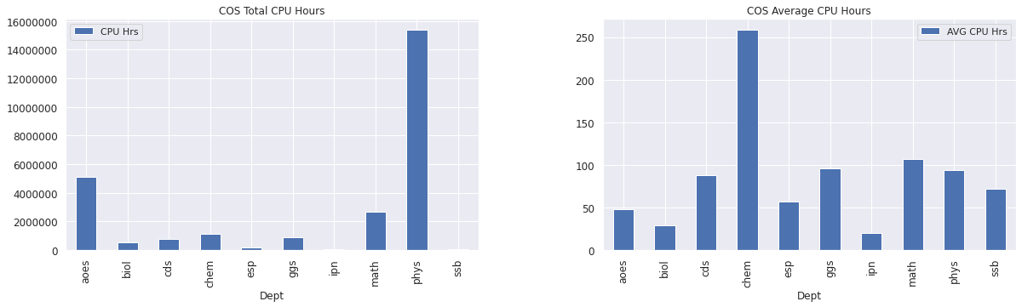
COS CPU Hours

Slide 32
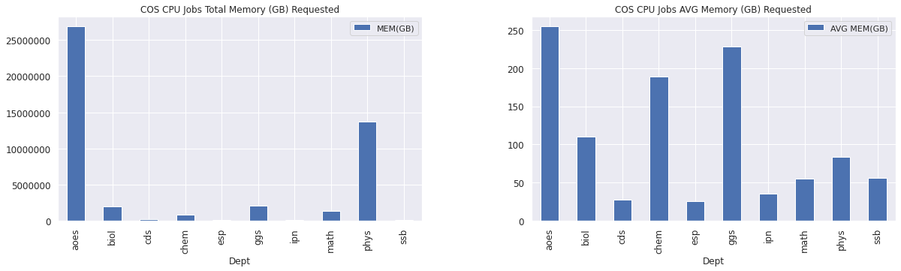
COS CPU Memory

Slide 33
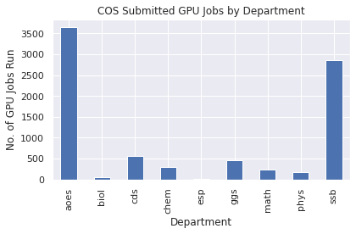
COS GPU Jobs
Dept | No. of GPU Jobs Submitted | CPU Hrs | AVG CPU Hrs | GPU Hrs | AVG GPU Hrs | MEM(GB) | AVG MEM(GB)
aoes | 3654 | 265170.01 | 72.57 | 35156.66 | 9.62 | 489199.00 | 133.88
biol | 57 | 746.06 | 13.09 | 79.26 | 1.39 | 730.24 | 12.81
cds | 558 | 45738.34 | 81.97 | 8782.21 | 15.74 | 21259.40 | 38.10
chem | 305 | 87361.18 | 286.43 | 15785.99 | 51.76 | 20871.43 | 68.43
esp | 3 | 0.01 | 0.00 | 0.01 | 0.00 | 30.00 | 10.00
ggs | 459 | 9195.00 | 20.03 | 1597.47 | 3.48 | 34870.00 | 75.97
math | 240 | 4354.16 | 18.14 | 4259.63 | 17.75 | 38482.00 | 160.34
phys | 164 | 671.48 | 4.09 | 100.08 | 0.61 | 7990.25 | 48.72
ssb | 2864 | 972632.48 | 339.61 | 62569.89 | 21.85 | 78642.00 | 27.46

Slide 34
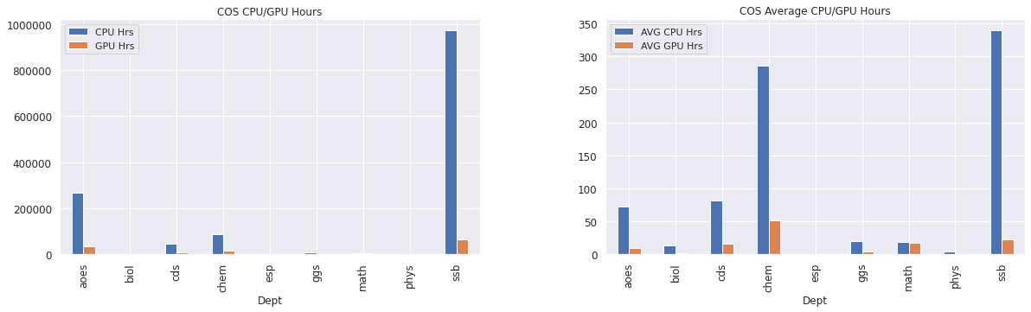
COS GPU Hours

Slide 35
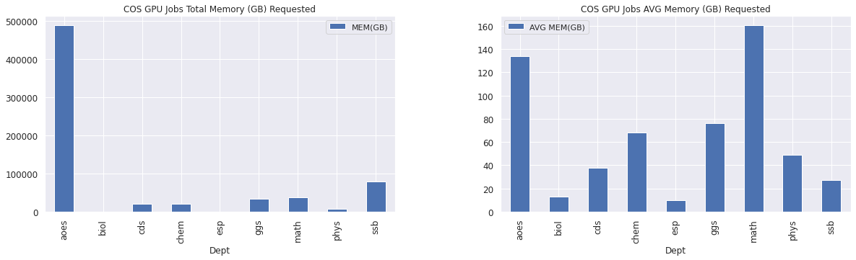
COS GPU Memory

Slide 36
Instructional Jobs

Slide 37
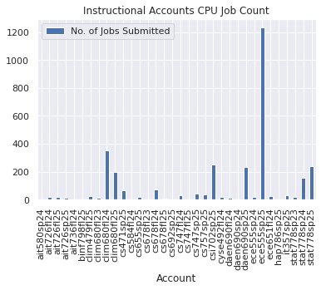
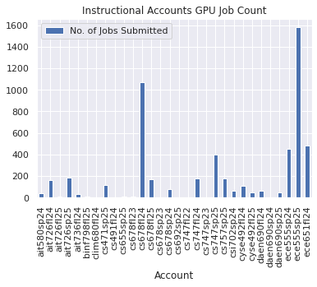
Instructional CPU and GPU

Slide 38
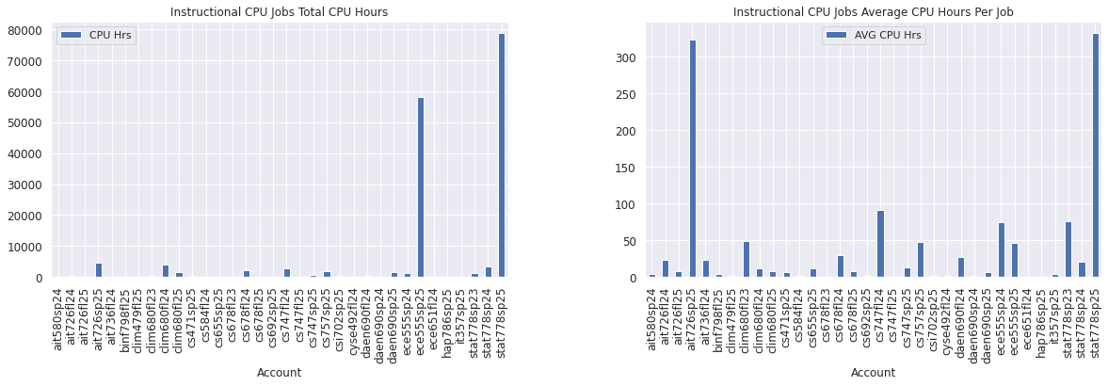
Instructional CPU Hours

Slide 39
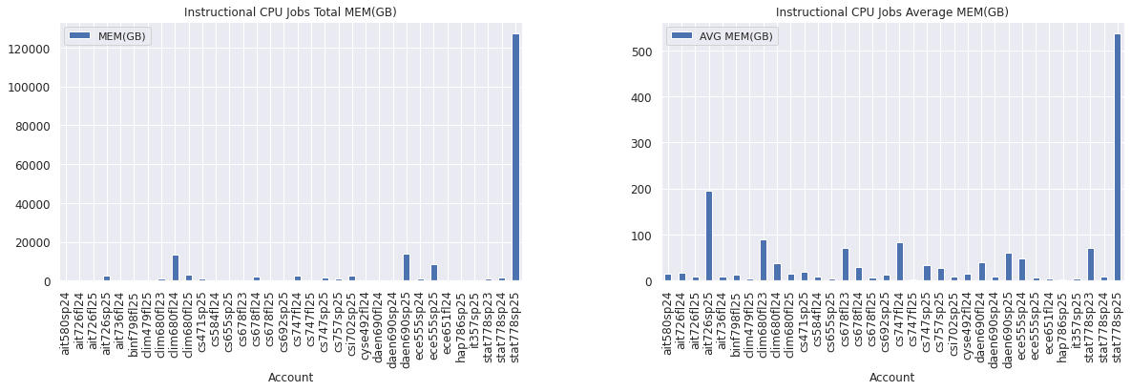
Instructional CPU Memory

Slide 40
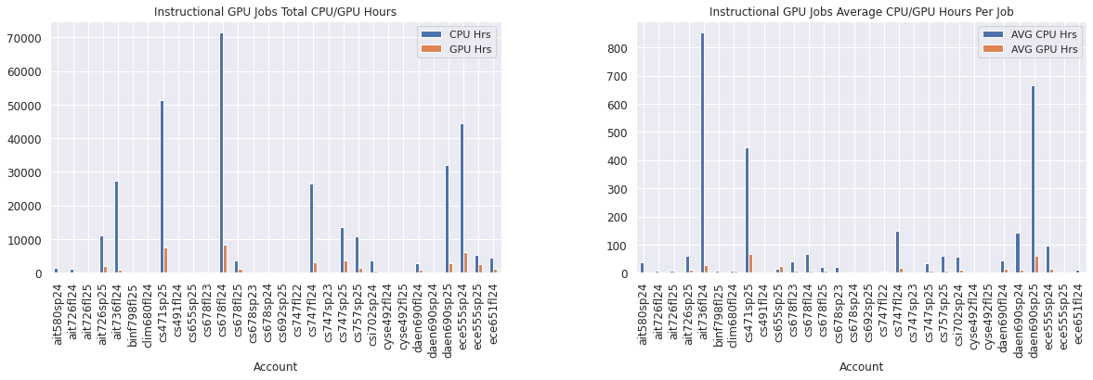
Instructional GPU Hours

Slide 41
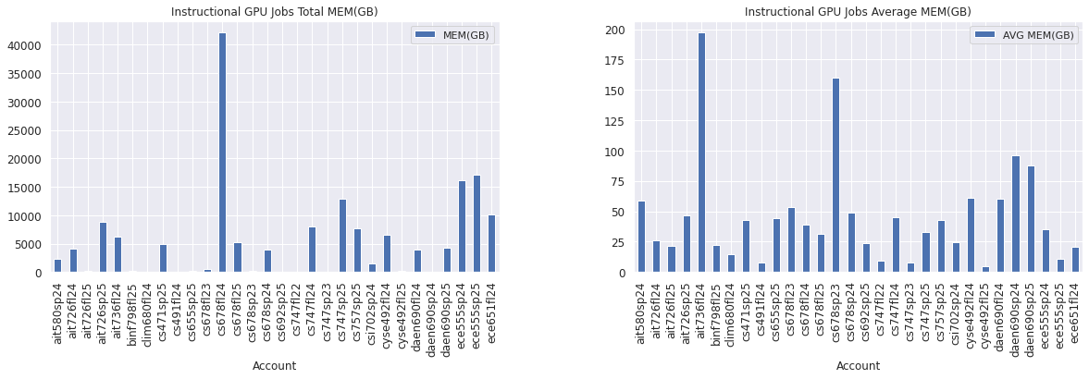
Instructional GPU Memory

