Slide 1
Hopper Stats – Fall 2025 – Spring 2026

Slide 2
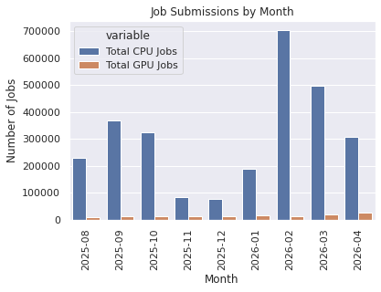
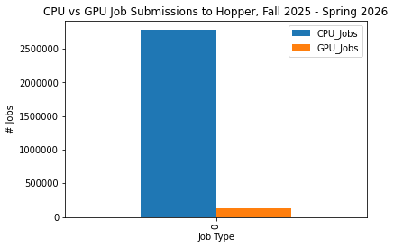
Overall Stats
CPU_Jobs | GPU_Jobs | Total
2777817 | 127787 | 2905604

Slide 3
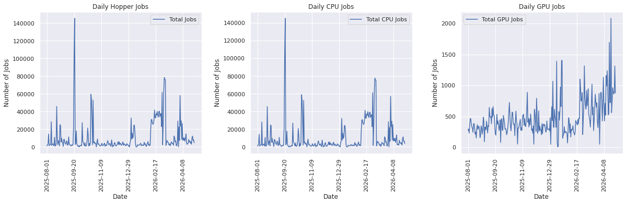

Slide 4
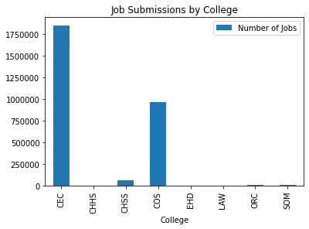
College | Number of Jobs
CEC | 1851516
CHHS | 403
CHSS | 63936
COS | 967083
EHD | 2
LAW | 6
ORC | 1865
SOM | 2660

Slide 5
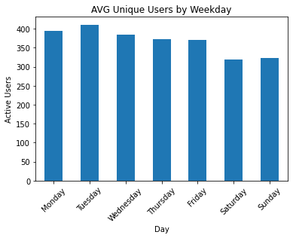
Average Unique Users by Weekday
weekday | AVG Unique Users
Monday | 395
Tuesday | 411
Wednesday | 385
Thursday | 373
Friday | 370
Saturday | 320
Sunday | 323

Slide 6
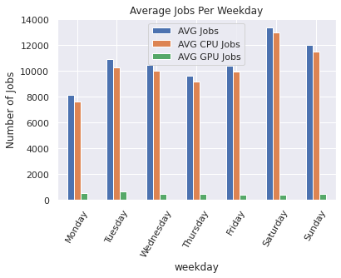
Average Jobs by Weekday
weekday | AVG Jobs | AVG CPU Jobs | AVG GPU Jobs
Monday | 8123.666667 | 7588.589744 | 502.307692
Tuesday | 10889.692308 | 10248.025641 | 613.871795
Wednesday | 10486.256410 | 9992.051282 | 471.076923
Thursday | 9648.105263 | 9167.473684 | 443.210526
Friday | 10411.948718 | 9972.179487 | 410.538462
Saturday | 13384.948718 | 12971.769231 | 398.538462
Sunday | 11986.153846 | 11521.051282 | 448.410256

Slide 7
CPU Stats

Slide 8
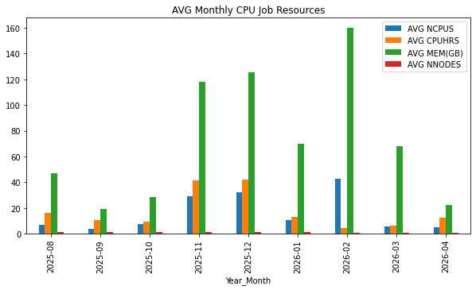
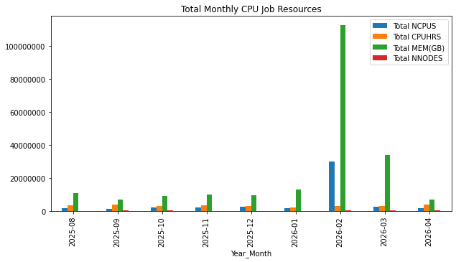
Overall CPU Resources
Year_Month | AVG NCPUS | AVG CPUHRS | AVG MEM(GB) | AVG NNODES | Total NCPUS | Total CPUHRS | Total MEM(GB) | Total NNODES
2025-08 | 7.040596 | 16.215532 | 46.748036 | 1.016309 | 1618471 | 3.727578e+06 | 1.074630e+07 | 233626
2025-09 | 3.799578 | 10.489074 | 19.470069 | 1.035958 | 1397766 | 3.858658e+06 | 7.162532e+06 | 381102
2025-10 | 7.196239 | 9.093548 | 28.729309 | 1.085821 | 2331085 | 2.945682e+06 | 9.306314e+06 | 351731
2025-11 | 28.995760 | 41.380131 | 118.165443 | 1.219440 | 2413984 | 3.445020e+06 | 9.837628e+06 | 101522
2025-12 | 32.296795 | 42.014480 | 125.495869 | 1.200192 | 2487370 | 3.235787e+06 | 9.665190e+06 | 92434
2026-01 | 10.454105 | 12.928640 | 69.765199 | 1.065747 | 1975000 | 2.442492e+06 | 1.318011e+07 | 201342
2026-02 | 42.866128 | 4.517201 | 159.879375 | 1.010522 | 30139989 | 3.176130e+06 | 1.124142e+08 | 710517
2026-03 | 5.416047 | 6.314004 | 68.061584 | 1.009447 | 2686630 | 3.132062e+06 | 3.376195e+07 | 500736
2026-04 | 5.153816 | 12.282554 | 22.520373 | 1.008480 | 1586221 | 3.780275e+06 | 6.931230e+06 | 310

Slide 9
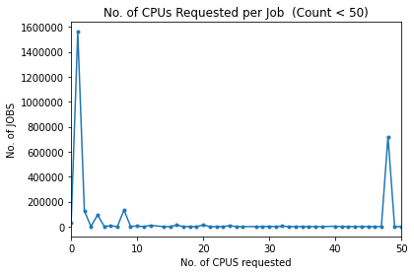
CPU Request Count

Slide 10
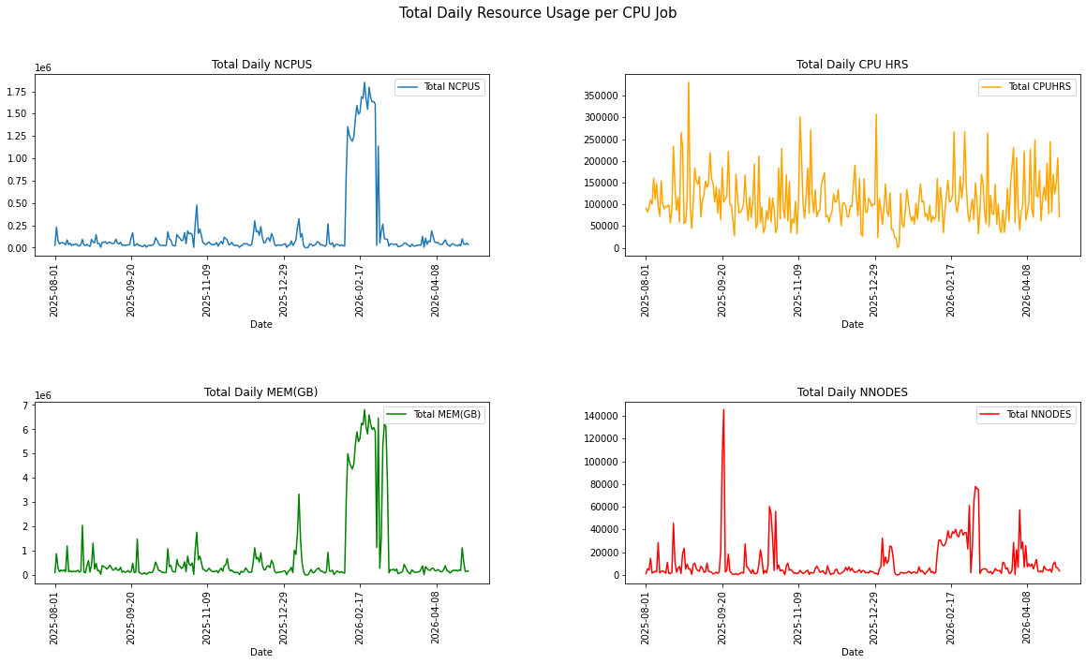
Total Daily CPU Resources

Slide 11
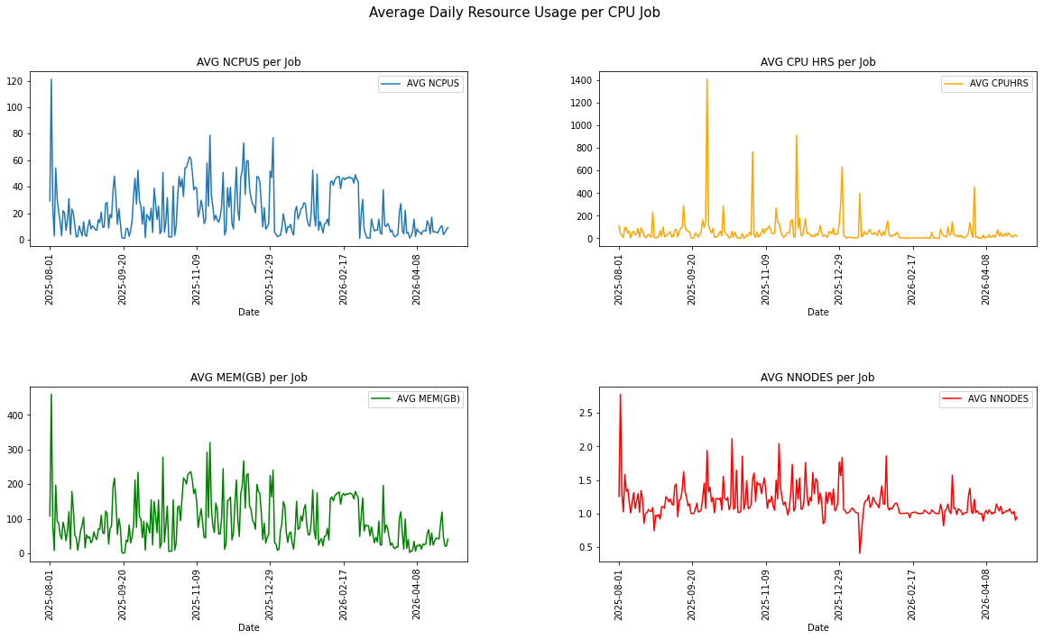
Average Daily CPU Resources

Slide 12
GPU Stats

Slide 13
Overall GPU Resources
Year_Month | AVG NCPUS | AVG NGPUS | AVG CPUHRS | AVG GPUHRS | AVG MEM(GB) | AVG NNODES | Total NCPUS | Total NGPUS | Total CPUHRS | Total GPUHRS | Total MEM(GB) | Total NNODES
2025-08 | 11.486919 | 1.391696 | 90.740495 | 7.540020 | 92.637598 | 0.940684 | 108448.0 | 13139 | 856681.015833 | 71185.332778 | 8.745916e+05 | 8881
2025-09 | 8.955438 | 1.331480 | 66.146368 | 7.002865 | 72.060323 | 0.907253 | 106310.0 | 15806 | 785223.531944 | 83131.005833 | 8.554281e+05 | 10770
2025-10 | 8.893326 | 1.234233 | 75.297769 | 6.849927 | 85.863963 | 0.937850 | 106462.0 | 14775 | 901389.590833 | 82000.480278 | 1.027878e+06 | 11227
2025-11 | 7.620386 | 1.239079 | 78.621395 | 6.888219 | 91.854907 | 0.934135 | 90012.0 | 14636 | 928675.913333 | 81363.643056 | 1.084990e+06 | 11034
2025-12 | 7.568230 | 1.181426 | 84.426439 | 7.194247 | 87.242768 | 0.892172 | 82471.0 | 12874 | 919994.901944 | 78395.711944 | 9.506844e+05 | 9722
2026-01 | 6.039229 | 1.087553 | 47.220716 | 4.559017 | 47.792537 | 0.916520 | 88982.0 | 16024 | 695750.029444 | 67172.551944 | 7.041752e+05 | 13504
2026-02 | 8.179623 | 1.264307 | 52.673490 | 5.439375 | 88.739806 | 0.905971 | 98908.0 | 15288 | 636927.841944 | 65772.923333 | 1.072953e+06 | 10955
2026-03 | 6.719201 | 1.019668 | 36.759902 | 3.936291 | 64.411064 | 0.861449 | 130843.0 | 19856 | 715825.574722 | 76651.403056 | 1.254277e+06 | 16775
2026-04 | 5.965602 | 0.954542 | 24.940246 | 3.337395 | 62.621262 | 0.811029 | 152099.0 | 24337 | 635876.512500 | 85090.228333 | 1.596592e+06 | 20678

Slide 14
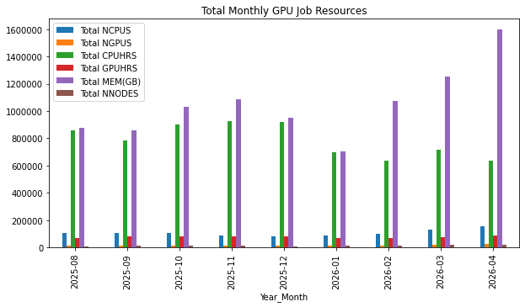
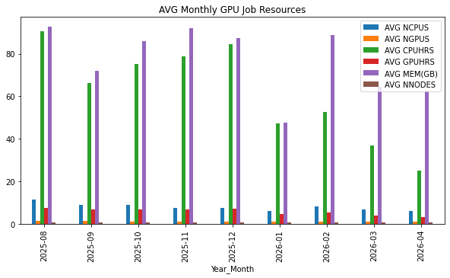

Slide 15
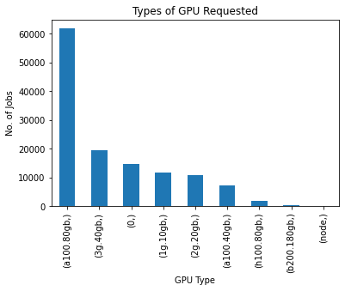
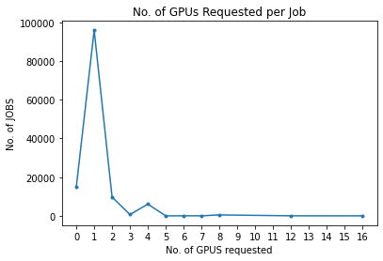
GPU Requests
GPUType | Requests
a100.80gb | 61869
3g.40gb | 19395
0 | 14772
1g.10gb | 11695
2g.20gb | 10848
a100.40gb | 7142
h100.80gb | 1727
b200.180gb | 335
node | 4

Slide 16
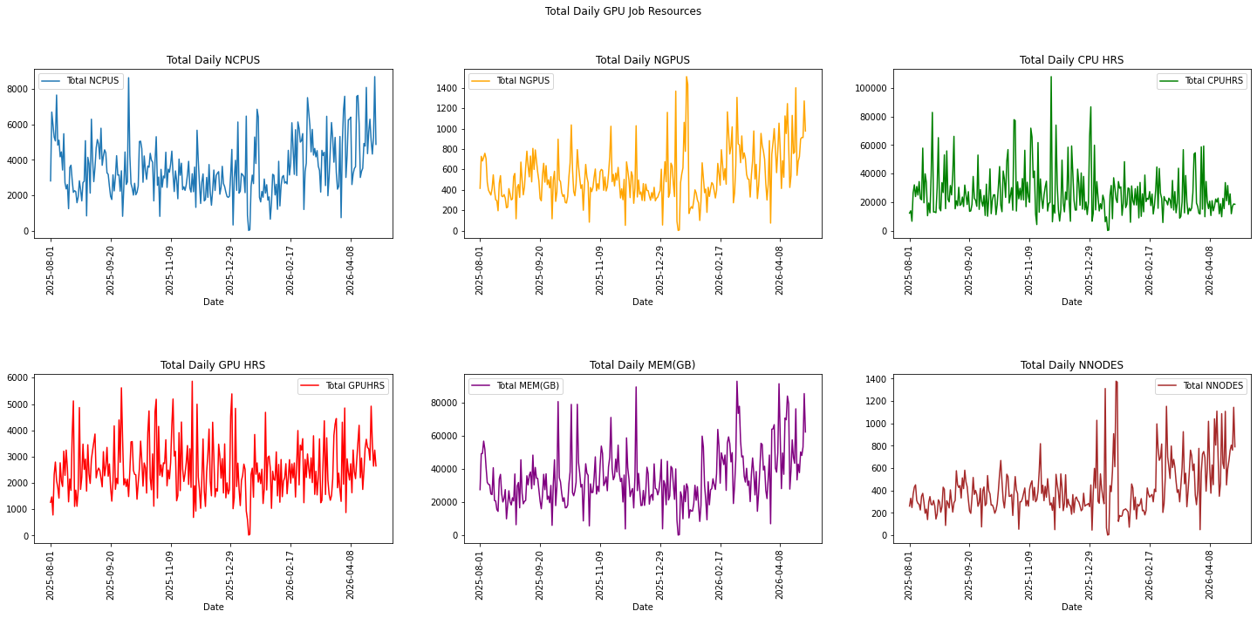
Total Daily GPU Resources

Slide 17
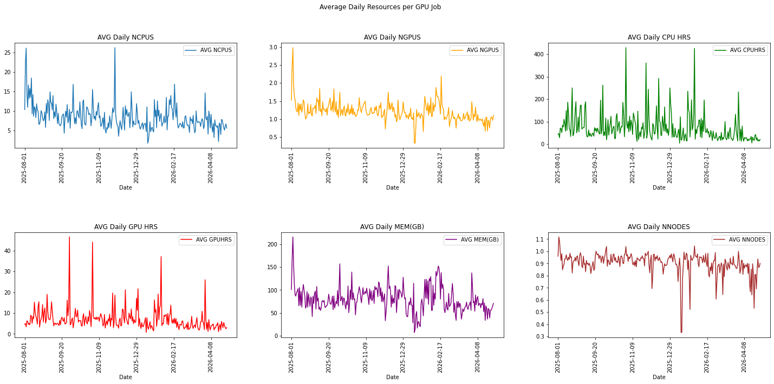
Average Daily GPU Resources

Slide 18
User GPU Stats

Slide 19
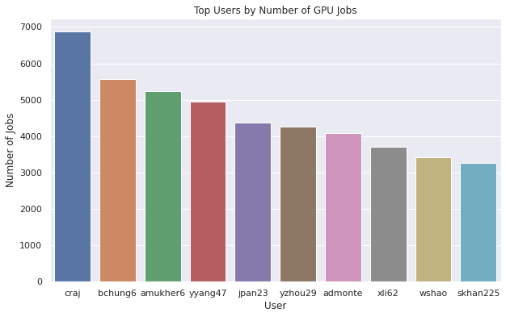
Users by Number of GPU Jobs
User | Number of Jobs
craj | 6883
bchung6 | 5574
amukher6 | 5233
yyang47 | 4944
jpan23 | 4376
yzhou29 | 4263
admonte | 4087
xli62 | 3710
wshao | 3428
skhan225 | 3269

Slide 20
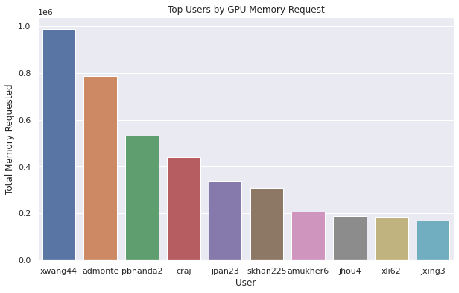
Users by Total GPU Memory Requested
User | Total Memory Requested
xwang44 | 987436.000000
admonte | 784691.000000
pbhanda2 | 532912.000000
craj | 441173.640625
jpan23 | 337708.000000
skhan225 | 309779.000000
amukher6 | 208909.640625
jhou4 | 188320.000000
xli62 | 186172.000000
jxing3 | 170820.000000

Slide 21
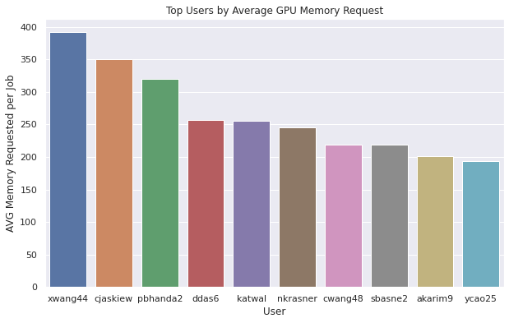
Users by Average GPU Memory Requested
User | AVG Memory Requested per Job
xwang44 | 392.462639
cjaskiew | 350.000000
pbhanda2 | 319.875150
ddas6 | 257.142857
katwal | 256.000000
nkrasner | 245.833333
cwang48 | 219.117647
sbasne2 | 218.811060
akarim9 | 201.775701
ycao25 | 193.333333

Slide 22
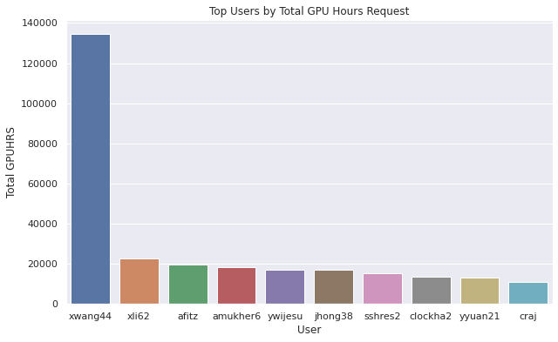
Users by Total GPUHRS Requested
User | Total GPUHRS
xwang44 | 134682.765556
xli62 | 22553.646389
afitz | 19575.707500
amukher6 | 18350.208889
ywijesu | 17166.997778
jhong38 | 16830.570556
sshres2 | 15175.370278
clockha2 | 13689.053333
yyuan21 | 13108.519167
craj | 11181.615278

Slide 23
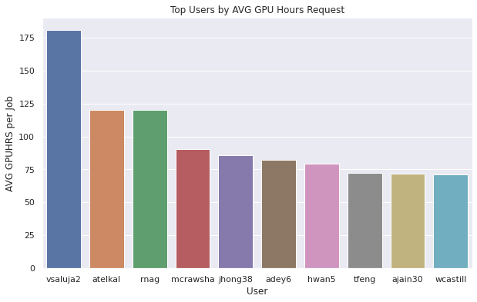
Users by AVG GPUHRS Requested
User | AVG GPUHRS per Job
vsaluja2 | 180.824194
atelkal | 120.004444
rnag | 120.000833
mcrawsha | 90.181474
jhong38 | 85.870258
adey6 | 82.184167
hwan5 | 79.300322
tfeng | 72.152083
ajain30 | 72.004583
wcastill | 71.483667

Slide 24
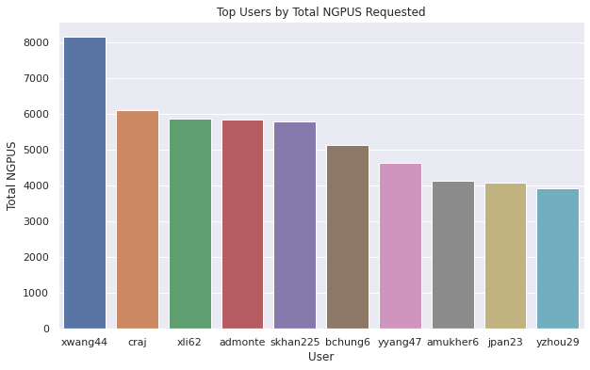
Users by Total NGPUS Requested
User | Total NGPUS
xwang44 | 8167
craj | 6095
xli62 | 5875
admonte | 5832
skhan225 | 5779
bchung6 | 5140
yyang47 | 4635
amukher6 | 4129
jpan23 | 4092
yzhou29 | 3916

Slide 25
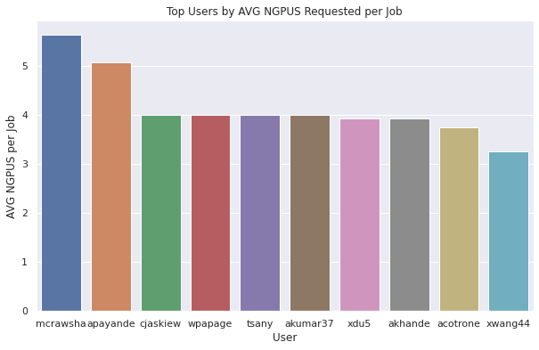
Users by AVG NGPUS Requested
User | AVG NGPUS per Job
mcrawsha | 5.638889
apayande | 5.063063
cjaskiew | 4.000000
wpapage | 4.000000
tsany | 4.000000
akumar37 | 4.000000
xdu5 | 3.934426
akhande | 3.925373
acotrone | 3.750000
xwang44 | 3.246025

Slide 26
Run Times and Wait Times

Slide 27
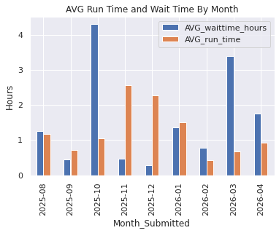
Run Times and Wait Times
Month_Submitted | AVG_run_time | AVG_waittime | AVG_waittime_hours
2025-08 | 1.165074 | 0 days 01:15:10.790826834 | 1.252997
2025-09 | 0.705952 | 0 days 00:27:13.557988204 | 0.453766
2025-10 | 1.041229 | 0 days 04:17:32.832265720 | 4.292453
2025-11 | 2.564708 | 0 days 00:27:25.875593542 | 0.457188
2025-12 | 2.275269 | 0 days 00:16:58.883899166 | 0.283023
2026-01 | 1.496460 | 0 days 01:22:07.556630339 | 1.368766
2026-02 | 0.432272 | 0 days 00:46:11.805520836 | 0.769946
2026-03 | 0.675519 | 0 days 03:23:50.666611212 | 3.397407
2026-04 | 0.933531 | 0 days 01:44:33.019032171 | 1.742505

Slide 28
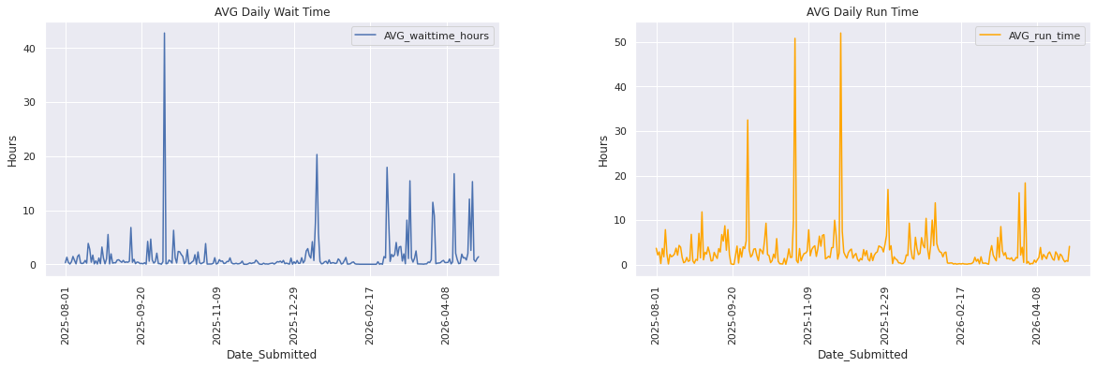

Slide 29
Instructional Jobs

Slide 30
Instructional CPU Jobs
Account | No. of Students | No. of Jobs Submitted | CPU Hrs | AVG CPU Hrs | MEM(GB) | AVG MEM(GB)
ait726fl25 | 2 | 38 | 410.243889 | 10.795892 | 834.0 | 21.947368
ait726sp25 | 1 | 1 | 0.075000 | 0.075000 | 8.0 | 8.000000
binf798fl25 | 2 | 4 | 18.578889 | 4.644722 | 50.0 | 12.500000
clim479fl25 | 1 | 27 | 54.767778 | 2.028436 | 108.0 | 4.000000
clim680fl24 | 2 | 315 | 7726.111389 | 24.527338 | 21024.0 | 66.742857
clim680fl25 | 6 | 276 | 3133.428056 | 11.353000 | 5854.0 | 21.210145
cs584fl24 | 1 | 1 | 2.005000 | 2.005000 | 8.0 | 8.000000
cs678fl24 | 1 | 4 | 8.031667 | 2.007917 | 32.0 | 8.000000
cs678fl25 | 10 | 117 | 1939.670278 | 16.578378 | 2784.0 | 23.794872
cs747fl24 | 2 | 28 | 2489.805556 | 88.921627 | 1840.0 | 65.714286
cs747fl25 | 1 | 1 | 0.000556 | 0.000556 | 2.0 | 2.000000
cs747sp25 | 3 | 8 | 24.745833 | 3.093229 | 84.0 | 10.500000
cs757sp25 | 1 | 30 | 1328.043056 | 44.268102 | 596.0 | 19.866667
daen690sp25 | 1 | 2 | 48.011111 | 24.005556 | 32.0 | 16.000000
ece555sp24 | 2 | 6 | 424.513333 | 70.752222 | 168.0 | 28.000000
ece555sp25 | 2 | 48 | 4333.610000 | 90.283542 | 1928.0 | 40.166667
ece651fl24 | 1 | 3 | 0.630000 | 0.210000 | 192.0 | 64.000000
stat778sp24 | 1 | 18 | 525.840000 | 29.213333 | 264.0 | 14.666667
stat778sp25 | 2 | 5 | 54.752778 | 10.950556 | 32.0 | 6.400000

Slide 31
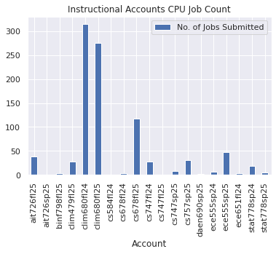
Instructional CPU Jobs

Slide 32
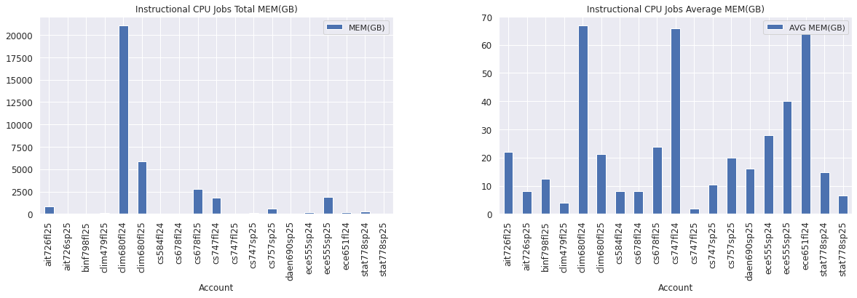
Instructional CPU Jobs

Slide 33
Instructional GPU Jobs
Account | No. of Students | No. of Jobs Submitted | CPU Hrs | AVG CPU Hrs | GPU Hrs | AVG GPU Hrs | MEM(GB) | AVG MEM(GB)
ait580sp24 | 1 | 48 | 57.903056 | 1.206314 | 5.855278 | 0.121985 | 2058.000000 | 42.875000
ait726fl24 | 3 | 126 | 2685.631944 | 21.314539 | 873.466667 | 6.932275 | 8145.417969 | 64.646174
ait726fl25 | 2 | 77 | 1000.111944 | 12.988467 | 239.169167 | 3.106093 | 1665.835938 | 21.634233
ait726sp25 | 1 | 94 | 6190.466111 | 65.856022 | 1092.788611 | 11.625411 | 4256.000000 | 45.276596
binf798fl25 | 1 | 11 | 84.495833 | 7.681439 | 25.861667 | 2.351061 | 242.000000 | 22.000000
cs471sp25 | 1 | 72 | 12021.467222 | 166.964823 | 4954.460000 | 68.811944 | 2300.000000 | 31.944444
cs491fl24 | 1 | 1 | 0.002778 | 0.002778 | 0.001389 | 0.001389 | 8.000000 | 8.000000
cs678fl23 | 1 | 1 | 9.966667 | 9.966667 | 2.491667 | 2.491667 | 32.000000 | 32.000000
cs678fl24 | 4 | 491 | 4063.897222 | 8.276776 | 1018.256667 | 2.073842 | 26532.000000 | 54.036660
cs678fl25 | 16 | 2174 | 34570.248333 | 15.901678 | 4601.710278 | 2.116702 | 111931.062500 | 51.486229
cs678sp23 | 1 | 5 | 1.531111 | 0.306222 | 0.236111 | 0.047222 | 248.000000 | 49.600000
cs678sp24 | 1 | 2 | 0.072222 | 0.036111 | 0.036111 | 0.018056 | 28.000000 | 14.000000
cs692sp25 | 1 | 1 | 4.004444 | 4.004444 | 1.001111 | 1.001111 | 28.000000 | 28.000000
cs747fl24 | 3 | 43 | 2032.380278 | 47.264658 | 2142.738056 | 49.831118 | 978.000000 | 22.744186
cs747sp23 | 1 | 1 | 0.003056 | 0.003056 | 0.003056 | 0.003056 | 8.000000 | 8.000000
cs747sp25 | 4 | 162 | 8301.075833 | 51.241209 | 1330.114167 | 8.210581 | 7312.000000 | 45.135802
cs757sp25 | 2 | 114 | 6018.928889 | 52.797622 | 1001.889167 | 8.788501 | 3746.000000 | 32.859649
csi702sp24 | 1 | 31 | 728.092222 | 23.486846 | 364.046111 | 11.743423 | 462.000000 | 14.903226
cyse492fl25 | 1 | 48 | 61.233333 | 1.275694 | 5.203889 | 0.108414 | 231.000000 | 4.812500
ece555sp24 | 2 | 20 | 583.051944 | 29.152597 | 81.681389 | 4.084069 | 593.000000 | 29.650000
ece555sp25 | 8 | 180 | 3501.115000 | 19.450639 | 879.153333 | 4.884185 | 3831.000000 | 21.283333
ece651fl24 | 2 | 126 | 498.268889 | 3.954515 | 498.214167 | 3.954081 | 1996.000000 | 15.841270

Slide 34
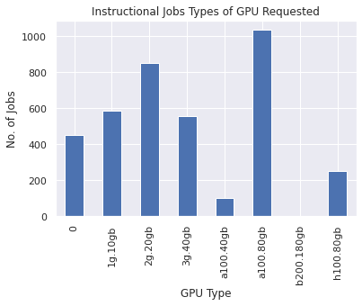
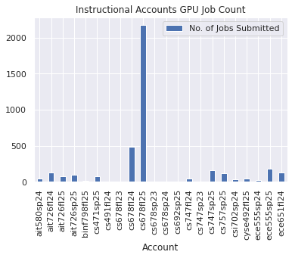
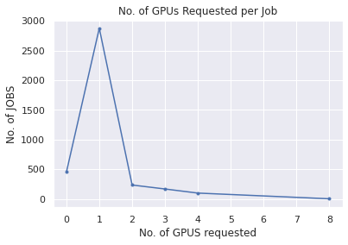
Instructional GPU Jobs

Slide 35
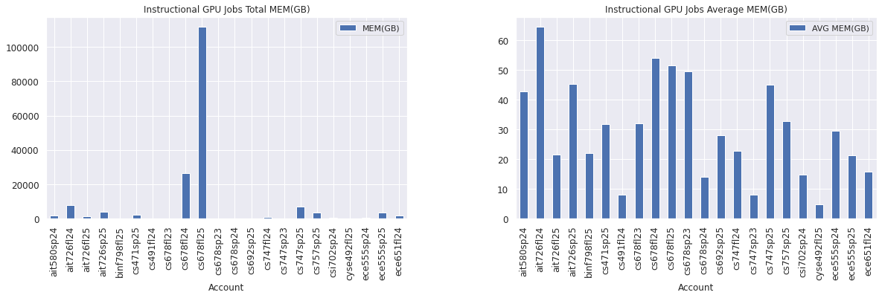
Instructional GPU Jobs

Slide 36
CEC Jobs

Slide 37
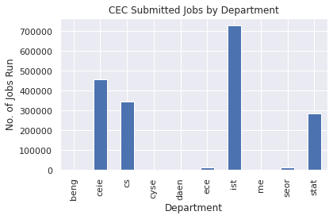
By Department
Dept | Submit
beng | 2599
ceie | 404490
cs | 185704
cyse | 5575
daen | 482
ece | 20089
ist | 818885
me | 696
seor | 1168
stat | 407919

Slide 38
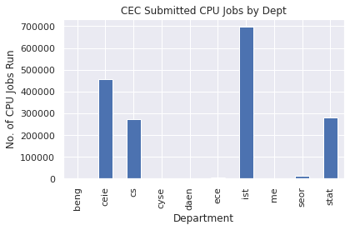
CEC CPU Jobs
Dept | No. of CPU Jobs Submitted | CPU Hrs | AVG CPU Hrs | MEM(GB) | AVG MEM(GB)
beng | 2062 | 72519.47 | 35.17 | 311830.00 | 151.23
ceie | 403909 | 7592789.35 | 18.80 | 14244531.80 | 35.27
cs | 128234 | 4044583.22 | 31.54 | 4437875.21 | 34.61
cyse | 2138 | 298125.52 | 139.44 | 473931.00 | 221.67
daen | 337 | 68950.76 | 204.60 | 16494.00 | 48.94
ece | 3339 | 679437.41 | 203.49 | 108727.30 | 32.56
ist | 785603 | 417913.51 | 0.53 | 3224156.47 | 4.10
me | 474 | 217120.83 | 458.06 | 68168.00 | 143.81
seor | 88 | 470.20 | 5.34 | 1047.00 | 11.90
stat | 404830 | 2598905.13 | 6.42 | 5383631.94 | 13.30

Slide 39
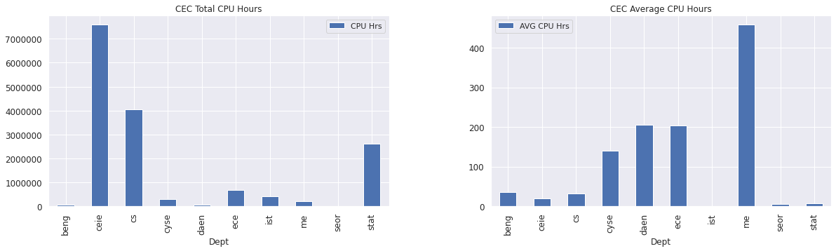

Slide 40
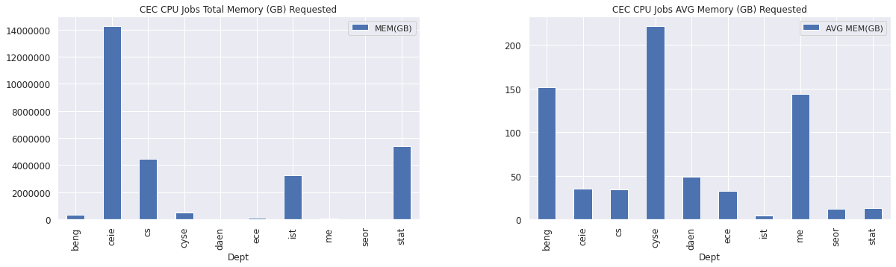

Slide 41
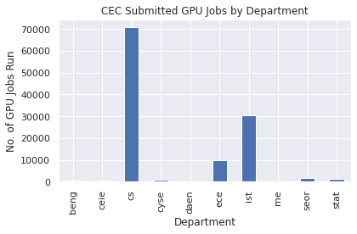
CEC GPU Jobs
Dept | No. of GPU Jobs Submitted | CPU Hrs | AVG CPU Hrs | GPU Hrs | AVG GPU Hrs | MEM(GB) | AVG MEM(GB)
beng | 537 | 1481.06 | 2.76 | 1481.06 | 2.76 | 11203.00 | 20.86
ceie | 576 | 93389.59 | 162.13 | 5465.83 | 9.49 | 32474.00 | 56.38
cs | 57388 | 2689278.67 | 46.86 | 424339.74 | 7.39 | 4543997.11 | 79.20
cyse | 3437 | 36496.97 | 10.62 | 7003.43 | 2.04 | 309877.72 | 90.16
daen | 145 | 35390.00 | 244.07 | 3809.35 | 26.27 | 9220.00 | 63.59
ece | 16750 | 559803.42 | 33.42 | 74278.77 | 4.43 | 700947.37 | 41.85
ist | 33244 | 2899977.88 | 87.23 | 220620.37 | 6.64 | 3684835.42 | 110.84
me | 222 | 9440.23 | 42.52 | 708.89 | 3.19 | 13888.00 | 62.56
seor | 1077 | 306811.36 | 284.88 | 25688.44 | 23.85 | 93199.52 | 86.54
stat | 190 | 23805.23 | 125.29 | 4359.83 | 22.95 | 6133.42 | 32.28

Slide 42
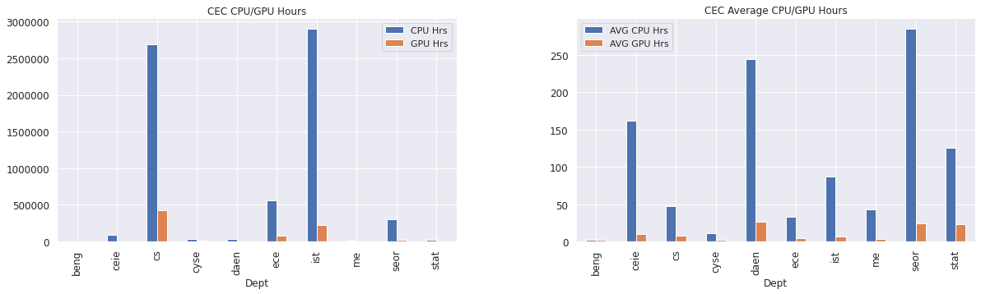

Slide 43
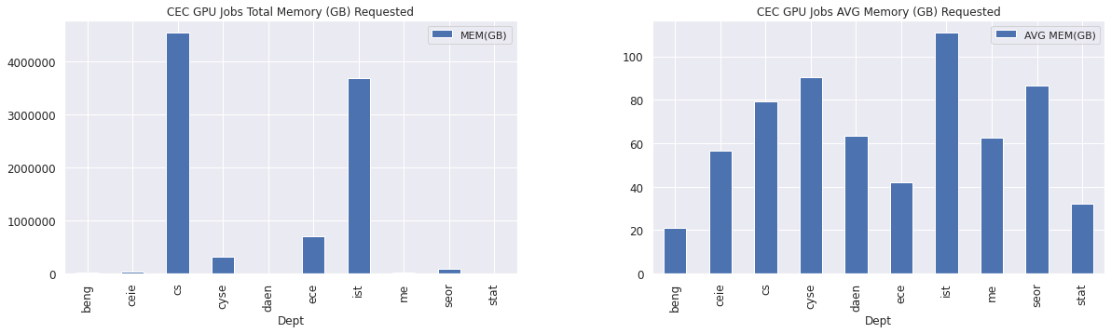

Slide 44
COS Jobs

Slide 45
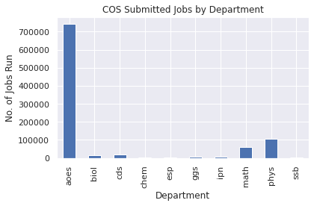
By Department
Dept | Submit
aoes | 109233
biol | 18244
cds | 9155
chem | 4744
esp | 2919
ggs | 9653
ipn | 2731
math | 25505
phys | 164625
ssb | 3976

Slide 46

COS CPU Jobs
Dept | No. of CPU Jobs Submitted | CPU Hrs | AVG CPU Hrs | MEM(GB) | AVG MEM(GB)
aoes | 105579 | 5106174.92 | 48.36 | 26880067.19 | 254.60
biol | 18187 | 525899.47 | 28.92 | 2001875.56 | 110.07
cds | 8587 | 751942.11 | 87.57 | 236857.22 | 27.58
chem | 4439 | 1146580.49 | 258.30 | 838196.08 | 188.83
esp | 2916 | 166798.86 | 57.20 | 75242.00 | 25.80
ggs | 9192 | 877813.74 | 95.50 | 2094253.00 | 227.83
ipn | 2731 | 53915.56 | 19.74 | 97501.00 | 35.70
math | 25265 | 2686842.51 | 106.35 | 1383968.68 | 54.78
phys | 164088 | 15371947.56 | 93.68 | 13746805.63 | 83.78
ssb | 1112 | 80277.96 | 72.19 | 62416.00 | 56.13

Slide 47
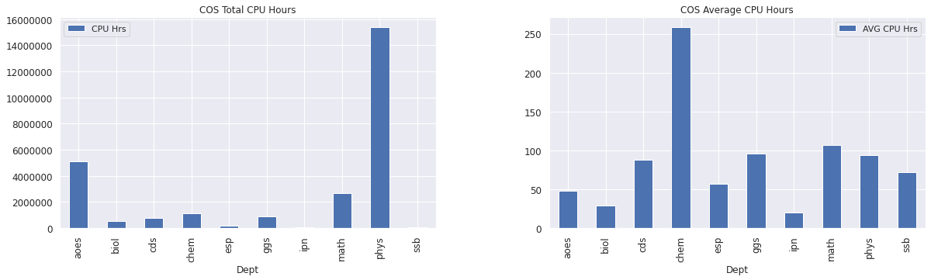
COS CPU Jobs

Slide 48
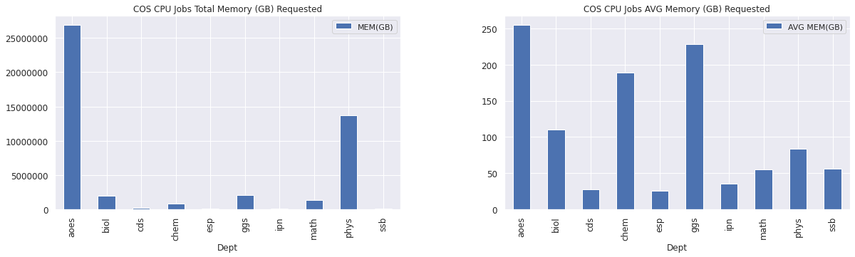
COS CPU Jobs

Slide 49
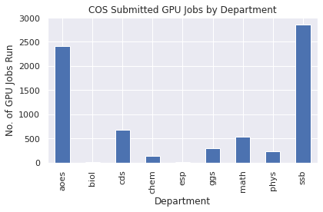
COS GPU Jobs
Dept | No. of GPU Jobs Submitted | CPU Hrs | AVG CPU Hrs | GPU Hrs | AVG GPU Hrs | MEM(GB) | AVG MEM(GB)
aoes | 3654 | 265170.01 | 72.57 | 35156.66 | 9.62 | 489199.00 | 133.88
biol | 57 | 746.06 | 13.09 | 79.26 | 1.39 | 730.24 | 12.81
cds | 558 | 45738.34 | 81.97 | 8782.21 | 15.74 | 21259.40 | 38.10
chem | 305 | 87361.18 | 286.43 | 15785.99 | 51.76 | 20871.43 | 68.43
esp | 3 | 0.01 | 0.00 | 0.01 | 0.00 | 30.00 | 10.00
ggs | 459 | 9195.00 | 20.03 | 1597.47 | 3.48 | 34870.00 | 75.97
math | 240 | 4354.16 | 18.14 | 4259.63 | 17.75 | 38482.00 | 160.34
phys | 164 | 671.48 | 4.09 | 100.08 | 0.61 | 7990.25 | 48.72
ssb | 2864 | 972632.48 | 339.61 | 62569.89 | 21.85 | 78642.00 | 27.46

Slide 50
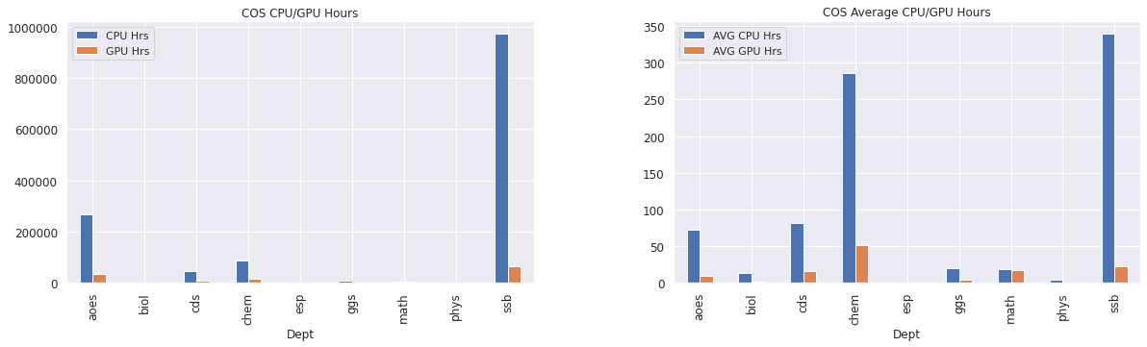
COS GPU Jobs

Slide 51
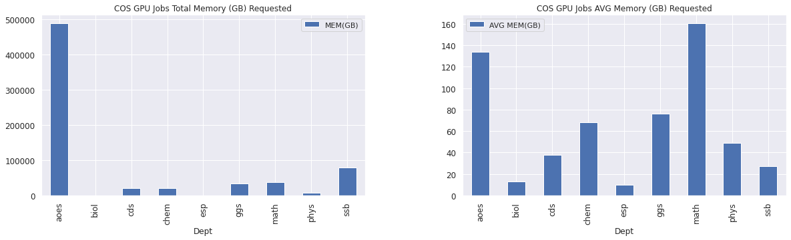
COS GPU Jobs

