Slide 1
Nashville Rock & Roll Marathon Analysis
by Sefa Simsek

Slide 2
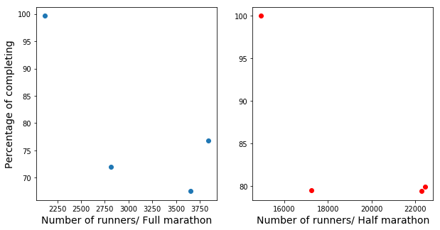
Participating vs. Finishing

Slide 3
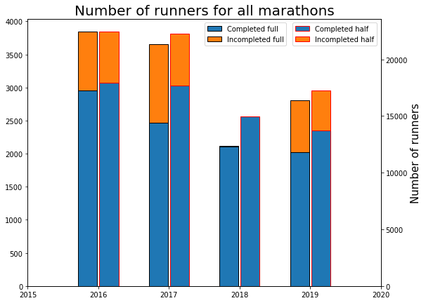
Participating vs. Finishing
Notes:
The harder to start a race, the easier to finish it!

Slide 4
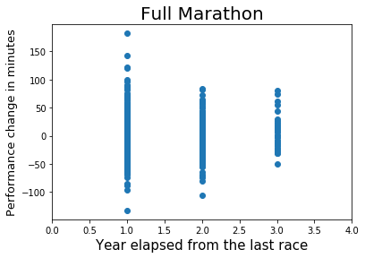
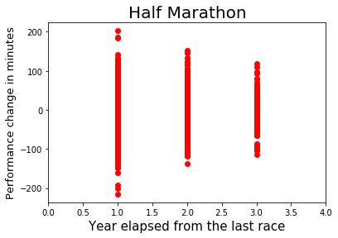
Correlation between performance change and idle time
Notes:
Go to notebook!

