Slide 1
Wine Quality Prediction Using Machine Learning Algorithms
Presented By
Sushma Mandati
Venkata Sruthi Muppa
Sri Sai Singala

Slide 2
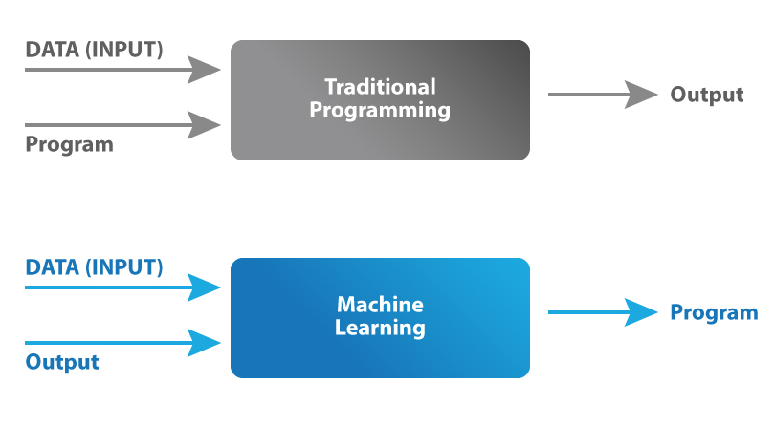
Machine Learning

Slide 3
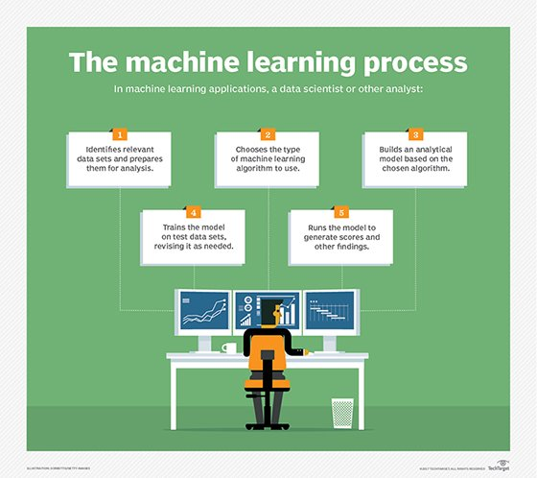

Slide 4

Wine Quality prediction
Here we will predict the quality of wine on the basis of given features. We use the wine quality dataset available on internet for free. This dataset has the fundamental features which are responsible for affecting the quality of the wine. By the use of several machine learning models, we will predict the quality of the wine.

Slide 5

Objective:
Wine quality testing is to ensure that the wine is of high quality and meet the expectations of consumers using different machine learning algorithms

Slide 6
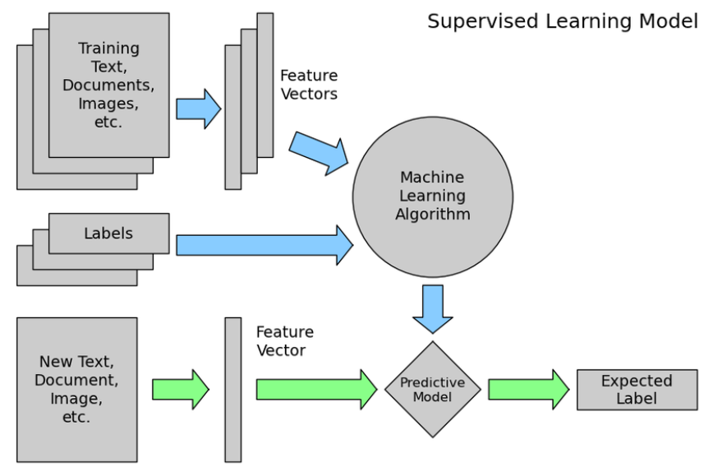
Supervised Learning

Slide 7
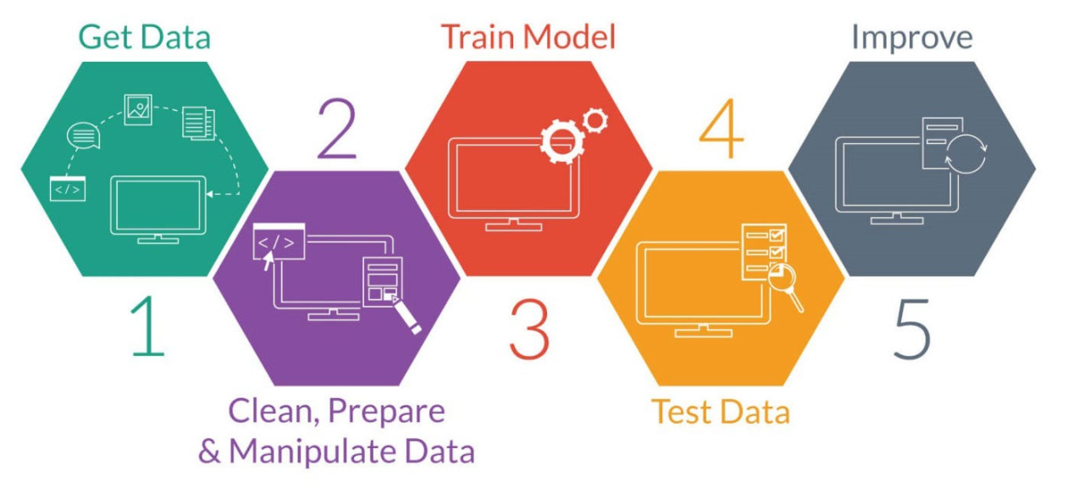

Slide 8
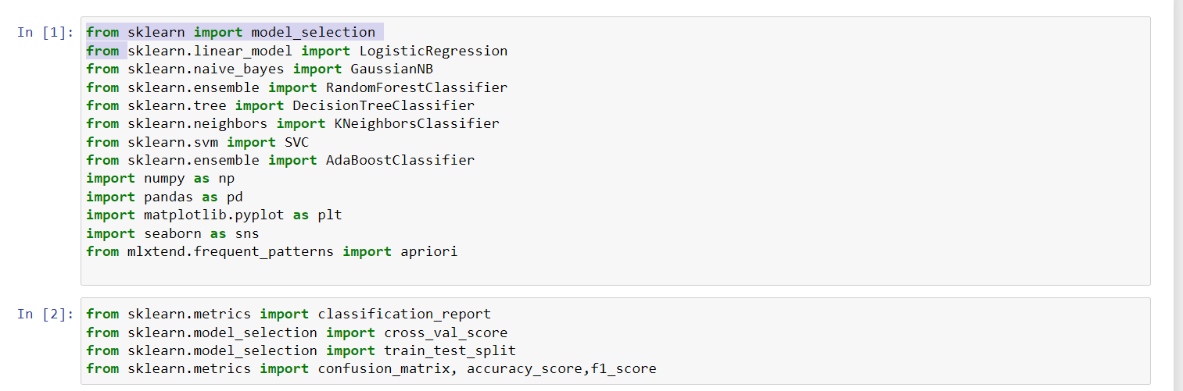
Libraries Used
Pandas
Numpy
Seaborn/matplotlib
Sklearn

Slide 9
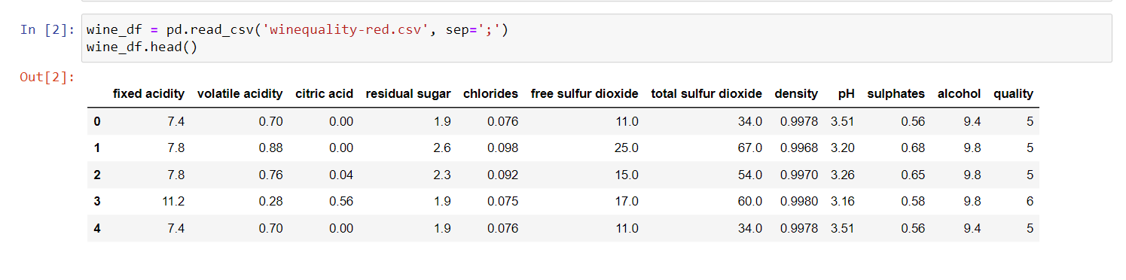
Reading the Dataset

Slide 10
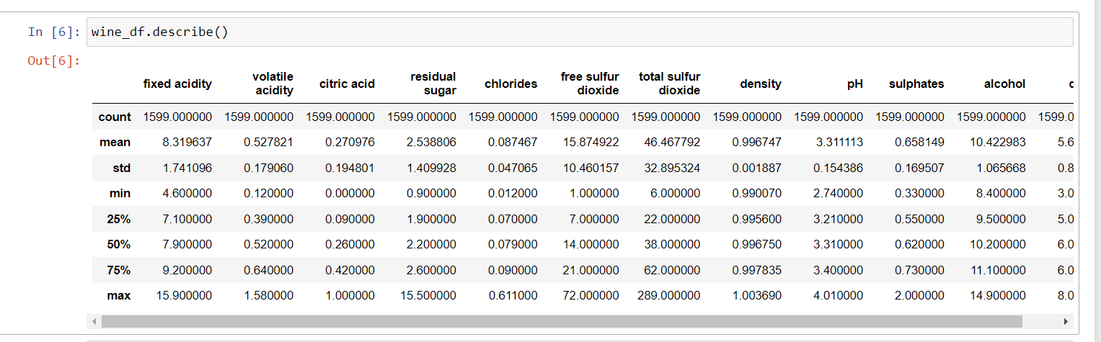
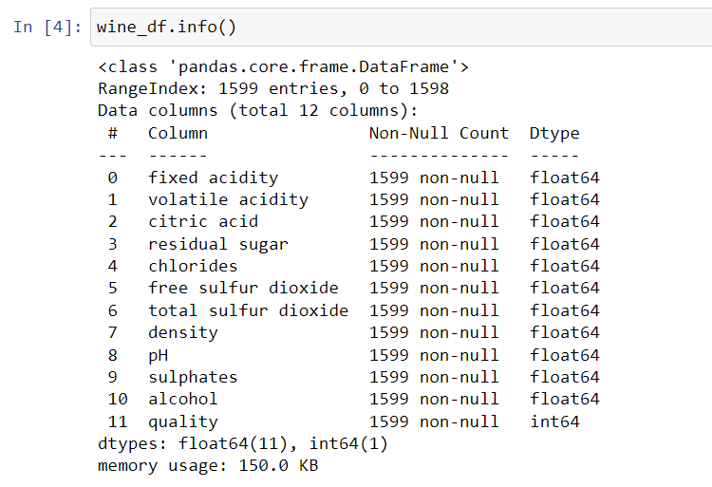
Understand data

Slide 11
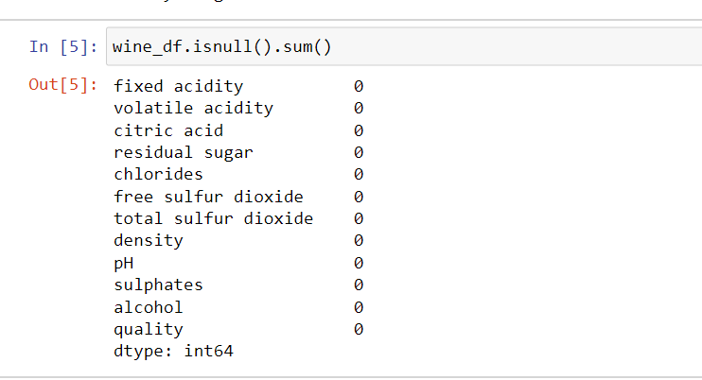
Find Null Values and Perform EDA

Slide 12
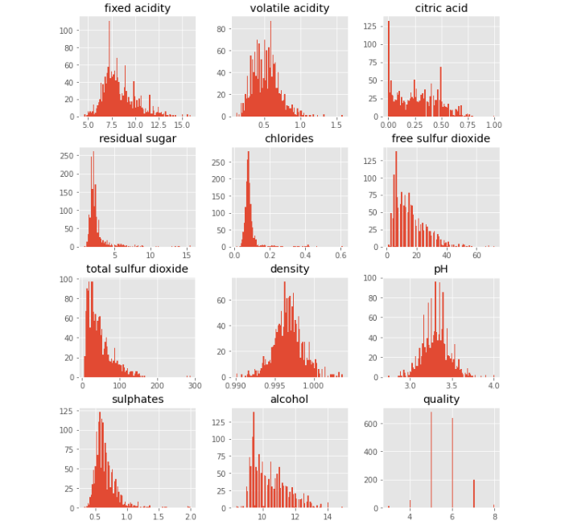

Slide 13
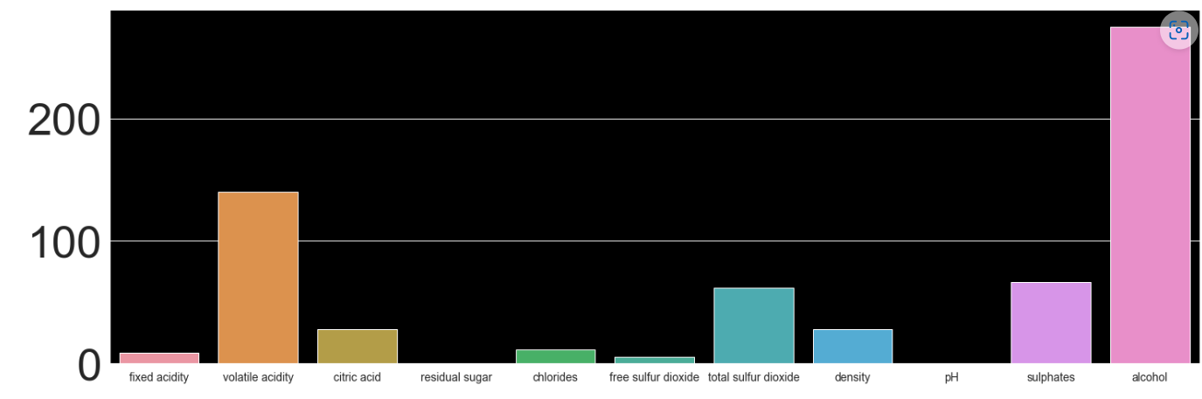

Slide 14
Machine Learning Algorithms:
Some of them are:
1.Logistic Regression
2.Random forest classifier
3.Decision tree classifier
4.k-nearest neighbors

Slide 15
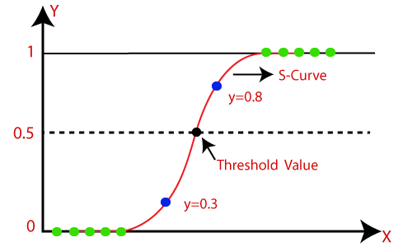
Logistic Regression
Logistic regression is a supervised learning algorithm used to predict a dependent categorical target variable.

Slide 16
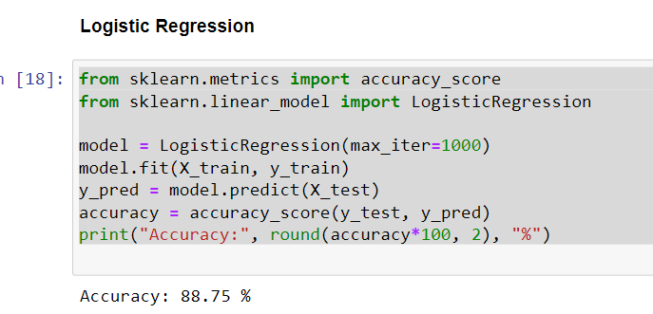

Slide 17
Decision Tree
Decision Tree is the most powerful and popular tool for classification and prediction. A Decision tree is a flowchart-like tree structure, where each internal node denotes a test on an attribute, each branch represents an outcome of the test, and each leaf node (terminal node) holds a class label.

Slide 18
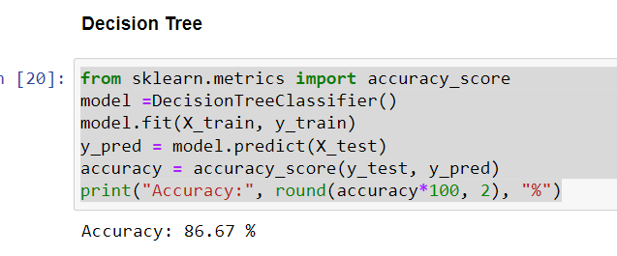

Slide 19
Random Forest
Random forest is a classifier that contains a number of decision trees on various subsets of the given dataset and takes the average to improve the predictive accuracy of that dataset." Instead of relying on one decision tree, the random forest takes the prediction from each tree and based on the majority votes of predictions, and it predicts the final output.

Slide 20
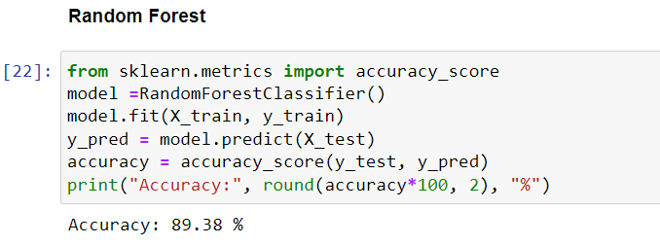

Slide 21
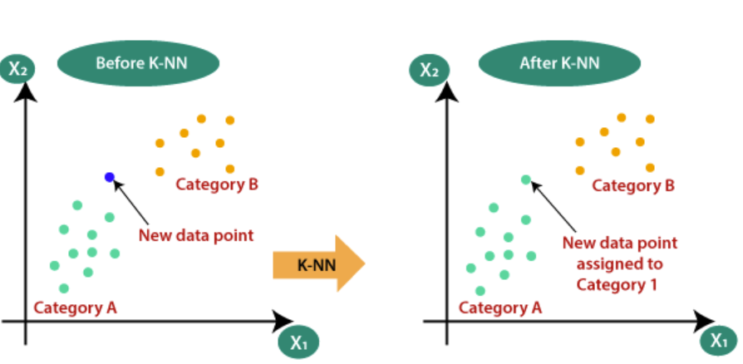
k nearest neighbors
A k-nearest-neighbor algorithm, often abbreviated k-nn, is an approach to data classification that estimates how likely a data point is to be a member of one group or the other depending on what group the data points nearest to it are in.

Slide 22
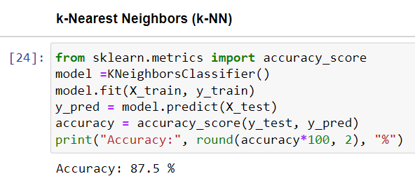

Slide 23
Applications
In machine learning, some of the common applications of supervised learning are:
Predictive analysis based on the problems of regression and classification.
Spam detection
Pattern detection
Natural language processing
Sentiment analysis
Image classification
Sequence processing

Slide 24
Advantages
Clear understanding.
Laymen learning process.
Expected output.
Well defined classes.
Storage Efficient.
Efficient in classification problems.
Accurate prediction.

Slide 25
Disadvantages
Difficult to handle complex tasks.
Hard to predict unknown information.
Classification and clustering is difficult.
Accuracy is dependent on data set.
Frequent supervision required.

Slide 26
Conclusion
Random Forest finally predicted with good accuracy to our wine prediction model very well.
Logistic regression. model also resulted in approximately same accuracy value as in Random Forest.

Slide 27
Thank you

