Slide 1
JavaScript Unit Testing
Jasmine Framework Overview
Integrating Karma with Jasmine
Automating Jasmine tests using Karma JS
Coverage using Karma-coverage
Display Formatted Test Results
Javascript Sample app + Jasmine Demo
1
Internal | RBEI/BSO14 | 05/09/2017
© Robert Bosch Engineering and Business Solutions Private Limited 2017. All rights reserved, also regarding any disposal, exploitation, reproduction, editing, distribution, as well as in the event of applications for industrial property rights.

Slide 2
Jasmine Overview
It is a Behaviour-driven development testing framework.
It does not depend on any other JavaScript frameworks.
It does not require a DOM.
2
Internal | RBEI/BSO14 | 05/09/2017
© Robert Bosch Engineering and Business Solutions Private Limited 2017. All rights reserved, also regarding any disposal, exploitation, reproduction, editing, distribution, as well as in the event of applications for industrial property rights.

Slide 3
Jasmine Overview
Sample Jasmine Test :
describe( "Module Name", function() {
it( "Testcase Name", function() {
expect(actual).toEqual(expected);
});
Main Jasmine Constructs:
Test module begins with a call to describe()
Test case begins with a call to it()
Assertions used to compare the actual and expected values. Starts with expect.
3
Internal | RBEI/BSO14 | 05/09/2017
© Robert Bosch Engineering and Business Solutions Private Limited 2017. All rights reserved, also regarding any disposal, exploitation, reproduction, editing, distribution, as well as in the event of applications for industrial property rights.

Slide 4
Jasmine Overview
Jasmine Matchers
expect(number).toBeEvenNumber();
expect(number).toBeGreaterThanOrEqualTo(otherNumber);
expect(number).toBeLessThanOrEqualTo(otherNumber);
expect(number).toBeNear(otherNumber, epsilon);
expect(number).toBeNumber();
expect(number).toBeOddNumber();
expect(number).toBeWholeNumber();
expect(number).toBeWithinRange(floor, ceiling);
expect(array).toBeArray();
expect(array).toBeArrayOfBooleans();
expect(array).toBeArrayOfNumbers();
expect(array).toBeArrayOfObjects();
expect(array).toBeArrayOfSize(number);
expect(array).toBeArrayOfStrings();
expect(array).toBeEmptyArray();
4
Internal | RBEI/BSO14 | 05/09/2017
© Robert Bosch Engineering and Business Solutions Private Limited 2017. All rights reserved, also regarding any disposal, exploitation, reproduction, editing, distribution, as well as in the event of applications for industrial property rights.

Slide 5

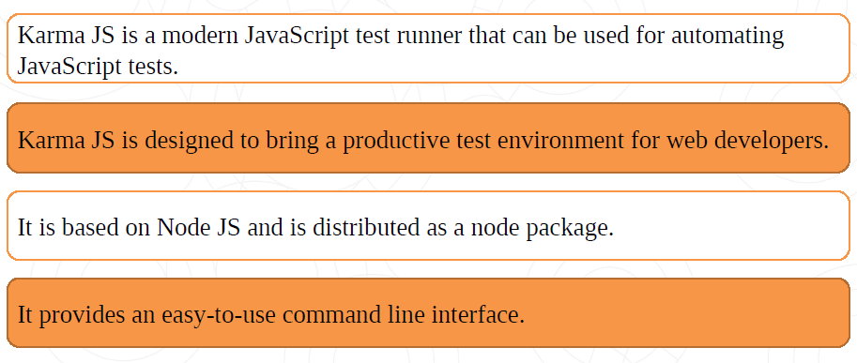
Test Runner
In order to automate Javascript test cases, we require javascript runner.
5
Internal | RBEI/BSO14 | 05/09/2017
© Robert Bosch Engineering and Business Solutions Private Limited 2017. All rights reserved, also regarding any disposal, exploitation, reproduction, editing, distribution, as well as in the event of applications for industrial property rights.

Slide 6
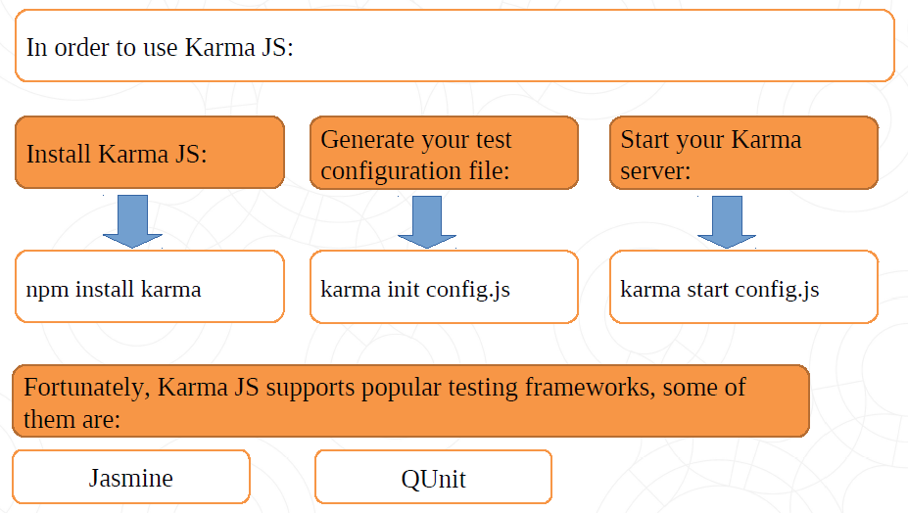
Test Runner
6
Internal | RBEI/BSO14 | 05/09/2017
© Robert Bosch Engineering and Business Solutions Private Limited 2017. All rights reserved, also regarding any disposal, exploitation, reproduction, editing, distribution, as well as in the event of applications for industrial property rights.

Slide 7
Integrating Karma with QUnit
In order to include karma-jasmine plugin into our project:
npm install karma-jasmine --save-dev
Installing Karma-CLI globally
npm install -g karma-cli
7
Internal | RBEI/BSO14 | 05/09/2017
© Robert Bosch Engineering and Business Solutions Private Limited 2017. All rights reserved, also regarding any disposal, exploitation, reproduction, editing, distribution, as well as in the event of applications for industrial property rights.

Slide 8
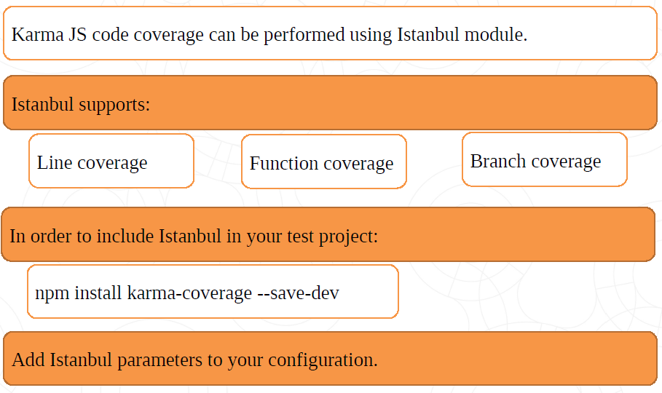
Code Coverage
8
Internal | RBEI/BSO14 | 05/09/2017
© Robert Bosch Engineering and Business Solutions Private Limited 2017. All rights reserved, also regarding any disposal, exploitation, reproduction, editing, distribution, as well as in the event of applications for industrial property rights.

Slide 9
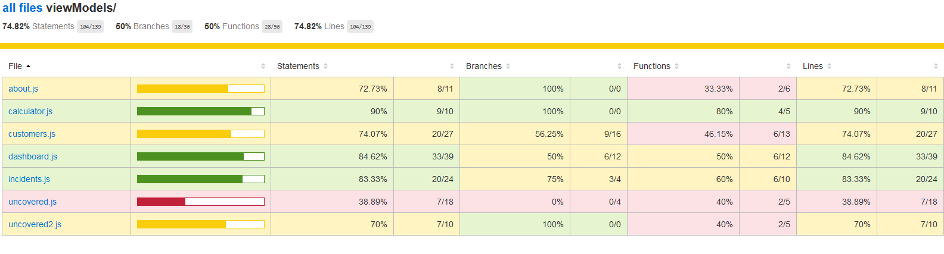
Code Coverage
9
Internal | RBEI/BSO14 | 05/09/2017
© Robert Bosch Engineering and Business Solutions Private Limited 2017. All rights reserved, also regarding any disposal, exploitation, reproduction, editing, distribution, as well as in the event of applications for industrial property rights.

Slide 10
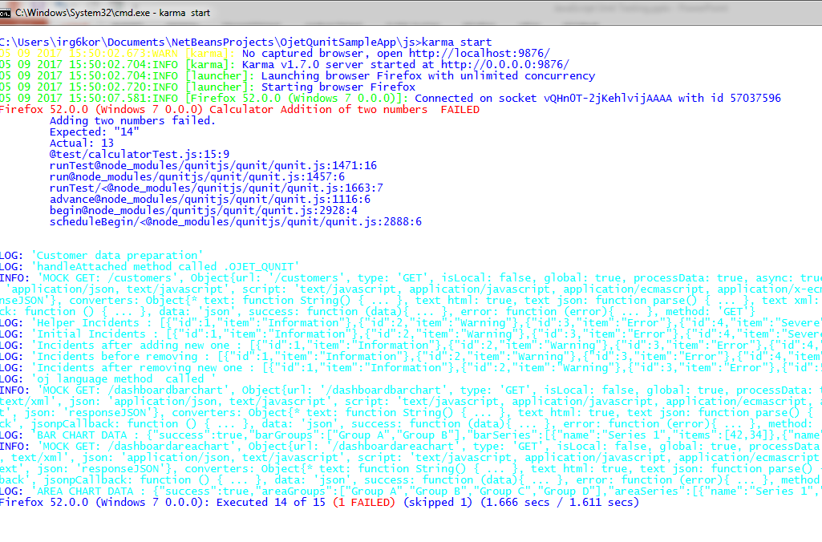
Display Formatted Test Results
Karma test runner displays the results in the console
10
Internal | RBEI/BSO14 | 05/09/2017
© Robert Bosch Engineering and Business Solutions Private Limited 2017. All rights reserved, also regarding any disposal, exploitation, reproduction, editing, distribution, as well as in the event of applications for industrial property rights.

Slide 11
Display Formatted Test Results
We will export test results as a styled HTML file using the Karma html file reporter js.
In order to include the html file reporter into your project :
npm install karma-htmlfile-reporter --save-dev
Add htmlfile reporter parameters to karma config file.
11
Internal | RBEI/BSO14 | 05/09/2017
© Robert Bosch Engineering and Business Solutions Private Limited 2017. All rights reserved, also regarding any disposal, exploitation, reproduction, editing, distribution, as well as in the event of applications for industrial property rights.

Slide 12
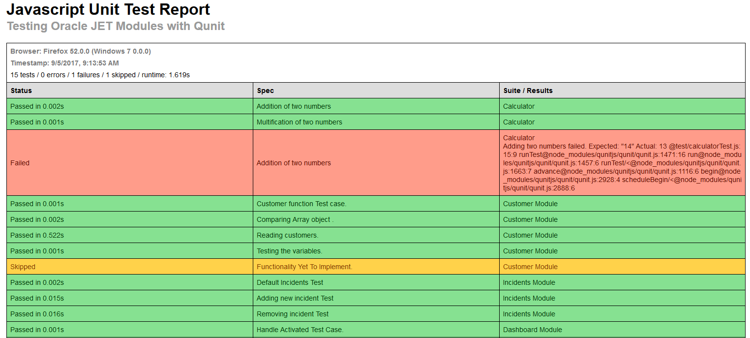
Test Case HTML Reporter
12
Internal | RBEI/BSO14 | 05/09/2017
© Robert Bosch Engineering and Business Solutions Private Limited 2017. All rights reserved, also regarding any disposal, exploitation, reproduction, editing, distribution, as well as in the event of applications for industrial property rights.

Slide 13
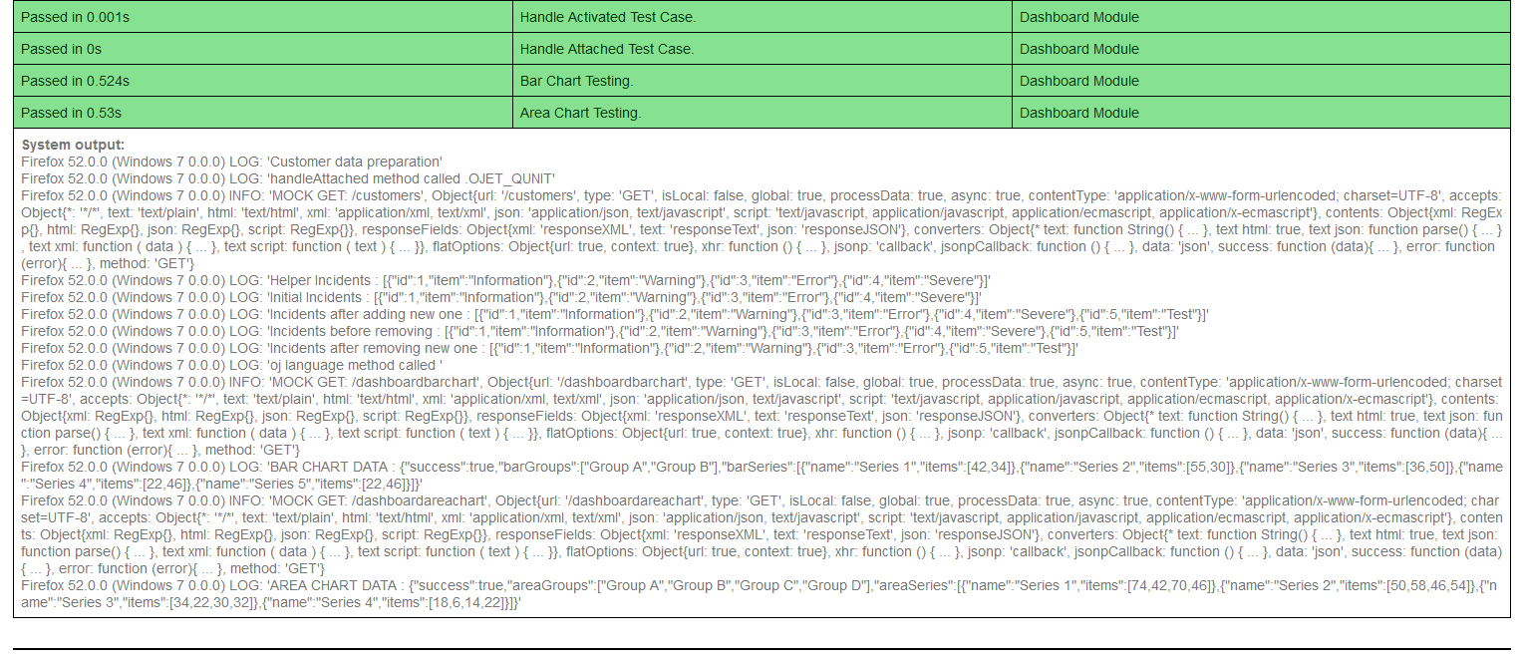
Test Case HTML Reporter
13
Internal | RBEI/BSO14 | 05/09/2017
© Robert Bosch Engineering and Business Solutions Private Limited 2017. All rights reserved, also regarding any disposal, exploitation, reproduction, editing, distribution, as well as in the event of applications for industrial property rights.

Slide 14

14
Internal | RBEI/BSO14 | 05/09/2017
© Robert Bosch Engineering and Business Solutions Private Limited 2017. All rights reserved, also regarding any disposal, exploitation, reproduction, editing, distribution, as well as in the event of applications for industrial property rights.

