Slide 1
Unit Testing
Concepts, JavaScript frameworks and Demo
1
Internal | RBEI/BSO14 | 05/09/2017
© Robert Bosch Engineering and Business Solutions Private Limited 2017. All rights reserved, also regarding any disposal, exploitation, reproduction, editing, distribution, as well as in the event of applications for industrial property rights.

Slide 2
The Concept of Unit Testing
A unit test is code written by a developer that tests as small a piece of
functionality (the unit) as possible
Unit tests ensures the code meets expectations and specifications
The code continues to meet expectations over time
2
Internal | RBEI/BSO14 | 05/09/2017
© Robert Bosch Engineering and Business Solutions Private Limited 2017. All rights reserved, also regarding any disposal, exploitation, reproduction, editing, distribution, as well as in the event of applications for industrial property rights.

Slide 3
Why Unit Testing
Reduce Bugs in new features and existing features
Reduce the Cost of Change
Confidence when refactoring and upgrading
Makes Development Faster
Fix them early and with less cost
3
Internal | RBEI/BSO14 | 05/09/2017
© Robert Bosch Engineering and Business Solutions Private Limited 2017. All rights reserved, also regarding any disposal, exploitation, reproduction, editing, distribution, as well as in the event of applications for industrial property rights.

Slide 4
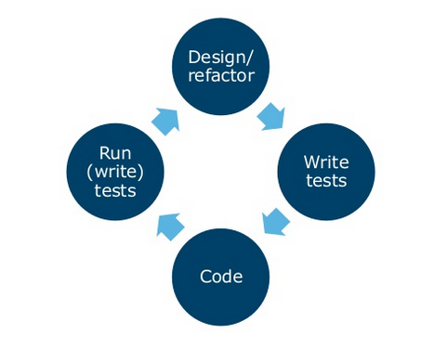
When To Write Unit Tests
Start
4
Internal | RBEI/BSO14 | 05/09/2017
© Robert Bosch Engineering and Business Solutions Private Limited 2017. All rights reserved, also regarding any disposal, exploitation, reproduction, editing, distribution, as well as in the event of applications for industrial property rights.

Slide 5
Structure of Unit Test
Setup
Prepare an Input to the test
Call the method to test
Check the result returned from method
Tear down
5
Internal | RBEI/BSO14 | 05/09/2017
© Robert Bosch Engineering and Business Solutions Private Limited 2017. All rights reserved, also regarding any disposal, exploitation, reproduction, editing, distribution, as well as in the event of applications for industrial property rights.

Slide 6
Java script unit testing frameworks
QUnit, Jasmine, Mocha
Jest, Tape, Ava
For complete list go thru below hyper link.
http://www.designyourway.net/drb/the-full-list-of-testing-frameworks-for-javascript-47-items/
6
Internal | RBEI/BSO14 | 05/09/2017
© Robert Bosch Engineering and Business Solutions Private Limited 2017. All rights reserved, also regarding any disposal, exploitation, reproduction, editing, distribution, as well as in the event of applications for industrial property rights.

Slide 7
Comparing Frameworks
 | Pros | Cons
QUnit | Simple setup Lot's of support Continuous Integration support Recommended By Oracle Uses for TDD | Lack of fluent syntax Difficult configuration most of the times Tedious async testing
Jasmine | Simple to setup Supported by many Cis Descriptive syntax for BDD testing | Tedious async testing A specific file suffix is expected (_spec.js)
Mocha | Easy to setup Allow use of any assertion library - Chai, expect.js, Must.js, etc. CI support Highly extensible Easy async testing | Young library, meaning it's still changing, maturing.
7
Internal | RBEI/BSO14 | 05/09/2017
© Robert Bosch Engineering and Business Solutions Private Limited 2017. All rights reserved, also regarding any disposal, exploitation, reproduction, editing, distribution, as well as in the event of applications for industrial property rights.

Slide 8
JavaScript Unit Testing Topics
QUnit Framework Overview
Integrating Karma with QUnit
Test Runner - Karma JS
Coverage using Karma-coverage
Display Formatted Test Results
Oracle Jet Sample app + Qunit Demo
8
Internal | RBEI/BSO14 | 05/09/2017
© Robert Bosch Engineering and Business Solutions Private Limited 2017. All rights reserved, also regarding any disposal, exploitation, reproduction, editing, distribution, as well as in the event of applications for industrial property rights.

Slide 9
QUnit Overview
QUnit is a powerful, easy-to-use JavaScript unit testing framework.
Qunit used by the jQuery, jQuery UI and jQuery Mobile projects.
Capable of testing any generic JavaScript code including itself.
Recommended by and for Oracle JET applications
9
Internal | RBEI/BSO14 | 05/09/2017
© Robert Bosch Engineering and Business Solutions Private Limited 2017. All rights reserved, also regarding any disposal, exploitation, reproduction, editing, distribution, as well as in the event of applications for industrial property rights.

Slide 10
QUnit Overview
Sample QUnit Test :
QUnit.module( "Module Name", function() {
QUnit.test( "Testcase Name", function( assert ) {
expected = call_js_function(var inputParams);
assert.equal( actual, expected[,message] );
}); });
Main QUnit Constructs:
Test module begins with a call to QUnit.module()
Test case begins with a call to QUnit.test()
Assertions used to compare the actual and expected values. Starts with assert.
10
Internal | RBEI/BSO14 | 05/09/2017
© Robert Bosch Engineering and Business Solutions Private Limited 2017. All rights reserved, also regarding any disposal, exploitation, reproduction, editing, distribution, as well as in the event of applications for industrial property rights.

Slide 11
QUnit Overview
QUnit Main Assertions:
assert.equal(act, exp, [,msg])
assert.propEqual(act,exp [,msg])
assert.deepEqual(act, exp, [,msg])
assert.async([acceptCallCount = 1])
assert.strictEqual(act, exp, [,msg])
assert.ok(booleanstate [, message ])
11
Internal | RBEI/BSO14 | 05/09/2017
© Robert Bosch Engineering and Business Solutions Private Limited 2017. All rights reserved, also regarding any disposal, exploitation, reproduction, editing, distribution, as well as in the event of applications for industrial property rights.

Slide 12

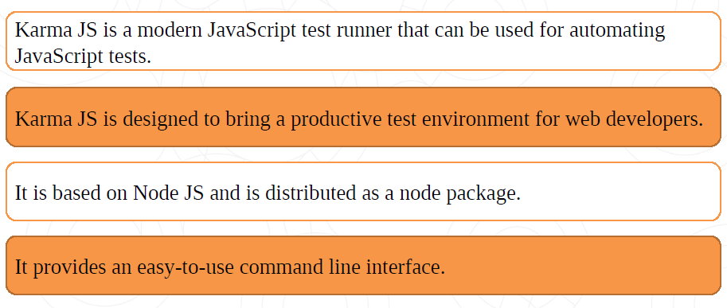
Test Runner
In order to automate Javascript test cases, we require javascript runner.
12
Internal | RBEI/BSO14 | 05/09/2017
© Robert Bosch Engineering and Business Solutions Private Limited 2017. All rights reserved, also regarding any disposal, exploitation, reproduction, editing, distribution, as well as in the event of applications for industrial property rights.

Slide 13
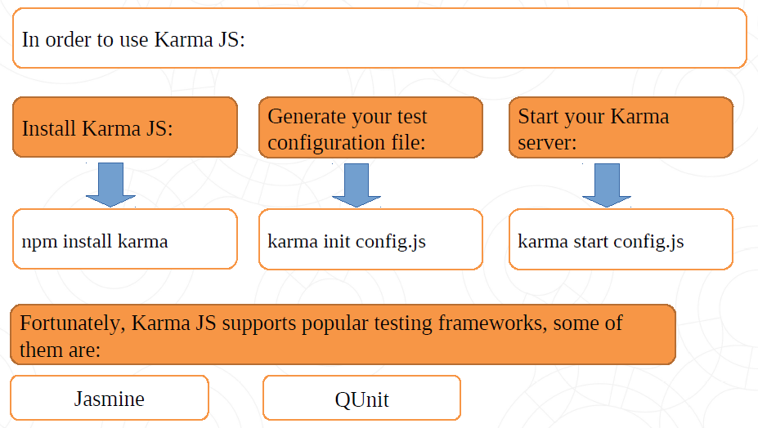
Test Runner
13
Internal | RBEI/BSO14 | 05/09/2017
© Robert Bosch Engineering and Business Solutions Private Limited 2017. All rights reserved, also regarding any disposal, exploitation, reproduction, editing, distribution, as well as in the event of applications for industrial property rights.

Slide 14
Integrating Karma with QUnit
In order to include karma-qunit plugin into our project:
npm install karma-qunit --save-dev
Installing Karma-CLI globally
npm install -g karma-cli
14
Internal | RBEI/BSO14 | 05/09/2017
© Robert Bosch Engineering and Business Solutions Private Limited 2017. All rights reserved, also regarding any disposal, exploitation, reproduction, editing, distribution, as well as in the event of applications for industrial property rights.

Slide 15
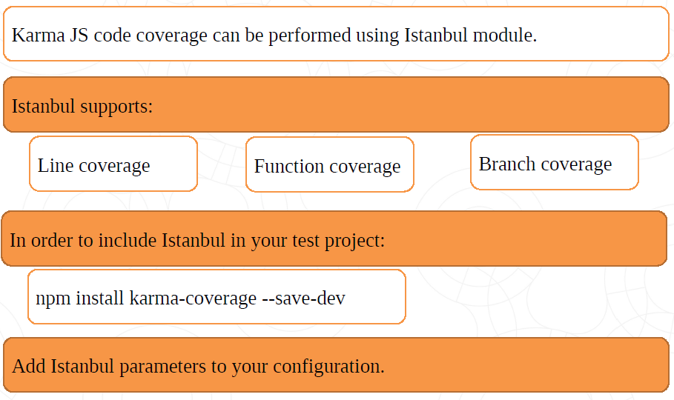
Code Coverage
15
Internal | RBEI/BSO14 | 05/09/2017
© Robert Bosch Engineering and Business Solutions Private Limited 2017. All rights reserved, also regarding any disposal, exploitation, reproduction, editing, distribution, as well as in the event of applications for industrial property rights.

Slide 16
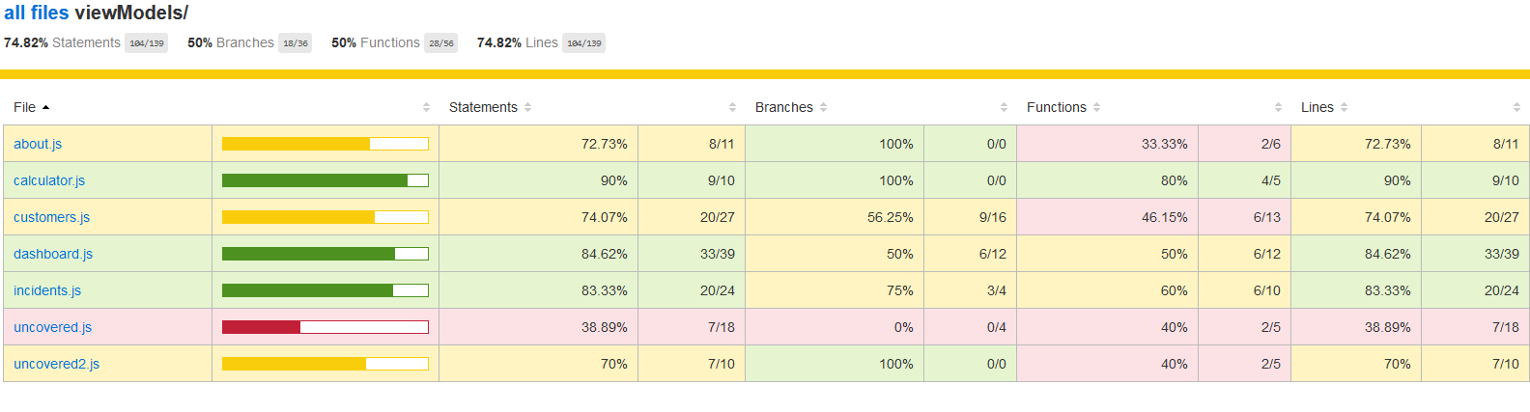
Code Coverage
16
Internal | RBEI/BSO14 | 05/09/2017
© Robert Bosch Engineering and Business Solutions Private Limited 2017. All rights reserved, also regarding any disposal, exploitation, reproduction, editing, distribution, as well as in the event of applications for industrial property rights.

Slide 17
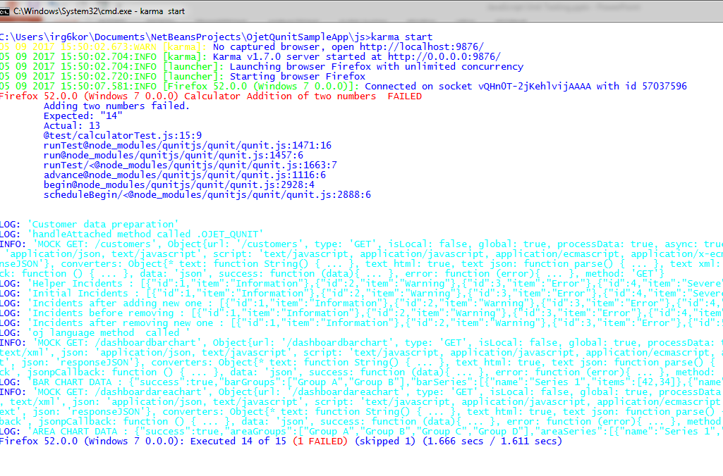
Display Formatted Test Results
Karma test runner displays the results in the console
17
Internal | RBEI/BSO14 | 05/09/2017
© Robert Bosch Engineering and Business Solutions Private Limited 2017. All rights reserved, also regarding any disposal, exploitation, reproduction, editing, distribution, as well as in the event of applications for industrial property rights.

Slide 18
Display Formatted Test Results
We will export test results as a styled HTML file using the Karma html file reporter js.
In order to include the html file reporter into your project :
npm install karma-htmlfile-reporter --save-dev
Add htmlfile reporter parameters to karma config file.
18
Internal | RBEI/BSO14 | 05/09/2017
© Robert Bosch Engineering and Business Solutions Private Limited 2017. All rights reserved, also regarding any disposal, exploitation, reproduction, editing, distribution, as well as in the event of applications for industrial property rights.

Slide 19
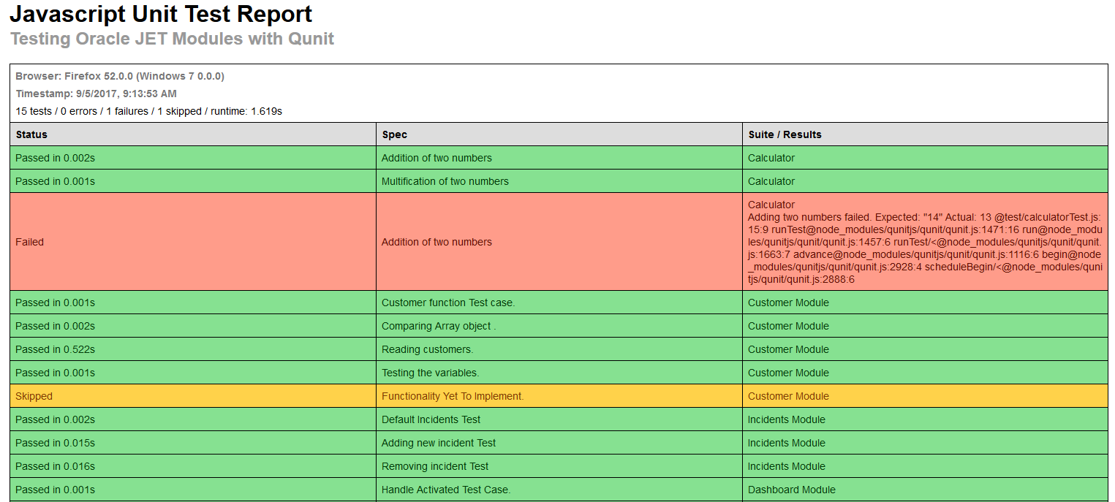
Test Case HTML Reporter
19
Internal | RBEI/BSO14 | 05/09/2017
© Robert Bosch Engineering and Business Solutions Private Limited 2017. All rights reserved, also regarding any disposal, exploitation, reproduction, editing, distribution, as well as in the event of applications for industrial property rights.

Slide 20
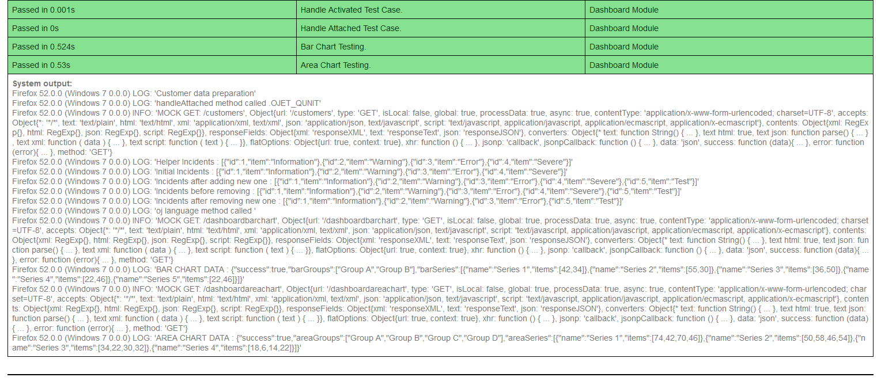
Test Case HTML Reporter
20
Internal | RBEI/BSO14 | 05/09/2017
© Robert Bosch Engineering and Business Solutions Private Limited 2017. All rights reserved, also regarding any disposal, exploitation, reproduction, editing, distribution, as well as in the event of applications for industrial property rights.

Slide 21

21
Internal | RBEI/BSO14 | 05/09/2017
© Robert Bosch Engineering and Business Solutions Private Limited 2017. All rights reserved, also regarding any disposal, exploitation, reproduction, editing, distribution, as well as in the event of applications for industrial property rights.

