Slide 1
JavaScript Unit Testing
QUnit Framework Overview
Integrating Karma with QUnit
Automating Qunit tests using Karma JS
Coverage using Karma-coverage
Display Formatted Test Results
Oracle Jet Sample app + Qunit Demo
1
Internal | RBEI/BSO14 | 05/09/2017
© Robert Bosch Engineering and Business Solutions Private Limited 2017. All rights reserved, also regarding any disposal, exploitation, reproduction, editing, distribution, as well as in the event of applications for industrial property rights.

Slide 2
QUnit Overview
QUnit is a powerful, easy-to-use JavaScript unit testing framework.
Qunit used by the jQuery, jQuery UI and jQuery Mobile projects.
Capable of testing any generic JavaScript code including itself.
Recommended for Oracle JET applications
2
Internal | RBEI/BSO14 | 05/09/2017
© Robert Bosch Engineering and Business Solutions Private Limited 2017. All rights reserved, also regarding any disposal, exploitation, reproduction, editing, distribution, as well as in the event of applications for industrial property rights.

Slide 3
QUnit Overview
Sample QUnit Test :
QUnit.module( "Module Name", function() {
QUnit.test( "Testcase Name", function( assert ) {
assert.equal( actual, expected [,message] );
});
});
Main QUnit Constructs:
Test module begins with a call to QUnit.module()
Test case begins with a call to QUnit.test()
Assertions used to compare the actual and expected values. Starts with assert.
3
Internal | RBEI/BSO14 | 05/09/2017
© Robert Bosch Engineering and Business Solutions Private Limited 2017. All rights reserved, also regarding any disposal, exploitation, reproduction, editing, distribution, as well as in the event of applications for industrial property rights.

Slide 4
QUnit Overview
QUnit Main Assertions:
assert.equal(act, exp, [,msg])
assert.propEqual(act,exp [,msg])
assert.deepEqual(act, exp, [,msg])
assert.async([acceptCallCount = 1])
assert.strictEqual(act, exp, [,msg])
assert.ok(booleanstate [, message ])
4
Internal | RBEI/BSO14 | 05/09/2017
© Robert Bosch Engineering and Business Solutions Private Limited 2017. All rights reserved, also regarding any disposal, exploitation, reproduction, editing, distribution, as well as in the event of applications for industrial property rights.

Slide 5

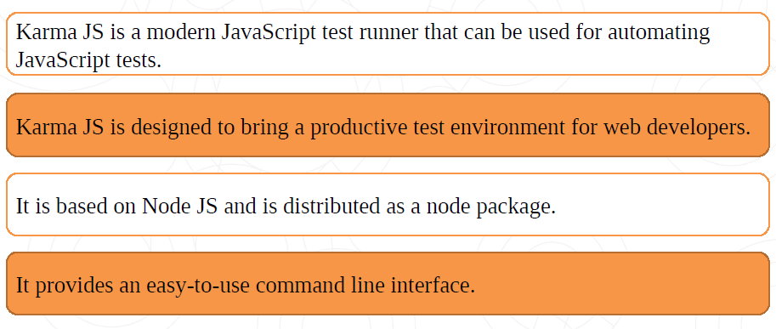
Test Runner
In order to automate Javascript test cases, we require javascript runner.
5
Internal | RBEI/BSO14 | 05/09/2017
© Robert Bosch Engineering and Business Solutions Private Limited 2017. All rights reserved, also regarding any disposal, exploitation, reproduction, editing, distribution, as well as in the event of applications for industrial property rights.

Slide 6
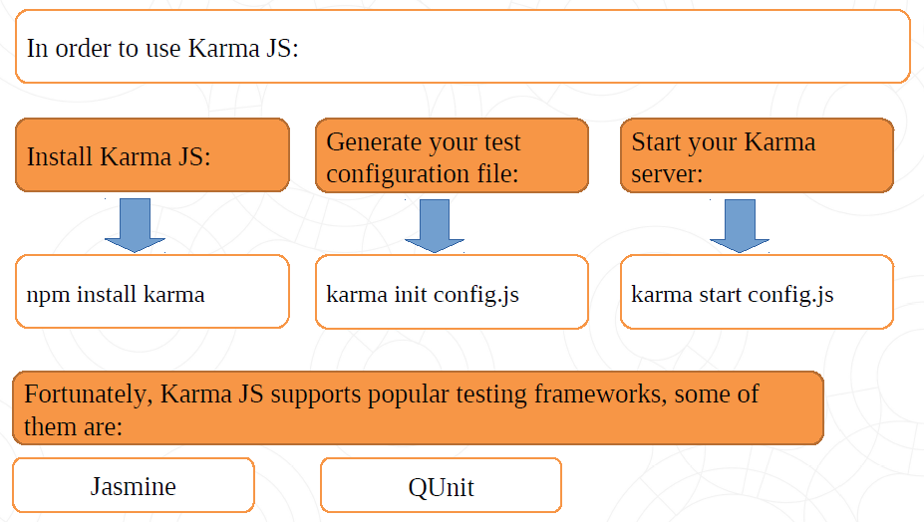
Test Runner
6
Internal | RBEI/BSO14 | 05/09/2017
© Robert Bosch Engineering and Business Solutions Private Limited 2017. All rights reserved, also regarding any disposal, exploitation, reproduction, editing, distribution, as well as in the event of applications for industrial property rights.

Slide 7
Integrating Karma with QUnit
In order to include karma-qunit plugin into our project:
npm install karma-qunit --save-dev
Installing Karma-CLI globally
npm install -g karma-cli
7
Internal | RBEI/BSO14 | 05/09/2017
© Robert Bosch Engineering and Business Solutions Private Limited 2017. All rights reserved, also regarding any disposal, exploitation, reproduction, editing, distribution, as well as in the event of applications for industrial property rights.

Slide 8
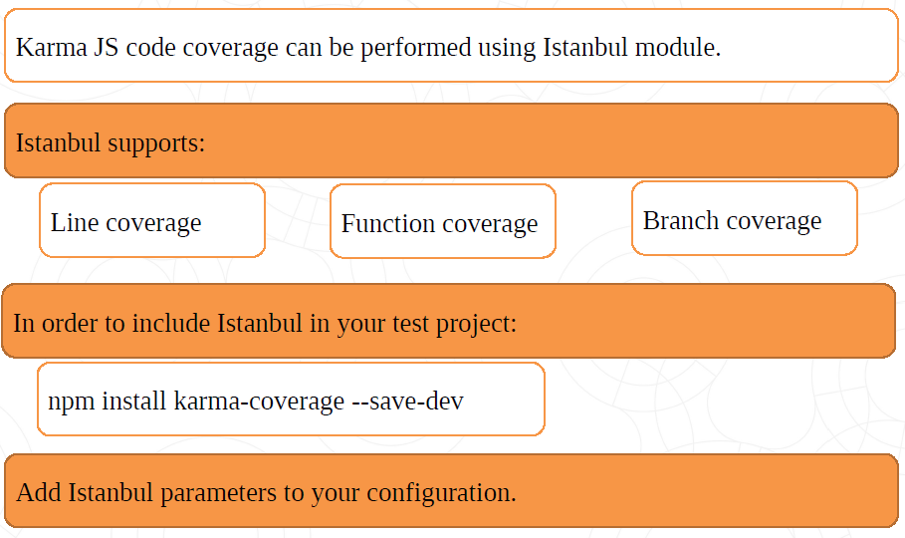
Code Coverage
8
Internal | RBEI/BSO14 | 05/09/2017
© Robert Bosch Engineering and Business Solutions Private Limited 2017. All rights reserved, also regarding any disposal, exploitation, reproduction, editing, distribution, as well as in the event of applications for industrial property rights.

Slide 9
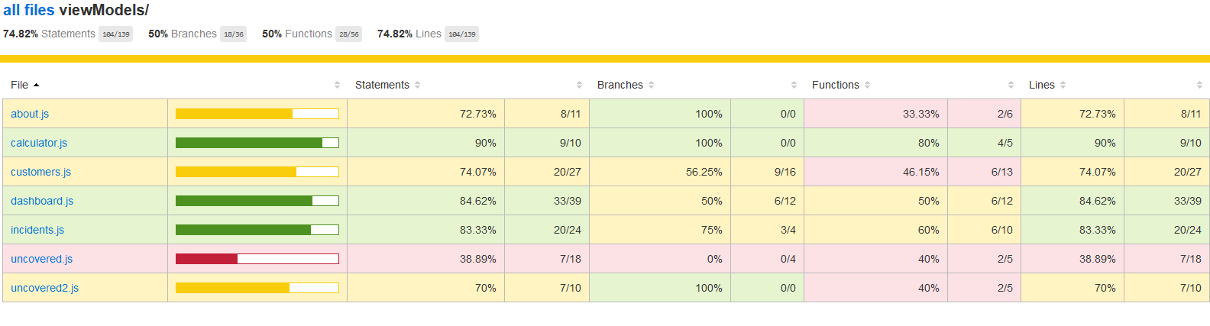
Code Coverage
9
Internal | RBEI/BSO14 | 05/09/2017
© Robert Bosch Engineering and Business Solutions Private Limited 2017. All rights reserved, also regarding any disposal, exploitation, reproduction, editing, distribution, as well as in the event of applications for industrial property rights.

Slide 10
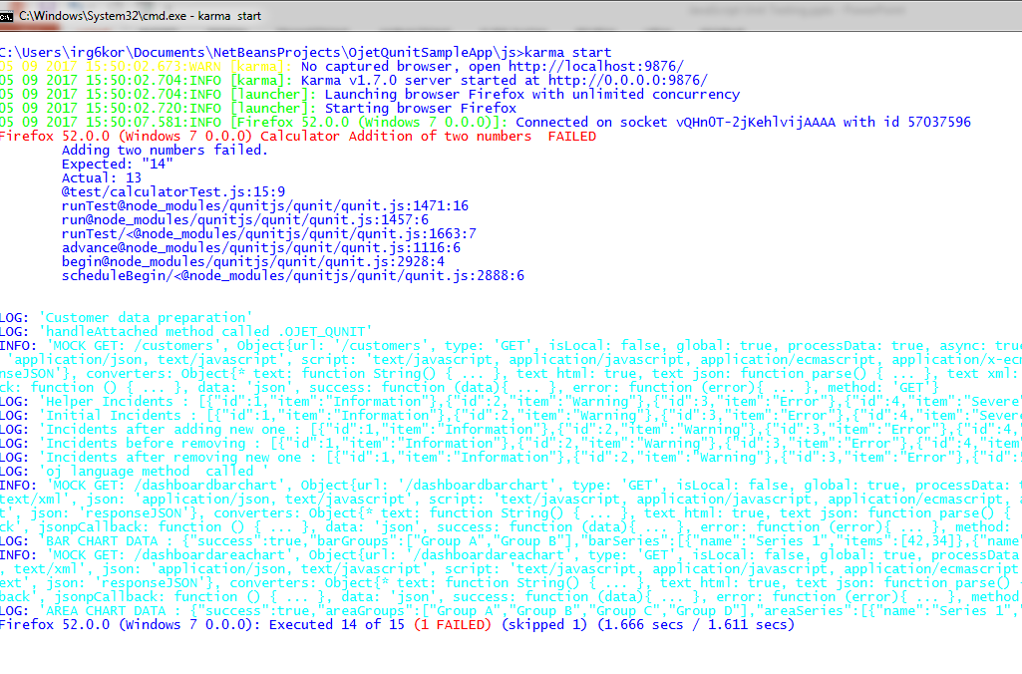
Display Formatted Test Results
Karma test runner displays the results in the console
10
Internal | RBEI/BSO14 | 05/09/2017
© Robert Bosch Engineering and Business Solutions Private Limited 2017. All rights reserved, also regarding any disposal, exploitation, reproduction, editing, distribution, as well as in the event of applications for industrial property rights.

Slide 11
Display Formatted Test Results
We will export test results as a styled HTML file using the Karma html file reporter js.
In order to include the html file reporter into your project :
npm install karma-htmlfile-reporter --save-dev
Add htmlfile reporter parameters to karma config file.
11
Internal | RBEI/BSO14 | 05/09/2017
© Robert Bosch Engineering and Business Solutions Private Limited 2017. All rights reserved, also regarding any disposal, exploitation, reproduction, editing, distribution, as well as in the event of applications for industrial property rights.

Slide 12
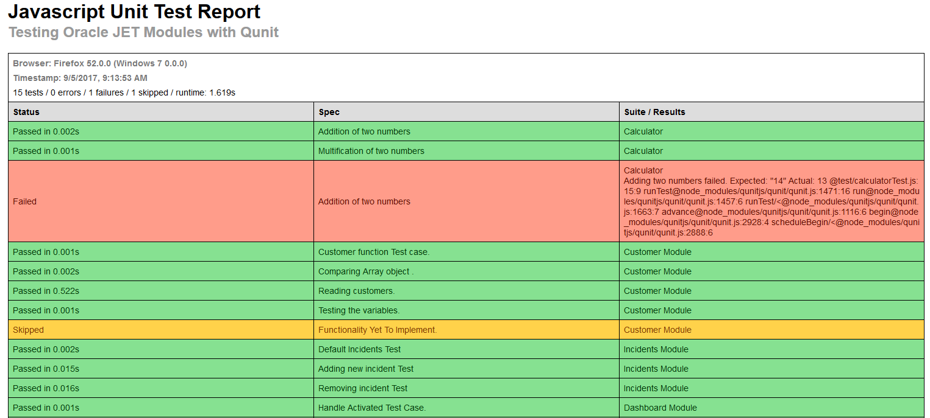
Test Case HTML Reporter
12
Internal | RBEI/BSO14 | 05/09/2017
© Robert Bosch Engineering and Business Solutions Private Limited 2017. All rights reserved, also regarding any disposal, exploitation, reproduction, editing, distribution, as well as in the event of applications for industrial property rights.

Slide 13
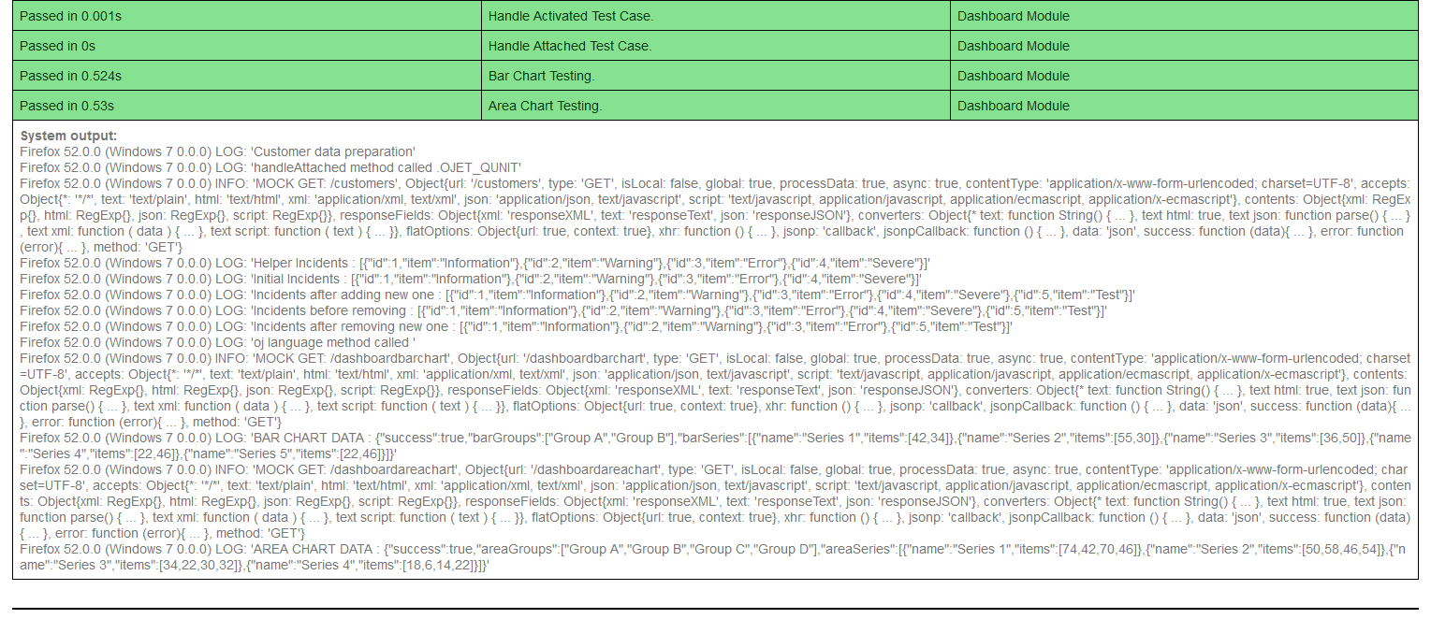
Test Case HTML Reporter
13
Internal | RBEI/BSO14 | 05/09/2017
© Robert Bosch Engineering and Business Solutions Private Limited 2017. All rights reserved, also regarding any disposal, exploitation, reproduction, editing, distribution, as well as in the event of applications for industrial property rights.

Slide 14

14
Internal | RBEI/BSO14 | 05/09/2017
© Robert Bosch Engineering and Business Solutions Private Limited 2017. All rights reserved, also regarding any disposal, exploitation, reproduction, editing, distribution, as well as in the event of applications for industrial property rights.

