Slide 1
INVESTMENT ASSIGNMENT SUBMISSION
Name: Satyam Singh

Slide 2
Spark Funds – Investment Analysis
Spark Funds, an asset management company. Spark Funds wants to make investments in a few companies. The CEO of Spark Funds wants to understand the global trends in investments so that it can take the investment decisions effectively.
Problem Statement:
• Spark Fund wants to invest between 5 to 15 million USD per round of investment
• It wants to invest only in English-speaking countries where maximum profit can be earned .
Business objective: To identify the best sectors, countries, and a suitable investment type for making investments.
Goals of data analysis:
• Investment type analysis to identify the most feasible investment type.
• Country analysis where the most of the investments are there .
•Sector analysis to identify the best sector where investment can be made .

Slide 3
Problem Solving Methodology
BEGIN
Business Objective
Reading the investment files
Merging the data set
Cleaning Data
END
Conclusion
(Identifying the most sutaible area where the investment can be made .)
Sector Analysis
Country Analysis
(only top 3 counties which are English speaking)
Fund Analysis
Neglecting the Extra Data

Slide 4
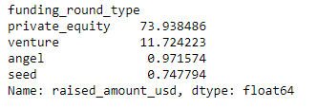
Funding Type Analysis
The different funding type is compared to the value they have raised in total.
The funding types such as seed, venture, angel, has the different amount of funding . For example, seed, angel and venture are three common stages of startup funding and venture and private equity are further large stages .
Here we see that Venture Funding type is the best type to invest in. Specifically the mean amount of venture funds is between 5-15 millions as required by Spark Funds. All values are in millions .

Slide 5
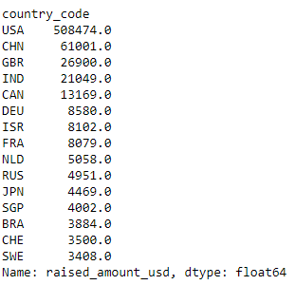
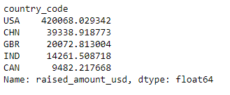
Country Based Analysis
The country based analysis is done only for the Venture funds as we need only this as the range is 5-15 million .
The details of the official language is English of the countries are scraped from the Wikipedia. Then we extract the top 3 countries where English is an official language .
USA, China (CHN), United Kingdom (GBR) and India (IND) are the topmost countries. But China being the non-English speaking country is excluded further analysis.

Slide 6
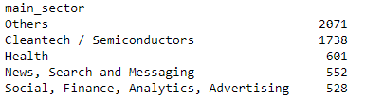
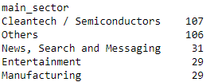
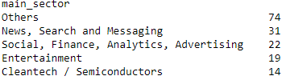
Sector Based Analysis
There are 8 main sectors listed in mapping file. The category list of all the companies map to one of these broad sectors.
After the analysis on countries, the input data is filtered and only the top 3 English speaking countries are retained to conduct analysis on sectors.
The data is now grouped based on the country and the main sectors to get the best performing sectors in the top 3 English speaking countries.
These best sectors are identified by the Number of Investments done in each sector for each country.
USA | GBR | IND

Slide 7
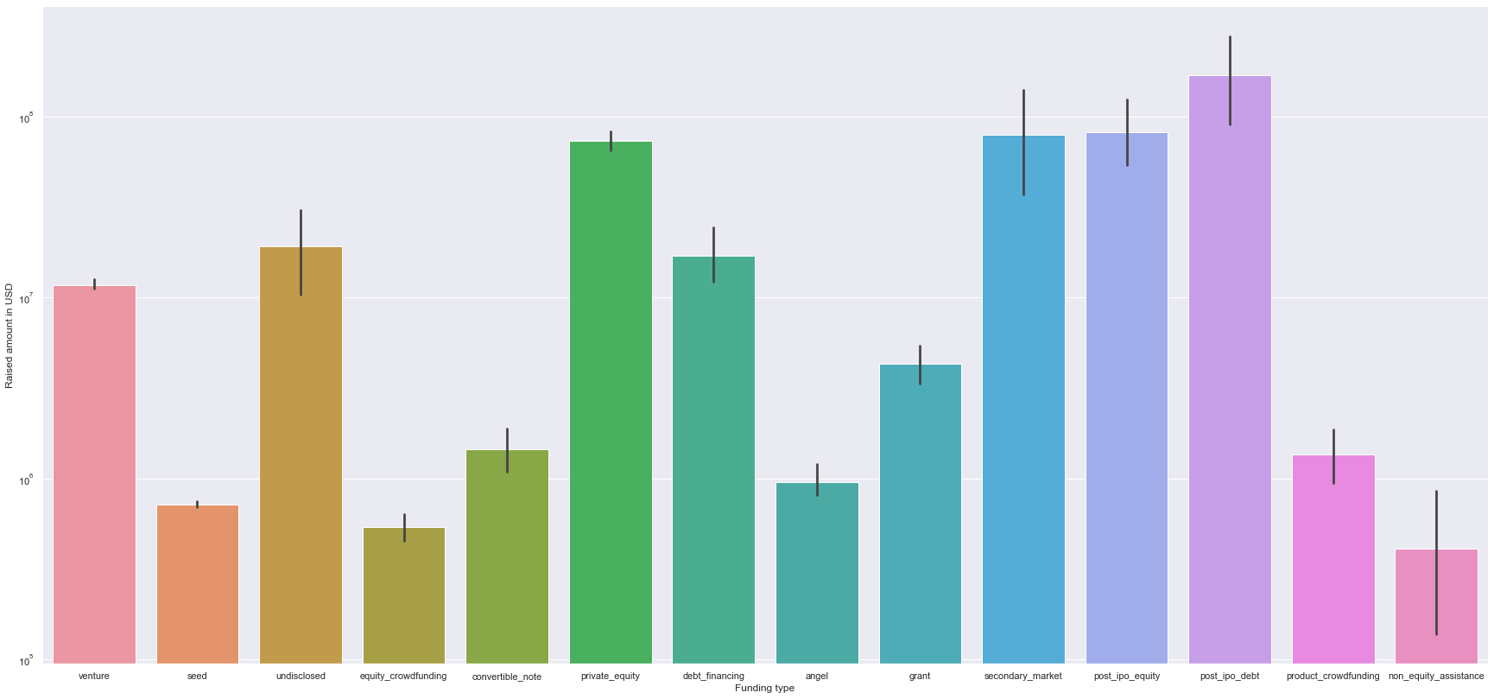

Funding Type Analysis-Result
The funding For the different sectors are marked along with the required types of funding .
As the investment to be done is between 5-15 million hence the Venture Funding would be preferable option .

Slide 8
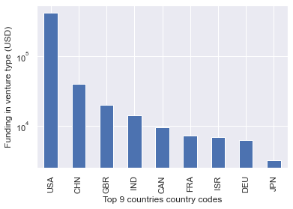
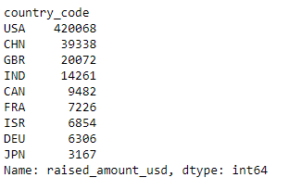
Country Based Analysis-Result
Here the Top nine countries along with the raised amount has been displayed .
As we would make investment in a English-speaking countries we will select the top 3 English speaking countries .
Hence , we can see USA,GBR and IND as top 3 countries where investment can be made .

Slide 9
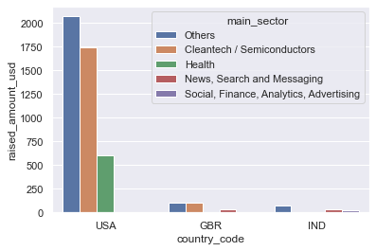
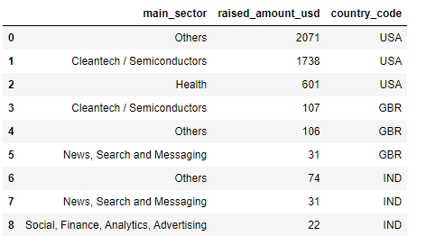
Sector Based Analysis-Result
Here we can see that the countries of USA, Great Britain and India have the top 3 sectors where investment can be made and analysis shows that we can earn maximum from investing in the above mentioned sectors .

Slide 10
Conclusions
From The analysis of the data, we can conclude the following:
Venture Capital is the best investment type with an average size in the 5-15 M USD range.
USA, Great Britain and India are the top 3 English speaking countries with the highest investment amount in the Venture Funding type.
The final decision by the Spark foundation to invest could be in Venture Funds in the sectors 'Others', 'Cleantech/Semiconductors‘ and Health within USA, Cleantech / Semiconductors , Others and News, Search and Messaging within Great Britain and Others , ‘News, Search and Messaging’ and ‘Social/Finance/Analytics/Advertising’ within , India.
THANK - YOU

