Slide 1

MSE643A: ARTIFICIAL INTELLIGENCE AND MACHINE LEARNING IN
MATERIALS ENGINEERING
Professor:Krishanu Biswas
Group Members:
Sai Shashank Rapolu(200839)
Sanyam Singla(200879)
Vaibhav Singh Dhruwanshi(190935)

Slide 2
Topic: Band Gap prediction for different compounds
Objective: To predict band gap using different machine learning models and compare their performance.
Overview
Theory
Dataset
Data Pre-processing
Evaluation Metrics
Training and Testing
Results

Slide 3
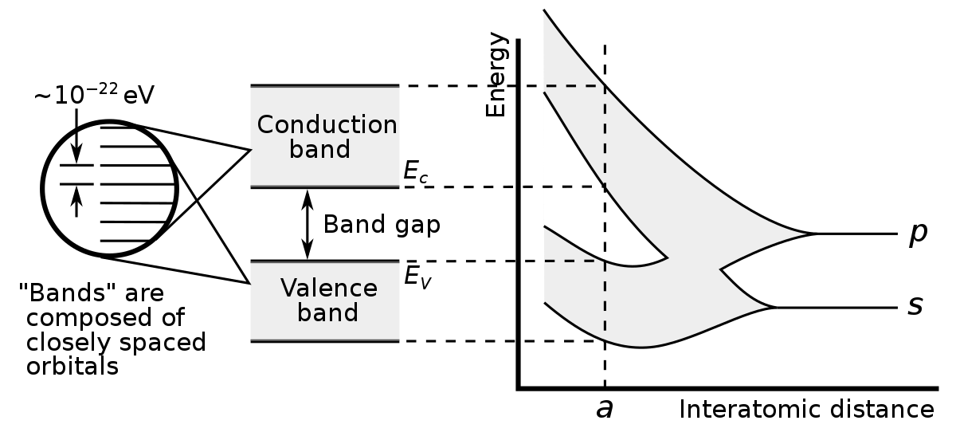
Introduction to the Topic
It refers to the energy difference between the top of the valence band and the bottom of the conduction band.
Band gap ∝ 1⁄√dielectric constant
Dielectric constant further depends upon:
Polarizability of atoms
Atomic structure
Density of atoms etc.
Band gap range
Conductors: 0-2 ev
Semiconductors: 2-3 ev
Insulators: 3-4 ev

Slide 4
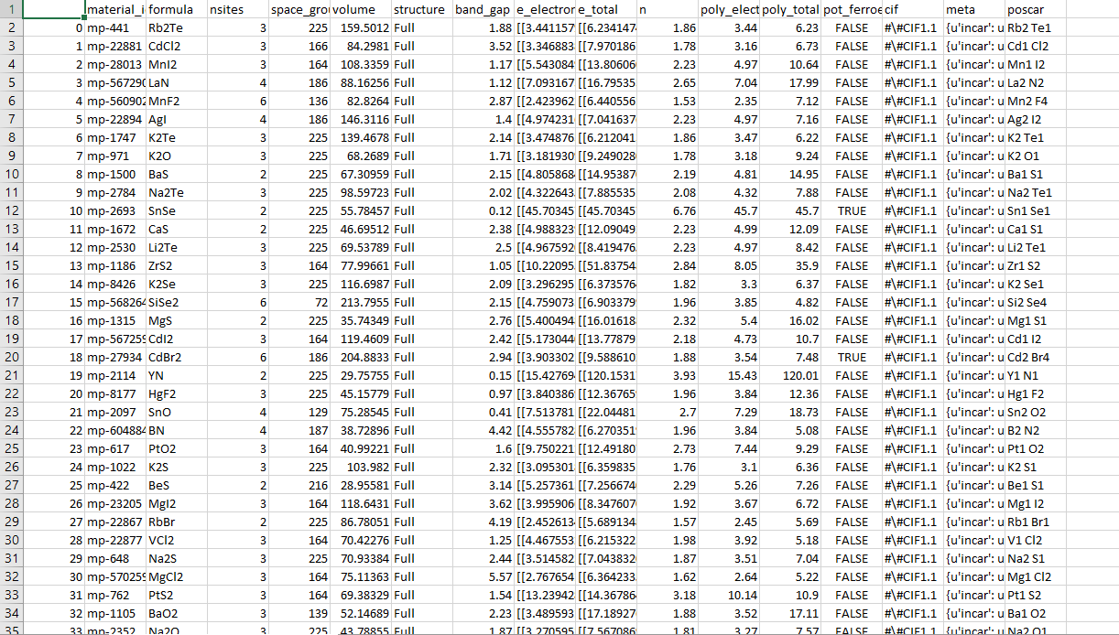

Dataset
Raw Dataset shown here
Obtained from matminer: an open source Python library for material science dataset.
Consists of data for about 1100 different compounds.
https://hackingmaterials.lbl.gov/matminer/dataset_summary.html

Slide 5
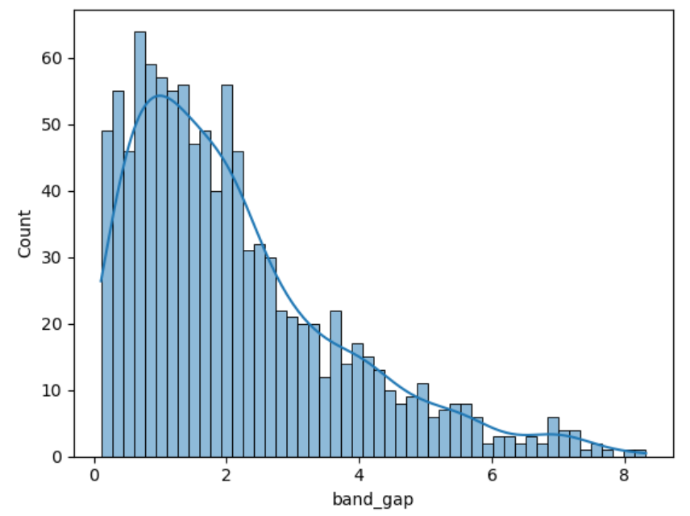
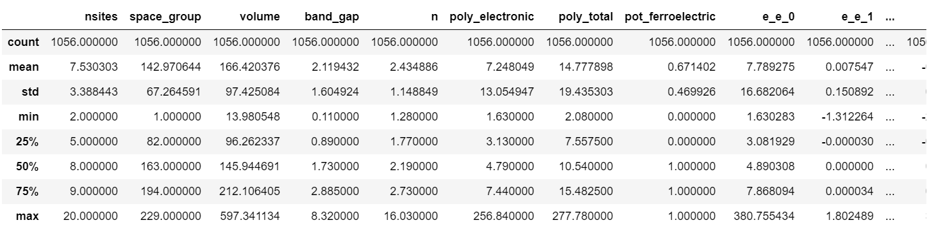
Meaningful Insights
Count of data sets: 1056
Mean band Gap: 2.1192
Mean Ferroelectric: 0.67

Slide 6
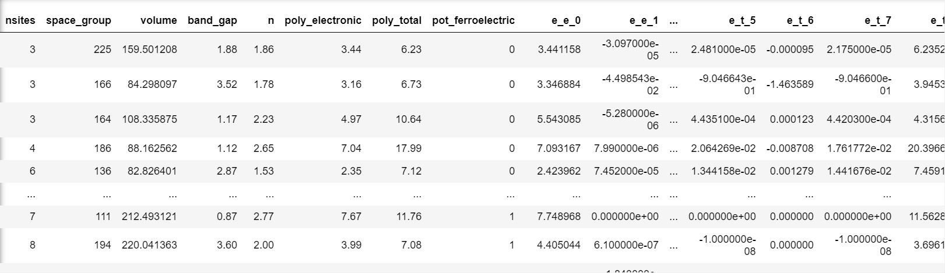
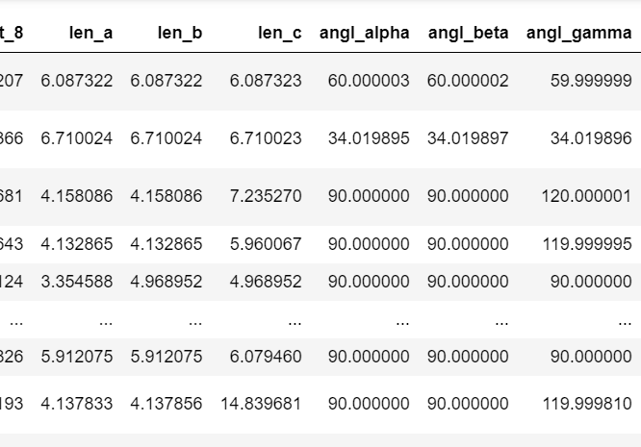
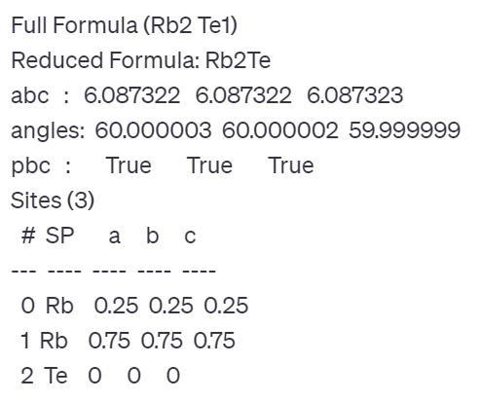
Data Pre-Processing
Removed independent features: material_id, formula, cif, poscar.
Dielectric tensor (electronic and total) are split from 3x3 tensor to 9 different columns.
Encoded pot_ferroelectric.
Structure Properties: Lattice parameters (abc), Lattice angles (alpha, beta, gamma).

Slide 7
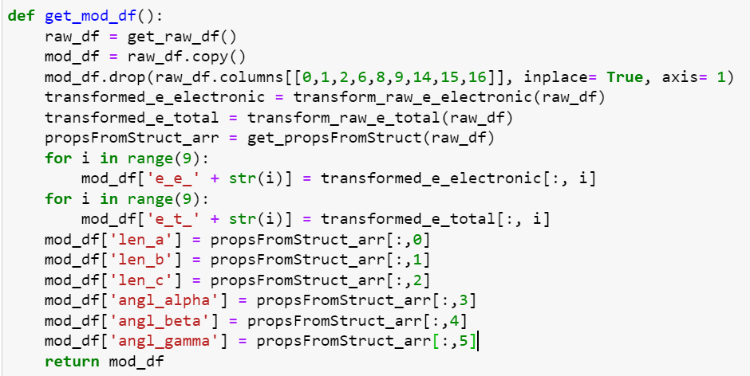
Implementation Code

Slide 8
Evaluation Metrics
Used two evaluation metrics: r2 score and mean absolute error.
Mean Absolute Error (MAE):
Measures the average absolute difference between actual and predicted values.
MAE = (Sum of Absolute Errors)/(Number of Predictions)
Lower value indicates better model performance.
R2 score:
Also known as coefficient of determination, measures the proportion of variance in the dependent variable that is predictable from independent variables.
R2 score = 1 – (Sum of Squared Residuals/Total Sum of Squared Residuals)
Ranges from 0 – 1, with higher value associated with better performance.

Slide 9
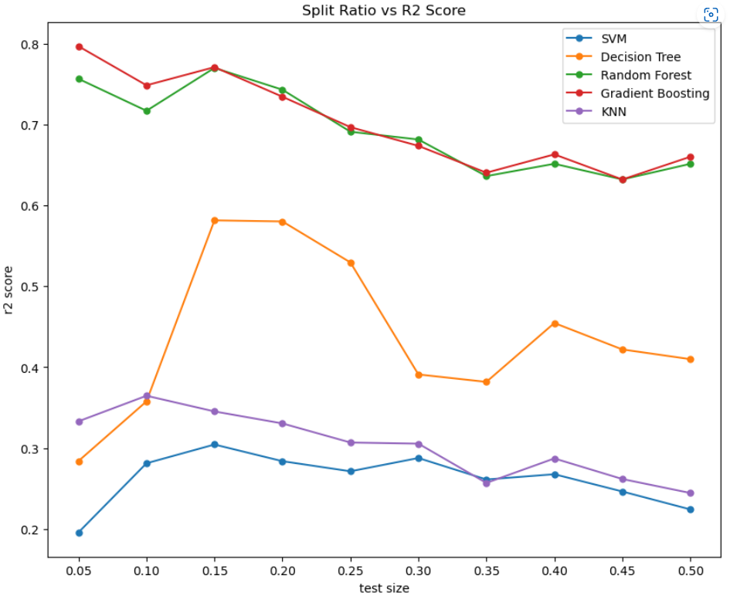
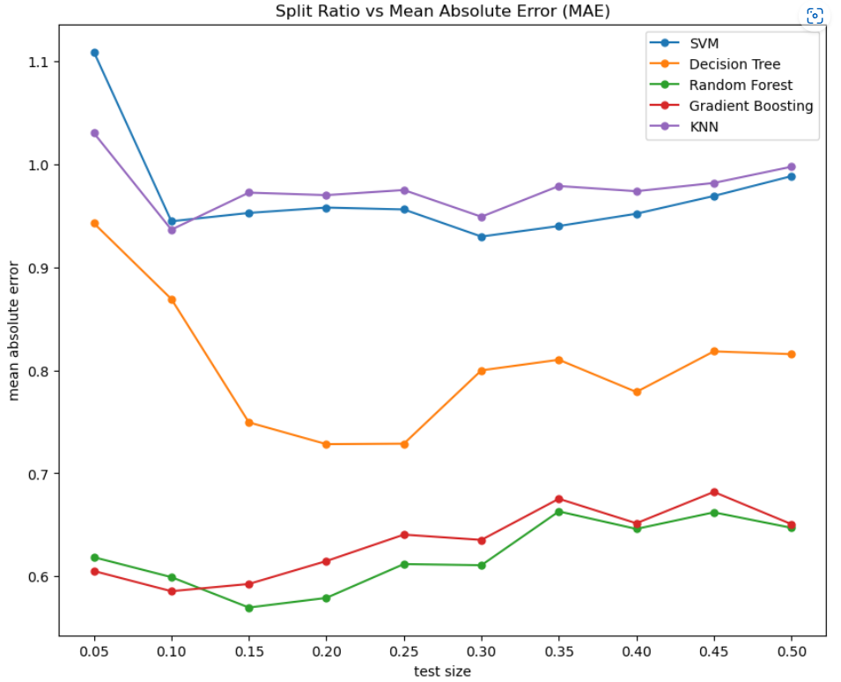
Train Test Split Ratio
Chosen models: SVM, Decision Tree, Random Forest, Gradient Boosting, K Nearest Neighbors
Trained the above models on the dataset after pre-processing

Slide 10
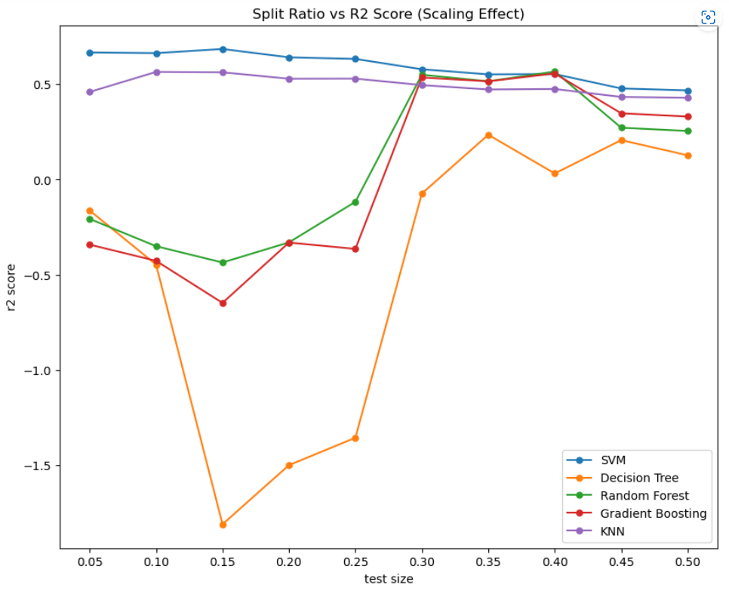
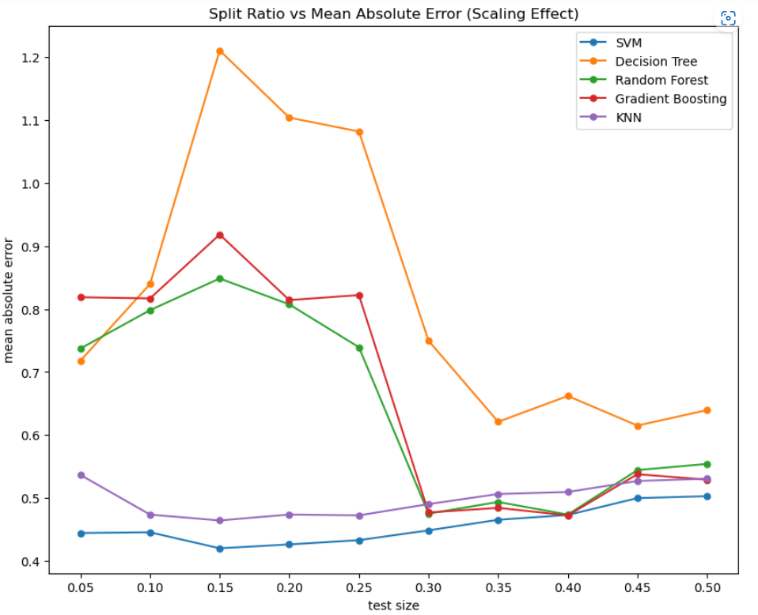
Train Test Split Ratio (Scaling Effect)
Poor performance of SVM and KNN is due to no scaling.
SVM and KNN are affected by scaling the input features.

Slide 11
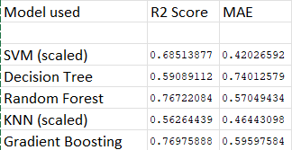
Best Performance
Below picture shows the best results obtained so far.
Observations:
Gradient Boosting, Random Forest have consistently performed well over other models.
There is a significant effect of scaling on SVM and KNN.

Slide 12
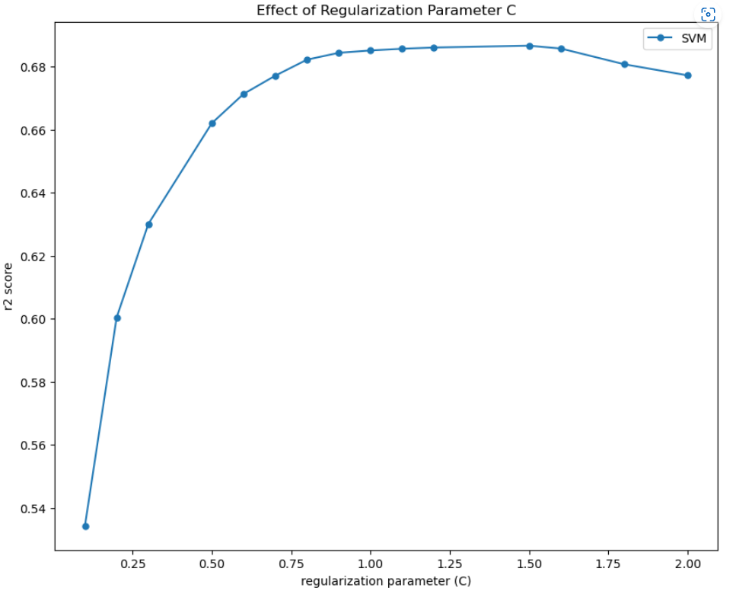
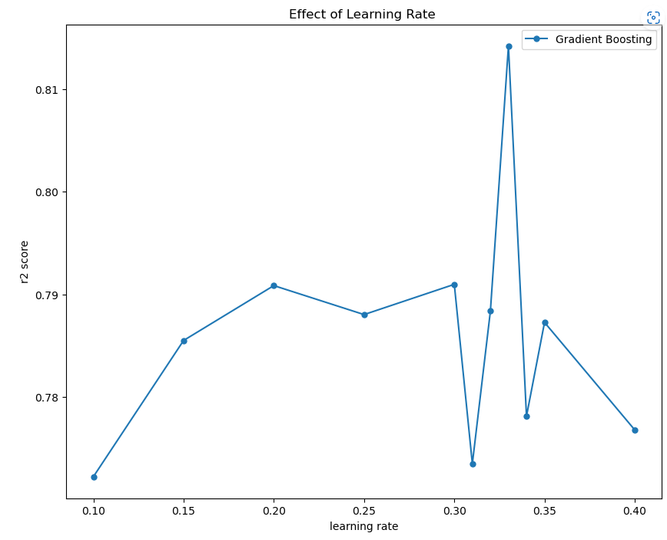
Hyperparameter Tuning
We have also tested the effect of hyperparameters on a model’s performance.
No significant effect on Decision Tree, Random Forest and KNN.
For SVM, best was for C= 1.5 with r2 score = 0.6866
For Gradient Boosting, best was for learning rate= 0.33, with r2 score= 0.8142

Slide 13
References:
Theory = https://en.wikipedia.org/wiki/Band_gap
Matminer = Table of Datasets — matminer 0.8.0 documentation (lbl.gov)
SciKit Learn = scikit-learn: machine learning in Python — scikit-learn 1.2.2 documentation
Pandas = pandas - Python Data Analysis Library (pydata.org)
Numpy = NumPy
Matplotlib = Matplotlib — Visualization with Python

