Slide 1
BIGDATA 230: Emerging technology in big data Stock DATA Analysis
Rajat Jain
SauRAB nog
Swati Sinha
Tri pham

Slide 2
Approach
Identifying Data Source
Deciding on Use Cases
Readying the Infrastructure
Injecting data through pipeline
Use spark for analysis

Slide 3
Identifying Data source
The dataset includes daily stock data for 20 stocks
Historical and Streaming
Data available through website https://www.alphavantage.co

Slide 4









Architecture

Slide 5
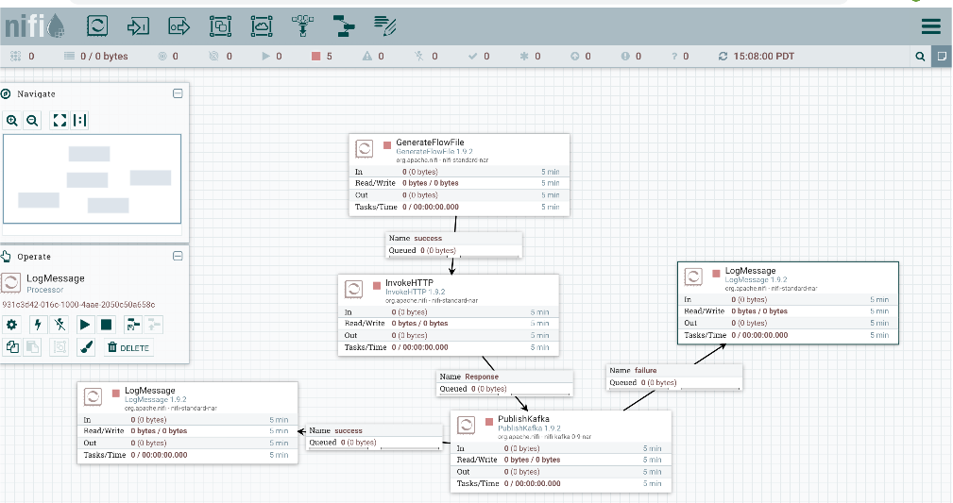
NIFI FLOW

Slide 6
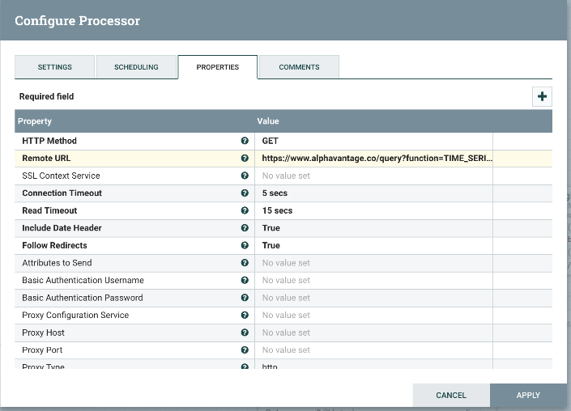
Invoke HTTP

Slide 7
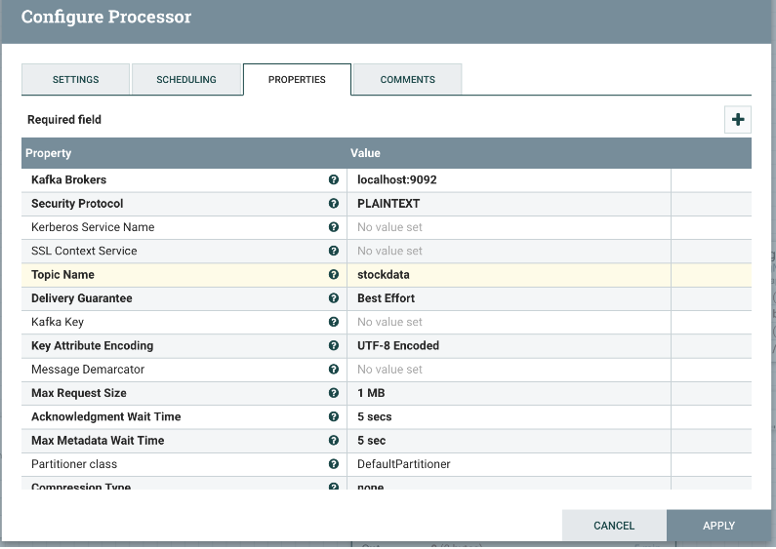
Publish Kafka

Slide 8
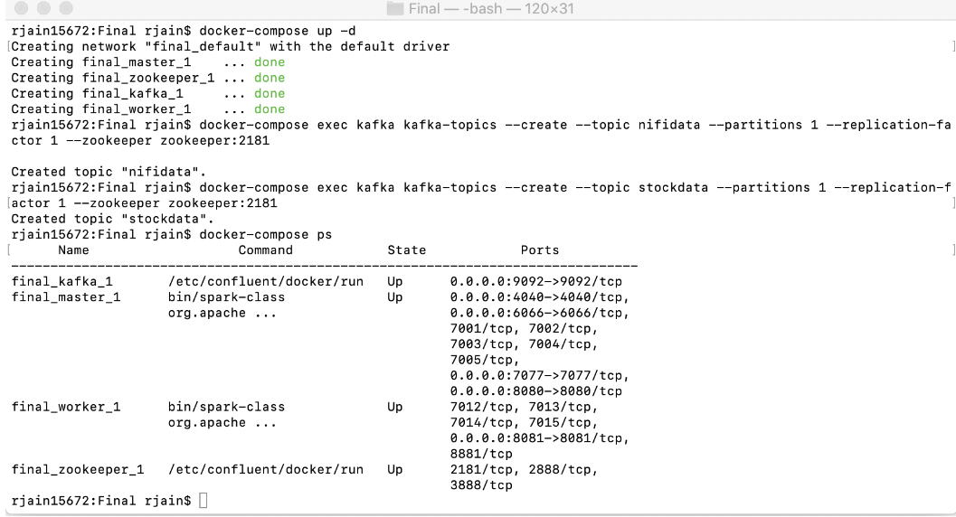
Docker

Slide 9
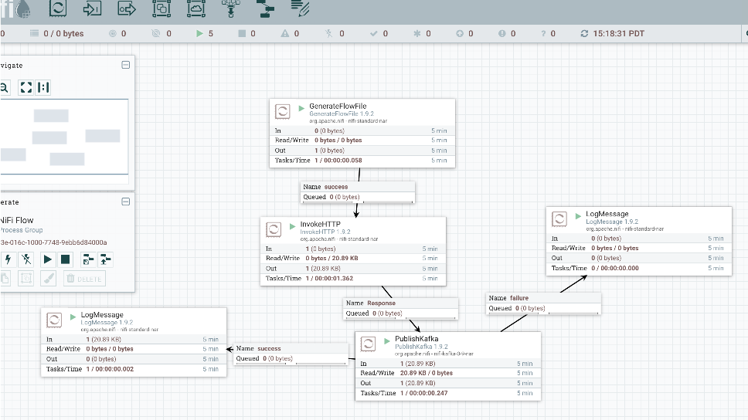
Running NIFI FLOW

Slide 10
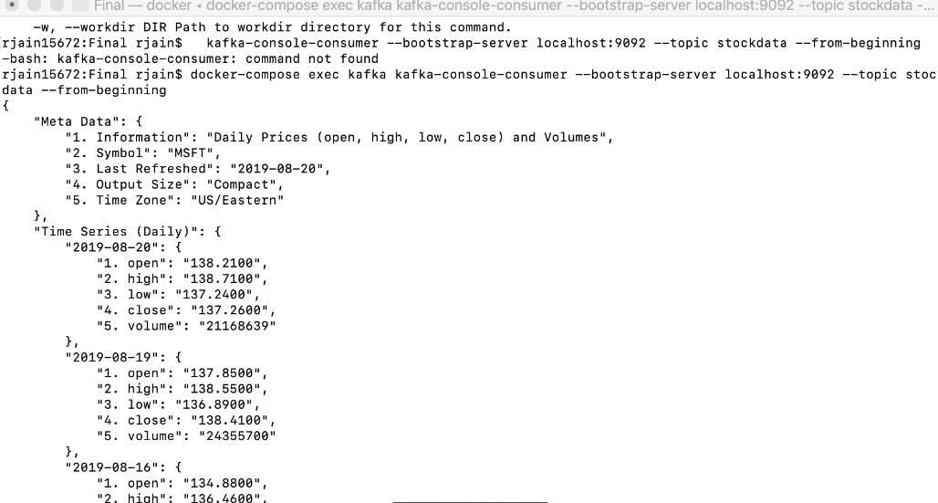
Data in Kafka from nifi

Slide 11
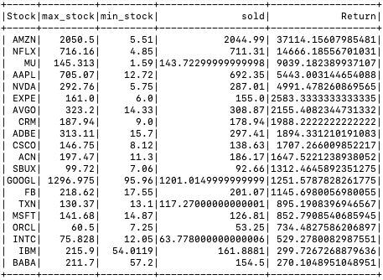
Stock with maximum returns in last 20 years
val StockReturn = StockDataDF.groupBy($"Stock").agg(max($"high").as("max_stock"),min($"low").as("min_stock")).withColumn("sold",coalesce($"max_stock"-$"min_stock",lit(0.0))).withColumn("Return",coalesce($"sold"*100/$"min_stock",lit(0.0)))
StockReturn.orderBy($"Return"desc).show

Slide 12
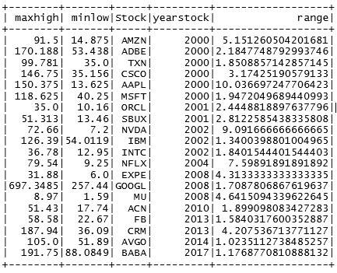
Which Year did the stock have the most change in price
scala> val YearlyDataDF = spark.sql("select max(high) as maxhigh, min(low) as minlow, Stock, year(timestamp) as yearstock from StockData group by Stock, yearstock order by yearstock")
scala> val maxYearlyFluctuationDF = spark.sql("select max((maxhigh - minlow)/minlow) as range, Stock from YearData group by Stock")
scala> val maxYearChanges = spark.sql("select y.*, range from YearData as y join maxYearlyFluctuation as m on y.Stock = m.Stock where (y.maxhigh - y.minlow)/y.minlow = m.range").show(50)

Slide 13
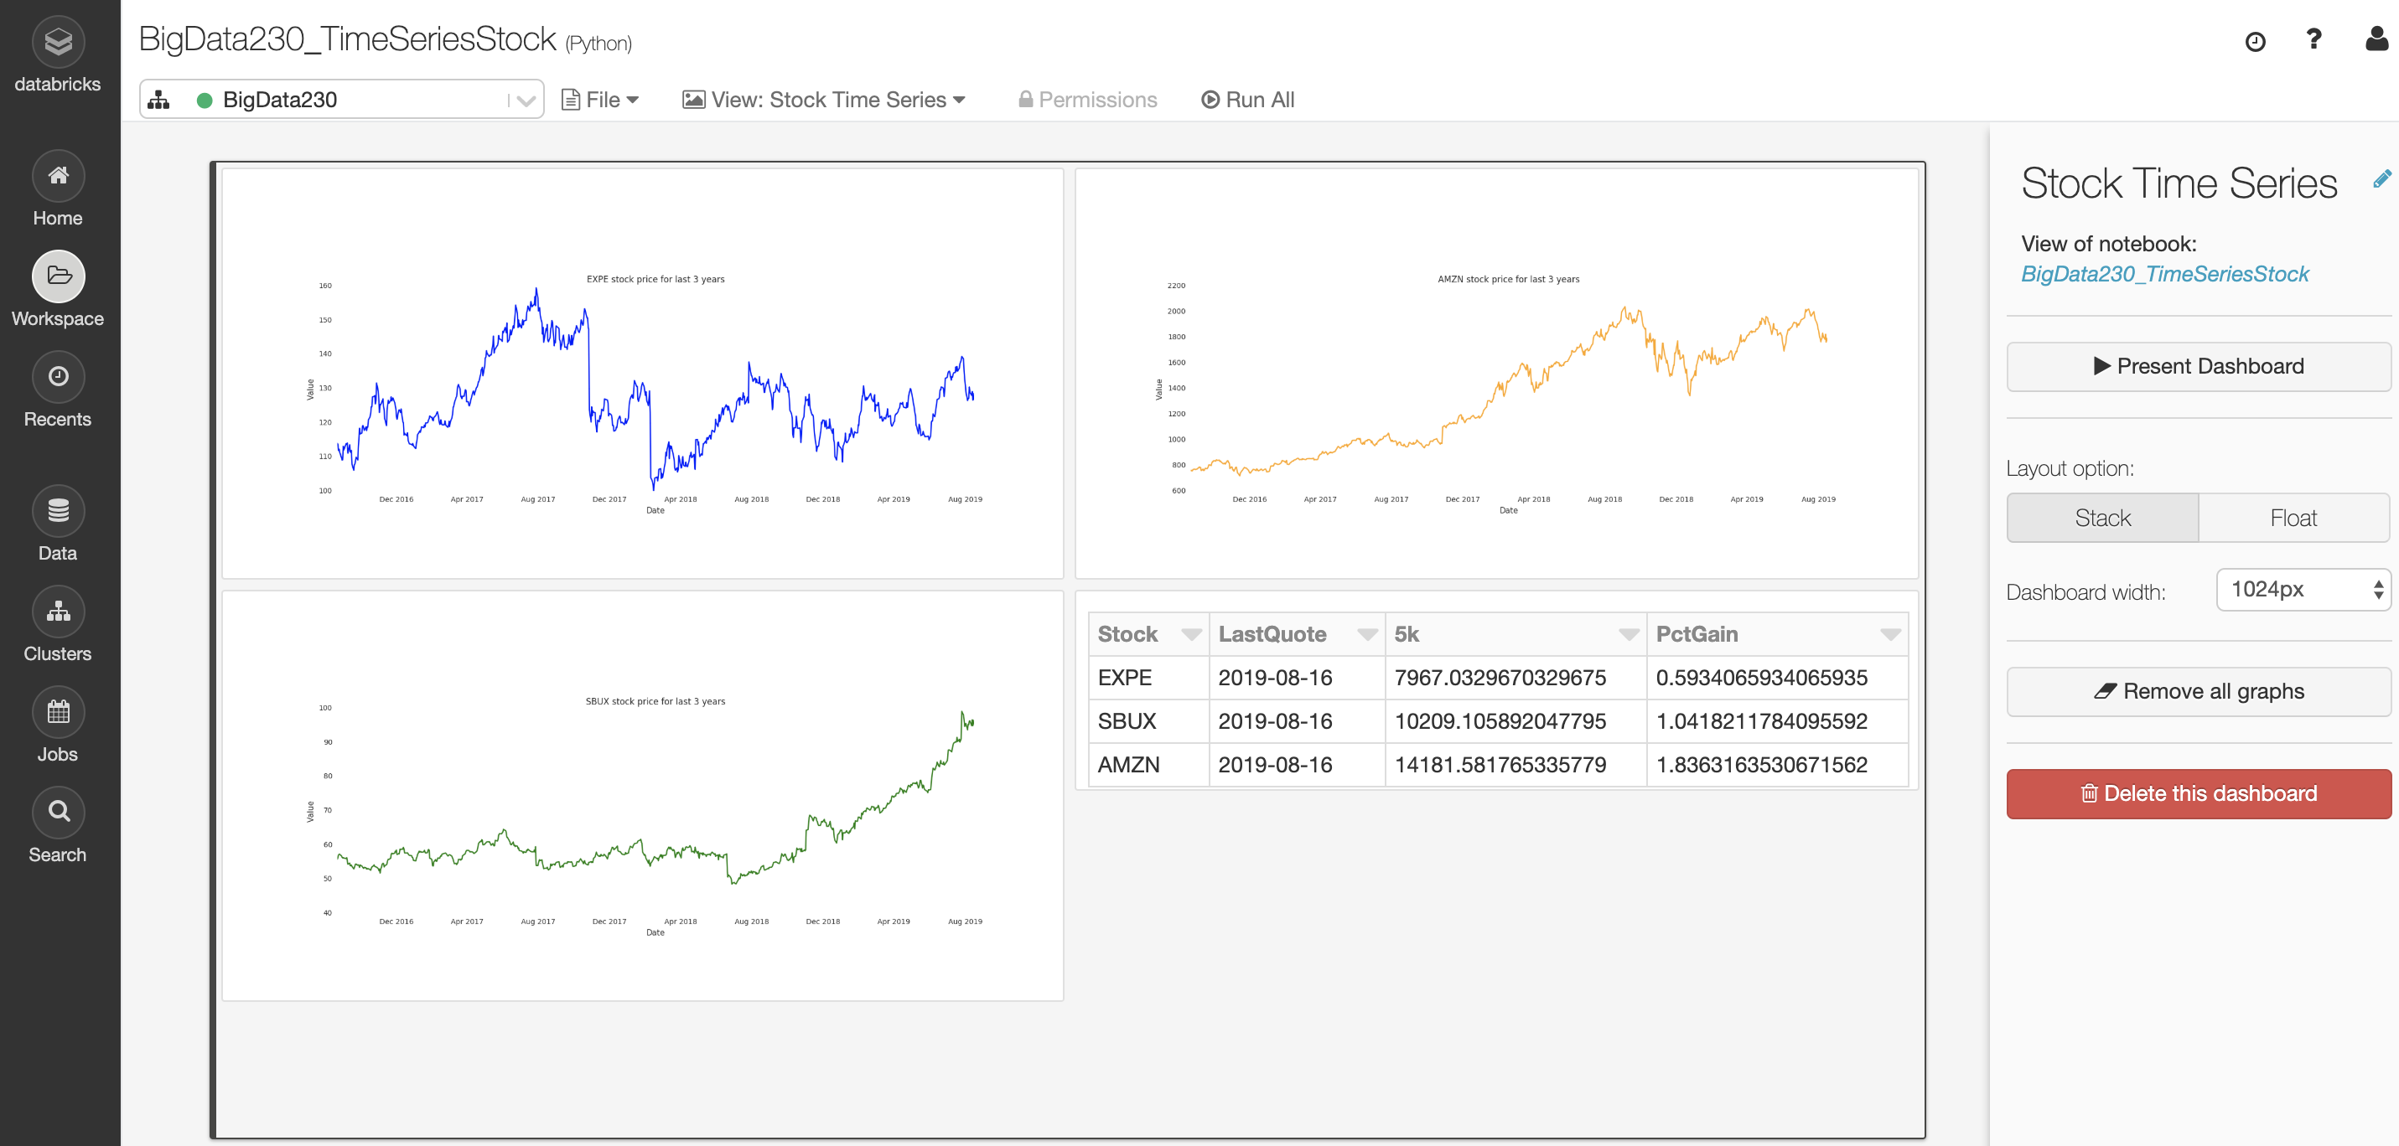
Stock Trend Over Three Years

Slide 14
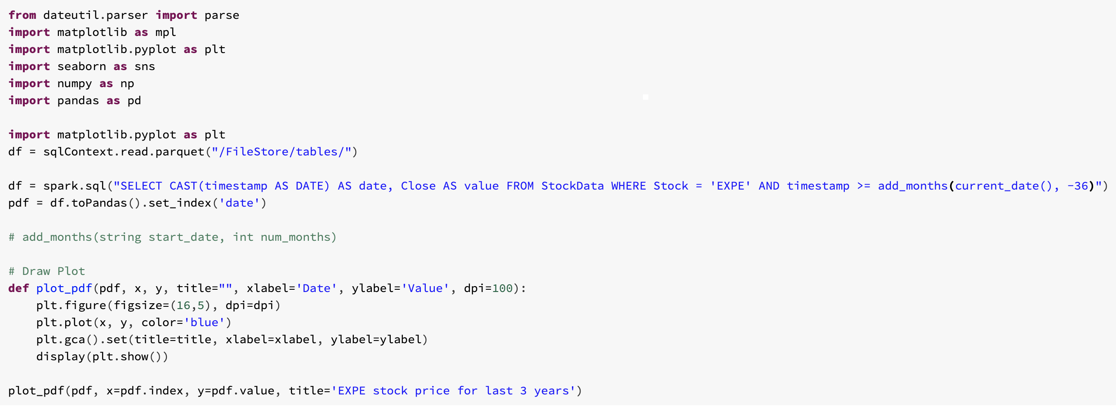
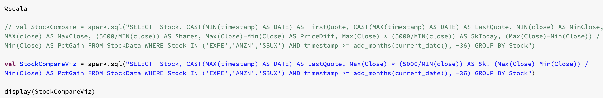
Databricks
Chart
Table

Slide 15
What if we had more time
Using docker , being able to connect nifi, kafka and spark together.
Persist the data in Cassandra to be able to analyze real-time data over a longer period of time.
Build Real-Time Dashboard in a tool like Tableau or Power BI

Slide 16
Thank You

