Slide 1

Pattern Classification
All materials in these slides were taken from
Pattern Classification (2nd ed) by R. O. Duda, P. E. Hart and D. G. Stork, John Wiley & Sons, 2000 with the permission of the authors and the publisher

Slide 2
Chapter 5:
Linear Discriminant Functions
(Sections 5.1-5.3, 5.4, 5.11)
Introduction
Linear Discriminant Functions and Decisions
Surfaces
Generalized Linear Discriminant Functions

Slide 3
Introduction
In chapter 3, the underlying probability densities were known (or given)
The training sample was used to estimate the parameters of these probability densities (ML, MAP estimations)
In this chapter, we only know the proper forms for the discriminant functions: similar to non-parametric techniques
They may not be optimal, but they are very simple to use
They provide us with linear classifiers

Slide 4
5.2 Linear discriminant functions and decisions surfaces
Definition
  It is a function that is a linear combination of the components of x
  g(x) = w^{t}x + w₀ (1)
  where w is the weight vector and w₀ the bias

Slide 5
Two-category classifier
A two-category classifier with a discriminant function of the form (1) uses the following rule:
Decide ω₁ if g(x) > 0
Decide ω₂ if g(x) < 0
⇔
Decide ω₁ if w^{t}x > -w₀
Decide ω₂ if w^{t}x < -w₀
If g(x) = 0 ⇒ x is assigned to either class

Slide 6
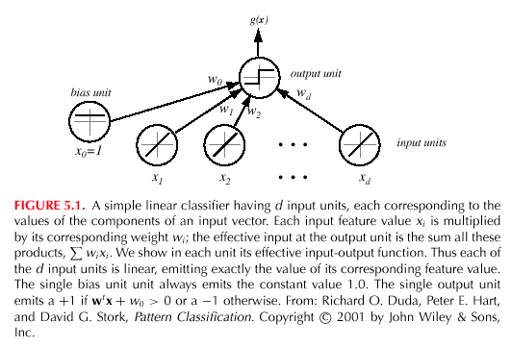

Slide 7
  The equation g(x) = 0 defines the decision surface that separates points assigned to the category ω₁ from points assigned to the category ω₂
  When g(x) is linear, the decision surface is a hyperplane
  Algebraic measure of the distance from x to the hyperplane (interesting result!)

Slide 8
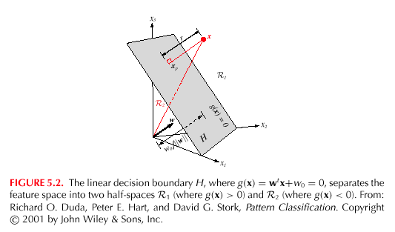

Slide 9
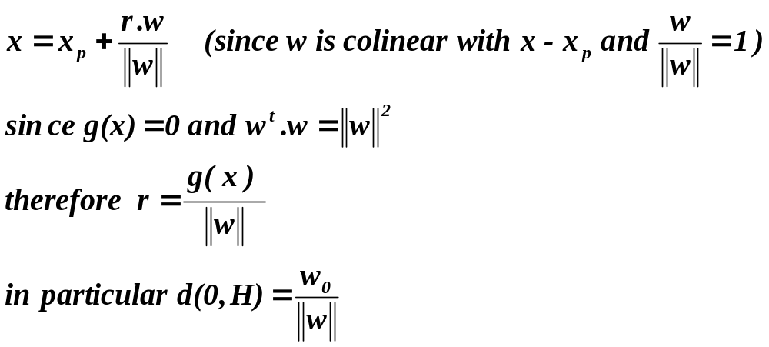
  In conclusion, a linear discriminant function divides the feature space by a hyperplane decision surface
  The orientation of the surface is determined by the normal vector w and the location of the surface is determined by the bias

Slide 10
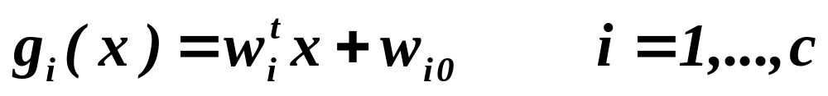
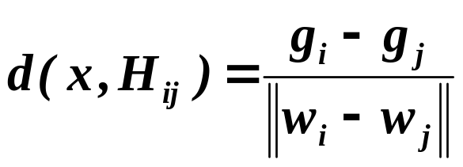
The Multicategory Case
  We define c linear discriminant functions
    and assign x to ω_{i} if g_{i}(x) > g_{j}(x) ∀ j ≠ i; in case of ties, the classification is undefined
    In this case, the classifier is a “linear machine”
    A linear machine divides the feature space into c decision regions, with g_{i}(x) being the largest discriminant if x is in the region R_{i}
    For a two contiguous regions R_{i} and R_{j}; the boundary that separates them is a portion of hyperplane H_{ij} defined by:
      g_{i}(x) = g_{j}(x)
    (w_{i} – w_{j})^{t}x + (w_{i0} – w_{j0}) = 0
    w_{i} – w_{j} is normal to H_{ij} and

Slide 11
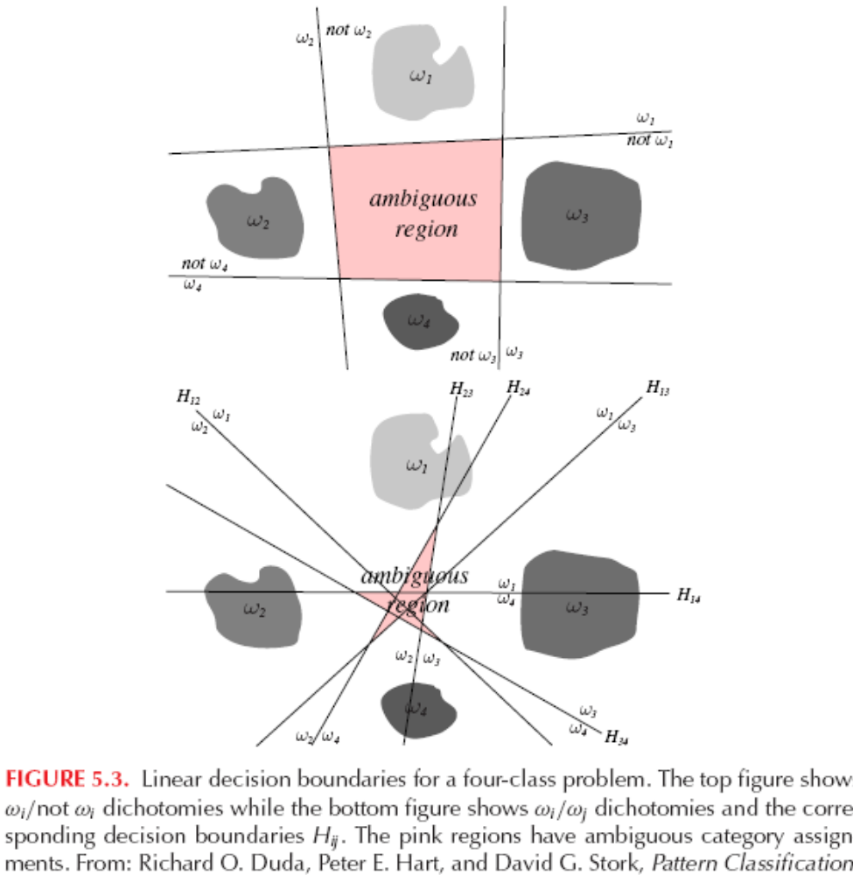

Slide 12
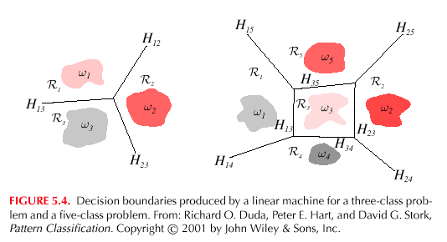

Slide 13
  It is easy to show that the decision regions for a linear machine are convex, this restriction limits the flexibility and accuracy of the classifier

Slide 14
5.3 Generalized Linear Discriminant Functions
Decision boundaries which separate between classes may not always be linear
The complexity of the boundaries may sometimes request the use of highly non-linear surfaces
A popular approach to generalize the concept of linear decision functions is to consider a generalized decision function as:
    g(x) = w₁f₁(x) + w₂f₂(x) + … + w_{N}f_{N}(x) + w_{N+1} (1)
    where f_{i}(x), 1 ≤ i ≤ N are scalar functions of the pattern x,
    x ∈ R^{n} (Euclidean Space)

Slide 15
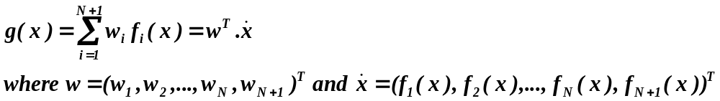
Introducing f_{n+1}(x) = 1 we get:
This latter representation of g(x) implies that any decision function defined by equation (1) can be treated as linear in the (N + 1) dimensional space (N + 1 > n)
g(x) maintains its non-linearity characteristics in R^{n}

Slide 16
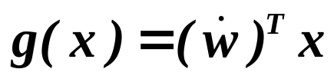

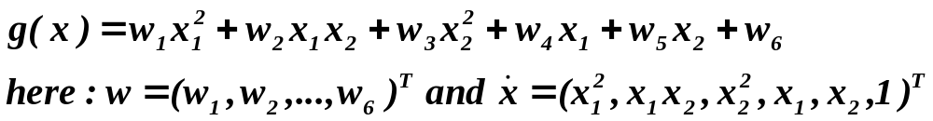
The most commonly used generalized decision function is g(x) for which f_{i}(x) (1 ≤ i ≤N) are polynomials
  Where is a new weight vector, which can be calculated from the original w and the original linear f_{i}(x), 1 ≤ i ≤N
Quadratic decision functions for a 2-dimensional feature space
T: is the vector transpose form

Slide 17
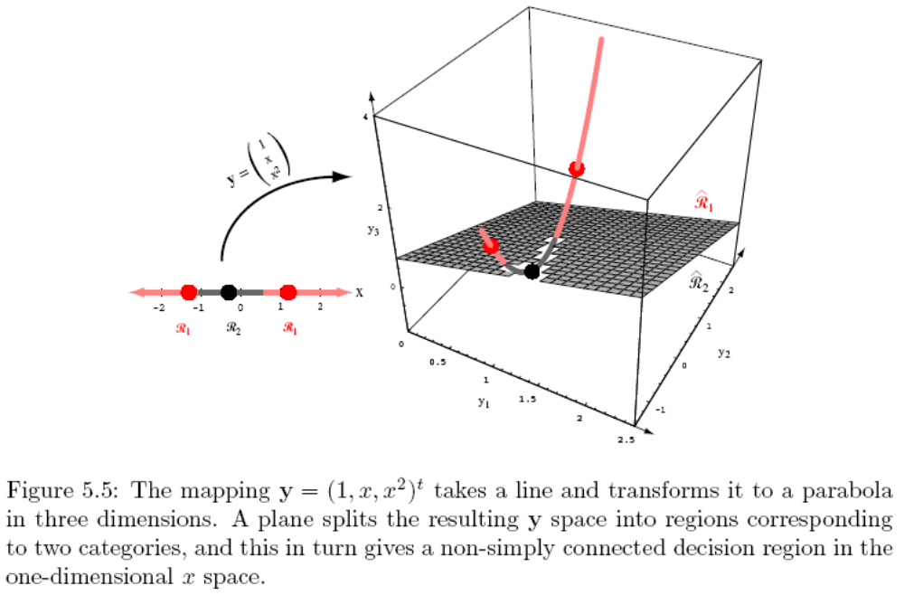
Mapping a line to a parabola

Slide 18
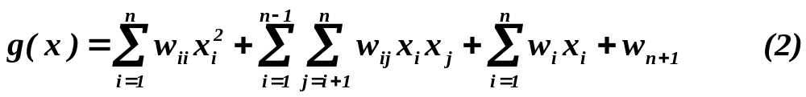
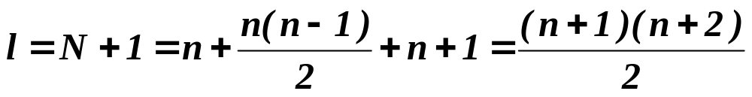

For patterns x ∈R^{n}, the most general quadratic decision function is given by:
The number of terms at the right-hand side is:
This is the total number of weights which are the free parameters of the problem
  If for example n = 3, the vector is 10-dimensional
  If for example n = 10, the vector is 65-dimensional

Slide 19
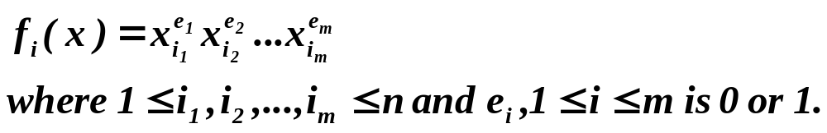
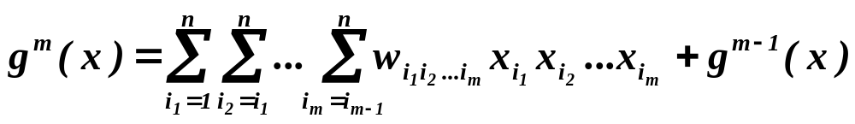
In the case of polynomial decision functions of order m, a typical f_{i}(x) is given by:
  It is a polynomial with a degree between 0 and m. To avoid repetitions, we request i₁ ≤ i₂ ≤ …≤ i_{m}
(where g⁰(x) = w_{n+1}) is the most general polynomial decision function of order m

Slide 20
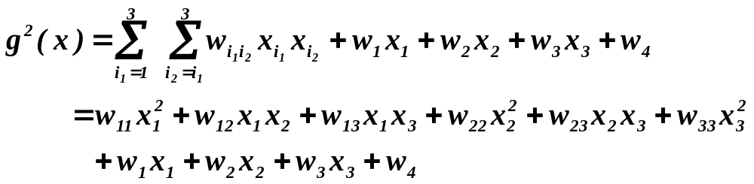
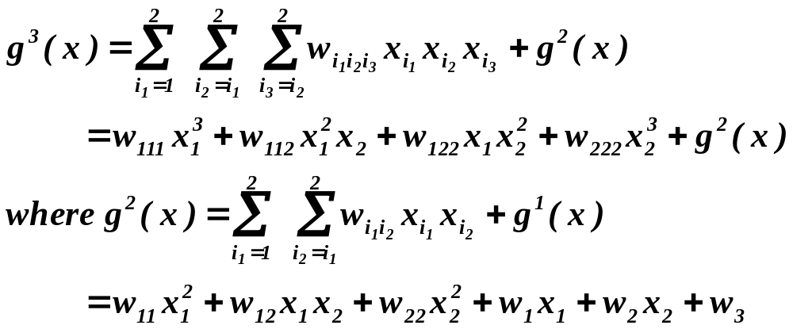
  Example 1: Let n = 3 and m = 2 then:
  Example 2: Let n = 2 and m = 3 then:

Slide 21
  The commonly used quadratic decision function can be represented as the general n- dimensional quadratic surface:
  g(x) = x^{T}Ax + x^{T}b +c
  where the matrix A = (a_{ij}), the vector b = (b₁, b₂, …, b_{n})^{T} and c, depends on the weights w_{ii}, w_{ij}, w_{i} of equation (2)
  If A is positive definite then the decision function is a hyperellipsoid with axes in the directions of the eigenvectors of A
    In particular: if A = I_{n} (Identity), the decision function is simply the n-dimensional hypersphere

Slide 22
If A is negative definite, the decision function describes a hyperhyperboloid
In conclusion: it is only the matrix A which determines the shape and characteristics of the decision function

Slide 23
Problem: Consider a 3 dimensional space and cubic polynomial decision functions
How many terms are needed to represent a decision function if only cubic and linear functions are assumed
Present the general 4th order polynomial decision function for a 2 dimensional pattern space
Let R³ be the original pattern space and let the decision function associated with the pattern classes ω₁ and ω₂ be:
for which g(x) > 0 if x ∈ ω₁ and g(x) < 0 if x ∈ ω₂
  Rewrite g(x) as g(x) = x^{T}Ax + x^{T}b + c
  Determine the class of each of the following pattern vectors:
  (1,1,1), (1,10,0), (0,1/2,0)

Slide 24
Positive Definite Matrices
  A square matrix A is positive definite if x^{T}Ax>0 for all nonzero column vectors x.
  It is negative definite if x^{T}Ax < 0 for all nonzero x.
  It is positive semi-definite if x^{T}Ax ≥ 0.
  And negative semi-definite if x^{T}Ax ≤ 0 for all x.
  These definitions are hard to check directly and you might as well forget them for all practical purposes.

Slide 25
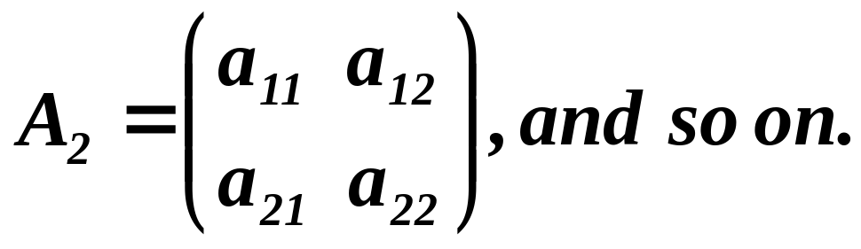
More useful in practice are the following properties, which hold when the matrix A is symmetric and which are easier to check.
The ith principal minor of A is the matrix A_{i} formed by the first i rows and columns of A. So, the first principal minor of A is the matrix A_{i} = (a₁₁), the second principal minor is the matrix:

Slide 26
  The matrix A is positive definite if all its principal minors A₁, A₂, …, A_{n} have strictly positive determinants
  If these determinants are non-zero and alternate in signs, starting with det(A₁)<0, then the matrix A is negative definite
  If the determinants are all non-negative, then the matrix is positive semi-definite
  If the determinant alternate in signs, starting with det(A₁)≤0, then the matrix is negative semi-definite

Slide 27
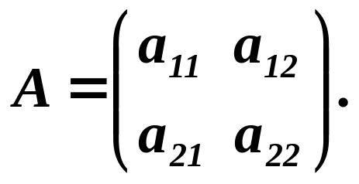
To fix ideas, consider a 2x2 symmetric matrix:
  It is positive definite if:
      det(A₁) = a₁₁ > 0
      det(A₂) = a₁₁a₂₂ – a₁₂a₁₂ > 0
  It is negative definite if:
      det(A₁) = a₁₁ < 0
      det(A₂) = a₁₁a₂₂ – a₁₂a₁₂ > 0
  It is positive semi-definite if:
      det(A₁) = a₁₁ ≥ 0
      det(A₂) = a₁₁a₂₂ – a₁₂a₁₂ ≥ 0
  And it is negative semi-definite if:
      det(A₁) = a₁₁ ≤ 0
      det(A₂) = a₁₁a₂₂ – a₁₂a₁₂ ≥ 0.

Slide 28
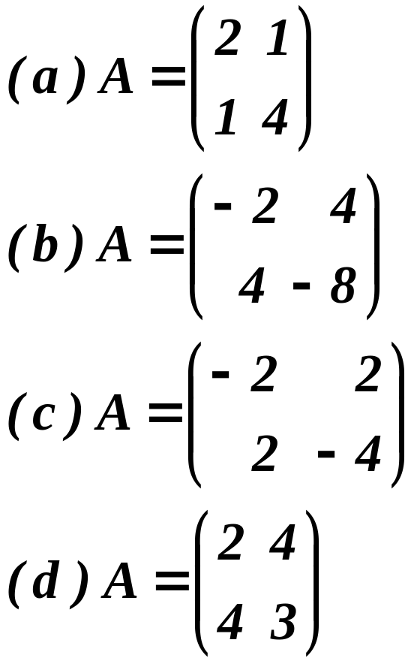
Exercise 1: Check whether the following matrices are positive
definite, negative definite, positive semi-definite, negative semi-
definite or none of the above.

Slide 29
Solutions of Exercise 1:
A₁ = 2 >0
A₂ = 8 – 1 = 7 >0 ⇒ A is positive definite
A₁ = -2
A₂ = (-2 x –8) –16 = 0 ⇒ A is negative semi-positive
A₁ = - 2
A₂ = 8 – 4 = 4 >0 ⇒ A is negative definite
A₁ = 2 >0
A₂ = 6 – 16 = -10 <0 ⇒ A is none of the above

Slide 30
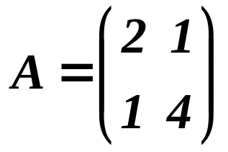
Exercise 2:
Let
Compute the decision boundary assigned to the matrix A (g(x) = x^{T}Ax + x^{T}b + c) in the case where
b^{T} = (1 , 2) and c = - 3
Solve det(A-λI) = 0 and find the shape and the characteristics of the decision boundary separating two classes ω₁ and ω₂
Classify the following points:
    x^{T} = (0 , - 1)
    x^{T} = (1 , 1)

Slide 31
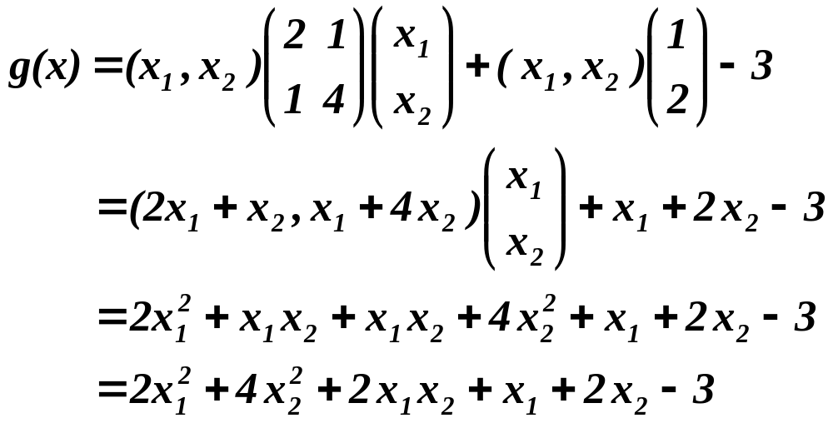
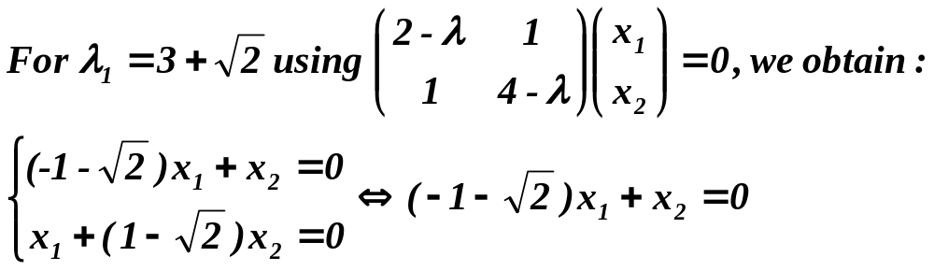
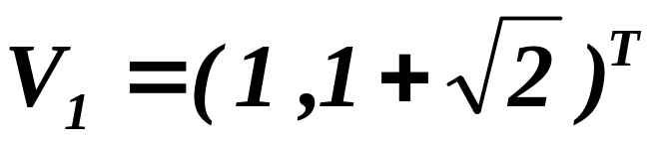
Solution of Exercise 2:
1.
2.
This latter equation is a straight line colinear to the vector:

Slide 32
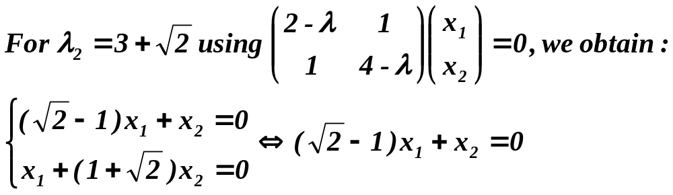
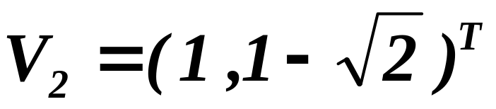
This latter equation is a straight line colinear to the vector:
The ellipsis decision boundary has two axes, which are
respectively colinear to the vectors V₁ and V₂
3. X = (0 , -1) ^{T} ⇒ g(0 , -1) = -1 < 0 ⇒ x ∈ ω₂
X = (1 , 1) ^{T} ⇒ g(1 , 1) = 8 > 0 ⇒ x ∈ ω₁

Slide 33
Section 5.4 Linearly Separable
Linearly separable
Separating Vector
Margin

Slide 34
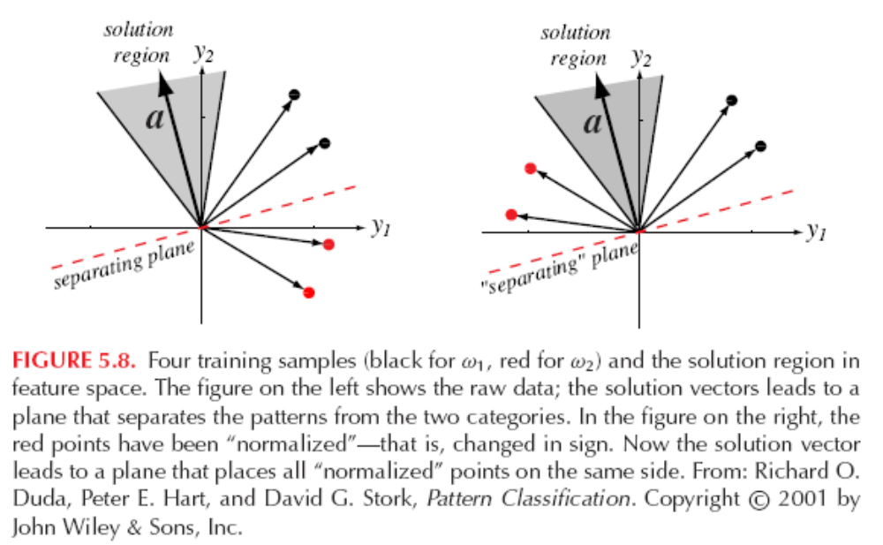
Change sign

Slide 35
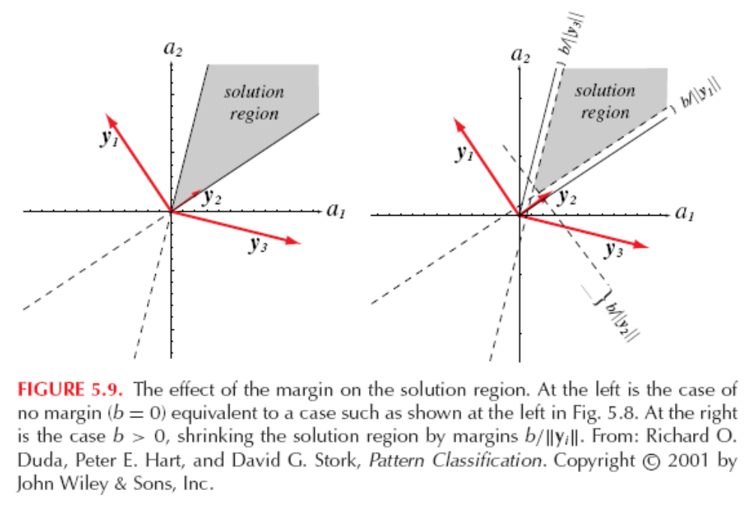
margin

Slide 36
Algo. Basic Gradient Decent
begin initialize a, threshold θ, η(.), k=0
  do k = k+1
    a = a – η(k) ▽J(a)
  unitl |η (k) ▽J(a)|<θ
return a
end
Threshold θ,
Learning rate η(.)
Gradient vector ▽J(a)

Slide 37
5.11 Support Vector Machines
Popular, easy-to-use, available
Support Vector
Data is mapped to a high dimension
SVM training
Example 2
  SVM for the XOR Problem

Slide 38
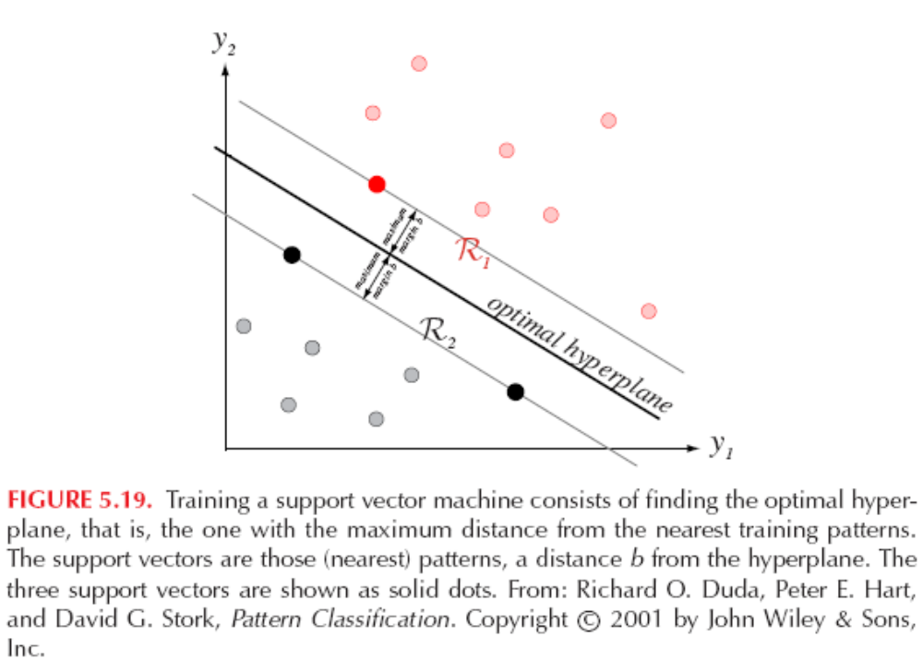
Optimal hyperplane

Slide 39
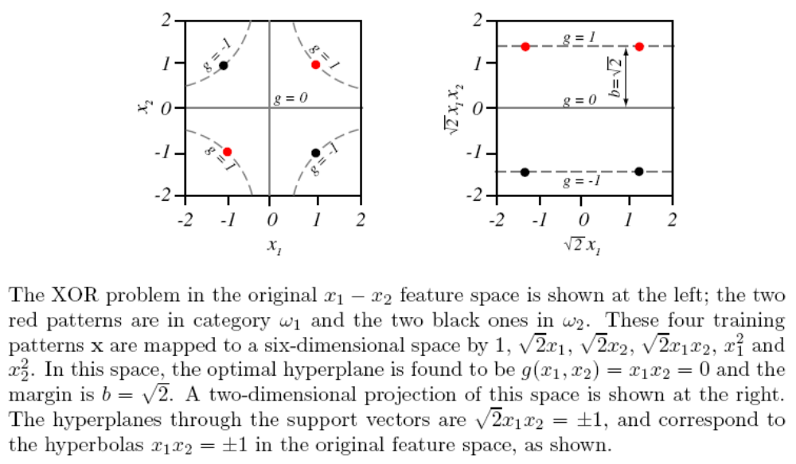
Mapping to higher dimensional space

Slide 40
SVM introduction
Example from Andrew Moor’s slides

Slide 41
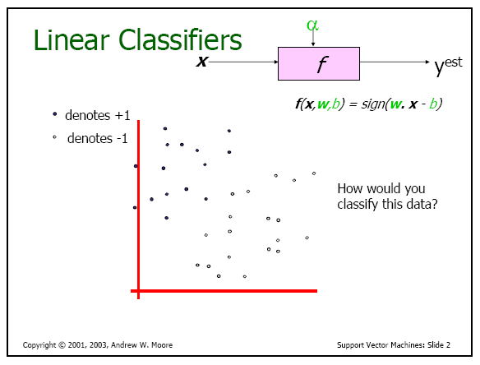

Slide 42
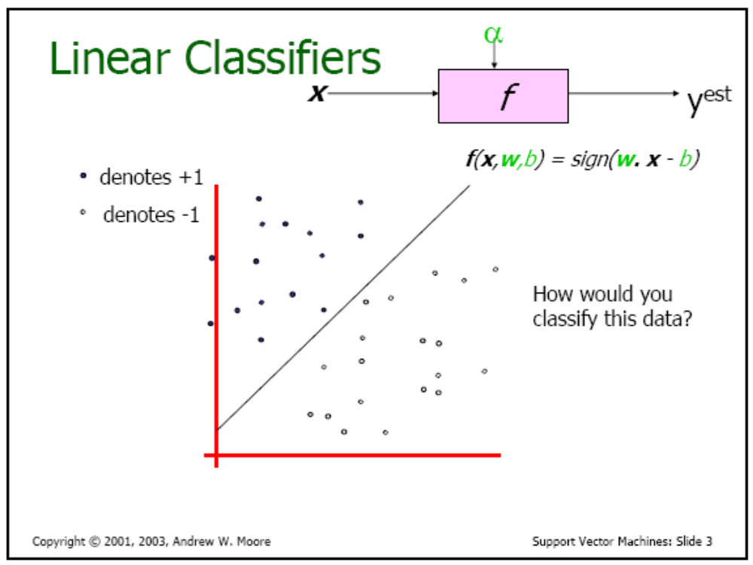

Slide 43
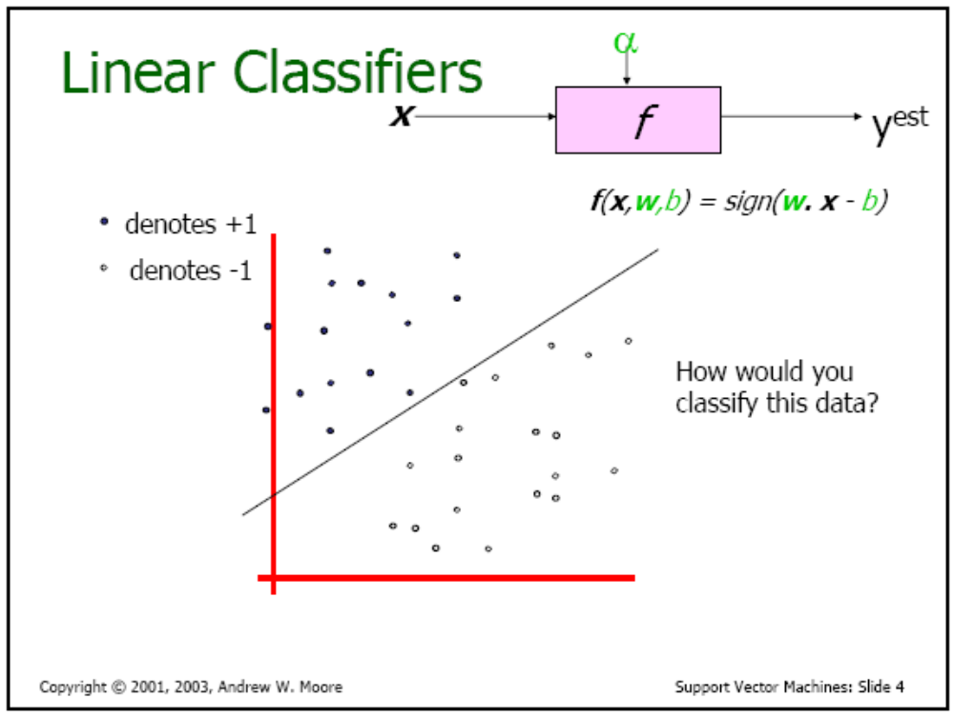

Slide 44
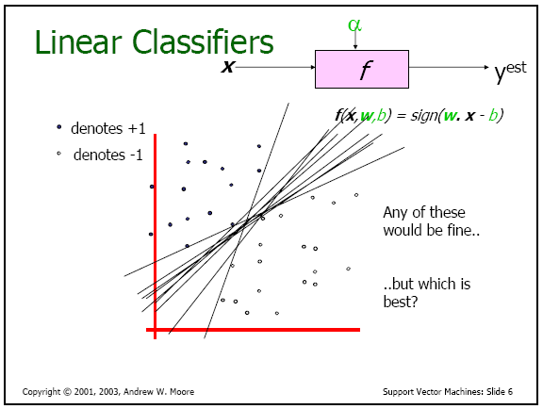

Slide 45
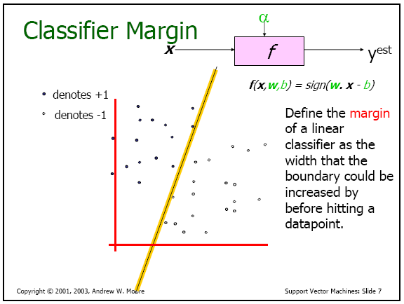

Slide 46
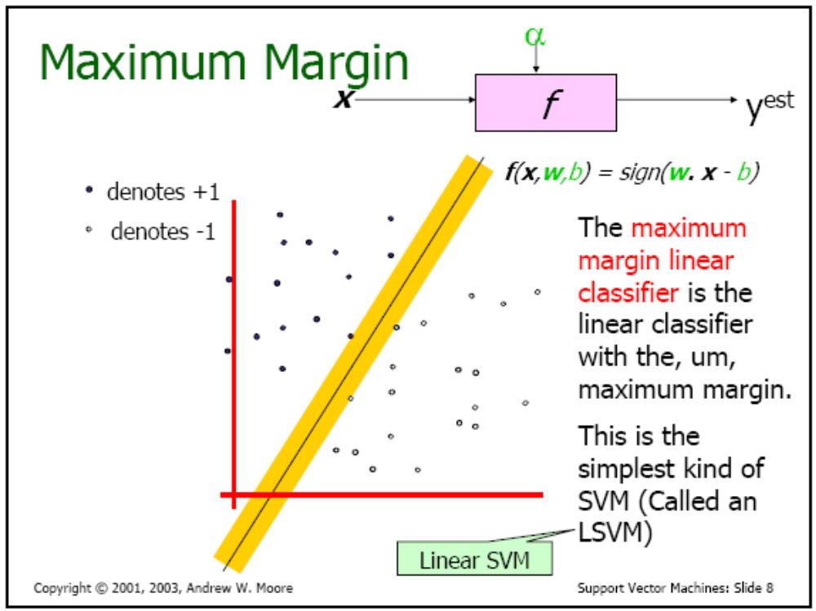

Slide 47
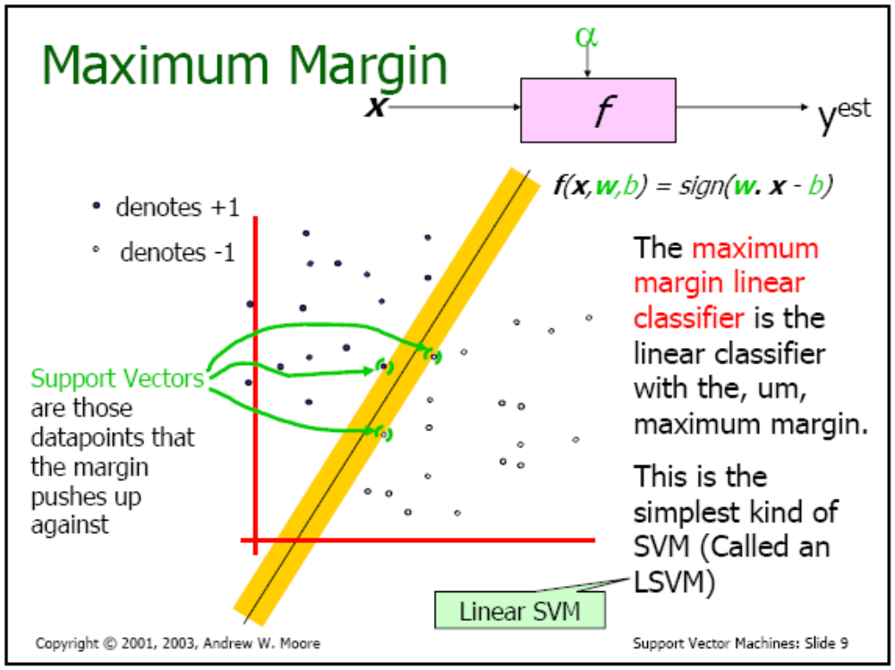

Slide 48
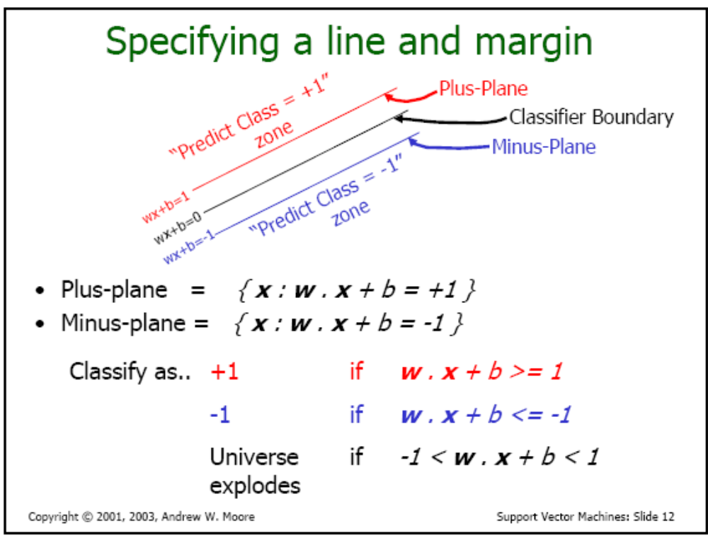

Slide 49
How to deal with Noisy Data?

Slide 50
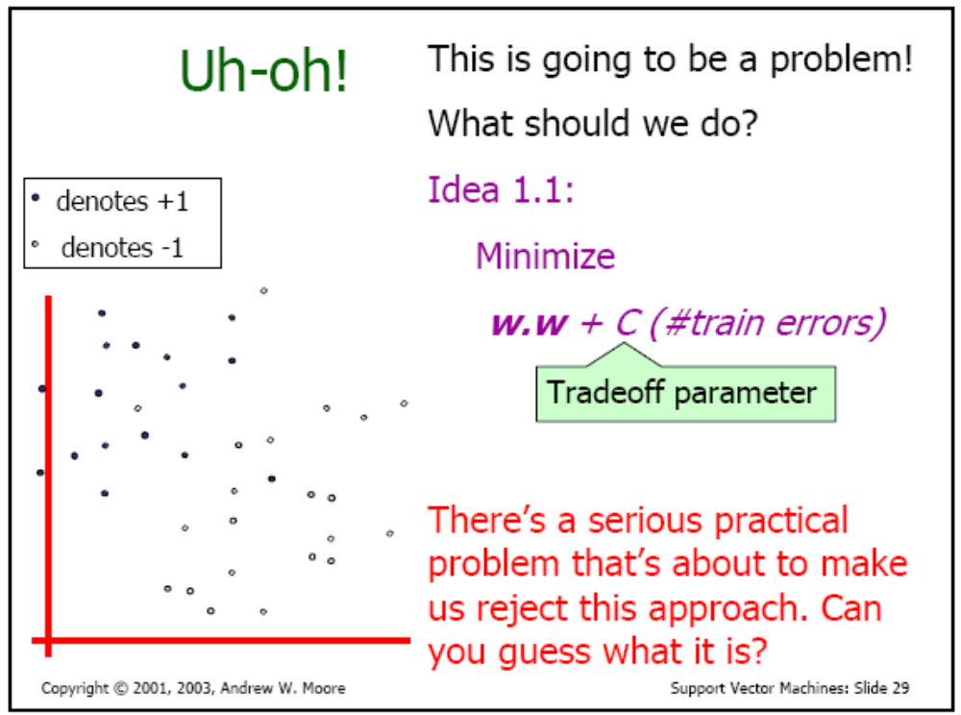

Slide 51
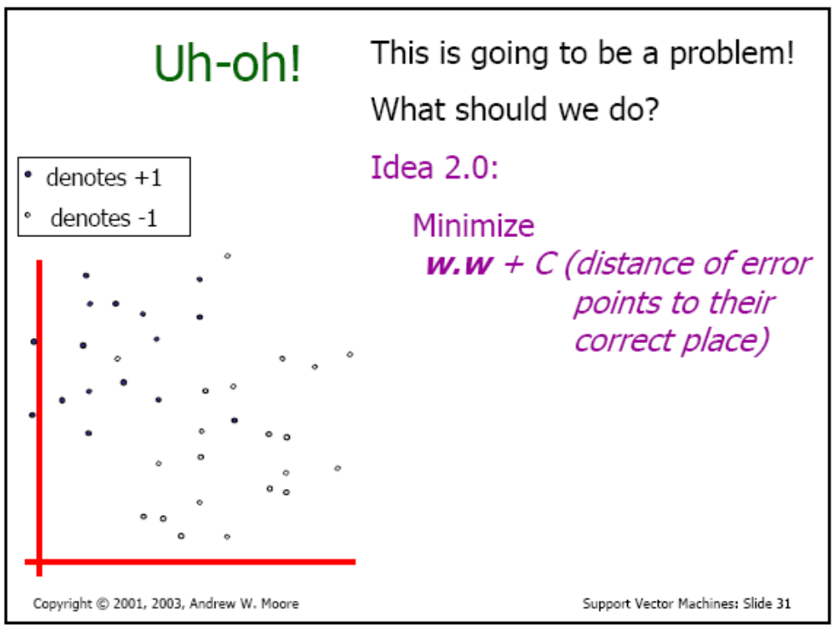

Slide 52
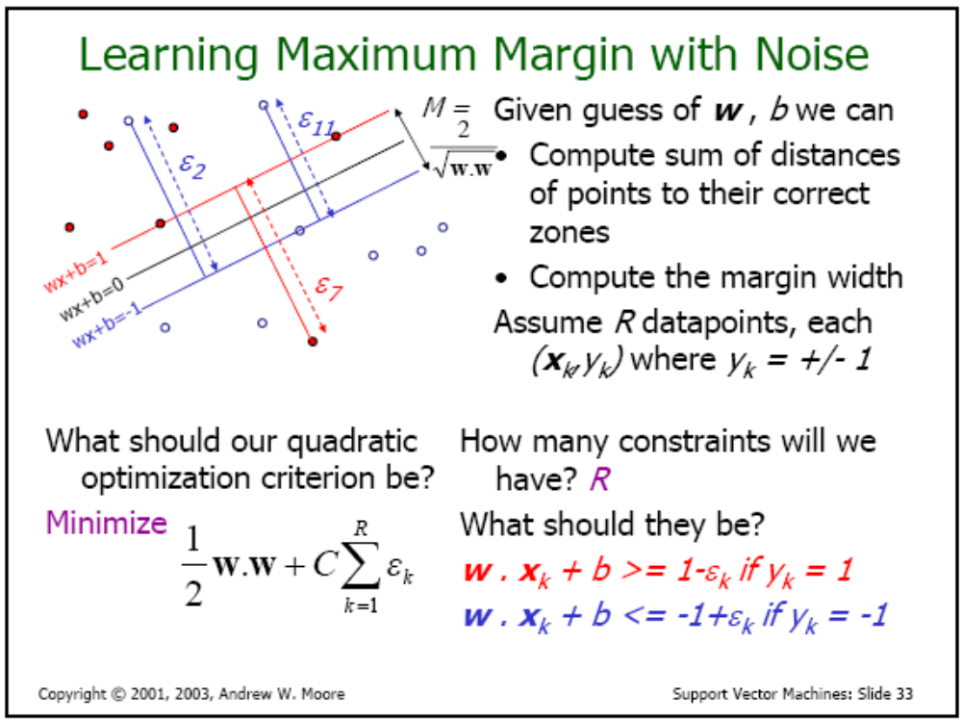

Slide 53
Mapping to a higher Dimensional space

Slide 54
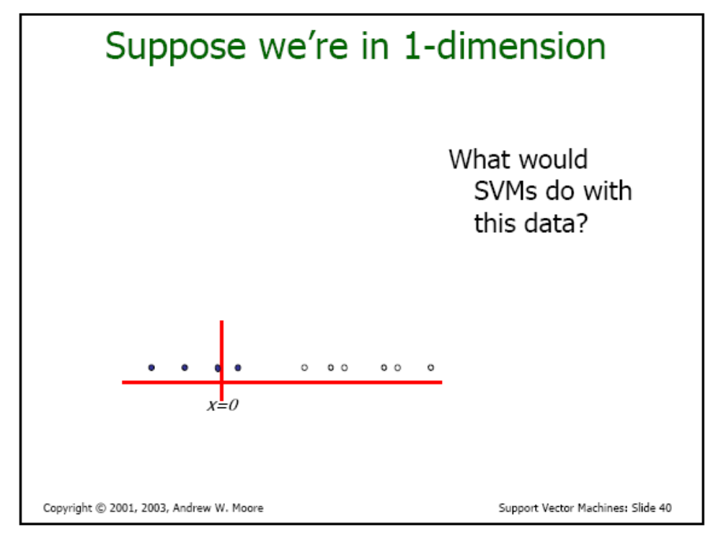

Slide 55
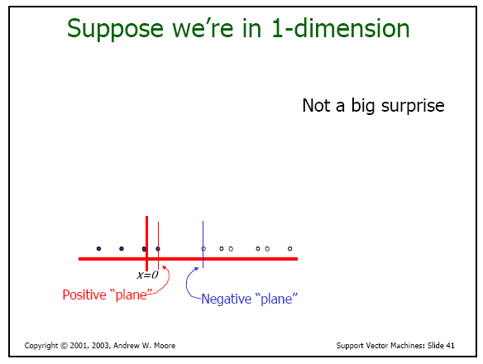

Slide 56
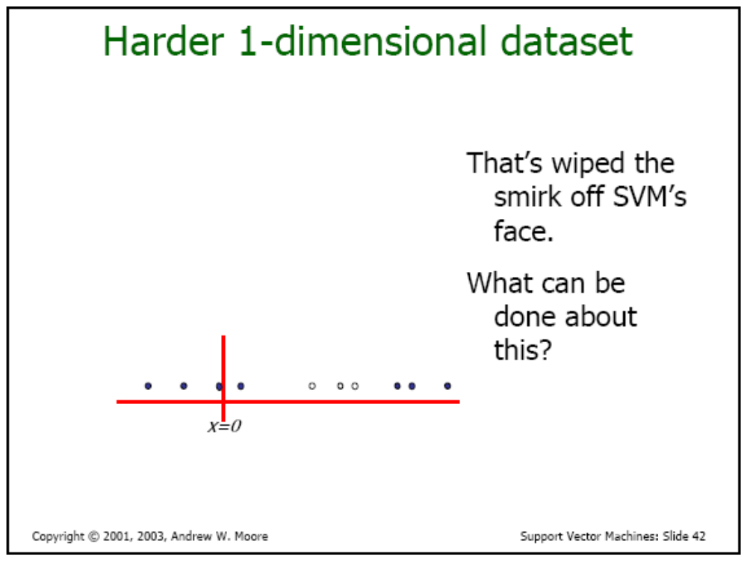

Slide 57
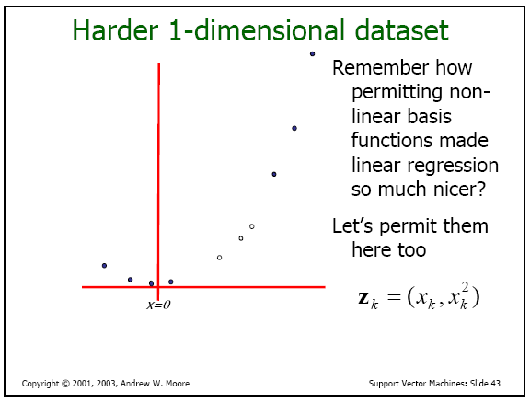

Slide 58
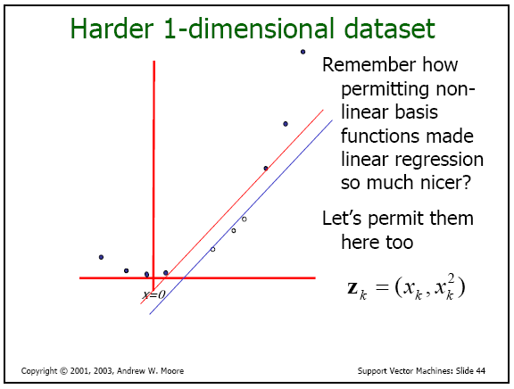

Slide 59
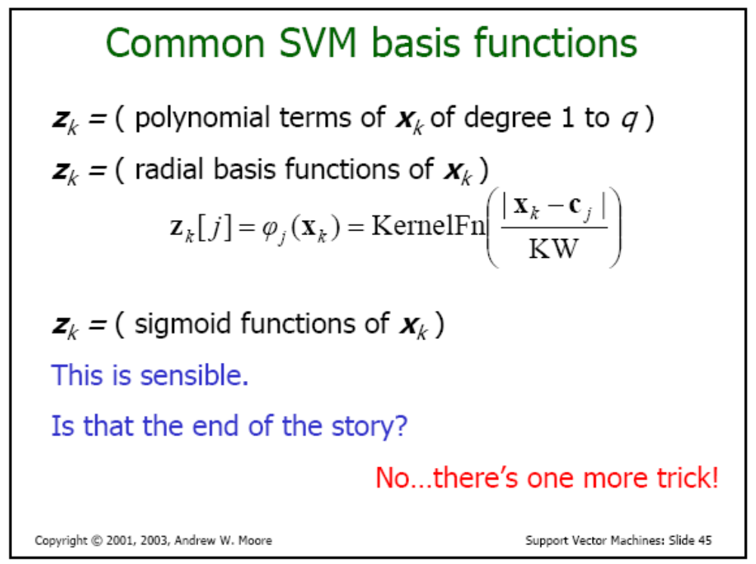

Slide 60
