Slide 1
PC Engines APU platform
User training
(c) 2017 Stanislav Sinyagin
ssinyagin@k-open.com

Slide 2
PC Engines GmbH product line
Founded in 1995, moved to Switzerland in 2002
WRAP: 2002-2006
  233 MHz AMD Geode SC1100 CPU, 64/128 MB RAM
ALIX: 2005-2011
  AMD Geode LX800, 256 MB RAM

Slide 3
PC Engines GmbH product line
APU (2014)
  AMD G series T40E APU, 1 GHz dual core
  2 or 4 GB RAM
  3x 1GE NIC (Realtek RTL8111E)
  MSATA slot
  Serial console

Slide 4
PC Engines GmbH product line
APU2 (2015)
  AMD GX-412TC, 1 GHz quad core, 2 or 4 GB RAM
  MSATA slot
  2x Mini-PCIe slots
  3x 1GE NICs (Intel i211AT)
  1 SIM card slot
  1 SATA interface
  2x USB 3.0 interfaces
  Serial console

Slide 5
PC Engines GmbH product line
APU3 (2017)
  Same active components as in APU2
  MSATA slot can hold a second LTE/3G modem
  2 SIM card slots

Slide 6
APU2/3 CPU
Quad-core CPU
  Operating speeds: 600, 800, 1000MHz
  x86_64 architecture
  AES-NI support
  32K data + 32K instruction cache per core
  shared 2MB L2 cache

Slide 7
APU2/3 Network ports
3x 1-Gigabit NICs (Intel i211AT)
  10/100/1000BASE-T with MDIX
  VLAN support
  Jumbo frame support
  IP checksum offload

Slide 8
APU2/3 Storage options
MSATA slot for standard SSD module
  The only needed storage in most cases
SD card slot
  In APU3, the MSATA slot can be occupied by a second 3G/LTE modem
  Some designs require a read-only partition for OS or hypervisor
SATA port and 5VDC for additional HDD or SSD

Slide 9
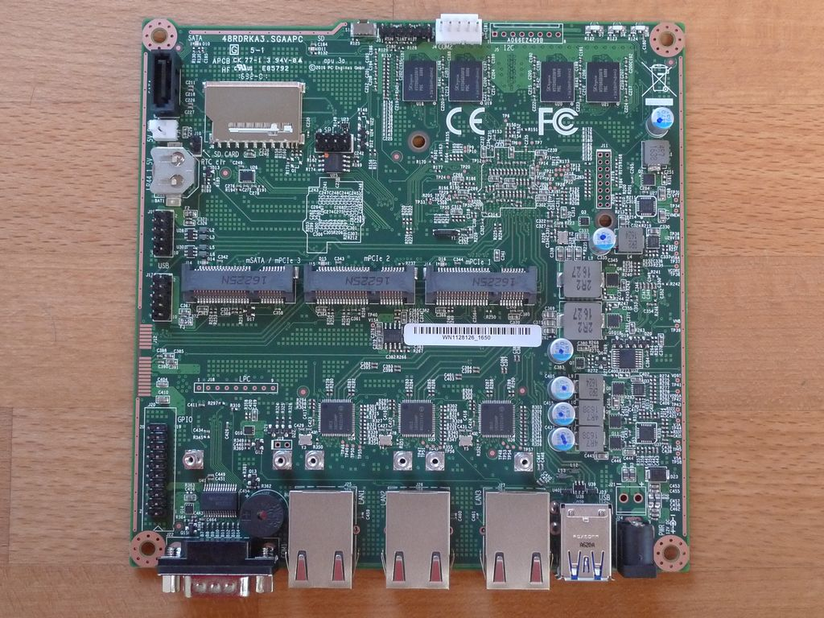
APU3 board

Slide 10
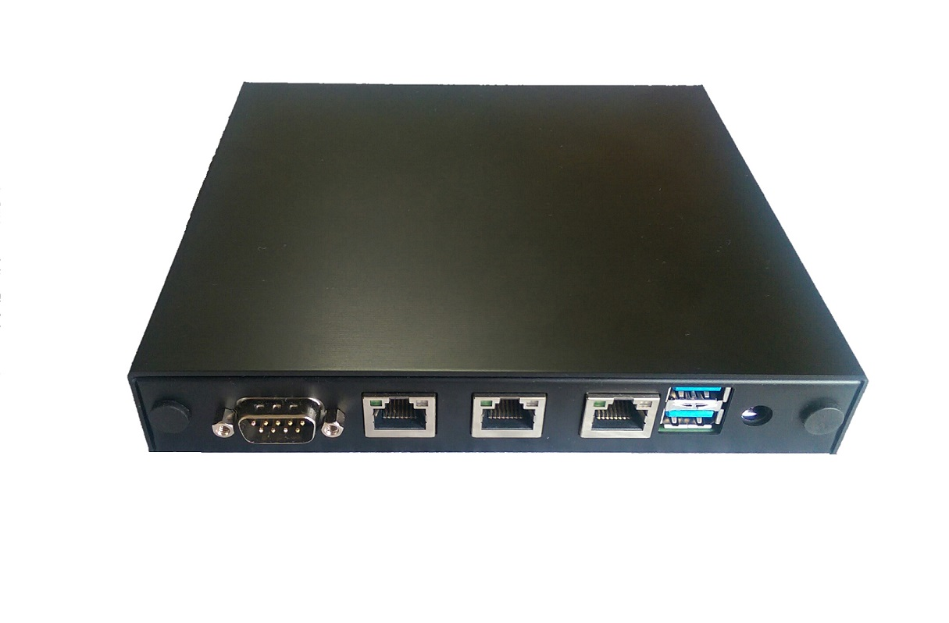
APU2/3 standard enclosure
Color options: red, black, blue
  also silver, but not recommended because of heat radiation efficiency)
Two SMA antenna mount holes
  option with 6 mount holes available on request
Heat dissipation through enclosure (do not stack!)

Slide 11
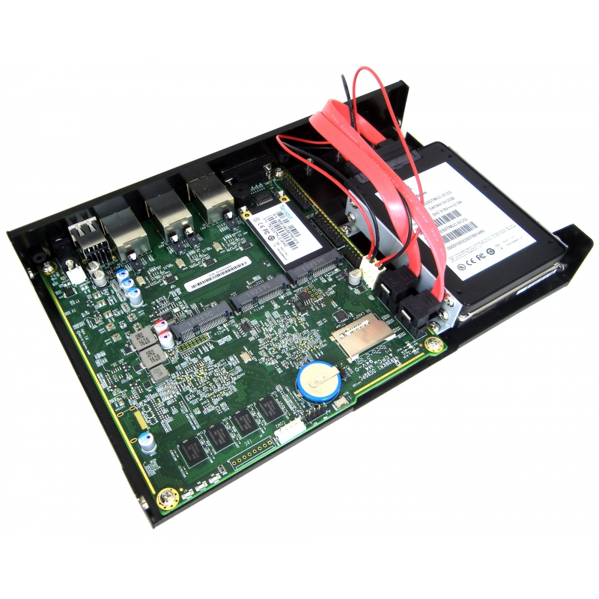
Calexium CXM-CASE1BLK
One or two 2.5” disks
Holes for additional ports
No rackmount option
External power supply

Slide 12
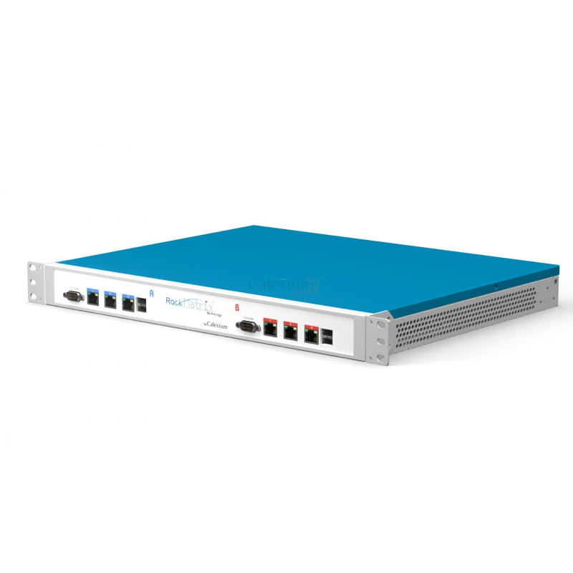
Calexium RackMatrix
One or two APU boards
Rack mount
Internal power supply
Customizable front panel
2.5” disks mount

Slide 13
Extension modules
Mini-PCIe WiFi (+Bluetooth) adapter, 2 SMA pigtails, 2 SMA antennas
3G or LTE Mini-PCIe modem, SMA pigtail, SMA antenna
MSATA to SATA adapter
Mini-PCIe to USB3.0 adapter
Mini-PCIe to SATA adapter

Slide 14
Debian Installer
github.com/ssinyagin/pcengines-apu-debian-cd
Build host of the same Debian release as the target ISO
Internet connection during ISO build
Physical USB port
USB thumb drive
Internet connection during Debian installation

Slide 15
Debian Installer
“apu64” profile
  The only user input is the host name
  As much as possible predefined and automated
  fstrim cronjob for SSD maintenance
“manual” profile
  Almost nothing is predefined
Your own profile
  Useful for mass installation

Slide 16
Debian Installer profiles
PROFILE.conf
  Defines profile name
  Sets Debian mirror URL for installer
  Sets country and locale for installer
PROFILE.packages
  Defines additional Debian packages to be installed

Slide 17
Debian Installer profiles
PROFILE.preseed
  Defines answers to installer questions
  Sets network, disk layout, root password
  Sets country, locale and mirrors for the target system

Slide 18
Debian Installer profiles
PROFILE.postinst
  Shell script to be launched after the installation
  Sysctl parameters
  Cron jobs
  SSH keys
  Custom scripts

Slide 19
Preparing installer media
./build apu64
dd if=images/debian-9.1-amd64-CD-1.iso of=/dev/sdc bs=16M

Slide 20
Installing Debian
Null-modem cable for serial console
115200 baud
Standard terminal program
Support for F10 key
Default boot from USB stick, but F10 and boot intervention might be needed
Internet and DHCP needed on NIC1
Installer halts when complete

Slide 21
Alternative ways of installing OS
Voyage Linux on SD card (http://linux.voyage.hk/)
Debian on external SATA disk
Dual-disk software mirror
Other distributions (RHEL, SmartOS, ...)

Slide 22
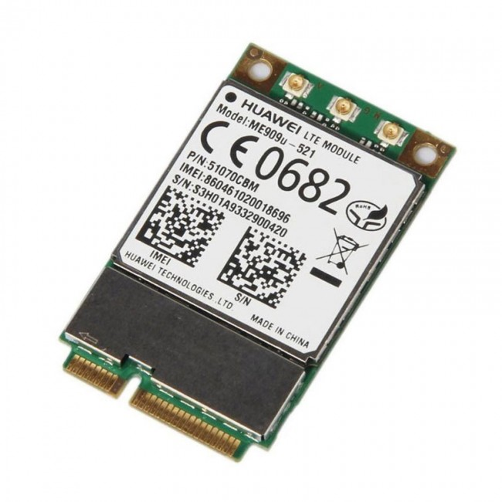
3G/LTE modems
Mini-PCIE full-size
USB pins for data and control
SIM card pins
PCI pins not used
U.FL(IPEX/IPX) antenna connector(s)

Slide 23
Frequency bands
6 regions
  North America, Latin America, Europe, Asia, Africa, Oceania
UMTS frequency bands (2100 and 900 for Europe, 1900 and 850 for Americas)
LTE frequency bands
Per-country list: www.frequencycheck.com

Slide 24
Frequency bands (Switzerland)
GSM: 900, 1800
UMTS: B1 (2100), B8 (900 GSM)
LTE: B3 (1800+), B7 (2600), B20 (800 DD)

Slide 25
LTE modem vendors and models
Huawei ME909s-120
Sierra Wireless MC7304
SimCom SIM7100E
  USB voice interface available

Slide 26
Udev rules
Problem: USB device numbers assigned randomly
A modem is represented by 4 or 5 ttyUSB devices
There might be USB serial adapters which are also ttyUSB devices
There might be two modems
Udev rules can be adapted to assign numbers in deterministic manner

Slide 27
Udev rules
Simple case: one modem of a known vendor
  Matches on subsystem, vendor ID and product ID
  Automatically creates symlinks /dev/ttyWWANx
cat >/etc/udev/rules.d/99-wwan.rules <<'EOT'
# SIMCom SIM7100
SUBSYSTEM=="tty", ATTRS{idVendor}=="1e0e", ATTRS{idProduct}=="9001", SYMLINK+="ttyWWAN%E{ID_USB_INTERFACE_NUM}"
SUBSYSTEM=="net", ATTRS{idVendor}=="1e0e", ATTRS{idProduct}=="9001", NAME="lte0"
EOT

Slide 28
Udev rules
Difficult case: Two LTE modems in APU3
  Modem slots are attached to different USB controllers
  The new symlink name contains the controller ID
cat >/etc/udev/devpath_to_pcislot <<'EOT'
#!/bin/sh echo ${DEVPATH} | sed -r \
-e 's,^\/[^\/]+\/[^\/]+\/[0-9af]{4}:[0-9af]{2}:,,' \
-e 's,\/.+,,' -e 's,\.,,g'
EOT
cat >/etc/udev/rules.d/99-wwan.rules <<'EOT'
SUBSYSTEM=="tty", ATTRS{idVendor}=="12d1", ATTRS{idProduct}=="15c1", PROGRAM="/etc/udev/devpath_to_pcislot" SYMLINK+="ttyWWAN%c{1}_%E{ID_USB_INTERFACE_NUM}"
SUBSYSTEM=="net", ATTRS{idVendor}=="12d1", ATTRS{idProduct}=="15c1", PROGRAM="/etc/udev/devpath_to_pcislot" NAME="lte%c{1}"
EOT

Slide 29
Modems and udev rules: more info
More details in my blog: https://txlab.wordpress.com/tag/3g/
Sets of udev rules: https://github.com/ssinyagin/wwan_udev_rules
Where to buy modems: https://techship.com/
  Also, aliexpress :-)

Slide 30
Setting up Huawei ME909s-120
Install picocom for manual commands
Set up udev rules for ME909s-120 and reboot
cat >/etc/udev/rules.d/99-huawei-wwan.rules <<'EOT'
SUBSYSTEM=="tty", ATTRS{idVendor}=="12d1", ATTRS{idProduct}=="15c1", SYMLINK+="ttyWWAN%E{ID_USB_INTERFACE_NUM}"
SUBSYSTEM=="net", ATTRS{idVendor}=="12d1", ATTRS{idProduct}=="15c1", NAME="lte0"
EOT

Slide 31
Setting up Huawei ME909s-120
AT command interface
picocom -b 115200 /dev/ttyWWAN02
SIM card PIN disabling:
AT+CPIN="1111"
AT^CARDMODE
AT+CLCK="SC",0,"1111"
Status information:
AT^SYSINFOEX

Slide 32
ME909s-120 connect script
cat >/etc/chatscripts/sunrise.HUAWEI <<'EOT'
ABORT BUSY
ABORT 'NO CARRIER'
ABORT ERROR
TIMEOUT 10
'' ATZ
OK 'AT+CFUN=1'
OK 'AT+CMEE=1'
OK 'AT\^NDISDUP=1,1,"internet"'
OK
EOT

Slide 33
ME909s-120 disconnect and interface init
cat >/etc/chatscripts/gsm_off.HUAWEI <<'EOT'
ABORT ERROR
TIMEOUT 5
'' AT+CFUN=0 OK
EOT
cat >/etc/network/interfaces.d/lte0 <<'EOT'
auto lte0
iface lte0 inet dhcp
pre-up /usr/sbin/chat -v -f /etc/chatscripts/sunrise.HUAWEI >/dev/ttyWWAN02 </dev/ttyWWAN02
post-down /usr/sbin/chat -v -f /etc/chatscripts/gsm_off.HUAWEI >/dev/ttyWWAN02 </dev/ttyWWAN02
EOT

Slide 34
OpenVPN optimized for mobile internet
port 1194
proto udp
fragment 1300
mssfix
dev tun
topology subnet
keepalive 10 120

Slide 35
LXC: light-weight containers
Kernel namespaces
By default, no CPU and memory restrictions
Container processes are allowed to take high priority
Virtual bridge can be used for inter-container communication
Physical interface can be dedicated to a container

Slide 36
LXC flavors
Debian way: do-it-yourself
Ubuntu way: bridge and NAT masquerading preconfigured
Docker way: predefined network, process priority restrictions

Slide 37
LXC example: network probe
LTE modem and OpenVPN client in main system
A NIC dedicated to the probe container
No internal bridge for security reasons
Probe has its own DHCP client and routing table
Probe performs network tests or remote management, and saves data to the local disk
A process in main system picks up the data from the disk and sends it to the management system

Slide 38
LXC example: SIP SBC
Two independent containers, each having a dedicated NIC, and an internal bridge for communicating between containers
Each container running a SIP and RTP proxy
Secure separation between two SIP domains
No direct IP communication between domains

Slide 39
Conclusion
Universal appliance platform
Extension flexibility
Good performance
Zero moving parts

