Slide 1
Fandango movie rating discrepancy analysis
CAPSTONE PROJECT
Presented By:
1. SASIKUMAR.A-8144-Sudharsan Engineering College-Civil

Slide 2
OUTLINE
Problem Statement
Proposed System/Solution
System Development Approach
Algorithm & Deployment
Result
Conclusion
Future Scope
References

Slide 3
Problem Statement
Fandango, a popular movie ticketing platform, has faced scrutiny in the past due to discrepancies in its movie ratings.
While users may trust the ratings displayed on the platform to make informed decisions about which movies to watch, there have been allegations that Fandango's ratings are inflated or biased. This issue undermines the credibility of the platform and can mislead consumers.

Slide 4
Proposed Solution
The proposed system aims to analyze the movie rating data provided by Fandango to identify any discrepancies or biases.
By implementing an algorithmic approach, the system will scrutinize the rating distribution, user reviews, and other relevant factors to assess the accuracy and fairness of Fandango's ratings.

Slide 5
System Approach
Data Collection: Gather movie rating data from Fandango's API or web scraping techniques.Data Preprocessing: Clean the data, handle missing values, and ensure consistency
.Exploratory Data Analysis: Analyze the distribution of ratings, user demographics, and any anomalies.
Algorithm Development: Develop algorithms to detect discrepancies, bias, or anomalies in the rating data.Model Training: Train the algorithms on historical data to learn patterns and trends.
Validation and Testing: Validate the models using cross-validation techniques and test against new data.Deployment: Implement the system as a web application or API for real-time analysis of Fandango's movie ratings.

Slide 6
Algorithm & Deployment
Rating Discrepancy Detection Algorithm: Utilize statistical methods such as outlier detection, sentiment analysis, and comparison with external rating sources to identify discrepancies.
Deployment: Deploy the algorithm either as a standalone tool or integrate it into Fandango's existing infrastructure for continuous monitoring of rating discrepancies.

Slide 7
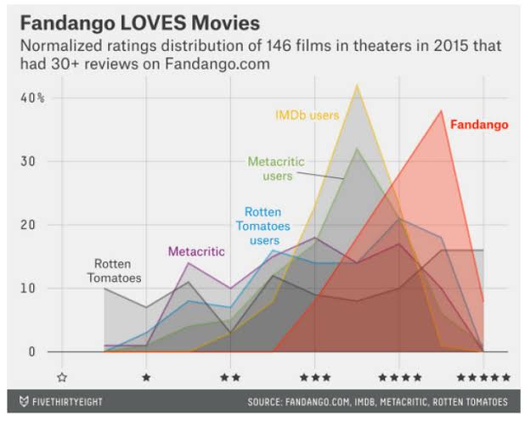
Result
Upon implementation and analysis, the system will provide insights into the consistency and reliability of Fandango's movie ratings.
It will highlight any discrepancies or biases present in the data, allowing for transparency and informed decision-making for consumers.

Slide 8
Conclusion
The analysis conducted by the system will shed light on the integrity of Fandango's movie ratings and help address any concerns regarding inflated or biased ratings.
By fostering transparency and accountability, the system aims to enhance consumer trust in Fandango's platform.
The analysis conducted by the system will shed light on the integrity of Fandango's movie ratings and help address any concerns regarding inflated or biased ratings. By fostering transparency and accountability, the system aims to enhance consumer trust in Fandango's platform.

Slide 9
Future scope
Enhanced Algorithm: Continuously improve the algorithm to adapt to evolving rating patterns and user behaviors.Integration with
External Data Sources: Incorporate data from other movie rating platforms or critics to provide a comprehensive analysis.User Feedback Analysis: Implement mechanisms to incorporate user feedback and preferences into the rating analysis.
Collaboration with Fandango: Collaborate with Fandango to integrate the system directly into their platform for real-time rating monitoring and transparency.

Slide 10
References
Fandango. (https://www.fandango.com/)
Sentiment Analysis and Opinion Mining. Synthesis Lectures on Human Language Technologies, 5(1), 1-167.McKinney, W. (2017). Python for Data Analysis. O'Reilly Media.

Slide 11
THANK YOU

