Slide 1
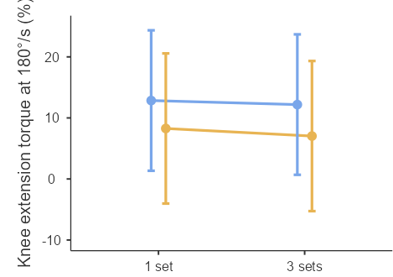
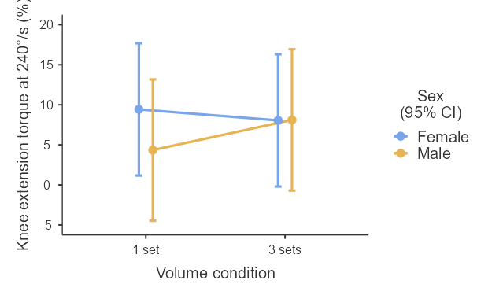
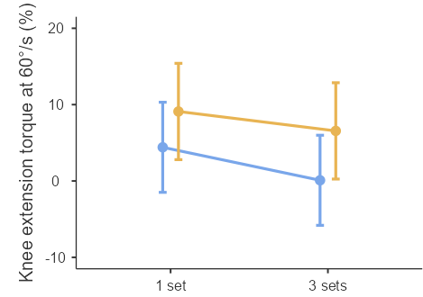
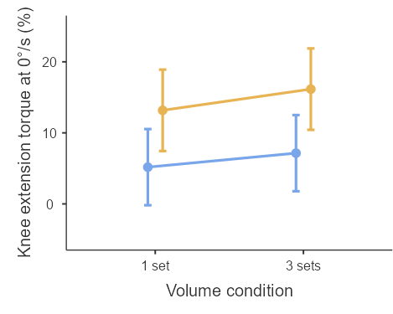
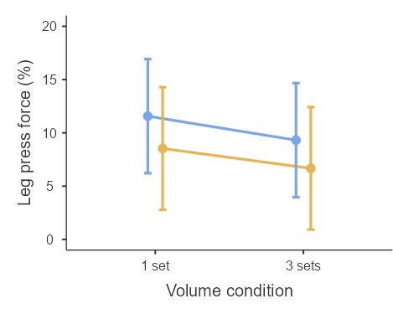
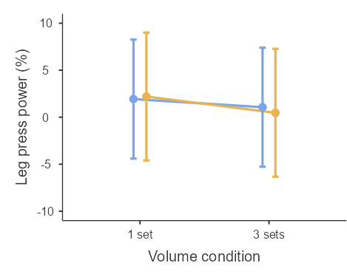
p
A
B
C
D
E
F
*
*
Figure 7. Relative pre-to-post increases in knee extension torque at 60°/s (A), 180°/s (B), 240°/s (C) and 0°/s (D) and peak force (E) and power (F) in the leg press test for males and females at each volume condition. *Significant sex-effect (p < 0.05).

