Slide 1

WEEK 01 · LECTURE
Introduction to Cybersecurity
Fundamental Concepts, Principles, and Threat Analysis
An introductory course on securing digital assets in adversarial environments.
Seoul Cyber University
Department of Information Security

Slide 2

UNIT SECTION
COURSE ORIENTATION
Course Overview
Introduction to Cybersecurity Course Structure and Roadmap
About Course
Contents & Goals
Assessment
Core mission and scope of cybersecurity discipline.
5 core curriculum areas and course learning objectives.
Grading criteria and key course reference books.
Seoul Cyber University

Slide 3
About the Course
Cybersecurity is about
Cybersecurity is the practice of protecting digital assets and systems from malicious attacks, unauthorized access, disruption, or destruction.
Digital Assets
Digital Systems
Adversaries
Confidential data
Customer records
Intellectual property
Financial systems
Cloud storage
Computer networks
Cloud platforms
Mobile endpoints
Software apps
IoT & ICS devices
Cybercriminals
Ransomware actors
Malicious insiders
Nation-state groups
Hacktivists

Slide 4
Learning Contents
In this course, you will explore five major areas of cybersecurity:
Concepts and basic Cryptography
1
Authentication and Access control
2
Network Security and Protocols
3
Software, Malware, and Databases
4
Cloud, AI, Risk, and Privacy
5

Slide 5
Learning Objectives
By the end of the course, you will be able to:
Explain core cybersecurity concepts, terminology, requirements, principles, and cryptography basics.
1
Apply user authentication and access control mechanisms across enterprise systems.
2
Describe network defenses and real-world security protocols in detail.
3
Analyze software flaws, malware, and database vulnerabilities across modern architectures.
4
Evaluate cloud and AI security, risk management, and organizational privacy protection.
5

Slide 6
Grading
Course Evaluation and Assessment Components
Attendance
Midterm
Final
Assignments
Participation
Exam
Exam
10%
20%
30%
30%
10%
Examination Formats
Assignments
Participation
Selected-Responses (SRs)
Multiple choice theoretical tests
Constructed-Responses (CRs)
Short-answer & descriptive questions
2 Assignments
Notice Board
Submissions
Discussions
Q&A Boards
Activity

Slide 7
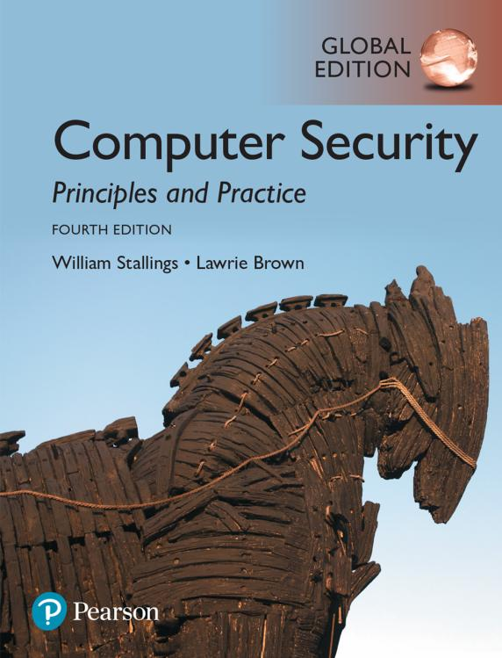
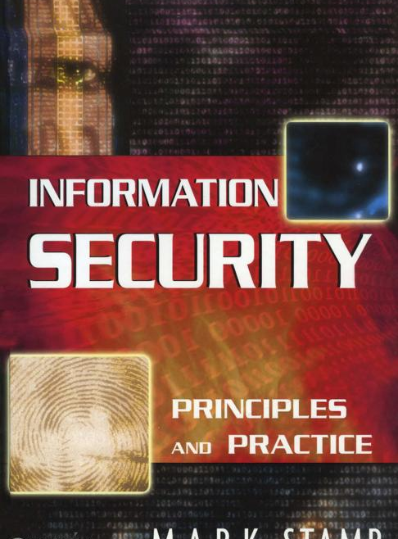
References
Recommended Textbooks and Standards
Primary Textbook
Reference Book
Computer Security
Information Security
Principles and Practice
Principles and Practice
4th Edition · Pearson (2018)
2nd Edition · Wiley (2011)
Authors
Author
William Stallings, Lawrie Brown
Mark Stamp
Publication Details
Publication Details
Publisher: Pearson, 2018
Length: 778 pages
ISBN: 978-0-13-479410-5
Publisher: John Wiley & Sons, 2011
Length: 606 pages
ISBN: 978-0-470-62639-9

Slide 8
UNIT 01
WEEK 01 · FOUNDATION
Cybersecurity Concepts
Definition of Cybersecurity, Cast of Characters, and Core Security Goals
Definitions
Characters
Security Goals
NISTIR 8170 standard and terminology scope.
Alice, Bob, Trudy and active/passive attacks.
CIA triad, authenticity, accountability, reliability.
Seoul Cyber University

Slide 9
Learning Objectives
By the end of this week, you will be able to:
1
Define Core Cybersecurity Concepts
Define core concepts and differentiate Cybersecurity, Information Security, and Computer Security.
2
Explain the CIA Triad and Extended Goals
Explain the CIA triad (Confidentiality, Integrity, Availability) alongside authenticity, accountability, and reliability.
3
Analyze Security Relationships & Attack Trees
Analyze relationships among assets, threats, and vulnerabilities, and evaluate systematic attack tree models.

Slide 10
Cybersecurity Concepts
This unit helps you understand:
Definition of Cybersecurity
Cast of Characters
Security Goals
NISTIR 8170 definition
Cyberspace protection
Information Security
Computer Security
Domain comparison
Alice (Sender)
Bob (Receiver)
Trudy (Adversary)
Passive Attacks
Active Attacks
CIA Triad
Authenticity
Accountability
Reliability
Alice’s Market case

Slide 11
Definition of Cybersecurity
Cybersecurity & Related Terminologies
NISTIR 8170
Related Terminologies
Cybersecurity
“The ability to protect or defend the use of cyberspace from cyber attacks.”
Information Security
Computer Security
- NISTIR 8170
Cybersecurity
Defends all connected cyberspace assets.
Focuses on resilience against active attacks.

Slide 12
Definition of Cybersecurity
Comparative Analysis of Security Domains
Criterion
Cybersecurity
Information Security
Computer Security
“The ability to protect or defend the use of cyberspace from cyber attacks.”
“The protection of info & systems from unauthorized access, use, disclosure, disruption, or destruction to provide confidentiality, integrity, and availability.”
“Measures and controls that ensure confidentiality, integrity, and availability of data processed and stored by a computer.”
Definition
Reference
NISTIR 8170
NIST FIPS 200
CNSSI 4009-2015
Primary Focus
The secure use of cyberspace
Information and information systems
Computer-based processing and storage
Typical Scope
Connected systems, networks, services, and digital communications
Information in any form (electronic, physical, paper) and the systems that handle it
Computer hardware, software, operating systems, processing, and stored info

Slide 13
Cast of Characters
In cybersecurity, we often consider the following entities:
Alice
Bob
Trudy
Legitimate Sender
Legitimate Receiver
Adversary (Intruder)
Wishes to transmit sensitive messages securely to Bob.
Receives messages and verifies authenticity/origin.
Attempts to intercept, alter, replay, or block traffic.
Transmission Channel Interaction Model
Message Flow
Alice
Bob
Trudy (Threat Actor)

Slide 14
Cast of Characters
What Trudy can do: Attack Types
Passive Attacks
Active Attacks
Nature & Objective
Nature & Objective
Goal: Learn or make use of info from the transmission system.
Does NOT affect system resources.
Goal: Alter system resources or affect their operation directly.
Involves active data tampering.
Two Key Types
Four Key Types
1. Release of Message Contents
Eavesdropping on plaintext data.
2. Traffic Analysis
Observing pattern, frequency, & length.
1. Masquerade (Identity spoofing)
2. Replay (Retransmitting valid packets)
3. Modification (Altering message contents)
4. Denial of Service (Disrupting access)
Defense Strategy
Defense Strategy
Very difficult to detect (silent).
Focus is on Prevention (Encryption).
Hard to prevent completely.
Focus is on Detection & Recovery.

Slide 15
Cast of Characters
Release of Message Contents & Traffic Analysis
Release of Message Contents
Traffic Analysis
- a passive attack that learns the contents of sensitive transmissions.
- a passive attack observing pattern, frequency, and length of messages.
Alice
Bob
Alice
Bob
→
Trudy
Trudy

Slide 16
Cast of Characters
Masquerade Attack & Replay Attack
Masquerade Attack
Replay Attack
- an active attack where an unauthorized party pretends to be a different authorized party.
- an active attack that captures a data unit and subsequently retransmits it later.
“This message
is from Alice.”
Alice
Alice
sniff
Bob
Bob
replay
Trudy
Trudy

Slide 17
Cast of Characters
Modifying Messages & Denial-of-Service (DoS)
Modifying Messages
Denial-of-Service (DoS)
- an active attack that alters or reorders a message to produce an illegal effect.
- an active attack preventing normal use or management of communications.
Alice
Bob
Alice
Bob
attack
Trudy
Trudy
→

Slide 18
Security Goals
CIA Triad: Confidentiality, Integrity, and Availability
Confidentiality
Integrity
Availability
Confidentiality
Integrity
Availability
preserves authorized restrictions on information access and disclosure.
protects personal privacy and proprietary records from unauthorized reading.
guards against improper information modification or destruction.
ensures that data and programs change only in a specified authorized way.
ensures timely and reliable access to info.
guarantees systems work promptly and service is available to users.

Slide 19
Security Goals
Other Goals: Accountability, Authenticity, and Reliability
Accountability
Authenticity
Reliability
Accountability
Authenticity
Reliability
requires that the actions of an entity be traced uniquely to that specific entity.
supports deterrence, fault isolation, intrusion detection, and forensic analysis.
property of being genuine, verifiable, and trusted.
provides confidence in the validity of a transmission, message, or originator.
ensures that a system performs its intended function in an unimpaired manner without failures.
uses formal IT security management processes.

Slide 20
Security Goals
Example: Alice’s Market (AM) Case Study (CIA Analysis)
E-Commerce Scenario
Confidentiality
Alice launches an online store called “Alice’s Market (AM).”
Only authorized parties can access Bob’s personal and credit card data.
Bob creates account to buy T-shirt.
Enters credit card number for payment.
Trudy seeks attack opportunities.
Integrity
Bob’s order and billing details remain accurate and completely unaltered.
Trudy's Threat
Availability
May steal Bob’s payment info, alter order items, or take the site down.
Alice’s Market remains online, responsive, and usable 24/7.

Slide 21
Security Goals
Example: Alice’s Market (Extended Goals Analysis)
Extended Analysis
Accountability
Beyond basic CIA protection, e-commerce platforms mandate strict verification & resilience.
Every order and login is logged, uniquely traced to Bob or Trudy.
Authenticity
Business Mandates
Alice's Market verifies the purchaser is genuinely Bob and not Trudy.
Non-repudiation of transactions
Impersonation defense
Consistent checkout performance
Unbroken transactional trust
Reliability
Transactions execute correctly without accidental system failure.

Slide 22
UNIT 02
WEEK 01 · SYSTEM MODELING
Security Concepts and Threat Analysis
Entity Relationships, Attack Surfaces, and Attack Trees Modeling
Concepts & Relationships
Surfaces & Attack Trees
Assets, Threats, Vulnerabilities, Risk, and Controls.
Reachable vectors, tree structures, and AND/OR logic.
Seoul Cyber University

Slide 23
Security Concepts and Threat Analysis
This unit helps you understand:
Security Concepts & Relationships
Attack Surfaces & Attack Trees
Core Definitions: Asset, Threat, Vulnerability, Attack, and Control.
Interaction Dynamics: Owners minimize Risk Threats exploit Vulnerabilities Countermeasures reduce Risk
3 Attack Surface Types: Network, Software, and Human
Attack Tree Modeling (1999): Root Goals, Sub-Goals, Leaves AND-Decomposition Logic OR-Decomposition Logic

Slide 24
Security Concepts and Relationships
Five Core Building Blocks of Information Security
Asset
A system resource or capability of value to an owner requiring protection.
Includes computer hardware, software apps, data records, and networks.
Threat
Potential for a threat actor to exploit a vulnerability and breach security.
Any circumstance capable of adversely impacting organization operations.
Vulnerability
A flaw or weakness in system design, implementation, or internal controls.
Leaves a system susceptible to exploitation, disruption, or data theft.
Attack
A deliberate threat action carried out resulting in a security breach.
Represents attempts to disrupt, alter, or steal organizational assets.
Control
Safeguards and countermeasures that reduce overall operational risk.
Eliminates vulnerabilities or minimizes impacts of potential violations.

Slide 25
Security Concepts and Relationships
Relationships Among Assets, Threats, Vulnerabilities, Risk, and Countermeasures
Value
Owners
Threat agents
Wish to abuse and/or may damage
Impose
Wish to minimize
Give rise to
Countermeasures
Asset
To reduce
To
To
Risk
Threat
That increase

Slide 26

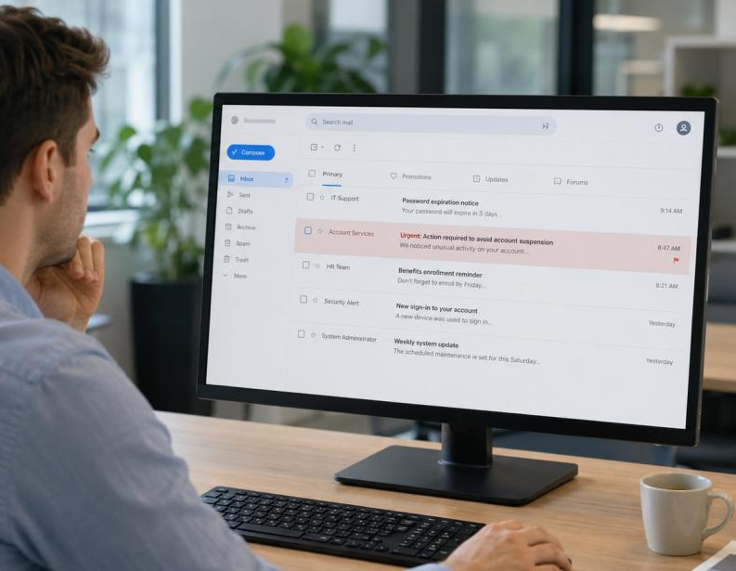
Attack Surfaces and Attack Trees
Attack Surfaces
Attack Surfaces
consists of the reachable and exploitable vulnerabilities in a system.
categorized into network, software, and human attack surfaces.
Analyzing attack surfaces helps evaluate threat scale & places defense controls.

Slide 27
Attack Surfaces and Attack Trees
Types of Attack Surface: Definitions and Examples
Types of attack surface
Network attack surface
Software attack surface
Human attack surface
Definition
Definition
Definition
vulnerabilities reachable over a network
vulnerabilities in the application code
vulnerabilities introduced by people
Example
Example
Example
open ports, exposed services, network protocols
the web application, the libraries it imports, the operating system beneath it.
an employee who can be tricked, a contractor with unnecessary access, a user reusing passwords.

Slide 28
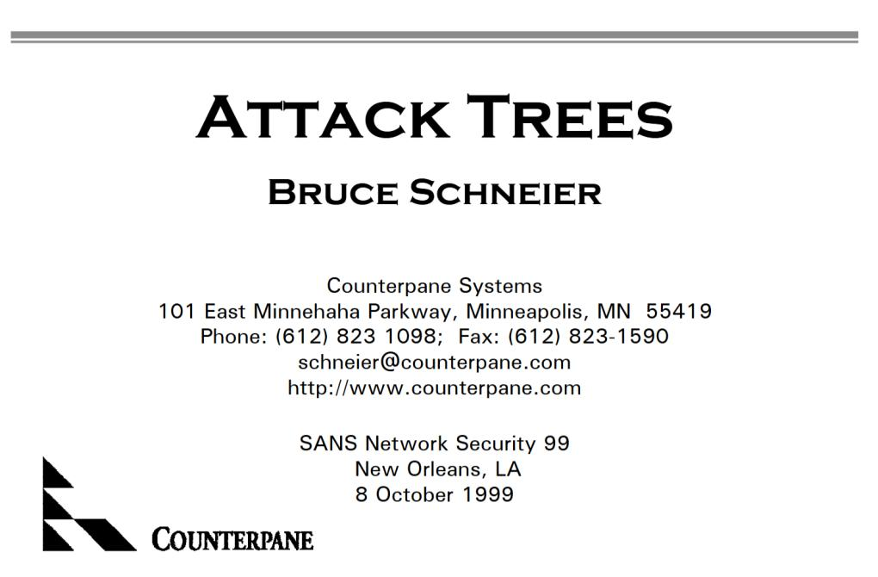
Attack Surfaces and Attack Trees
Attack Trees: Systematic Threat Modeling
Attack Trees
Bruce Schneier introduced the attack tree concept in 1999 to identify attack vectors.
are tools to evaluate system security based on various threats.
provide a formal, methodical way of describing system security postures.
Represent attacks against a system in an intuitive tree structure.

Slide 29
Attack Surfaces and Attack Trees
Structure of Attack Trees: Root, Sub-Goals, and Leaves
Structure of Attack Trees
An attack tree lays out how a goal can be reached.
The root node represents the ultimate goal of the attacker.
Each level breaks the goal into finer sub-goals, representing different ways to achieve it.
The leaf nodes are the concrete, actionable attacks at the bottom of the tree.
Attacker's Goal
The overall goal
Sub-Goal A
Sub-Goal B
A sub-goal or method that refines the goal
Leaf Attack
Leaf Attack
A specific attack that can be directly attempted

Slide 30
Attack Surfaces and Attack Trees
Relations: AND-Decomposition vs OR-Decomposition
1. AND-Decomposition
2. OR-Decomposition
All sub-goals must be achieved for the overall goal to succeed.
Represented by an arc connecting lines.
Any one sub-goal is sufficient for the goal to succeed.
Independent branches (alternative attack paths).
Goal: Hack Safe
Goal: Gain Access
AND
OR
Sub-Goal 1
Sub-Goal 2
Path A
Path B
Steal Key
Crack Code
Phishing
Brute Force

Slide 31
Key Takeaways
Cybersecurity protects digital systems and valuable data assets even in adversarial environments.
Foundations
Security Goals
Threat Models
NISTIR 8170 Standard Protects cyberspace use.
3 Security Domains Cyber vs Info vs Computer.
Communication Model Alice, Bob, and Trudy.
Active vs. Passive 4 attack classifications.
CIA Triad Confidentiality, Integrity, and Availability.
Extended Goals Authenticity, Accountability, and Reliability.
Practical Cases Alice's Market analysis.
Entity Relationships Assets, Threats, Risk.
3 Attack Surfaces Network, Software, Human.
Attack Tree Logic Schneier (1999) AND/OR.
Next Week Preview
Week 02: Basic Cryptography & Symmetric Ciphers

